Slide 1
DEVOPS · KUBERNETES · MICROSERVICES
VProfile on Kubernetes
Deploying a multi-tier Java application as four secure microservices on a highly-available cluster.
6-node HA cluster · RHEL 9
4 custom secure images
Fronted by HAProxy
Yousef Salem
DevOps Engineer · ALnaqib

Slide 2
THE PROJECT
Project Overview
VProfile is a classic multi-tier Java (Spring MVC) web application — a small social-network demo whose stack mirrors real enterprise systems.
In its original form each tier ran on its own VM (Vagrant). The goal here: re-platform it as independent microservices on Kubernetes — self-healing, scalable, and reproducible.
The Nginx web tier is dropped — the existing HAProxy plays that role at the cluster edge.
Application
Database
Tomcat 9 · Java WAR
MySQL 8.0 · accounts
Cache
Broker
Memcached
RabbitMQ
4 microservices, one namespace: vprofile

Slide 3
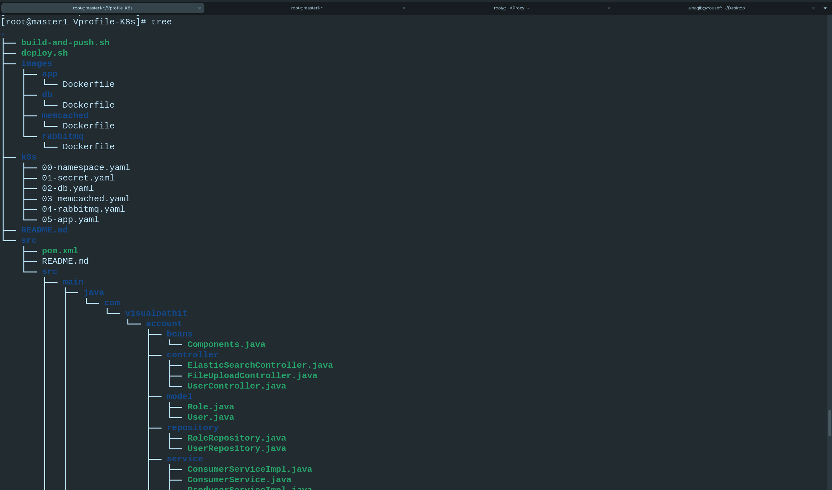
HOW IT'S ORGANIZED
Project Structure
Laid out like a real production repository — every concern in its own place:
images/
one hardened Dockerfile per service
k8s/
manifests, numbered in apply order
haproxy/ · scripts
edge config + build & deploy automation
$ tree · Vprofile-K8s

Slide 4
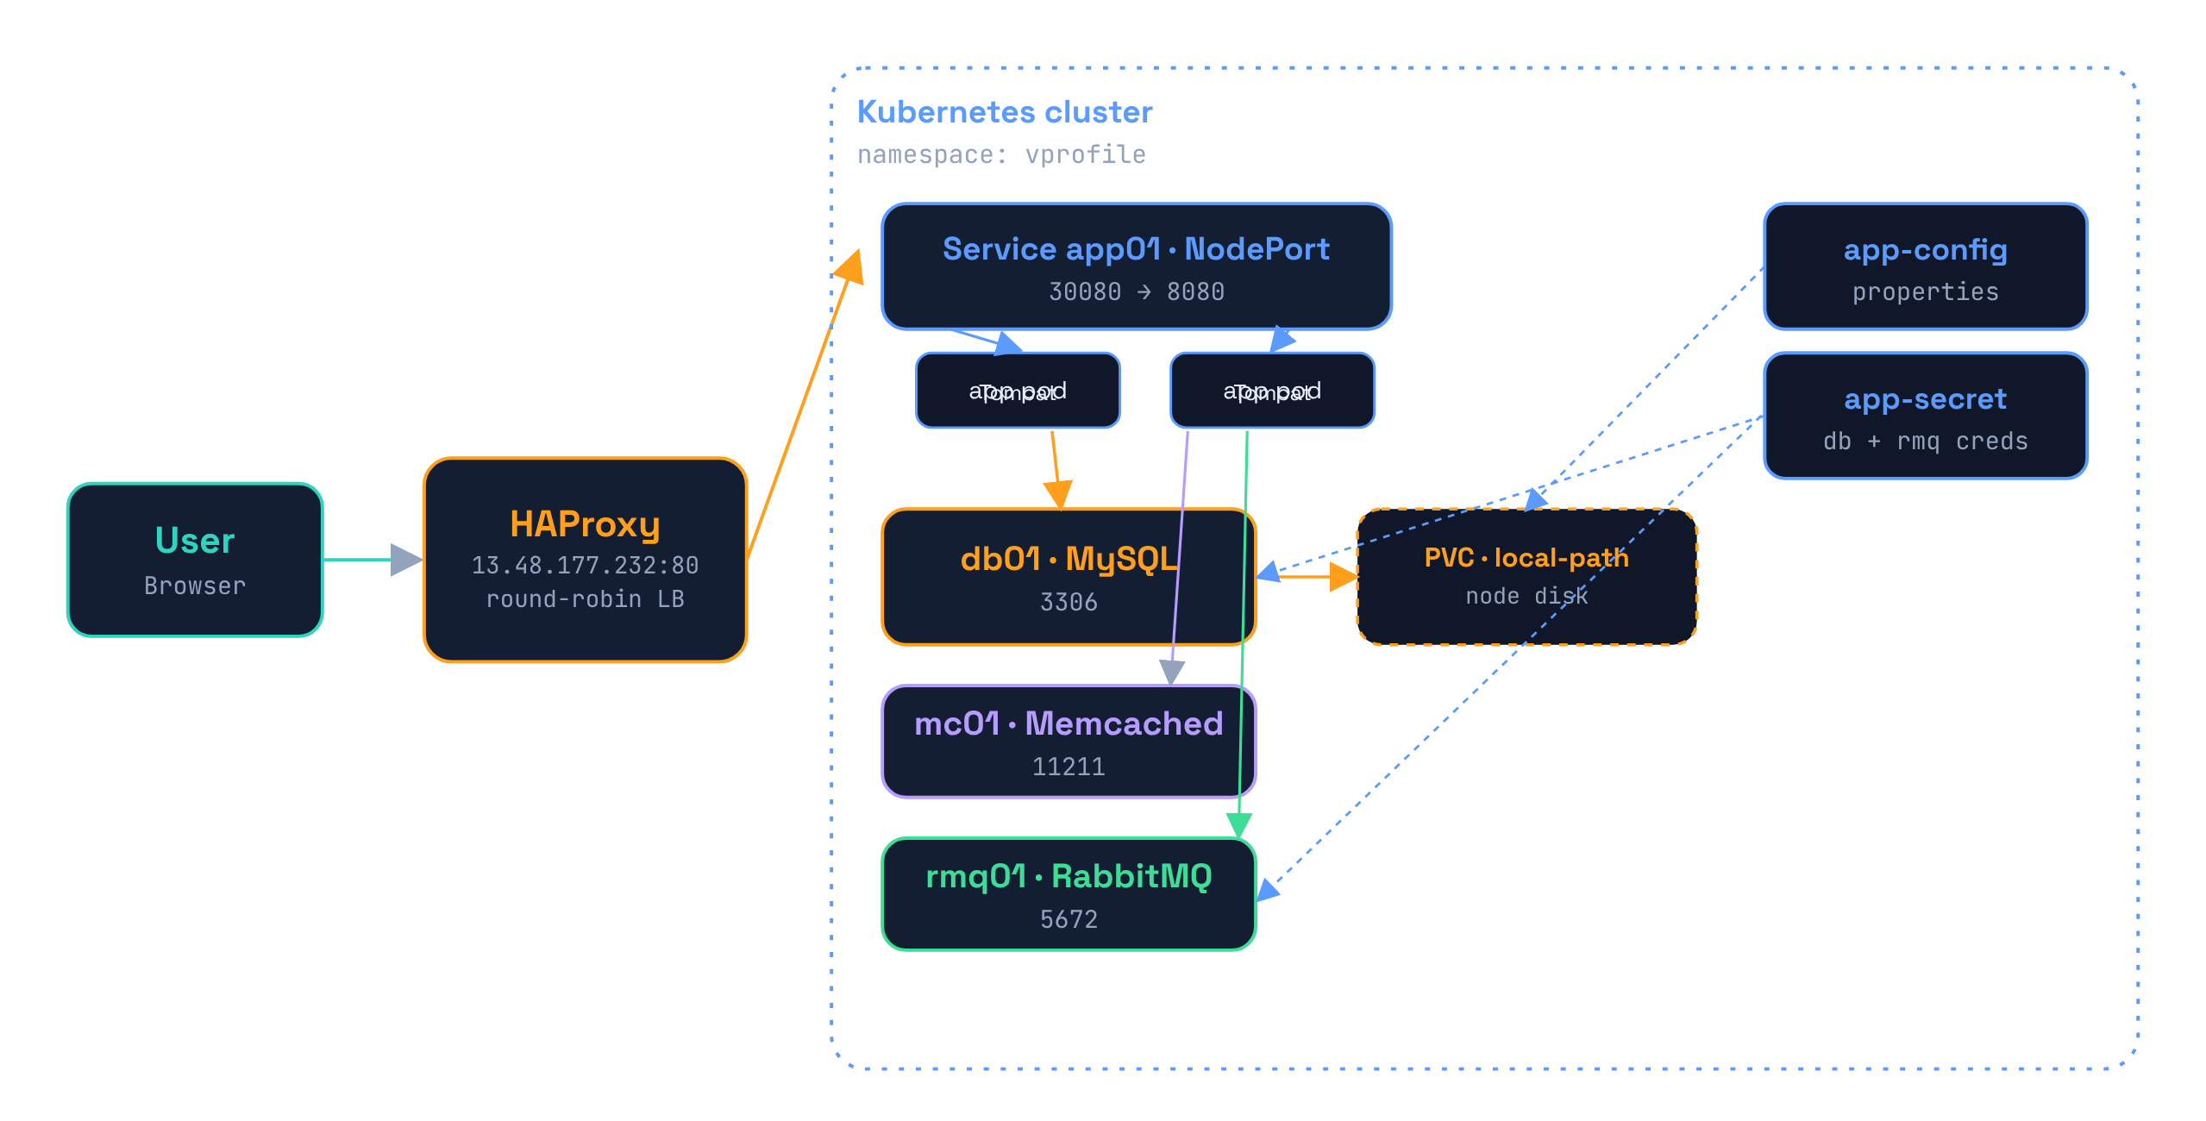
THE BIG PICTURE
System Architecture
User → HAProxy → NodePort (app01) → app pods → db01 · mc01 · rmq01

Slide 5
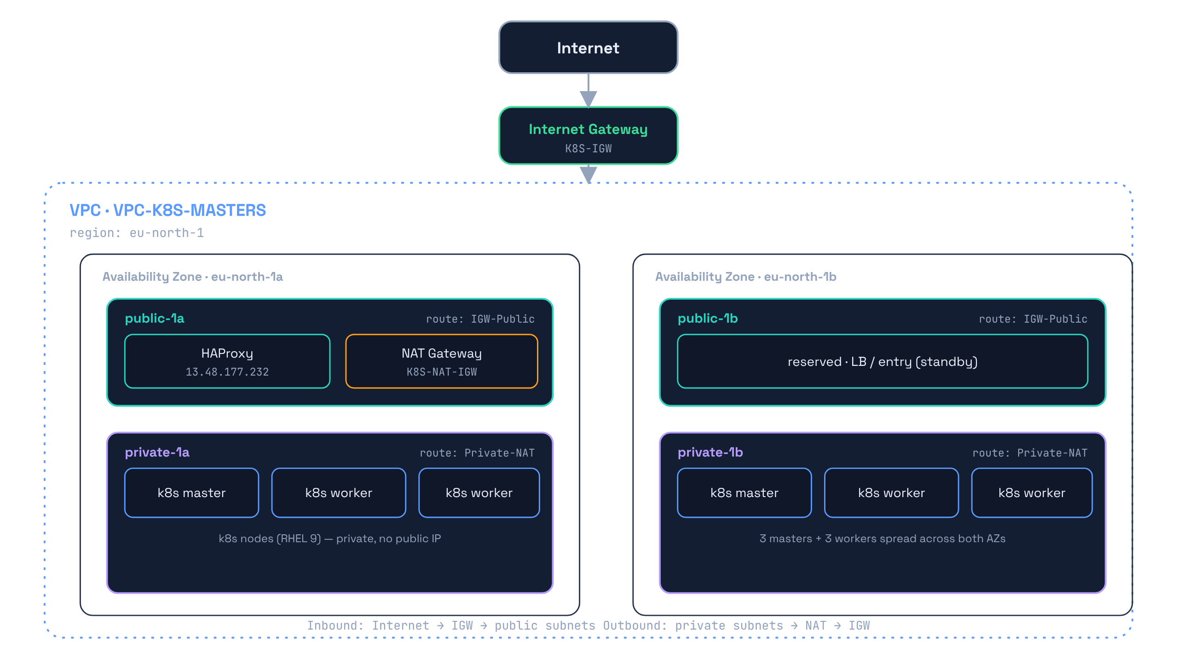
WHERE IT RUNS
Cloud Infrastructure · AWS VPC
2 Availability Zones
eu-north-1a / 1b — real HA spread
Public / private split
4 subnets: HAProxy & NAT public, nodes private
NAT egress
private nodes reach the internet via NAT → IGW
k8s lives here
the whole cluster sits inside this VPC

Slide 6
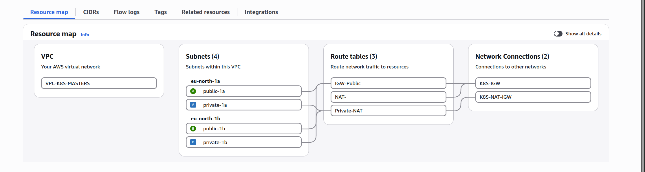
LIVE ON AWS
AWS Console · Resource Map
VPC-K8S-MASTERS · 4 subnets across 2 AZs · IGW + NAT — the foundation the cluster runs on

Slide 7
WHAT IT TAKES
Build & Requirements
Requirements
Image pipeline
Cluster 6 nodes · 3 masters + 3 workers · RHEL 9
1
Build
Orchestrator Kubernetes v1.36 · HAProxy in front
multi-stage · --platform linux/amd64
Storage local-path-provisioner (default SC)
Scan
2
Trivy · HIGH & CRITICAL
Build host docker / podman + trivy
Registry Docker Hub · alnaqib/*
3
Push
to alnaqib/vprofile-*:1.0

Slide 8
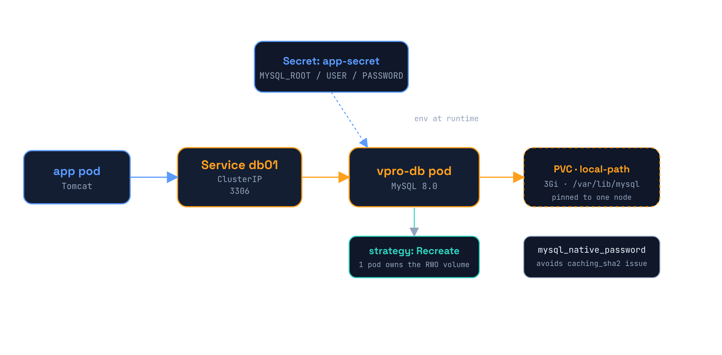
COMPONENT · DATA
Database — db01
MySQL 8.0
own image, seeded 'accounts' DB
Persistent
PVC on local-path · survives restarts
Secret-fed
MYSQL_* from app-secret at runtime
Recreate
one pod owns the RWO volume

Slide 9
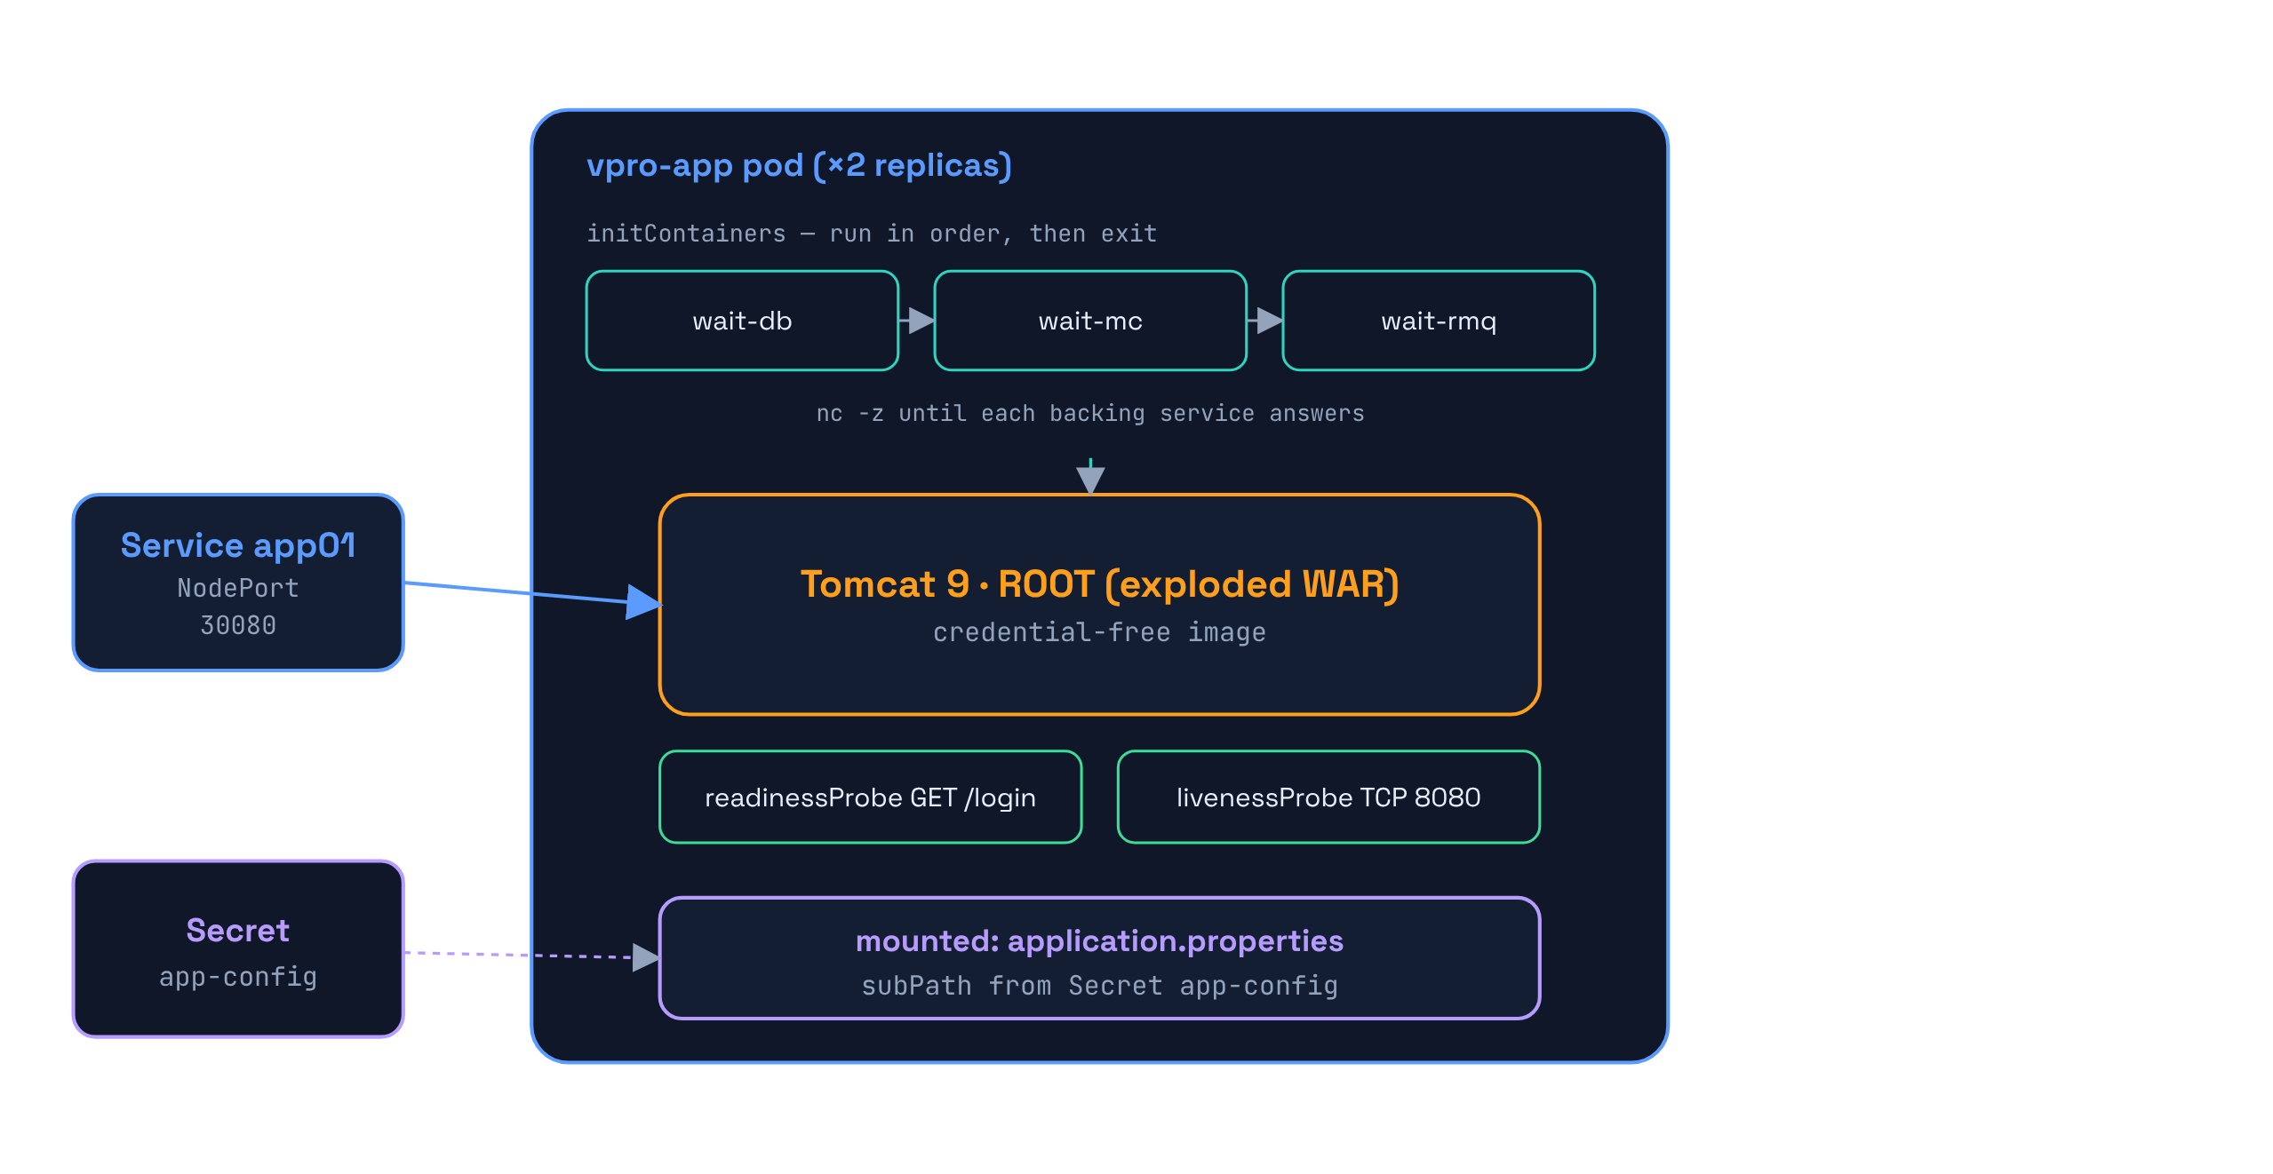
COMPONENT · APP
Application — app01
Ordered start
initContainers wait for db/mc/rmq
Credential-free
no secrets baked in the image
Config mount
application.properties from Secret
Health probes
readiness /login · liveness TCP

Slide 10
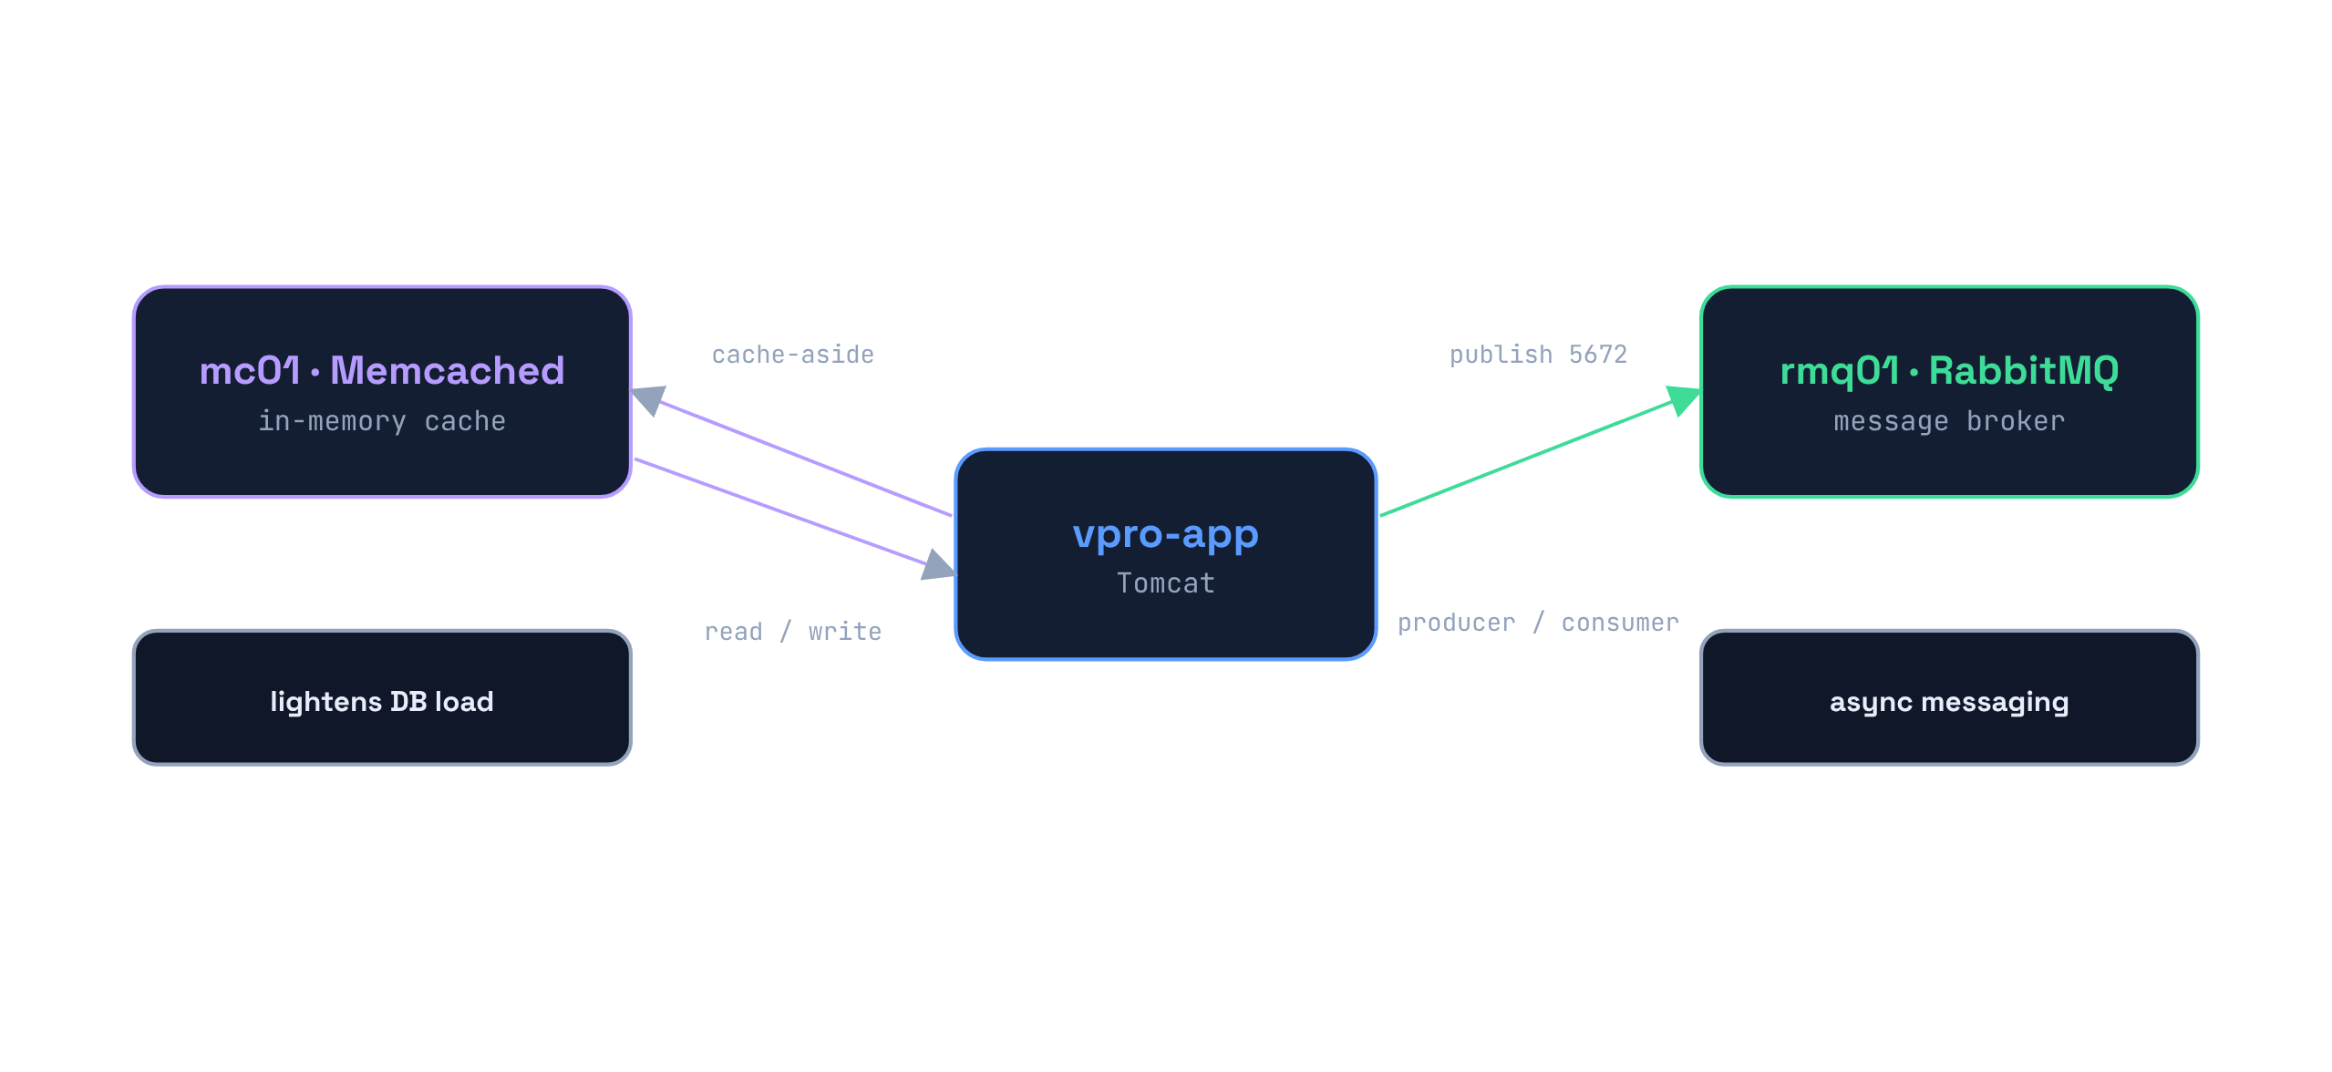
COMPONENT · SUPPORT
Cache & Broker
Memcached
cache-aside · lightens DB load
RabbitMQ
async producer / consumer
Stateless
no PVC — rebuilt on demand

Slide 11
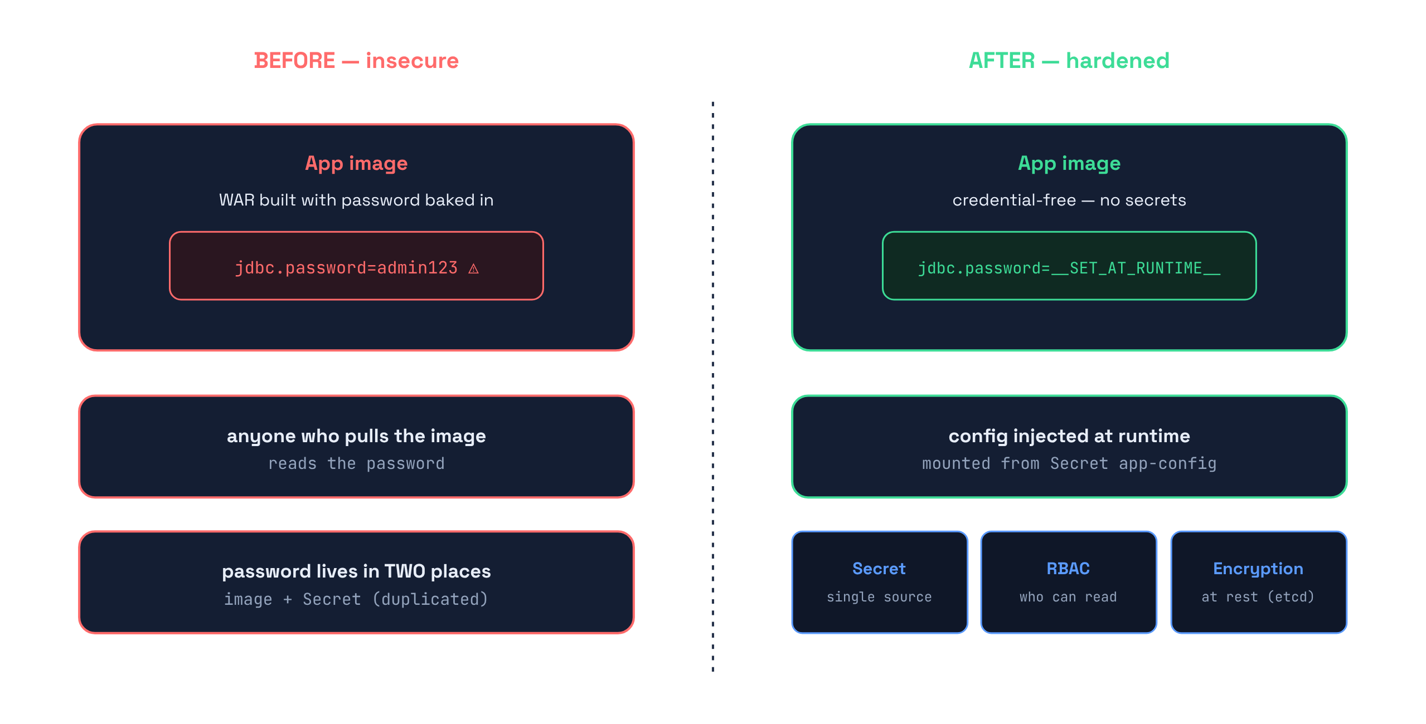
HARDENING
Security · Layered Defense
Credential-free image
the root cause fix
Single-source Secret
one place for the password
RBAC
limits who can read secrets
Encryption at rest
protects etcd & backups

Slide 12
UPDATE STRATEGY
Recreate vs RollingUpdate
Database
Application
Recreate
RollingUpdate
Volume is ReadWriteOnce — only one pod may hold it
RollingUpdate would start a new pod before killing the old one
Both would fight over the same PV → corruption risk
Recreate stops the old pod first, then starts the new
Stateless tier — any pod is interchangeable
2 replicas updated gradually, no downtime
Traffic keeps flowing during the rollout
Readiness probe gates each new pod before it serves

Slide 13
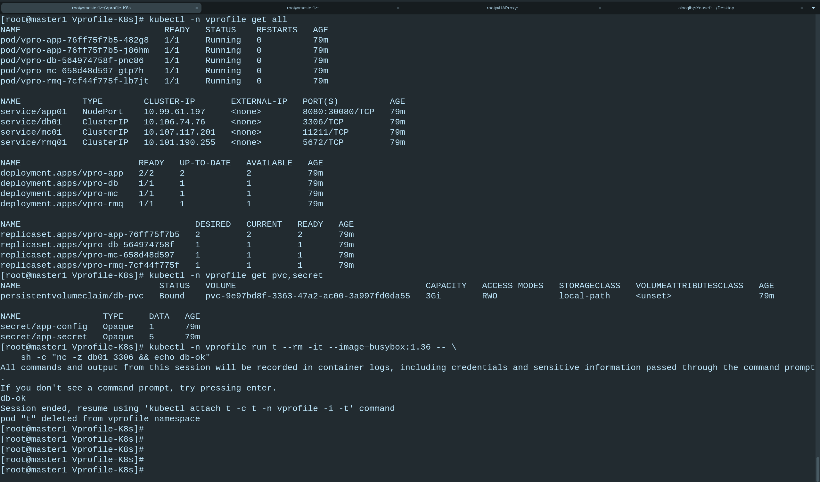
RUNNING STATE
Deployment · It's Alive
2/2
app replicas ready
4
services
Bound
PVC · local-path
0
restarts

Slide 14
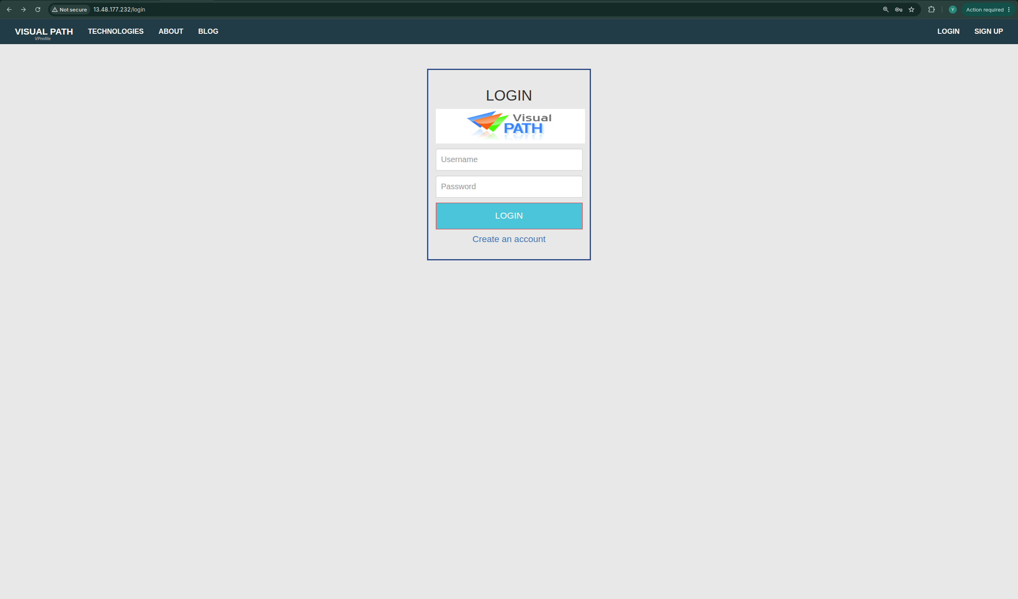
OPENING THE PROJECT
Accessing the Application
Via HAProxy (main)
1
http://13.48.177.232/
Direct NodePort
2
http://<node-ip>:30080/
Quick test
3
kubectl port-forward svc/app01 8080:8080
VProfile login page
Login admin_vp / admin_vp

Slide 15
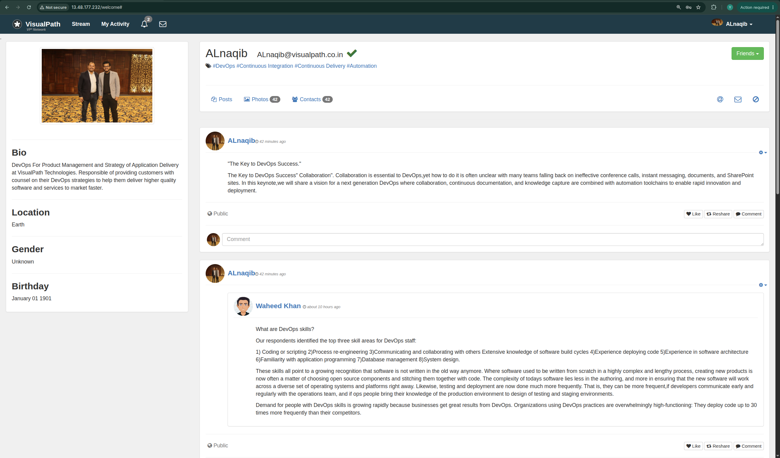
IT WORKS
The Application, Live
Signed in as admin_vp
Login succeeded → DB connected
Feed & profile render → cache OK
Served through HAProxy

Slide 16
WHAT I HIT & FIXED
Challenges Faced
HAProxy health check
MySQL 8 auth
GET / returned 302 → all backends marked DOWN → 503
caching_sha2_password broke the JDBC connection over plain TCP
Fix: health-check GET /login (returns 200)
Fix: force mysql_native_password
Secrets in the image
NodePort routing
password was baked into the WAR at build time
HAProxy pointed at wrong worker IPs → no traffic
Fix: credential-free image + mounted Secret
Fix: real INTERNAL-IPs from get nodes -o wide

Slide 17
WITH GRATITUDE
Acknowledgment
Thank you, Eng. Abdelrahman
For the guidance, the clear explanations, and the hands-on mentorship that made this project possible. Your patience in teaching the “why” behind every step — not just the “how” — is what turned these tools into real understanding.

Slide 18

Thank You
VProfile on Kubernetes · DevOps · Cairo · 2026

