Slide 1


DEVOPS PROJECT · CONTAINERIZATION
VProfile on Docker
Multi-stage containerized deployment of a 3-tier Java application
Tomcat · MySQL · RabbitMQ · Memcached · AWS ALB

Slide 2

OVERVIEW
Agenda
01
Project overview
05
Deploy from scratch
02
Tech stack
06
Project structure
03
Architecture
07
On-prem vs Docker
04
Multi-stage build
08
Notes & roadmap
02

Slide 3
THE PROJECT
What is VProfile
VProfile is a classic 3-tier Java (WAR) web application served by Apache Tomcat.
Presentation
User / Browser · ALB
We containerized the full stack with Docker Compose — mirroring the original on-prem 5-VM topology one-to-one, where each VM becomes a container and the service hostnames carry over unchanged.
Application
Tomcat · ROOT.war :8080
Data & Services
MySQL · RabbitMQ · Memcached
03

Slide 4
FOUR SERVICES
Tech Stack
A
app
D
db01
R
rmq01
M
mc01
tomcat:9-jre8
mysql:8.0
rabbitmq:3-mgmt
memcached:1.6
:8080
:3306
:5672 / :15672
:11211
Serves the VProfile WAR as ROOT.war
Primary database (accounts) on a volume
Message broker + management UI
In-memory cache layer
04

Slide 5
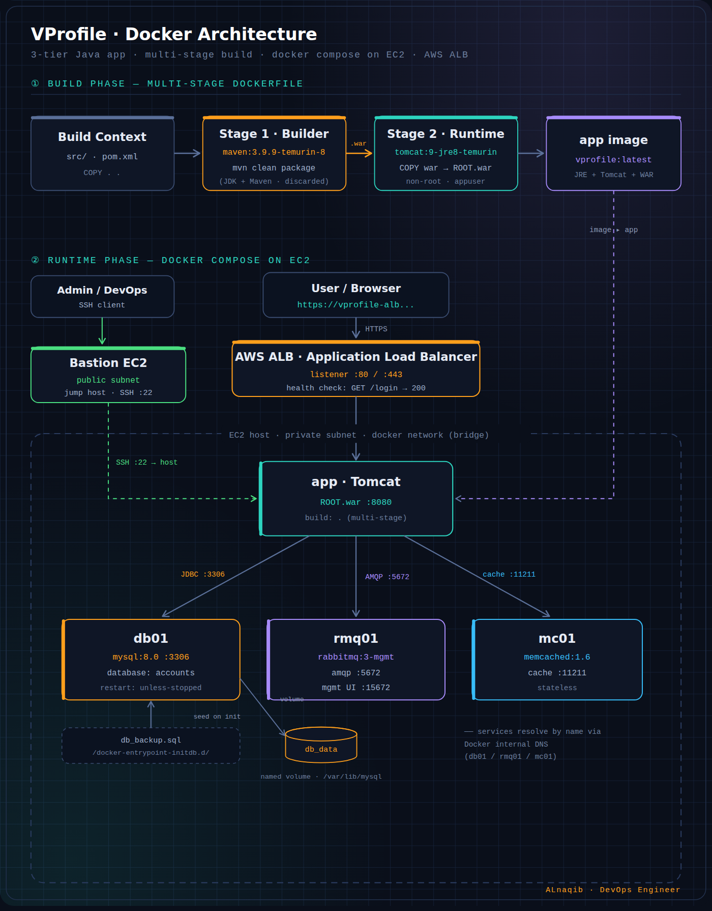
END-TO-END
Architecture
Build phase
A multi-stage Dockerfile compiles the WAR with Maven, then copies it into a slim Tomcat/JRE runtime as ROOT.war.
Runtime phase
docker compose runs four containers on a shared bridge network; services resolve each other by name via Docker DNS.
AWS ALB
Fronts the app on :80/:443 and forwards to :8080. Health check must be GET /login (200), not GET / (302).
Bastion EC2
A jump host in the public subnet provides SSH access to the private EC2 host running the stack.
05

Slide 6
HOW THE IMAGE IS BUILT
Multi-stage Build
Stage 1 · Builder
Stage 2 · Runtime
maven:3.9.9-temurin-8
tomcat:9-jre8-temurin
mvn clean package
COPY war → ROOT.war
Compiles the source into vprofile-v2.war. Contains the full JDK + Maven — this whole stage is discarded.
Slim JRE + Tomcat only. Runs as a non-root appuser. This is the only image that ships.
Result: a smaller image with a reduced attack surface — no compiler, no source, no JDK in production.
06

Slide 7
MULTI-STAGE
The Dockerfile
# ---------- Build stage ----------
FROM maven:3.9.9-eclipse-temurin-8 AS builder
WORKDIR /build
COPY . .
RUN mvn -B clean package
# ---------- Runtime stage ----------
FROM tomcat:9-jre8-temurin
RUN groupadd -r appgroup && useradd -r -g appgroup appuser
RUN rm -rf /usr/local/tomcat/webapps/*
COPY --from=builder --chown=appuser:appgroup \
/build/target/vprofile-v2.war ROOT.war
USER appuser
EXPOSE 8080
CMD ["catalina.sh", "run"]
COPY . .
Source lives in the repo — no git clone inside the image.
ROOT.war
Deployed at / so the app answers on the web root.
non-root
Runs as appuser; conf/ and lib/ stay root-owned.
07

Slide 8
ORCHESTRATION
Docker Compose
services:
app:
build: .
ports: ["8080:8080"]
depends_on: [db01, rmq01, mc01]
db01:
image: mysql:8.0
volumes:
- db_data:/var/lib/mysql
- ./db_backup.sql:/docker-
entrypoint-initdb.d/...
rmq01: image: rabbitmq:3-management
mc01: image: memcached:1.6
volumes: { db_data: }
Service discovery
Each service reaches the others by name (db01 / rmq01 / mc01), resolved by Docker's internal DNS.
depends_on ≠ ready
It waits for a container to START, not to be READY. Add a healthcheck with condition: service_healthy for deterministic startup.
08

Slide 9
STEP BY STEP
Deploy from Scratch
1
Clone the repository
$ git clone <repo> && cd vprofile-docker
2
Build and start the stack
$ docker compose up --build -d
3
Verify the containers
$ docker compose ps
4
Follow the app logs
$ docker compose logs -f app
5
Open the application
$ http://localhost:8080 (login page)
6
Stop and clean up
$ docker compose down · down -v
09

Slide 10
WHAT'S NEEDED VS EXTRA
Project Structure
sourcecodeseniorwr/
├── Dockerfile
├── docker-compose.yml
├── .dockerignore
├── pom.xml
├── src/main/resources/
│ ├── application.properties
│ └── db_backup.sql
├── target/ 105MB · rebuilt
├── db/db_backup.sql/ empty dir
└── .git/ vcs only
Required
Dockerfile, compose, .dockerignore, pom.xml, src/, application.properties and db_backup.sql.
Extra / removable
target/ (rebuilt inside the image) and the empty db/ folder. Both are already excluded by .dockerignore.
10

Slide 11
MIGRATION MAPPING
On-prem to Docker
COMPONENT
ON-PREM (VAGRANT VM)
DOCKER COMPOSE
Database
db01 — VM · MariaDB
db01 — mysql:8.0
Cache
mc01 — VM · Memcached
mc01 — memcached:1.6
Message broker
rmq01 — VM · RabbitMQ
rmq01 — rabbitmq:3
Application
app01 — VM · tomcat.sh
app — multi-stage image
Reverse proxy
web01 — VM · Nginx
not included
Name resolution
hostmanager
Docker internal DNS
11

Slide 12
THINGS TO WATCH
Notes & Gotchas
Health check path
depends_on isn't readiness
The ALB health check must be GET /login (returns 200). GET / returns a 302 redirect and marks the target unhealthy.
Add a healthcheck to db01 with condition: service_healthy so the app doesn't race MySQL's initialization.
No Nginx / Elasticsearch
Secrets are inline
The app is exposed on :8080 directly. application.properties still references vprosearch01 — search won't resolve, but the app starts fine.
Move credentials to a .env file or Docker secrets before any shared or staging deployment.
12

Slide 13
HARDENING
Production Roadmap
✓
Add healthcheck blocks for every service
✓
Move credentials to .env / Docker secrets
✓
Add an Nginx reverse-proxy container
✓
Pin all image tags to fixed digests
✓
Split into frontend / backend networks
✓
CI pipeline to build and push to Docker Hub
13

Slide 14
ACKNOWLEDGEMENT
Thank you, Eng. Abdelrahman
For the guidance, the clear explanations, and the hands-on mentorship that made this project possible. Your patience in teaching the “why” behind every step — not just the “how” — is what turned these tools into real understanding.

