Slide 1

MAZE game
Rl project

Slide 2
Team name :
Yousef hamdy shehab eldeen-MI
(Explanation of the game-create the environment)
Mohamed rabea ayed-MI
(Determine what is (action-state-policy-reword))
Ziad shehata torky-DS
(make the q-learning algoritm)
Ahmed mohamed ghorab-DS
(make condithon on q-learning)
Mahmoud mohamed elshikh-MI
(test the agent)

Slide 3
Explanation of the game
The project below sets up a simple maze with walls, a starting point (S), and a goal point (G). The maze is set up on a grid where each cell is either a 0 or 1, with 0 representing a black empty space and 1 representing a white wall.

Slide 4
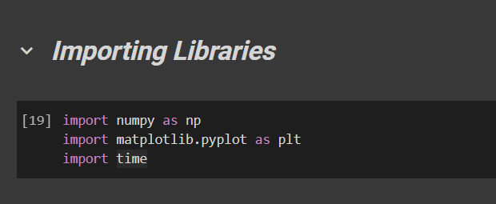
Importing Libraries
Numpy : it's used for representing and manipulating arrays efficiently.
Matplotlib: MATLAB. It is a plotting library used for 2D graphics and used for visualizing the maze, the agent's path, and for plotting training statistics.
Time : used for time-related operations, such as measuring the execution time of code

Slide 5
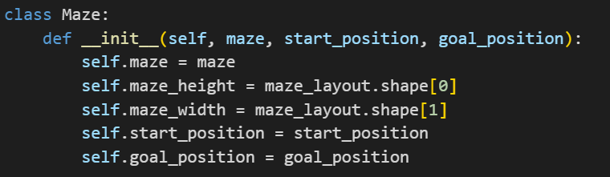
Creating the Maze Environment
The Maze class represents a maze with its layout, starting position, and goal position.
The __init__ method initializes the Maze object with the given maze layout, start position, and goal position.

Slide 6
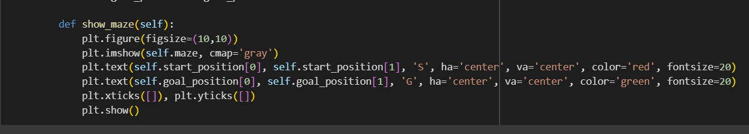
Creating the Maze Environment
The show_maze method visualizes the maze using matplotlib.pyplot.
The maze layout is displayed in grayscale, with the start position marked with a red 'S' and the goal position marked with a green 'G'.
The tick marks on the x and y axes are removed for a cleaner visualization.visualization..

Slide 7
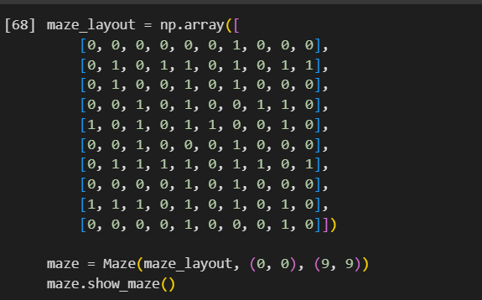
Create an instance of the maze
maze_layout is a 2D numpy array representing the maze layout.
The Maze object maze is created with the given maze layout, starting position (0, 0), and goal position (9, 9) and The maze is represented as a grid where 0 represents an empty space and 1 represents a wall.
The show_maze() method of the maze object is called to visualize the maze, with the starting position marked in red ('S') and the goal position marked in green ('G').

Slide 8
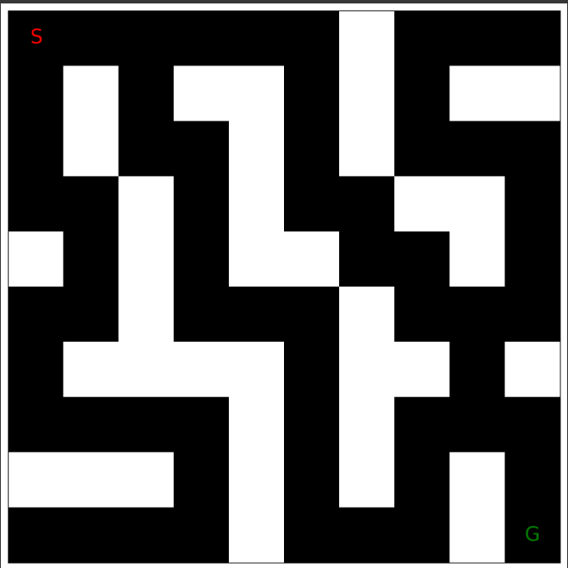
Output

Slide 9

actions
The agent can move in four directions:
up, down, left, and right.
(-1, 0) => Up Moving one step up, reducing the row index by 1
(1, 0) => Down: Moving on step down, increasing the row index by 1
(0, -1) => Left: Moving one step to the left, reducing the column index by 1
(0, 1) => Right: Moving one step to the right, increasing the column index by 1

Slide 10
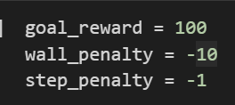
Reward System
values for the reward system

Slide 11
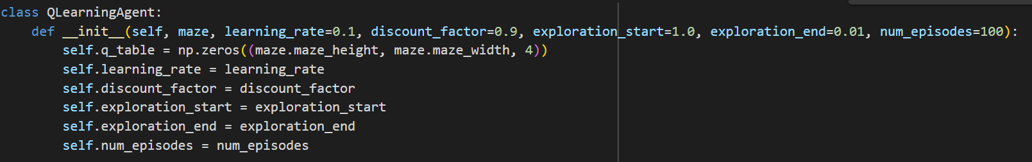
Q-Learning-agent
Initialize the Q-learning agent with a Q-table containing all zeros
where the rows represent states, columns represent actions, and the third dimension is for each action (Up, Down, Left, Right)
4 actions: Up, Down, Left, Right
Learning rate controls how much the agent updates its Q-values after each action
Discount factor determines the importance of future rewards in the agent's decisions
Exploration rate determines the likelihood of the agent taking a random action

Slide 12
Q-Learning-agent
Calculate the current exploration rate using the given formula

Slide 13
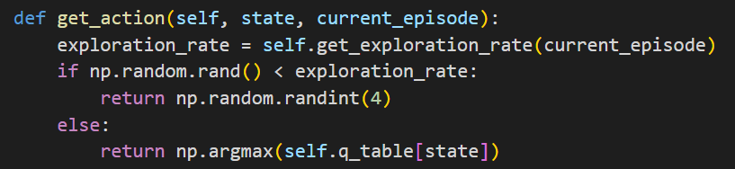
Q-Learning-agent
Select an action for the given state either randomly (exploration) or using the Q-table (exploitation)

Slide 14
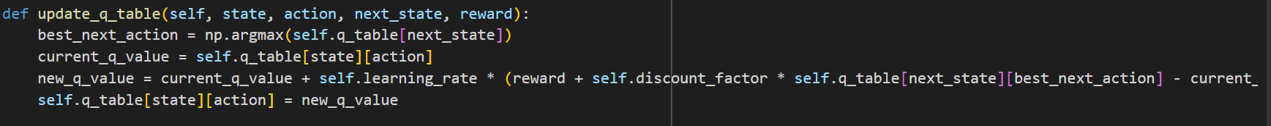
Q-Learning-agent
.Find the best next action by selecting the action that maximizes the Q-value for the next state
Get the current Q-value for the current state and action
Q-value update using Q-learning formula
Update the Q-table with the new Q-value for the current state and action

Slide 15
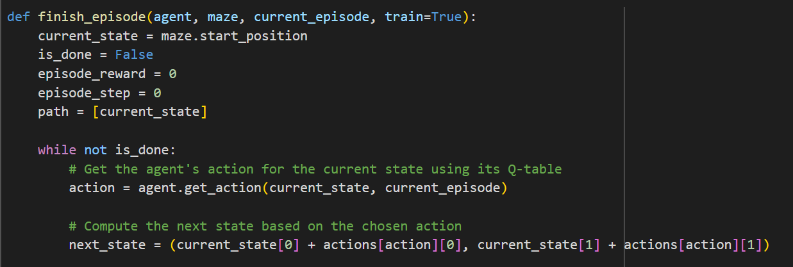
Testing the Agent
The code above tests how well the agent navigates the maze. It reports the total number of steps the agent took to get through the maze as well as the total reward the agent accumulated.Every time you want to test the agent, run the function ten times. Each time note the number of steps the agent used to travel between the start and the goal, as well as the total reward. Calculate the average steps and average reward across all ten test trials.

Slide 16
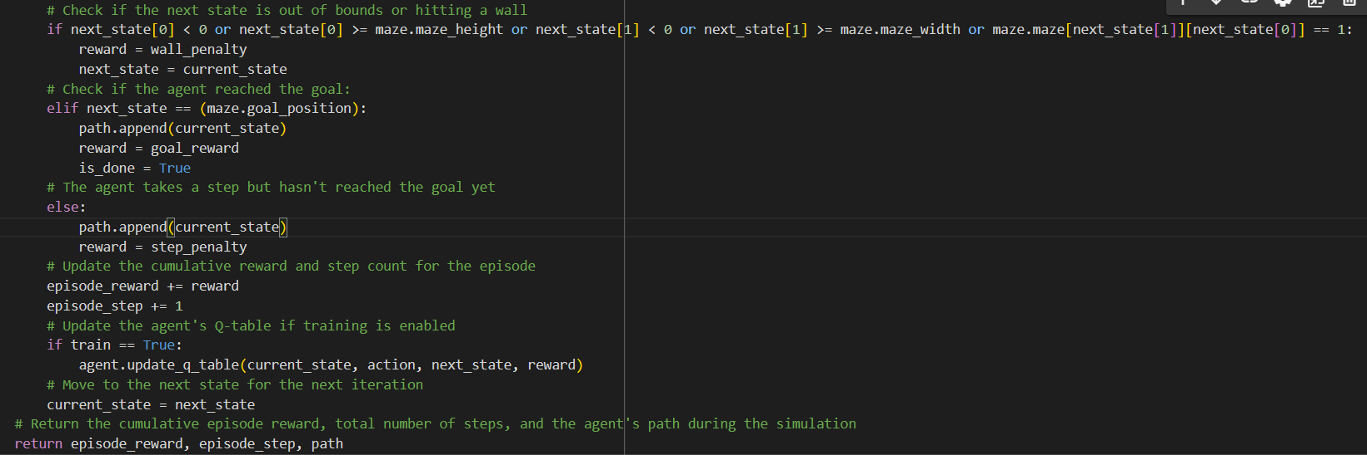
Testing the Agent
The code below tests how well the agent navigates the maze. It reports the total number of steps the agent took to get through the maze as well as the total reward the agent accumulated.

Slide 17
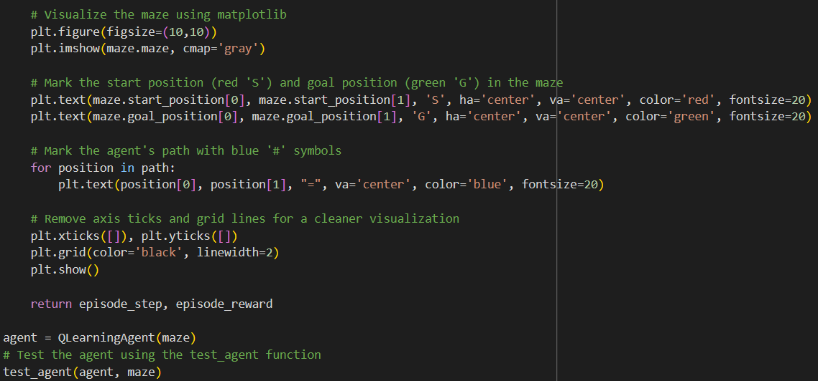
Visualize the maze using matplotlib

Slide 18
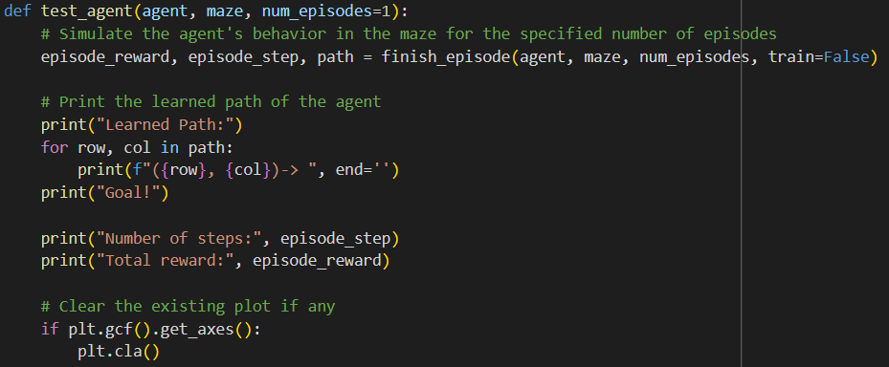
test & simulate the agent's movements in the maze
This function evaluates an agent's performance in the maze. The function simulates the agent's movements in the maze, updating its state, accumulating the rewards, and determining the end of the episode when the agent reaches the goal position. The agent's learned path is then printed along with the total number of steps taken and the total reward obtained during the simulation. The function also visualizes the maze with the agent's path marked in blue for better visualization of the agent's trajectory.

Slide 19
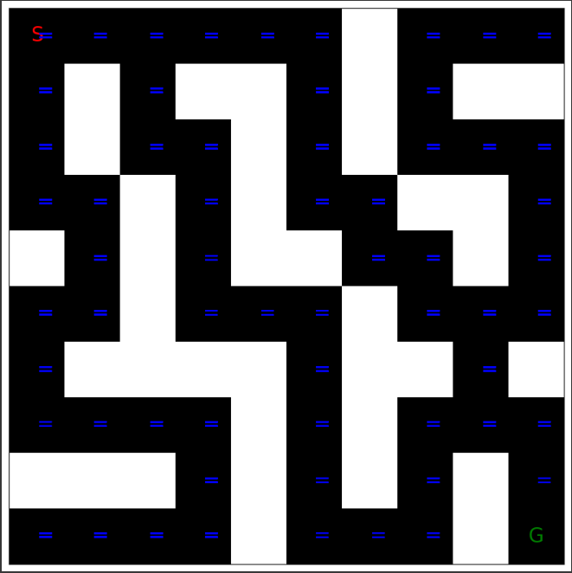
The output :

Slide 20
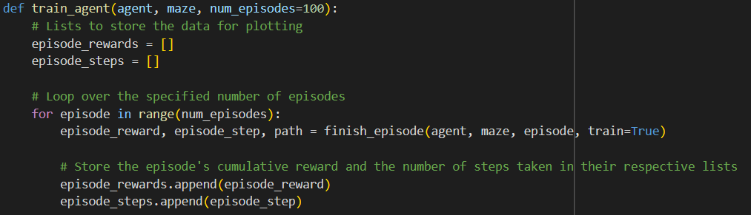
train the agent
Below is the code for Q-learning, a basic reinforcement learning algorithm. This is used to train the agent. This code updates the Q-values based on the rewards it receives during exploration. You do not need to change this code for your engineering project.

Slide 21
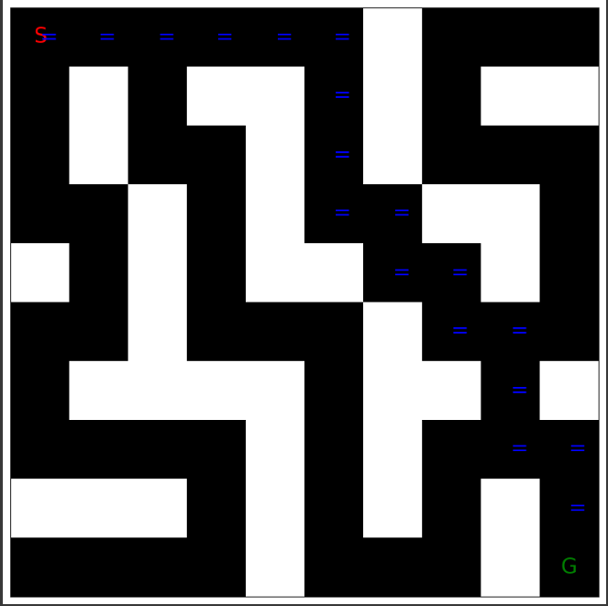
the agent after training (optimal policy)
(0, 0)-> (0, 0)-> (1, 0)-> (2, 0)-> (3, 0)-> (4, 0)-> (5, 0)-> (5, 1)-> (5, 2)-> (5, 3)-> (6, 3)-> (6, 4)-> (7, 4)-> (7, 5)-> (8, 5)-> (8, 6)-> (8, 7)-> (9, 7)-> (9, 8)-> Goal!

Slide 22
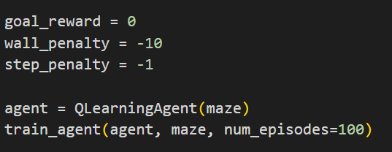
Experimenting and Improving
Try experimenting with a different reward system to see how that affects how the agent learns
agent = QLearningAgent(maze)` initializes a Q-learning agent to explore and learn from the maze environment.
After that, the `train_agent` function is called to train the agent on the maze. This function likely takes the agent, maze environment, and the number of episodes as input parameters.

Slide 23
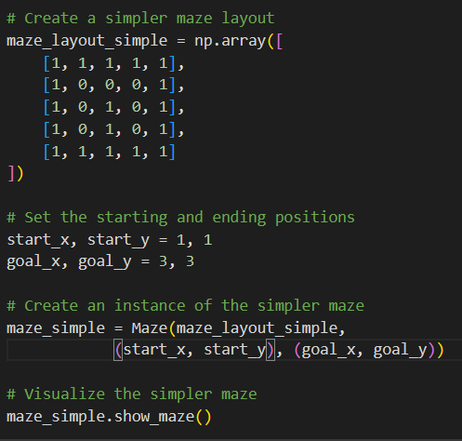
Creating More Mazes
maze_layout is a 2D numpy array representing the maze layout.​
The Maze object maze is created with the given maze layout, starting position (1,1), and goal position (3 3) and The maze is represented as a grid where 0 represents an empty space and 1 represents a wall.​
The show_maze() method of the maze object is called to visualize the maze, with the starting position marked in red ('S') and the goal position marked in green ('G').​

Slide 24
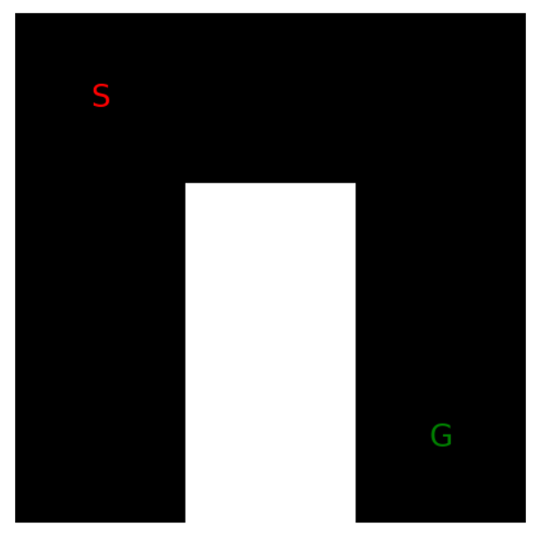
Out put

Slide 25
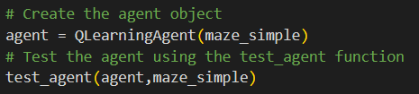
Test the agent

Slide 26
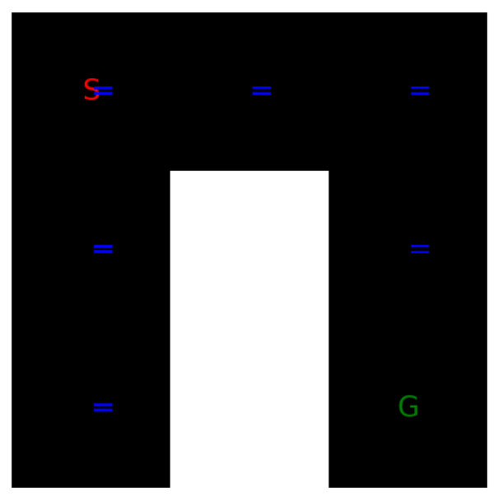
The output
Learned Path: (1, 1)-> (1, 1)-> (2, 1)-> (3, 1)-> (2, 1)-> (1, 1)-> (1, 2)-> (1, 3)-> (1, 2)-> (1, 3)-> (1, 2)-> (1, 3)-> (1, 2)-> (1, 3)-> (1, 2)-> (1, 1)-> (1, 2)-> (1, 3)-> (1, 2)-> (1, 3)-> (1, 2)-> (1, 1)-> (1, 2)-> (1, 3)-> (1, 2)-> (1, 3)-> (1, 2)-> (1, 1)-> (1, 2)-> (1, 3)-> (1, 2)-> (1, 3)-> (1, 2)-> (1, 1)-> (2, 1)-> (1, 1)-> (2, 1)-> (3, 1)-> (3, 2)-> Goal!
Number of steps: 100
Total reward: -647

Slide 27

Trainig the agent
train_agent` function is called to train the agent on the maze. This function likely takes the agent, maze environment, and the number of episodes as input parameters.

Slide 28

Testing agent again after training

Slide 29
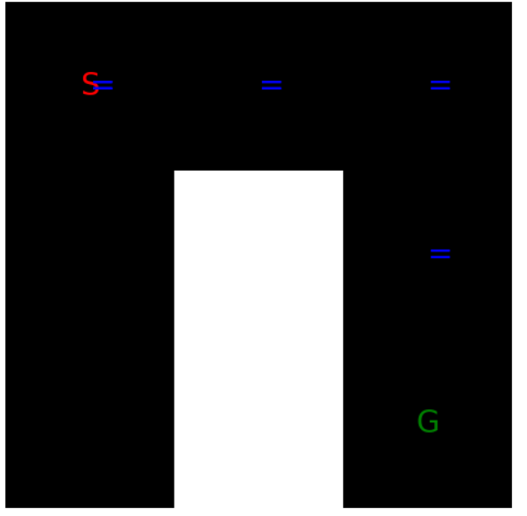
Output after testing
Learned Path:
(1, 1)-> (1, 1)->
(2, 1)-> (1, 1)->
(2, 1)-> (3, 1)->
(3, 2)-> Goal!
Number of steps: 14
Total reward: -75

Slide 30

Thank you

