Slide 1
Software-Defined Perimeter (SDP)
SDP & CYBERSECURITY INNOVATIONS

Slide 2

What is a SDP?
A Software-Defined Perimeter (SDP) is a modern security architecture that hides an organization’s infrastructure from the public internet and only allows access to resources after verifying the user’s identity, device, and context. It’s often described as “zero trust network access” (ZTNA) in practice.

Slide 3
What is a VSP?
An SDP creates a virtual security applications instead of around networks.
Traditional security builds a perimeter (firewalls, VPNs).
perimeter
(VSP)
around
around an entire network
SDP builds a perimeter dynamically and individually for each user and each application.

Slide 4
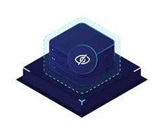



Key concepts
CONCEPT
DECLARATION
Default deny
Nothing is visible or accessible until the user is authenticated and authorized.
Identity-based access
Access depends on who the user is, not which network they’re on.
Micro-segmentation
Each user gets a personalized, isolated connection (a “party of one”) to only the resources they are allowed to use.
Invisible attack surface
Because services are not discoverable, scanners and attackers can’t see them.

Slide 5
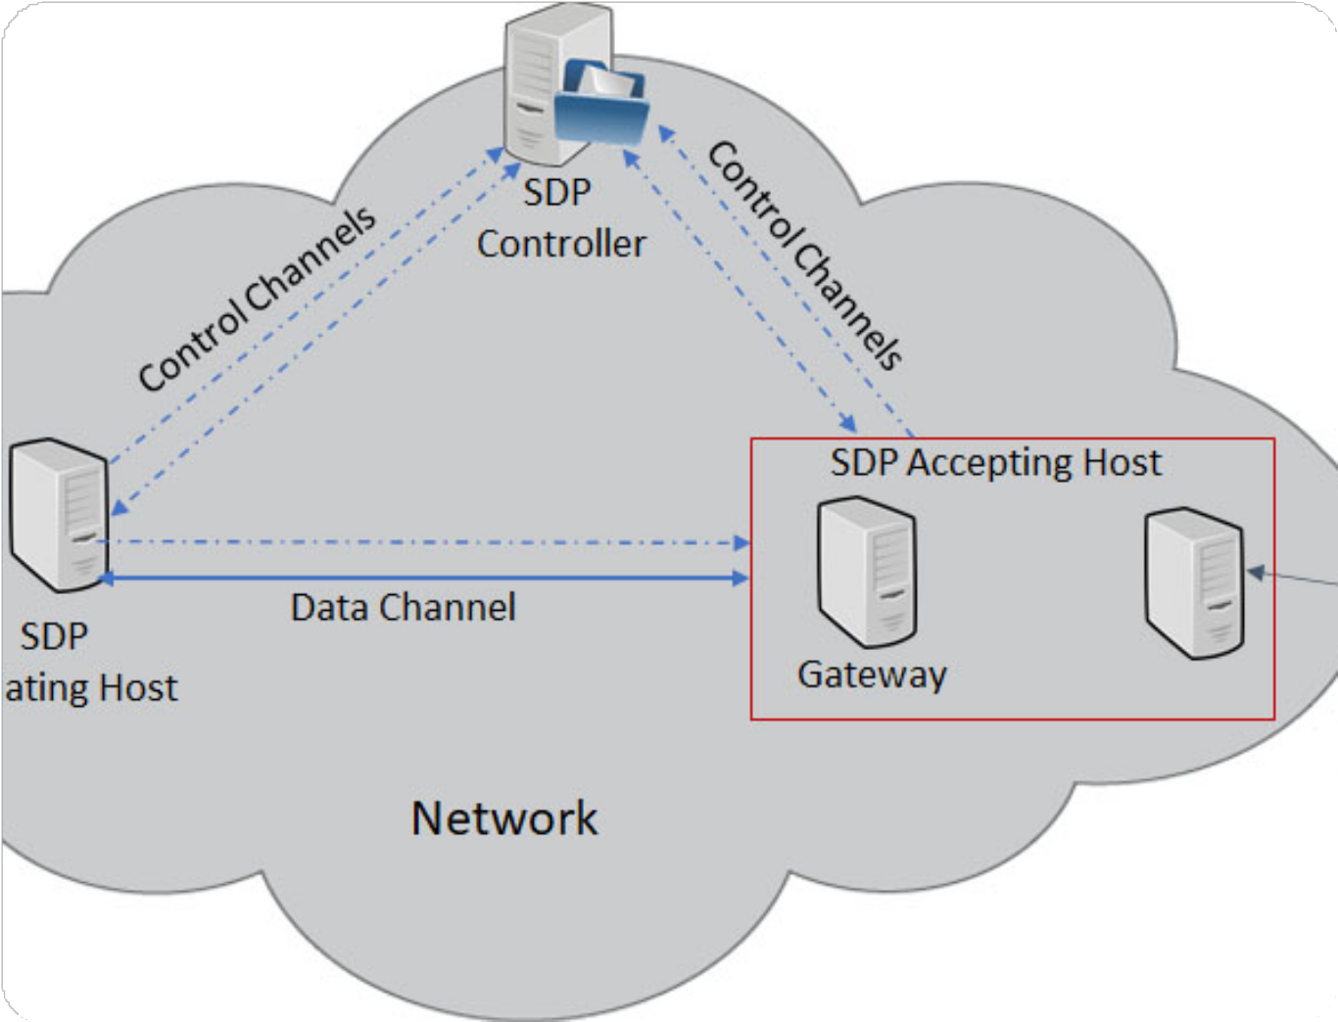

How an SDP works
User/device verifies identity with an SDP controller (using MFA, certificates, etc.)
The controller checks policies (user role, device posture, location, time, etc.)
If approved, it instructs an SDP gateway to create a temporary, encrypted, one-to- one connection for that user to a specific resource.
All other resources stay hidden and inaccessible.

Slide 6
How an SDP works cont.
Instead of letting a connection into the network and then authenticating, the SDP authenticates before allowing any access.
What happens in this step:
User authentication: Often uses multi-factor authentication (password + token + biometrics).
ex: SAML/SSO, OAuth, FIDO2, TOTP codes, etc.
Device authentication (“device identity”): The system ensures the device itself is known and trusted.
Methods include: Device certificates, MDM/UEM enrollment, Hardware IDs / TPM-
backed keys
No network access yet: At this stage, the user cannot see internal IPs, servers, or apps.They only interact with the SDP controller, which is usually internet-facing and hardened.

Slide 7
How an SDP works cont.
Once identity is verified, the SDP performs real-time policy evaluation to determine whether access should be approved.
What happens in this step:
Role-based evaluation: SDP checks who the user is (role, group, department). ex: Developers vs. contractors vs. admins.
Device posture evaluation: is the device compliant with requirements?
ex: is disk encryption enabled?, is antivirus/EDR active?, is OS up to date?
Contextual checks: These determine whether the request fits expected behavior.
ex: Location (country, subnet, geolocation), Time-of-day or business hours, Network type (corporate, home, public Wi-Fi)
Policy decision:Allow (conditions met)/Deny (conditions not met)/Step-up authentication (extra MFA needed)
Still no access granted yet. Approval at this stage only means the controller allows the gateway to accept a connection if the user initiates one. They still cannot see any internal resources.

Slide 8
How an SDP works cont.
After the policy engine approves, the SDP controller sends instructions to an SDP gateway (also called an acceptor or enforcement point) to allow a connection specifically for this user and this resource.
What happens in this step:
Dynamic, ephemeral connectivity: The SDP gateway opens a temporary “micro-tunnel.” This tunnel is dedicated to one user and one application. It uses mutual TLS (mTLS) or similar strong encryption.
No network-level access: The user does not join a network (unlike a VPN).They connect only to the application they’re allowed.
Application-level segmentation:
ex: User A can only access app1.internal, User B can only access db-read-api.internal, All other services remain invisible
Continuous validation: The connection is monitored the entire time. If the user’s context changes (e.g., device becomes non-compliant or location changes), the SDP can immediately cut the session.
Tunnel disappears after use When the user disconnects, the gateway tears down the tunnel.There is no persistent exposure.

Slide 9
Waverley Labs Framework
SDP & CYBERSECURITY INNOVATIONS

Slide 10


AGENDA
Introduction to Waverley Labs
The Core Framework
Alignment with NIST Framework Key Components and Architecture Implementation and Tools Benefits and Risk Reduction Challenges and Best Practices

Slide 11
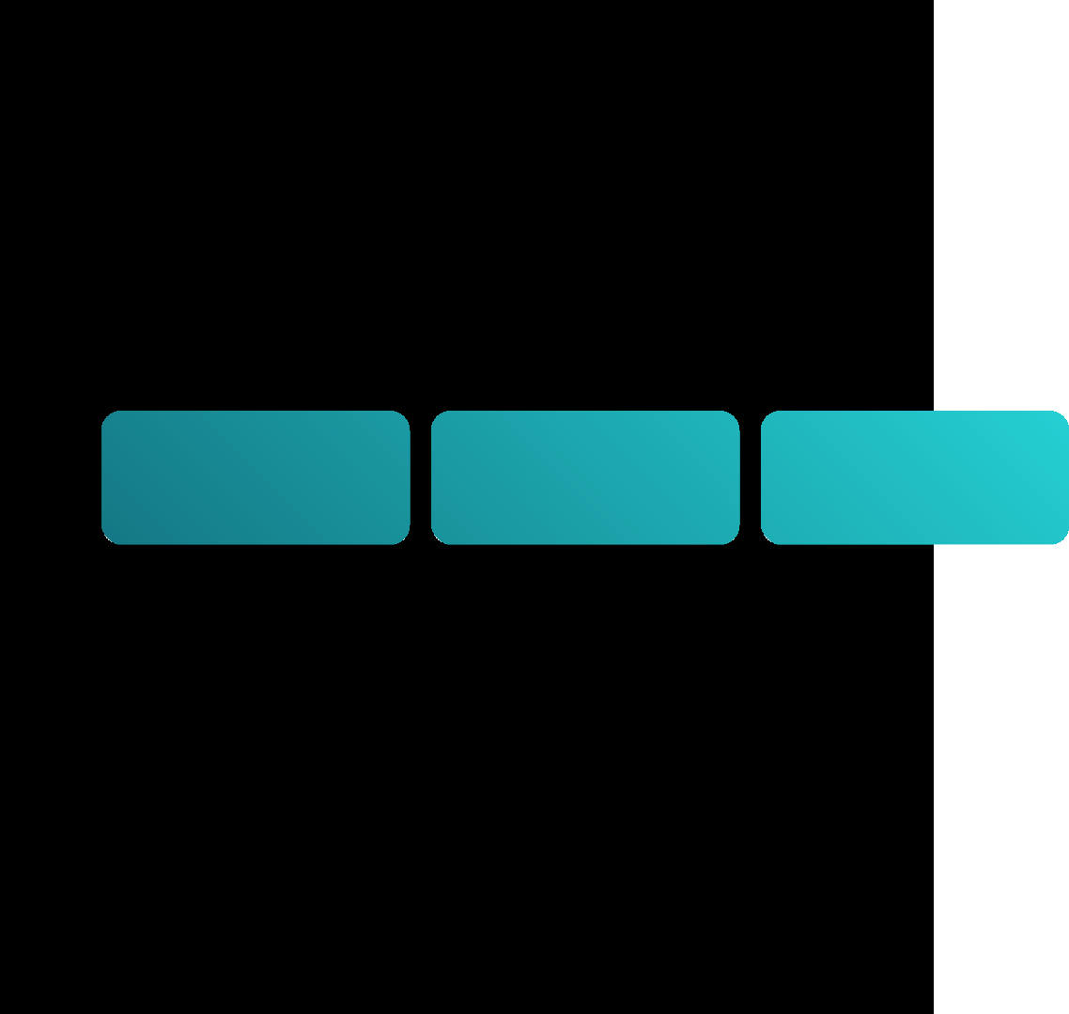

Introduction to Waverley Labs
FOUNDED
MISSION
EXPERTISE
LEADERSHIP
CLIENTS
Cloud security
DevSecOps penetration testing cyber risk profiling
agile ATO (Authority to Operate).
Juanita Koilpillai (Founder & CEO)
Pioneer in SDP and co-author of CSA's SDP Architecture Guide.
Federal agencies (DHS, DARPA, AFRL, NAVSEA, FEMA),
enterprises (e.g., Lockheed Martin), and research partners (UNC Charlotte).
2012,
headquartered in Waterford, VA.
Quantify, reduce, and control digital risk through open-source SDP, Zero Trust, and DRM solutions.

Slide 12



Evolution of Cybersecurity: From Perimeters to Zero Trust
BEFORE
AFTER
Traditional Perimeters
Static firewalls; visible attack surface Network-centric
Reactive patching
Zero Trust (Waverley Approach)
Dynamic, invisible perimeters; assume breach
Identity-centric with continuous verification Proactive risk quantification and mitigation

Slide 13
1. Definition
SDP creates a "black cloud" – resources invisible to unauthorised users until authenticated.
2. Key Principles:
Mutual authentication (client & gateway).
Just-in-time access (dynamic policy enforcement).
Micro-segmentation (per-resource isolation).
The Core Framework: Software Defined Perimeter (SDP)
3. Open-Source Pioneer:
First commercial SDP spec; DHS- funded open-source version for DDoS defense.

Slide 14
Alignment with NIST Cybersecurity Framework
NIST Function Waverley SDP Integration
Identify Risk profiling & asset mapping via automated tools Protect SDP micro-perimeters & encryption
Detect Unified attack pattern analysis & SIEM integration Respond Incident analysis & agile ATO
Recover Digital resilience modeling (e.g., power grid collab)

Slide 15

Architecture Deep Dive
Deployment Models:
On-premises, public/private cloud, hybrid.
User requests access → Gateway intercepts.
Authenticator verifies identity → Controller queries policies.
Access granted → Encrypted tunnel to resource.
Session ends → Resource re-hidden.
Scalability: Handles large-scale DDoS via open-source adaptations.

Slide 16
Implementation and Tools
Open-Source Repo:
GitHub.com/WaverleyLabs – SDP toolkit, Black Cloud prototypes.
Services:
Penetration testing, DevSecOps consulting, R&D lab for custom tools.
Integration:
With SIEM, Azure (encrypted storage), and probabilistic programming for risk modelling.
Getting Started:
Assess assets → Deploy gateway → Automate policies.

Slide 17

Benefits and Risk Reduction
Benefits:
75%+ cost savings vs. traditional clouds (via efficient perimeters).
Enhanced resilience: NIST-aligned; proactive threat detection.
Business Impact: Prioritized risks with visualizations for CISOs.
Drawbacks
Quantified Wins:
Initial setup complexity requires policy tuning.
Min. retweets/faves in engagements; real-time on mobile CPUs for sparse models.

Slide 18
Challenges and Best Practices
Policy Overload
Automate with controllers; start small (micro-segments)
Hybrid deployment; phased rollout
Anonymized data; encrypted Azure storage
Integration Legacy
Compliance (GDPR/NIST)

Slide 19
Future Directions
Expanding AI/ML Integration: For predictive risk modeling.
Open-Source Evolution:
More SDP adaptations for edge/IoT.
Vision:
"Perpetual peace & prosperity" via ethical AI in security (inspired by broader trends).
Roadmap:
Enhanced VERTEX-like scores for framework evaluation.

Slide 20
Thank you
Yousef Tamer 20235047
Abdelrahman Mahmoud 20235052
Omar Raafat 20235075
Abdallah Keylany 20235062

