Slide 1






HallPass — Student Reviews & Campus Survival Guide
Turning Scattered Campus Information into One Trusted Starting Point
ICT105 Fundamental Technology Entrepreneurship
Instructor: Dr. Herison Surbakti | July 31, 2026
TriByte Team
1

Slide 2


Meet the Team
TriByte Team
Htet Htet Myint Zaw(6808360)
Yousel Zangmo(6807458)
Khaing Zin Thet (6807597)
UX/UI & Validation Lead
Designed interface screens, contributed CSS and interaction design, managed customer discovery, validation evidence, privacy documentation, and marketing communication.
Technical Lead
Drives frontend architecture, prototype development, and technical implementation of the HallPass platform.
Product & Documentation Lead
Leads product strategy, project documentation, and overall delivery coordination for HallPass.
2

Slide 3




01
02
Problem & Target Users
Core Problem
Scattered, incomplete, and outdated campus information about dormitories, cafeterias, and daily life spread across multiple sources — leaving new students overwhelmed and underinformed.
Target Users
First-year, international & exchange students (primary)
Senior students contributing experience-based advice
Administrators moderating content quality
Discovery Evidence
• 13/20 respondents spent 30+ minutes searching for basic campus info
• 8/20 identified scattered information as their biggest problem
• 16/20 said they would use HallPass if it existed
• All international/exchange respondents flagged language barriers as a key challenge
3

Slide 4
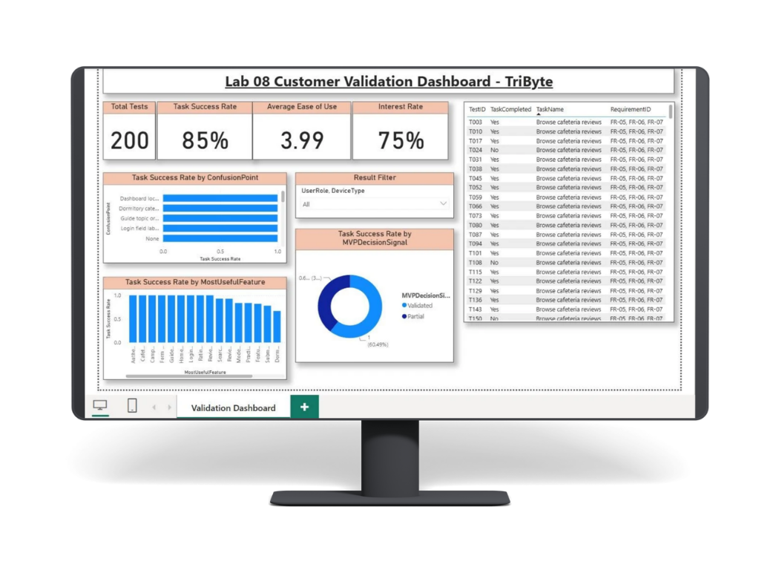
Evidence from Discovery & Validation
Customer Discovery
20 survey responses collected
13/20 spent 30+ min searching
8/20: scattered info = #1 problem
16/20 would use HallPass
Campus Survival Guide identified as core feature
All international students flagged language barriers
Usability Testing
200 task attempts recorded
85.0% overall task completion
Ease of Use: 3.99/5
Usefulness: 4.30/5
Interest: 4.34/5
Survival Guide: 92.9% | Dorm: 89.7% | Cafe: 89.7%
4

Slide 5
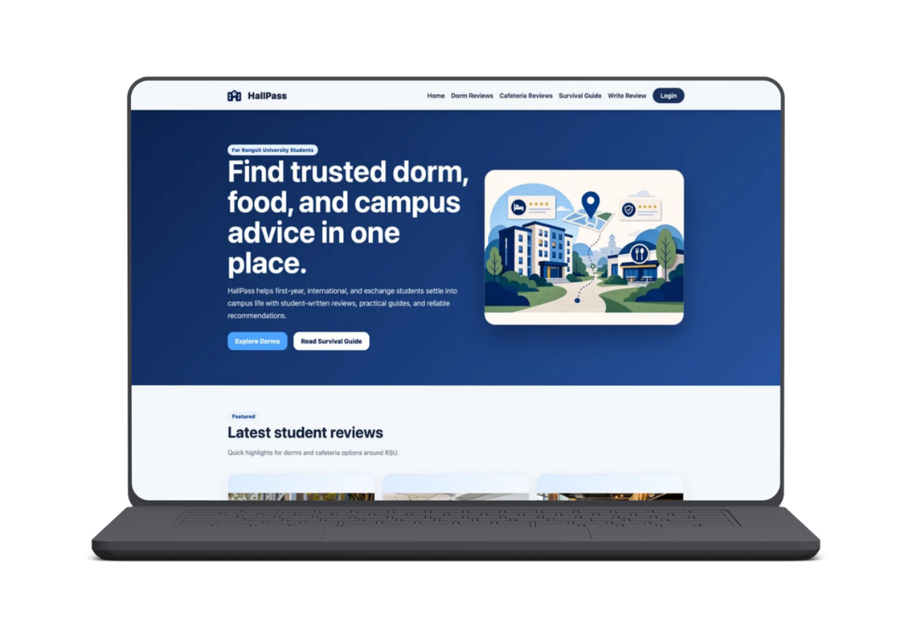
SOLUTION
HallPass Platform
HallPass is a browser-based platform combining campus reviews, survival guides, contribution tools, student status tracking, and moderated content — no app installation required.
Value Propositions
Centralized Campus Info: dormitories, cafeterias, and survival guides in one place
Faster Decisions: search, filters, ratings, saved places, and Maps links
Student-Driven Knowledge: verified senior reviews and shared experiences
Trust & Transparency: review status, verification, and moderation workflow
Accessible Entry: responsive web access, no installation needed
"HallPass reduces uncertainty by bringing student experiences, reviewed place information, and practical campus guidance into one accessible platform."
5

Slide 6
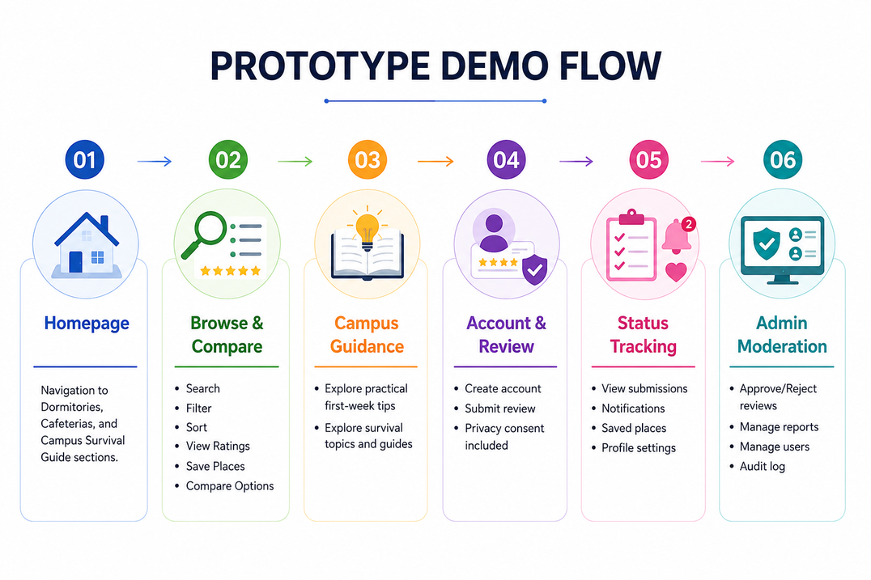
Prototype Demo Flow
Complete student and administrator pathway covering homepage, navigation, authentication, storage simulation, browsing, filtering, detail views, submissions, status tracking, validation, dashboards, reports, moderation, and traceability.
6

Slide 7

Business Model Canvas Summary
Channels
• Mobile-friendly website & GitHub Pages
• University pages & orientation events
• QR posters, LINE, student clubs & social media
Customer Relationships
• Self-service browsing & account creation
• Student contributions & notifications
• Admin moderation workflow
Key Activities
• Platform maintenance & content updates
• Review verification & moderation
• User testing & community outreach
Key Resources
• TriByte team & prototype codebase
• Testing data & university partnerships
Key Partners
• Student Affairs & university IT
• International College & student council
• Dormitory & cafeteria management
Sustainability
• University-supported onboarding & knowledge preservation service
Customer Segments
• First-year, international & exchange students
• Senior student contributors
• Administrators moderating content
Value Proposition
• Trusted, student-focused campus review & guidance platform with moderation
• One centralized starting point for campus life
7

Slide 8
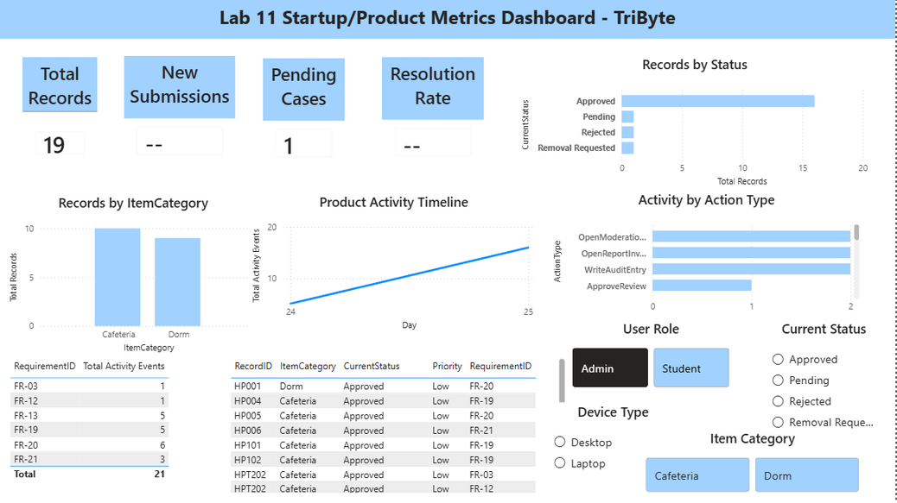
Product Metrics & Testing Findings
Validated Product Metrics:
200 task attempts, 170 successes
85% overall task completion rate
Avg task time: 1.89 minutes
Avg feedback score: 3.99/5
Usefulness: 4.30/5
Interest: 4.34/5
Go-to-Market Measurement Targets:
50 landing page visitors
• 40% CTA click-through rate
• 30 prototype demo views
• 10 feedback responses
• 25% landing-to-demo conversion
• Note: Targets only — strongest evidence is usability data
Prototype / Dashboard Metrics:
Student review submissions and status counts.
Pending moderation workload and approval rate.
Dormitory versus cafeteria activity.
Average rating, helpful votes, reports, users, and audit activity.
Mobile activity and task-processing time in the Lab 11 analytics demonstration.
8

Slide 9
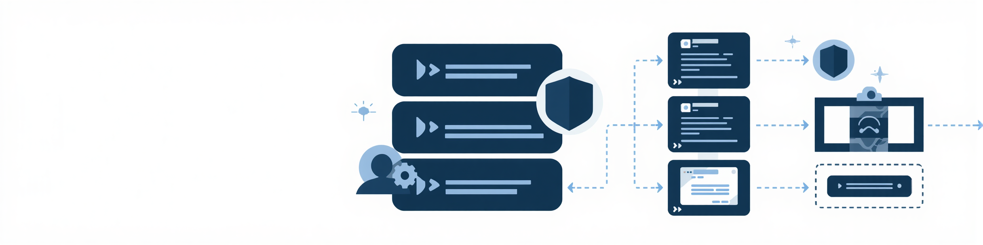

Technical Architecture & Responsible Data Handling
Architecture & Tech Stack
• Frontend: HTML5, CSS3, modular Vanilla JavaScript
• Hosting: GitHub Pages (no-install browser demo)
• Data Layer: fictional seed data + browser localStorage for accounts, reviews, saved places, reports, moderation, audits
• Interface: responsive layouts, keyboard focus, reduced motion, WebP images, mobile-friendly controls
Key Design Principles
• No personal data stored on external servers
• All interactions handled client-side for demo safety
• Modular codebase supports future backend integration
• Accessibility: keyboard focus, reduced motion support
Responsible IT & Privacy Design
• Privacy notice and consent integrated into review submission
• Data minimization and client-side input validation applied
• Duplicate-report prevention enforced
• Separation of student and administrator workflows maintained
Current Limitations & Production Path
• No backend, production database, password hashing, or server-side auth
• Suitable only for classroom demonstration
• Production Path: secure API, shared database, hashed credentials, server-side authorization, and monitoring
9

Slide 10


IMPROVEMENTS & FUTURE
Improvements From Testing
Future Development Priorities
Secure backend with authenticated sessions and server-side authorization
Verified university-managed accounts and official campus data updates
Multilingual support (Thai/English and more)
Structured moderation reasons, deletion recovery, and transparent appeals
Larger live pilots on multiple platforms and real student groups
Production-grade accessibility, privacy, security, backup, and monitoring controls
• Clearer homepage navigation and shorter feature text
• Enhanced search, filter, and sort UI visibility
• Stronger login/signup guidance and confirmation messages
• Clear required fields, privacy consent, and submission confirmation
• Added Saved Places, comparison, notifications, removal requests, report investigations, user and audit management
10

Slide 11
Thank You
"HallPass turns scattered campus knowledge into one clearer starting point for every new student."
Thank you, Dr. Herison Surbakti & evaluators — we welcome your questions and feedback.
11

