Slide 1
Direct Stiffness Method Program for 3D Structural Analysis
A Simplified DSM Solver and Validation Example
Siyuan Wang | CEE6501 | 04/24/2026

Slide 2
Project Objective and Workflow
Overview
A Direct Stiffness Method program is developed for 3D truss, frame, and hybrid truss-frame systems.
A JSON input file is used to define geometry, supports, materials, sections, and loading.
One consistent pipeline is followed: read input → element calculations → assembly → partition → solve → postprocess.
Displacement, reaction, and member-force tables are exported, and the deformed shape is visualized in the notebook.
JSON Input
Element Calculations
Global Assembly
Partition
Solve
Postprocess & Output

Slide 3
Validation Strategy
How to reproduce
By running main.ipynb sequentially, the analysis can be reproduced.
Truss Validation (4 cases)
Frame Validation (6 cases)
Nodal loads
Support displacement
Temperature load
Fabrication error
Nodal moments
Distributed member loads
Moment release
Support displacement
Temperature load
Fabrication error

Slide 4
Truss Validation I: Nodal Loads and Support Displacement
Nodal Loads
Support Displacement
Node 11:
Node 12:
Key check: reactions balance the applied forces
Observed behavior: reaction sums are consistent with global equilibrium
Node 1: prescribed
Key check: restrained-node displacement should match the input exactly
Observed behavior: the displacement table reports the imposed value correctly
Interpretation: this validates boundary-condition handling

Slide 5
Truss Validation II: Temperature and Fabrication Error
Temperature Load
Fabrication Error
All 43 members:
Thermal coefficient:
Expected axial strain:
Purpose: verify thermal-load assembly in the truss solver
Element 6: +0.01m length error
Element 17: -0.01m length error
Purpose: convert local incompatibility into equivalent element actions
Observed behavior: moderate redistributed displacement field

Slide 6
Frame Validation I: Nodal Moments and Member Loads
Nodal Moments
Distributed Member Loads
Selected M_{x} and M_{y} nodal moments are applied at intermediate floors
Purpose: show directional deformation in the 3D frame model
The case demonstrates bending-dominated frame behavior rather than pure axial response
12 members:
Total applied x-direction load: 2000 kN
Key check: reactions sum to -2000 kN in F_{x}
Purpose: verify member-load conversion and reaction recovery

Slide 7
Frame Validation II: Moment Release and Support Displacement
Moment Release
Support Displacement
Use the same member-load case with selected release codes MT=1 or 2
Expected trend: the released structure becomes softer
Observed result: max displacement rises from 12.764 m to 16.353 m
Displacement increase: about 28.1%
Node 1:
Node 3:
Key check: restrained-node displacements should equal the imposed values
Purpose: verify prescribed support movement in the frame solver

Slide 8
Frame Validation III: Temperature and Fabrication Error
Temperature Load
Fabrication Error
All 43 members:
Thermal coefficient:
Expected axial strain:
Purpose: verify thermal-load assembly in the truss solver
Element 5 and element 6: error = -0.01 m
Purpose: convert local incompatibility into equivalent element actions
Observed behavior: moderate redistributed displacement field

Slide 9
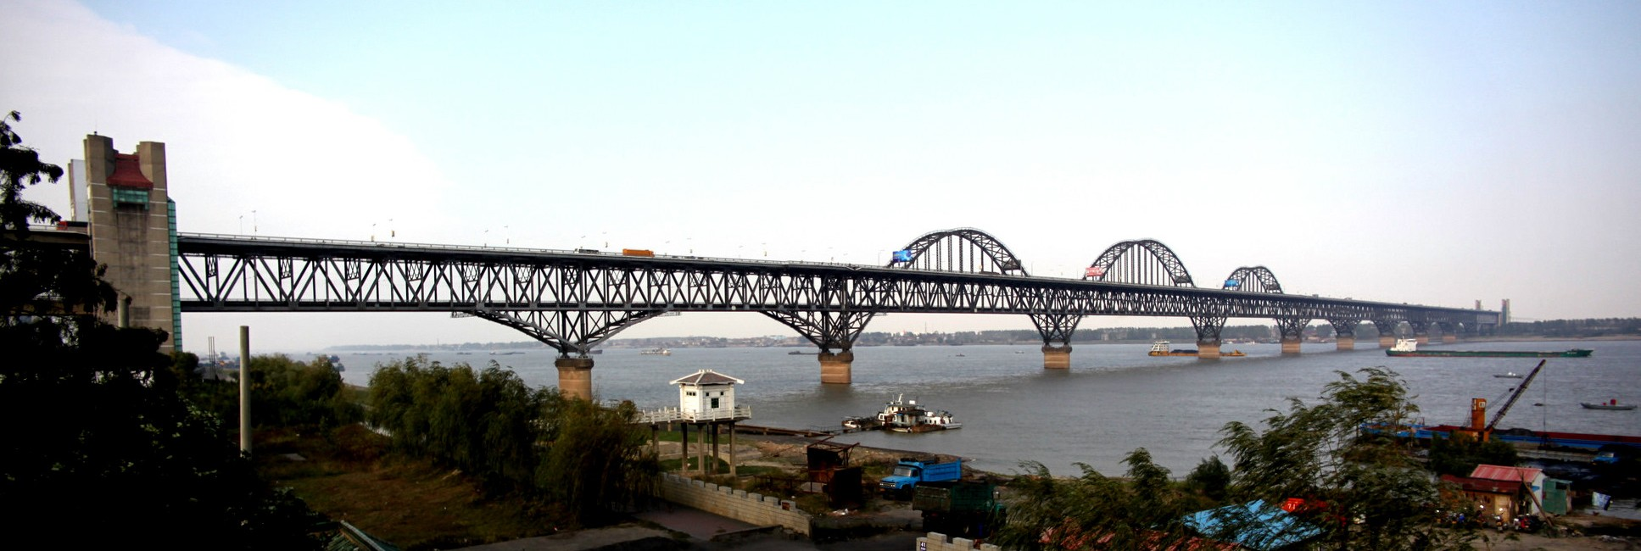
Case Study: Jiujiang Yangtze River Bridge
Three-span continuous arch-truss bridge
Total length: 576 m; span arrangement: 180 + 216 + 180 m
Modeled as a mixed truss-frame system

Slide 10
Final Bridge Model and Load Cases
Model
Load Files
Load case | Main loading description
Nodal loads only | 130 loaded nodes with concentrated downward loads (full 3 spans)
Member loads only | 350 members with (full 3 spans)
Support disp only | 4 internal support nodes with (middle 4 supports)
Temperature only | All members:
Comprehensive case | 50 nodal loads, 40 loaded members, 8 support movements, +50°C on all members
Three-span continuous arch-truss bridge based on the Jiujiang Yangtze River Bridge configuration.
354 nodes and 1225 elements.
Mixed idealization: 1005 truss elements + 220 frame elements.

Slide 11
Comprehensive Bridge Case: Load Balance and Key Responses
Applied Actions
Key Results
50 nodal loads with total vertical load
40 loaded members with
→ total distributed vertical load
8 support movements
Uniform temperature rise: +50°C on all members
Total applied vertical mechanical load
Support reactions sum to in z axis
Maximum total displacement: 3.2791 m at node 350
Largest vertical displacement:
at node 181

Slide 12
Main Takeaways
Conclusion
The validation cases support the correctness of equilibrium, compatibility, thermal strain, temperature load, member load calculation, and release handling.
The hybrid solver can analyze a much larger mixed truss-frame system in one global model.
For the bridge, critical axial forces concentrate near support-adjacent truss members, while large bending moments concentrate in the arch ribs.
Questions?

