Slide 1
VISUAL C#
Using GUI Objects and the Visual Studio IDE

Slide 2
OBJECTIVES
Design principles of graphical user interfaces (GUIs).
How to create graphical user interfaces.
How to process events that are generated by user interactions with GUI controls.
How to create and manipulate Button, Label, RadioButton, CheckBox, TextBox, Panel and NumericUpDown controls.
How to process mouse and keyboard events.

Slide 3
Introduction
Graphical User Interface (GUI)
Allows the user to interact visually with a program
Gives a program distinctive “look” and “feel”
GUI's are built from GUI controls
Also known as components or widgets
They are objects that can:
Display information on the screen, or
Enable users to interact with an application via the mouse, keyboard or other form of input
Examples - commonly used types of GUI controls
Label, TextBox, Button, CheckBox ComboBox, ListBox

Slide 4
Properties and Methods for GUI Controls
Each control has properties (and some methods)
Example properties:
Enable
Font
Text
Visible
Example methods:
Hide
Select
Show
In C#, default names for controls/components are:
button1, label1, textbox1, etc.
not very descriptive (“generic”)
Use better, descriptive names
Names to have meanings that make sense

Slide 5
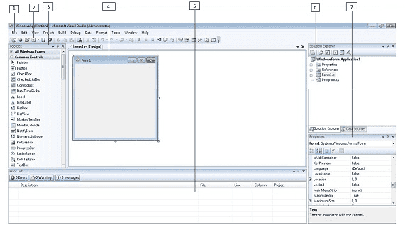
C# is designed for building a variety of applications that run on the .NET Framework

Slide 6
1. Menu Bar
2. Standard Toolbar
3. ToolBox
4. Forms Designer
5. Output Window
6. Solution Explorer
7. Properties Window

Slide 7

The first step is to start a new project and build a form. Open your Visual Studio and select File->New Project and from the new project dialog box select Other Languages->Visual C# and select Windows Forms Application. Enter a project name at the bottom of the dialouge box and click OK button. The following picture shows how to create a new Form in Visual Studio.

Slide 8
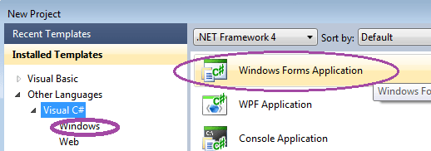
Select Windows Forms Application from New Project dialog box.

Slide 9
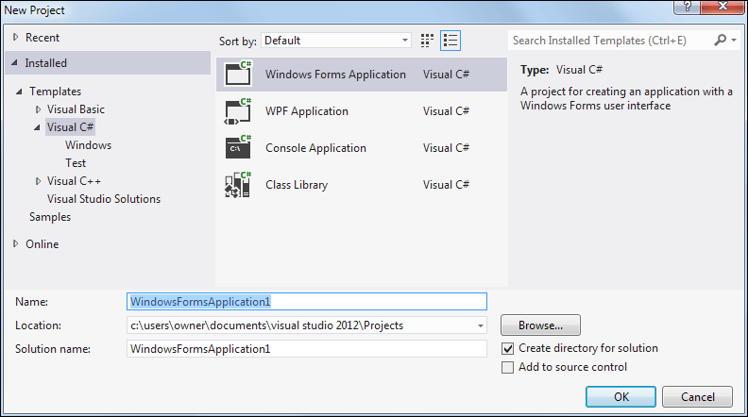
To create your first Windows form project, click the File menu again. This time, select New Project from the menu. When you do, you'll see the New Project dialogue box again.

Slide 10
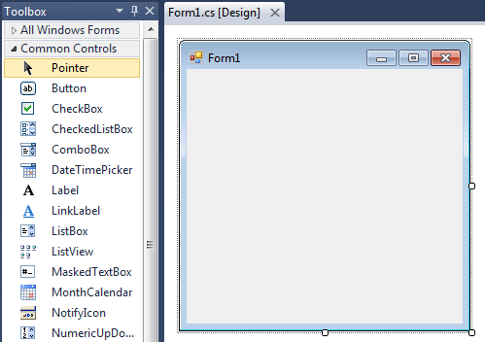
After selecting Windows Forms Application , you can see a default Form (Form1) in your new C# project. The Windows Form you see in Designer view is a visual representation of the window that will open when your application is opened. You can switch between this view and Code view at any time by right-clicking the design surface or code window and then clicking View Code or View Designer. The following picture shows how is the default Form (Form1) looks like.

Slide 11
CONTROLS
You may not notice it, but when you work with Windows Forms, you are working with the System.Windows.Forms namespace. This namespace is included in the using directives in one of the files that hold the Form class. Most controls in .NET derive from the System.Windows.Forms.Control class. This class defines the basic functionality of the controls, which is why many properties and events in the controls you’ll see are identical. Many of these classes are themselves base classes for other controls, as is the case with the Label and TextBoxBase classes

Slide 12
Properties
All controls have a number of properties that are used to manipulate the behavior of the control. The base class of most controls, System.Windows.Forms.Control, has several properties that other controls either inherit directly or override to provide some kind of custom behavior. For example, the Text property specifies the text that appears on a control. The location of this text varies depending on the control. In a Windows Form, the text appears in the title bar, but the text of a Button appears on its face.

Slide 15
Windows Forms
Windows Forms
Used to create GUIs for programs
Graphical element that appears on your computer’s desktop
Active window is the front most window
A Form is a container for controls and components
In visual programming, Visual Studio generates much of the GUI-related code

Slide 16
To create a Windows application, you generally create a Windows Form, set its properties, add controls to the Form, set their properties and implement event handlers (methods) that respond to events generated by the controls.

Slide 17
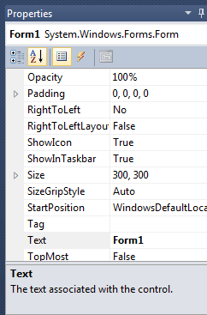
If you want to set any properties of
the Form, you can use Visual
Studio Property window to change it.
If you do not see the Properties
window, on the View menu, click
Properties window. This window
lists the properties of the currently
selected Windows Form or control,
and its here that you can change the
existing values.

Slide 18
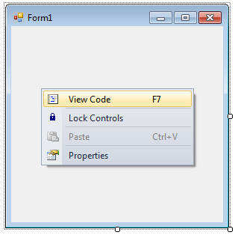
You can also set the properties of the Form1 through coding. For coding, you should right-click the design surface or code window and then clicking View Code.

Slide 20
Event Handling
When a user interacts with a form, this causes an event to occur
E.g., clicking a button, typing in a textbox, etc. are events
Events signal that certain code should be run
To perform some actions
Event Handler = method that runs after an event occurs
Event Handling = the overall process of responding to events
All GUI controls have associated events

Slide 21
faster way to define an event is to simply double-click on the control in the design form. This will add code for a default event. For a button, this is click. The default event will vary for other controls.
For example, double-click on an empty part of the form itself:
private void Form1_Load(object sender, EventArgs e)
{
}
Any code we enter in here is executed when the form is loaded for the first time. In our case, this corresponds to when the application is initially started. Try adding the following code

Slide 22
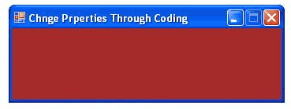
When you right click on Form then you will get code behind window, there you can write your code
For example , if you want to change the back color of the form to Brown , you can code in the Form1_Load event like the following.
private void Form1_Load(object sender, EventArgs e)
{
this.Text = "Change Properties Through Coding";
this.BackColor = Color.Brown;
this.Size = new Size(350, 125);
this.Location = new Point(300, 300);
this.MaximizeBox = false;
}

Slide 23
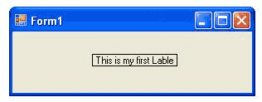
C# Label Control
Labels are one of the most frequently used C# control. We can use the Label control to display text in a set location on the page. Label controls can also be used to add descriptive text to a Form to provide the user with helpful information. The Label class is defined in the System.Windows.Forms namespace.
Add a Label control to the form - Click Label in the Toolbox and drag it over the forms Designer and drop it in the desired location.
If you want to change the display text of the Label, you have to set a new text to the Text property of Label.
label1.Text = "This is my first Label";
label1.Location = new Point(20, 150);
label1.Font = new Font("Georgia", 16);
label.BackColor = Color.Red;
label.ForeColor = Color.Blue;

Slide 25
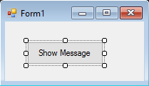
C# Button Control
A button is a control, which is an interactive component that enables users to communicate with an application. The Button class inherits directly from the ButtonBase class. A Button can be clicked by using the mouse, ENTER key, or SPACEBAR if the button has focus.
Here we show a Message box when a button is clicked. We add a button to a form, name it cmdShowMessage as used in code to identify the object and set the buttons text to Show Message.
We just need to double click the button on the visual designer and Visual Studio will generate the code for the click Event. Now we just need to add the code for the MessageBox there:
private void cmdShowMessage_Click(object sender, EventArgs e)
{
MessageBox.Show("Hello world!");
}

Slide 26
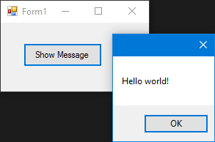
If we run the program now and click the button we'll see the message appearing:

Slide 27
Common Button Class Properties
FlatStyle Changes the style of the button. If you set the style to Popup, the button appears flat until the user moves the mouse pointer over it. When that happens, the button pops up to a 3-D look.
Image Specifies an image (bitmap, icon, and so on) that will be displayed on the button.
ImageAlign Specifies where the image on the button appears.
ForeColor The foreground color of the control.
BackColor The background color of a control
TabIndex The number the control has in the tab order of its containe

Slide 28
Name The name of the control. This name can be used to reference the control in code.
Text Holds the text that is associated with this control
Dock Docks a control to the edges of its container.
Anchor Specifies how the control behaves when its container is resized.
Enabled Setting Enabled to true usually means that the control can receive input from the user. Setting Enabled to false usually means that it cannot.. Setting it to false means that the button becomes grayed out and nothing happens when you click it.
Visible Specifies whether the control is visible at runtime.

Slide 29
Anchor and Dock Properties
The Anchor property specifies how the control behaves when a user resizes the window. You can specify that the control should resize itself, anchoring itself in proportion to its own edges, or stay the same size, anchoring its position relative to the window’s edges.
The Dock property specifies that a control should dock to an edge of its container. If a user resizes the window, then the control continues to be docked to the edge of the window. If, for instance, you specifythat a control should dock with the bottom of its container, then the control resizes and/or moves itself to always occupy the bottom part of the window, no matter how the window is resized.

Slide 30
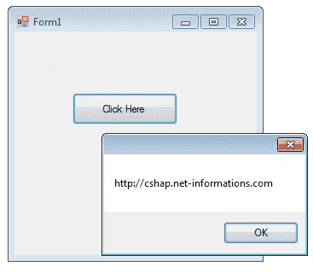
C# Button Control
When you want to change display text of the Button , you can change the Text property of the button.
button1.Text = "Click Here";
Similarly if you want to load an Image to a Button control , you can code like this
button1.Image = Image.FromFile("C:\\testimage.jpg");

Slide 31
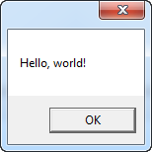
C# MessageBox
In today’s applications, it is always required that a message is displayed to the user as a token of information or confirmation so that the user is aware of the status of the operation he performed.
A message box can be considered as an interface between the user and the application. It is nothing but a window that has text, images, or symbols to guide or convey something to the user. Until appropriate action is performed, and the message box is closed, it will not allow other actions to be performed.
In its simplest form, the MessageBox just takes
a single parameter, which is the message to be
displayed:
MessageBox.Show("Hello, world!");

Slide 32
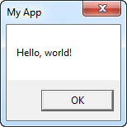
MessageBox with a title
- a title on the window displaying the message would probably help.
Fortunately, the second
and optional parameter allows
us to specify the title:
MessageBox.Show("Hello, world!", "My App");

Slide 33
MessageBox with extra buttons
By default, the MessageBox only has the one Ok button
MessageBox.Show("This MessageBox has extra options.\n\nHello, world?", "My App", MessageBoxButtons.YesNoCancel);
You control which buttons are displayed by using a value from the MessageBoxButtons enumeration - in this case, a Yes, No and Cancel button is included. The following values, which should be self-explanatory, can be used:
OK
OKCancel
YesNoCancel
YesNo

Slide 34
if (MessageBox.Show(“Would you like to great the world Hello", “My App",MessageBoxButtons.YesNoCancel, MessageBoxIcon.Question)
== DialogResult.Yes)
MessageBox.Show(“Hello to you too");

Slide 35
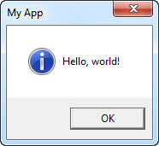
MessageBox with an icon
The MessageBox has the ability to show a pre-defined icon to the left of the text message, by using a fourth parameter:
MessageBox.Show("Hello, world!", "My App", MessageBoxButton.OK, MessageBoxicon.Information);
Using the MessageBoxIcon enumeration, you can choose between a
range of icons for different situations. Here's the complete list:
Asterisk
Error
Exclamation
Hand
Information
None
Question
Stop
Warning

Slide 36
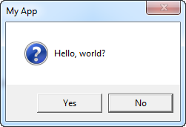
MessageBox with a default option
The MessageBox will select a button as the default choice, which is then the button invoked in case the user just presses Enter once the dialog is shown. For instance, if you display a MessageBox with a "Yes" and a "No" button, "Yes" will be the default answer. You can change this behavior using a fifth parameter to the MessageBox.Show() method though:
MessageBox.Show("Hello, world!", "My App", MessageBoxButtons. YesNo,MessageBoxIcon.Question);
MessageBox.Show("Hello, world!", "my app", MessageBoxButtons.OKCancel, MessageBoxIcon.Information);

