Slide 1
Timer Control
We require Timer Object in many situations on our development environment. We have to use Timer Object when we want to set an interval between events, periodic checking, to start a process at a fixed time schedule, to increase or decrease the speed in an animation graphics with time schedule etc.
A Timer control does not have a visual representation and works as a component in the background.
Add a timer control to the form
Set its interval – 1000 ms = 1 second
Set its Tick event handler to handle the timer event at every interval
Start and Stop Timer
The Timer control have included the Start and Stop methods for start and stop the Timer control functions.
timer1.Interval = 1000;
timer1.Start();
Timer Tick Event
Timer Tick event occurs when the specified timer interval has elapsed and the timer is enabled.
timer1.Start();
private void timer1_Tick(object sender, EventArgs e)
} label1.Text = DateTime.Now.ToString(); }

Slide 2
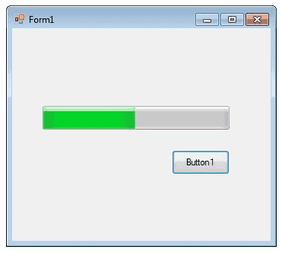
C# ProgressBar Control A progress bar is a control that an application can use to indicate the progress of a lengthy operation such as calculating a complex result, downloading a large file from the Web etc.
Minimum : Sets the lower value for the range of valid values for progress.
Maximum : Sets the upper value for the range of valid values for progress.
Value : This property obtains or sets the current level of progress.
private void button1_Click(object sender, EventArgs e)
{ int i;
progressBar1.Minimum = 0;
progressBar1.Maximum = 200;
for (i = 0; i <= 200; i++)
{ progressBar1.Value = i; } }

Slide 3
private void timer1_Tick(object sender, EventArgs e)
{
label1.Text = DateTime.Now.ToLongTimeString();
if (progressBar1.Value<progressBar1.Maximum)
{ progressBar1.Value +=2 ;}
else
{ timer1.Stop();
MessageBox.Show("finished progrss");
}

Slide 4
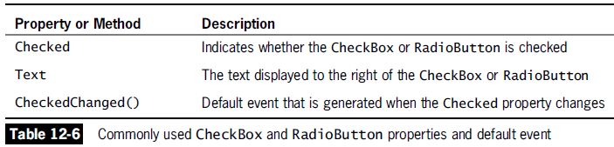
Radio button and the Check box
The radio button and the check box are used for different functions. Use a radio button when you want the user to choose only one option. When you want the user to choose all appropriate options, use a check box.

Slide 5
CheckBoxes
Labeled boxes which can be checked or unchecked
Checked – get/set Boolean to determine if box is checked
CheckedChanged – delegate called when the box is checked or unchecked

Slide 6
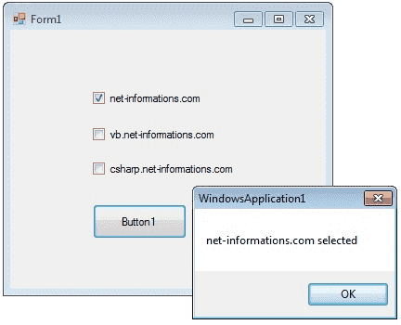

Slide 7
private void button1_Click(object sender, EventArgs e)
{ string msg = "";
if (checkBox1.Checked == true)
{ msg = "net-informations.com";
}
if (checkBox2.Checked == true)
{ msg = msg + " vb.net-informations.com";
}
if (checkBox3.Checked == true)
{ msg = msg + " csharp.net-informations.com";
}
if (msg.Length > 0)
{ MessageBox.Show (msg + " selected ");
}
else
{
MessageBox.Show ("No checkbox selected");
}
checkBox1.ThreeState = true; } }

Slide 8

RadioButton Control
Radio buttons are similar to checkboxes, but
Appear slightly different
Allow buttons to be grouped so that only one can be checked at a time
Checked – get/set Boolean indicating if the button is checked
CheckedChanged – delegate invoked when the button is checked or unchecked
A group is formed when the radio buttons are in the same container – usually a group box or panel

Slide 9
GroupBox
Displays a border around a group of controls
Can have optional label controlled by Text property
Controls can be added by
Placing them within the group box in the designer
Adding to the Controls list programmatically

Slide 10
Panels
A panel is like a group box but does not have a text label
It contains a group of controls just like group box
BorderStyle – get/set border style as
BorderStyle.Fixed3D
BorderStyle.FixedSingle
BorderStyle.None

Slide 11
Understanding GroupBoxes and Panels
GroupBox or Panel
Groups related Controls on a Form
Can be anchored or docked inside a Form
GroupBoxes
Can display a caption
Do not have scroll bars
Panels
Cannot display a caption
Have scroll bars

Slide 12
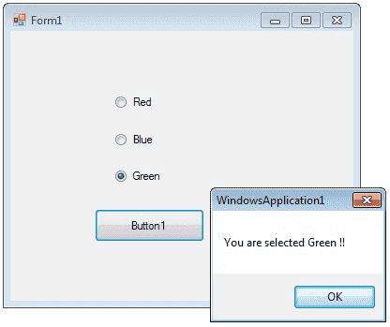

Slide 13
private void button1_Click(object sender, EventArgs e)
{
if (radioButton1.Checked == true)
{
MessageBox.Show ("You are selected Red !! ");
}
else if (radioButton2.Checked == true)
{
MessageBox.Show("You are selected Blue !! ");
}
else
{
MessageBox.Show("You are selected Green !! ");
}}

