Slide 1
컴퓨터네트워크
한국외국어대학교
컴퓨터⋅전자시스템공학부
정 대 인

Slide 2



교재
OR
7판
8판
eBook only (2020)
https://gaia.cs.umass.edu/kurose_ross/

Slide 3
What is the Internet?
There are a couple of ways to answer this question.
First, we can describe the nuts and bolts of the Internet, that is, the basic hardware and software components that make up the Internet.
Second, we can describe the Internet in terms of a networking infrastructure that provides services to distributed applications.
What is Protocol?

Slide 4
TCP/IP Protocol Stack
application
transport
network
link
physical
E-mail, Web, FTP, DNS
TCP, UDP
IP
WLAN, Ethernet

Slide 5
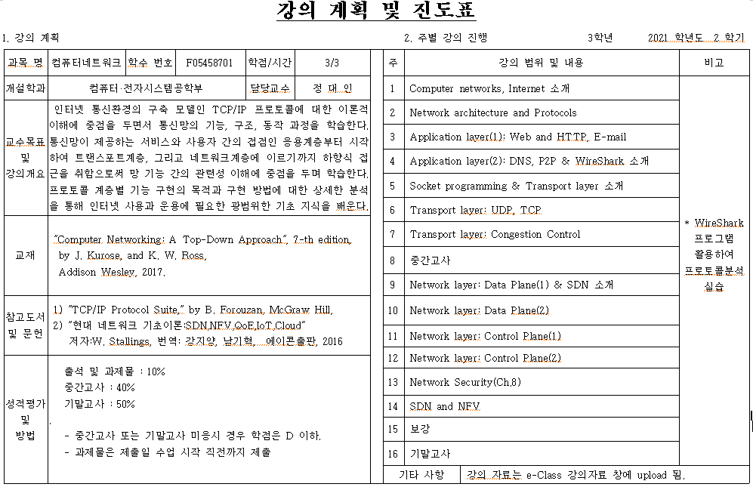

Slide 6



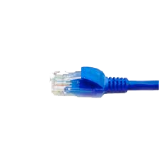

application
(www browser,
email client)
packet
analyzer
application
OS
packet
capture
(pcap)
Transport (TCP/UDP)
Network (IP)
Link (Ethernet)
Physical
copy of all Ethernet frames sent/received
WireShark (Protocol analyzer)

Slide 7
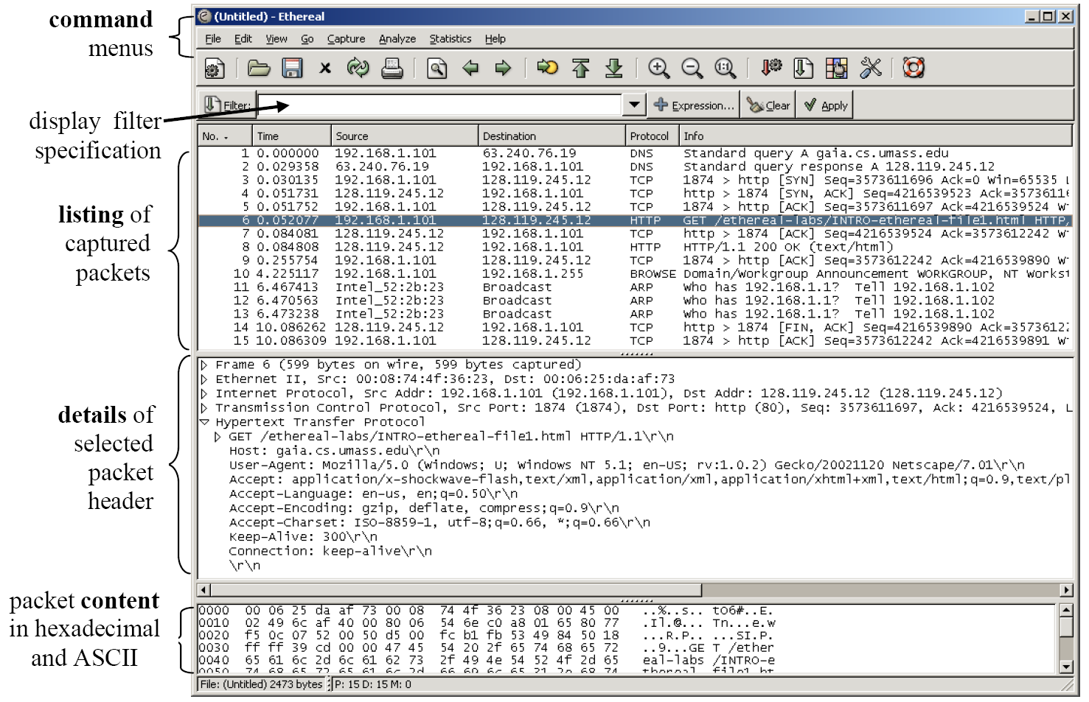
WireShark Graphical User Interface

Slide 8
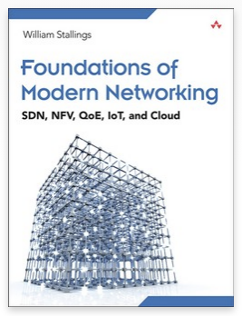
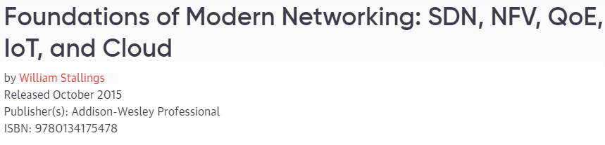
Reference
1: Introduction

Slide 9
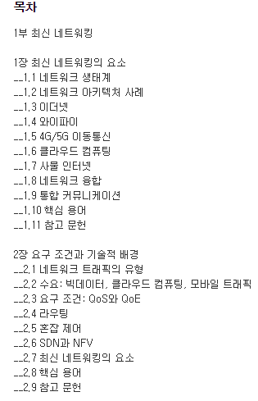
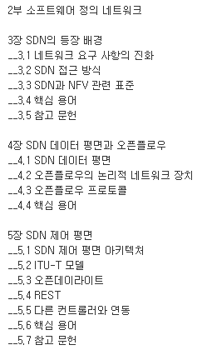
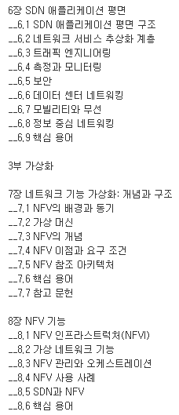
1: Introduction

Slide 10
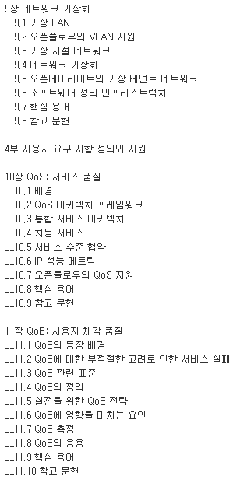
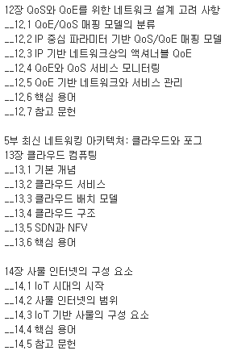
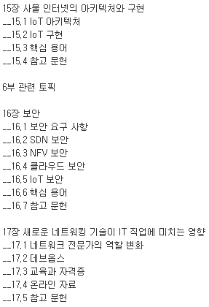
1: Introduction

Slide 11
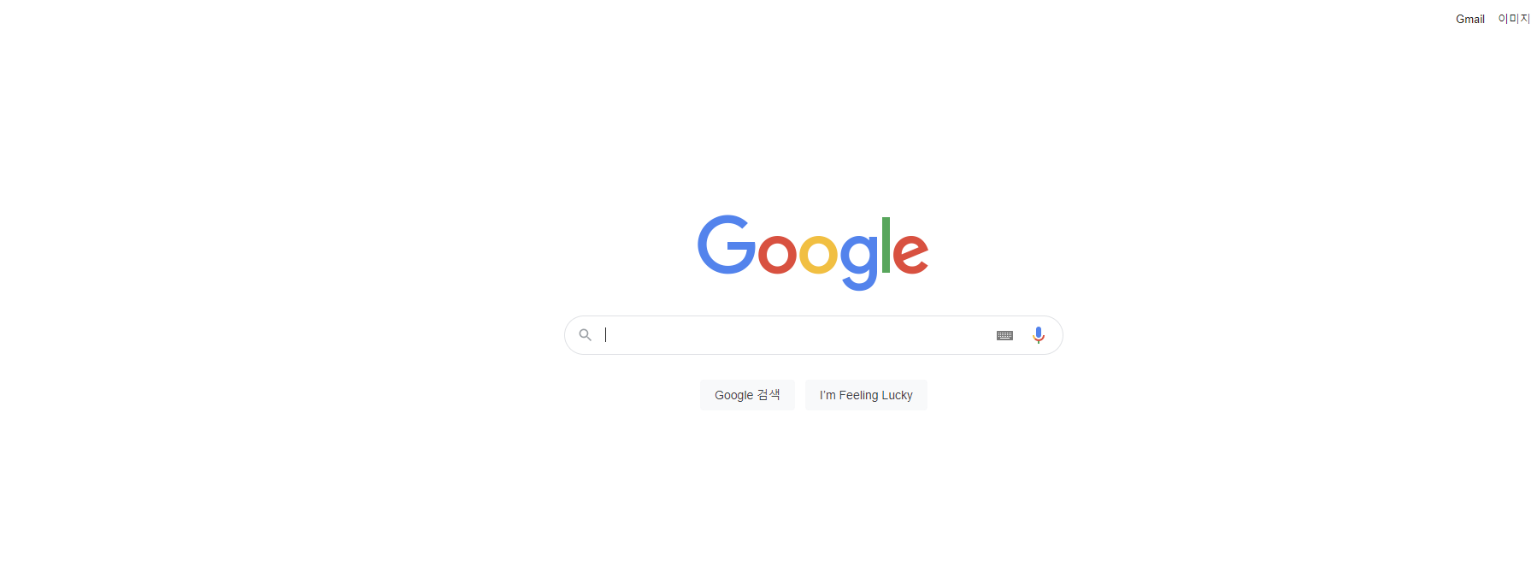
Synthesis: a day in the life of a web request (Ch.6.7)
www.google.com
What happens?

Slide 12
Synthesis: a day in the life of a web request
journey down protocol stack complete!
  application, transport, network, link
putting-it-all-together: synthesis!
  goal: identify, review, understand protocols (at all layers) involved in seemingly simple scenario: requesting www page
  scenario: student attaches laptop to campus network, requests/receives www.google.com
Link Layer and LANs
6-<number>

Slide 13





A day in the life: scenario
browser
DNS server
Comcast network
68.80.0.0/13
school network
68.80.2.0/24
web page
web server
Google’s network
64.233.160.0/19
64.233.169.105
Link Layer and LANs
6-<number>

Slide 14

A day in the life… connecting to the Internet
DHCP
DHCP
UDP
IP
Eth
Phy
connecting laptop needs to get its own IP address, addr of first-hop router, addr of DNS server: use DHCP
DHCP
DHCP
DHCP
DHCP
DHCP request encapsulated in UDP, encapsulated in IP, encapsulated in 802.3 Ethernet
DHCP
DHCP
UDP
IP
Eth
Phy
DHCP
DHCP
DHCP
DHCP
router
(runs DHCP)
Ethernet frame broadcast (dest: FFFFFFFFFFFF) on LAN, received at router running DHCP server
Ethernet demuxed to IP demuxed, UDP demuxed to DHCP
Link Layer and LANs
6-<number>

Slide 15
A day in the life… connecting to the Internet
DHCP
DHCP
UDP
IP
Eth
Phy
DHCP server formulates DHCP ACK containing client’s IP address, IP address of first-hop router for client, name & IP address of DNS server
DHCP
DHCP
DHCP
encapsulation at DHCP server, frame forwarded (switch learning) through LAN, demultiplexing at client
DHCP
DHCP
UDP
IP
Eth
Phy
DHCP
DHCP
DHCP
router
(runs DHCP)
DHCP
DHCP client receives DHCP ACK reply
Client now has IP address, knows name & addr of DNS
server, IP address of its first-hop router
Link Layer and LANs
6-<number>

Slide 16
A day in the life… ARP (before DNS, before HTTP)
DNS
UDP
IP
Eth
Phy
before sending HTTP request, need IP address of www.google.com: DNS
DNS
DNS
DNS
ARP
ARP query
DNS query created, encapsulated in UDP, encapsulated in IP, encapsulated in Eth. To send frame to router, need MAC address of router interface: ARP
ARP
ARP reply
Eth
Phy
ARP query broadcast, received by router, which replies with ARP reply giving MAC address of router interface
router
(runs DHCP)
client now knows MAC address of first hop router, so can now send frame containing DNS query
Link Layer and LANs
6-<number>

Slide 17
A day in the life… using DNS
DNS
UDP
IP
Eth
Phy
DNS
DNS server
DNS
UDP
IP
Eth
Phy
DNS
DNS
DNS
DNS
DNS
DNS
DNS
DNS
Comcast network
68.80.0.0/13
IP datagram forwarded from campus network into Comcast network, routed (tables created by RIP, OSPF, IS-IS and/or BGP routing protocols) to DNS server
router
(runs DHCP)
IP datagram containing DNS query forwarded via LAN switch from client to 1st hop router
demuxed to DNS server
DNS server replies to client with IP address of www.google.com
Link Layer and LANs
6-<number>

Slide 18
A day in the life…TCP connection carrying HTTP
HTTP
HTTP
TCP
IP
Eth
Phy
SYNACK
SYN
SYNACK
SYN
SYNACK
SYN
SYN
to send HTTP request, client first opens TCP socket to web server
router
(runs DHCP)
TCP
IP
Eth
Phy
TCP SYN segment (step 1 in 3-way handshake) inter-domain routed to web server
SYNACK
SYN
SYNACK
SYN
SYNACK
SYN
SYNACK
web server responds with TCP SYNACK (step 2 in 3-way handshake)
web server
64.233.169.105
TCP connection established!
Link Layer and LANs
6-<number>

Slide 19
A day in the life… HTTP request/reply
HTTP
HTTP
TCP
IP
Eth
Phy
web page finally (!!!) displayed
HTTP
HTTP
HTTP
HTTP
HTTP
HTTP
HTTP
HTTP
HTTP request sent into TCP socket
router
(runs DHCP)
IP datagram containing HTTP request routed to www.google.com
HTTP
HTTP
TCP
IP
Eth
Phy
HTTP
HTTP
HTTP
web server responds with HTTP reply (containing web page)
HTTP
web server
64.233.169.105
IP datagram containing HTTP reply routed back to client
Link Layer and LANs
6-<number>

