Slide 1
Shadowsocks ---- Socks5 Proxy solution
Team : Ni Luo , Yousong Zhang

Slide 2
The Great (Fire)wall of China
Across the Great Wall we can reach every corner of the world. ---- first email sent from China (1987)

Slide 3
proxy solutions
HTTP PROXY
SSH Tunnel
VPN
Go App host
Tor FreeGate
Shadowsocks

Slide 4
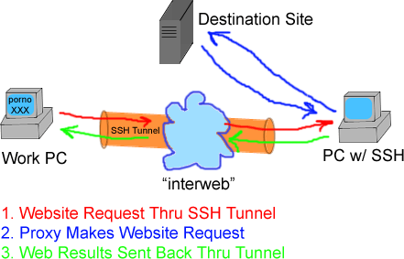
SSH server ← SSH Turnnel→ SSH client

Slide 5
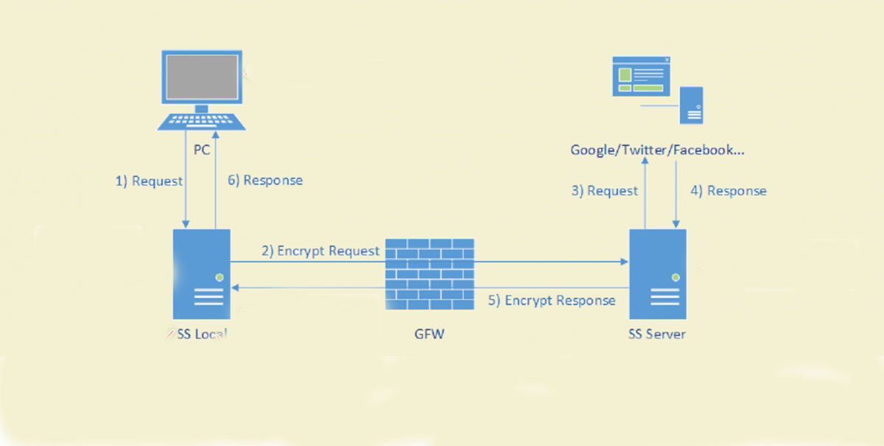
SS server = Shadowsocks server

Slide 6
Generating the Poly1305 Key Using ChaCha20
ChaCha20 create a 512-bit state
Poly1305 uses first 256 bits as key
key size: 256bit 8 eight 32-bit little- endian integers.
blockcount 3 * 32
nonce 1* 32 12 * 8 = 96 = 32 * 3 ss-server -m chacha20-ietf-poly1305 -u --fast-open -p 25924 -k toexofFr8YTY --manager-address 127.0.0.1:4717 -d 183.60.83.19 -d 183.60.82.98

Slide 7
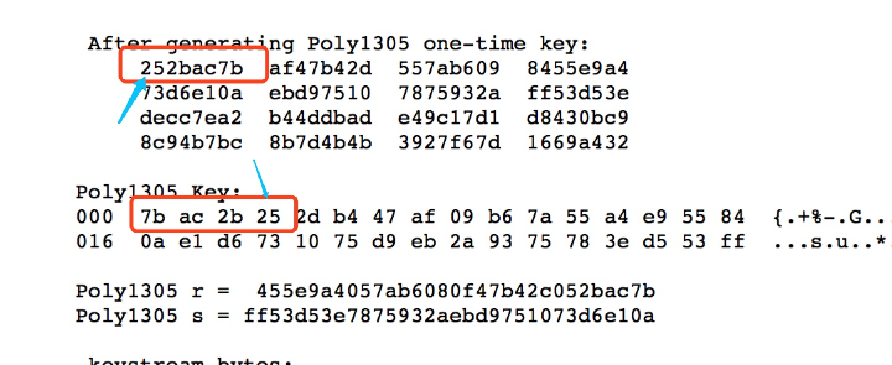
ChaCha20 and Poly1305 for IETF Protocol 32-bit unsigned integers

Slide 8
How to install OUtline
https://github.com/yousongzhang/Shadowsocks_VPN/blob/master/README.md

Slide 9
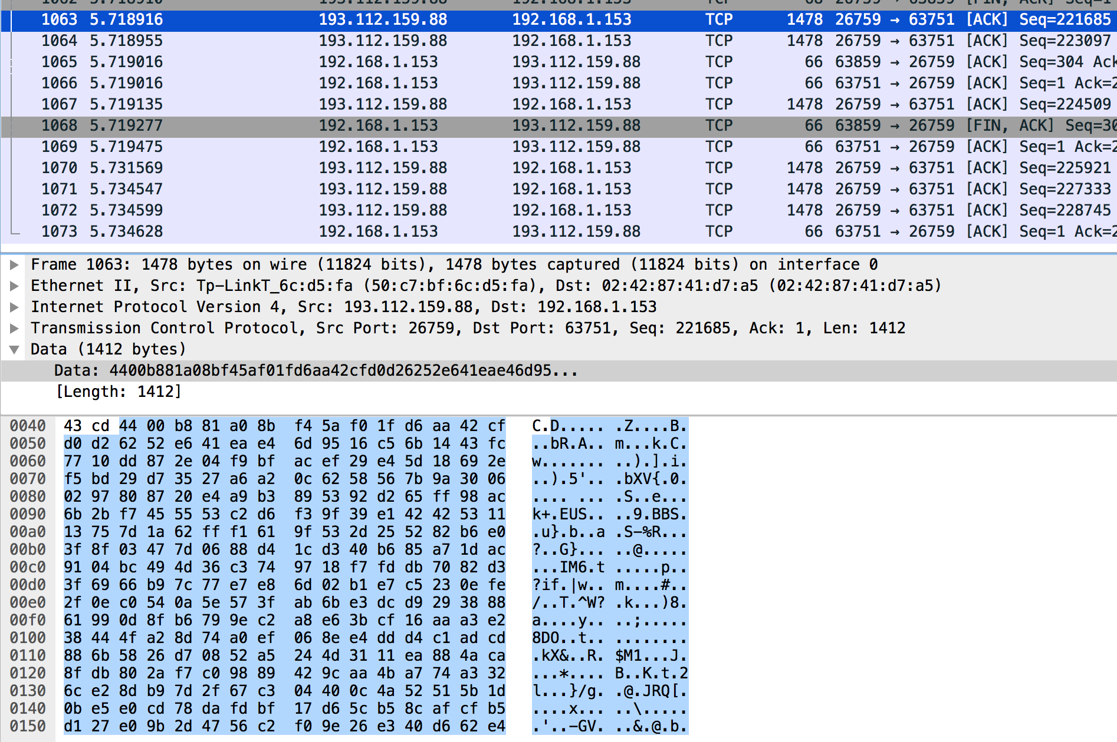
WireShark Package

Slide 10
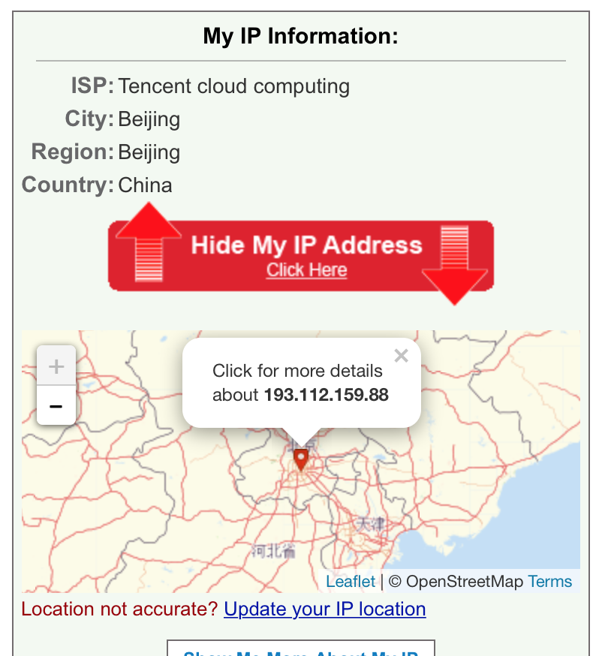
proxy sever local in China

