Slide 1
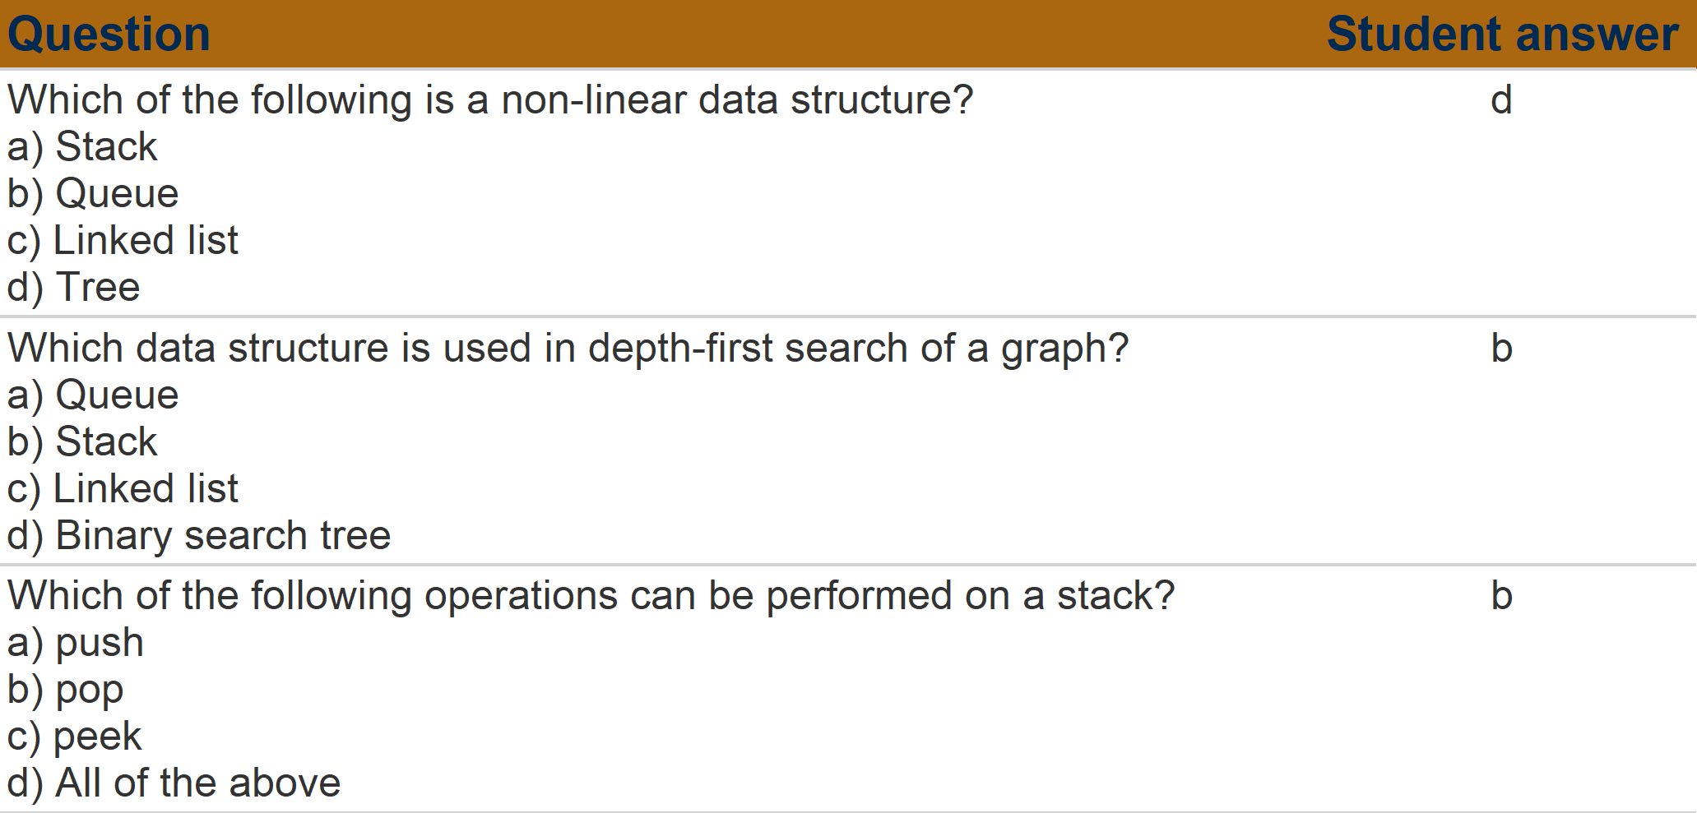
Questions for Student NO 1 and Exam NO 1

Slide 2
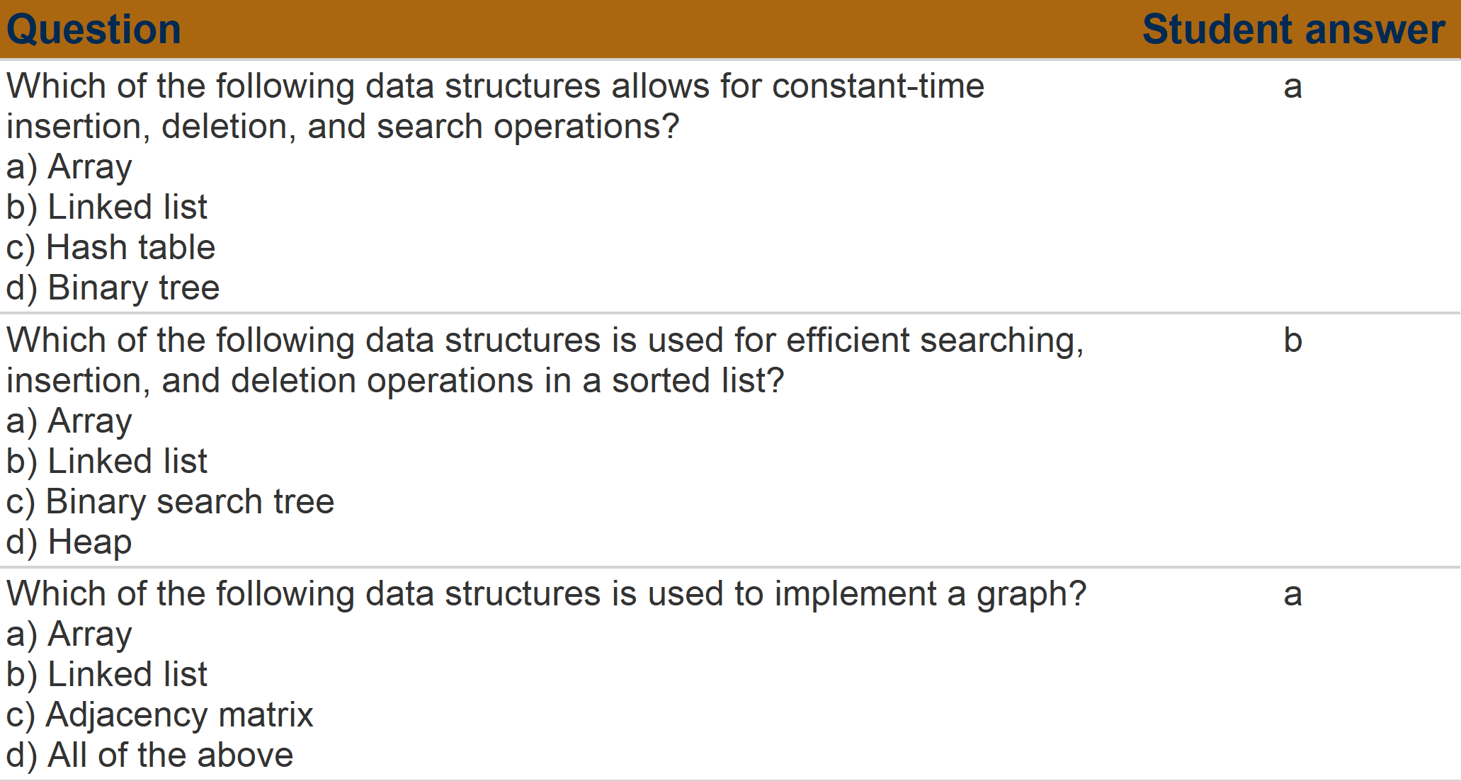

Slide 3
