Slide 1

Digital Logic Design 4-bit full adder

Slide 2
CONTENTS
01 The idea of 4-bit full adder
02 Truth table
03 simulator
04 Datasheet of ic
05 Hardware

Slide 3
The idea of 4-bit full adder
A four bit full Adders is a Logical Circuit that takes Carry and two expressions with four bits as its inputs and as a result shows the Four bits output along with the carry at output terminals." The Circuit of Four bit Full Adder consists of the XOR Gate, AND Gate and OR Gate.

Slide 4

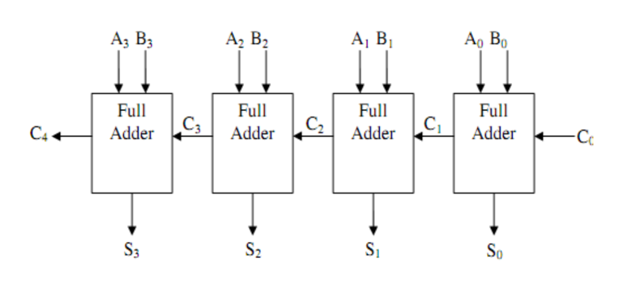
Explanation of 4-bit full adder:

Slide 5
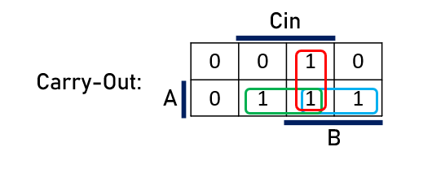
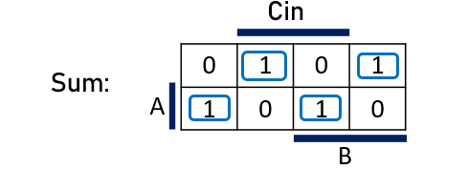
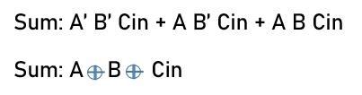

Full adder diagram and k-map

Slide 6
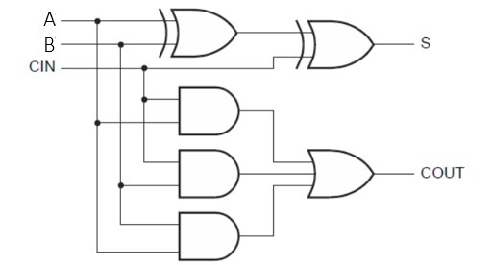
4-bit full adder function
S0 = A0 ⊕ B0 ⊕ Cin
Cout0 = A Cin + A B + B Cin
S1 = A1 ⊕ B1 ⊕ Cout0
Cout1 = A Cin + A B + B Cin
S2 = A2 ⊕ B2 ⊕ Cout1
Cout2 = A Cin + A B + B Cin
S3 = A3 ⊕ B3 ⊕ Cout2
Cout3 = A Cin + A B + B Cin

Slide 7
Truth table code
#include <iostream>
#include <iomanip>
using namespace std;
void generateTruthTable() {
int a[4], b[4], carryIn, carryOut, sum[4];
cout << setw(4) << "A3" << setw(4) << "A2" << setw(4) << "A1" << setw(4) << "A0"
<< setw(4) << "B3" << setw(4) << "B2" << setw(4) << "B1" << setw(4) << "B0"
<< setw(8) << "CarryIn"
<< setw(10) << "CarryOut"
<< setw(8) << "Sum3" << setw(8) << "Sum2" << setw(8) << "Sum1" << setw(8) << "Sum0" << endl;
for (int i = 0; i < 16; ++i) {
a[3] = (i & 8) >> 3;
a[2] = (i & 4) >> 2;
a[1] = (i & 2) >> 1;
a[0] = (i & 1);
for (int j = 0; j < 16; ++j) {
b[3] = (j & 8) >> 3;
b[2] = (j & 4) >> 2;
b[1] = (j & 2) >> 1;
b[0] = (j & 1);

Slide 8
Truth table code
carryIn = 0;
carryOut = 0;
for (int k = 0; k < 4; ++k) {
sum[k] = a[k] ^ b[k] ^ carryIn;
carryOut = (a[k] & b[k]) | ((a[k] ^ b[k]) & carryIn);
carryIn = carryOut;
}
cout << setw(4) << a[3] << setw(4) << a[2] << setw(4) << a[1] << setw(4) << a[0]
<< setw(4) << b[3] << setw(4) << b[2] << setw(4) << b[1] << setw(4) << b[0]
<< setw(8) << carryIn
<< setw(10) << carryOut
<< setw(8) << sum[3] << setw(8) << sum[2] << setw(8) << sum[1] << setw(8) << sum[0] << endl;
}
}
}
int main() {
generateTruthTable();
return 0;
}

Slide 9
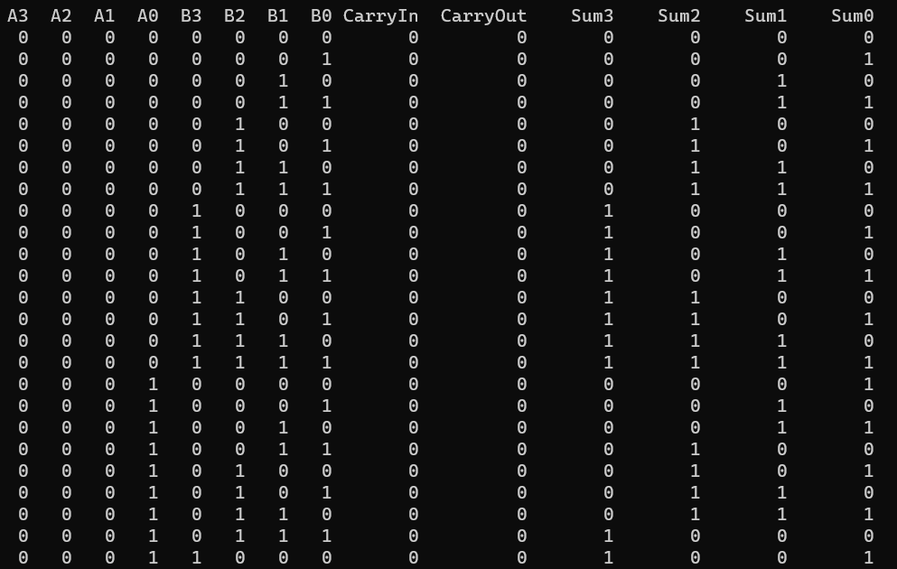
Truth table code

Slide 10
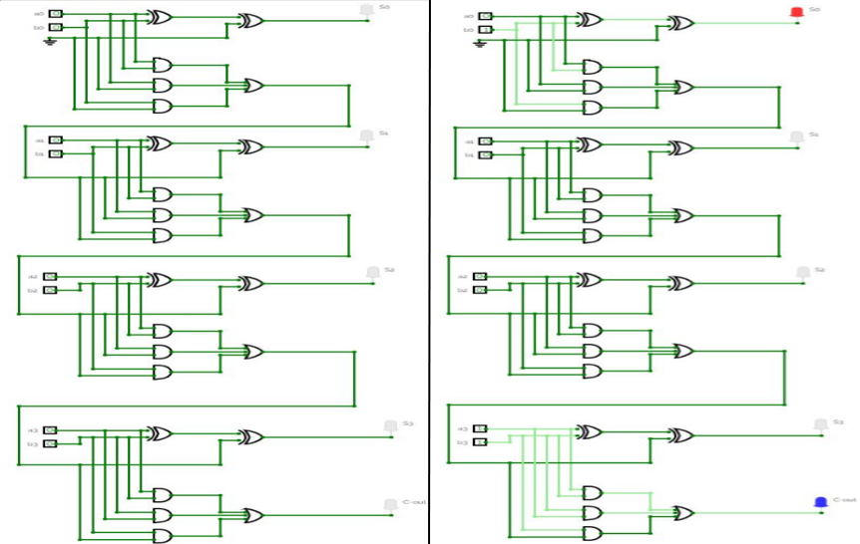
Simulator
https://circuitverse.org/simulator/embed/final_simulator_dld

Slide 11
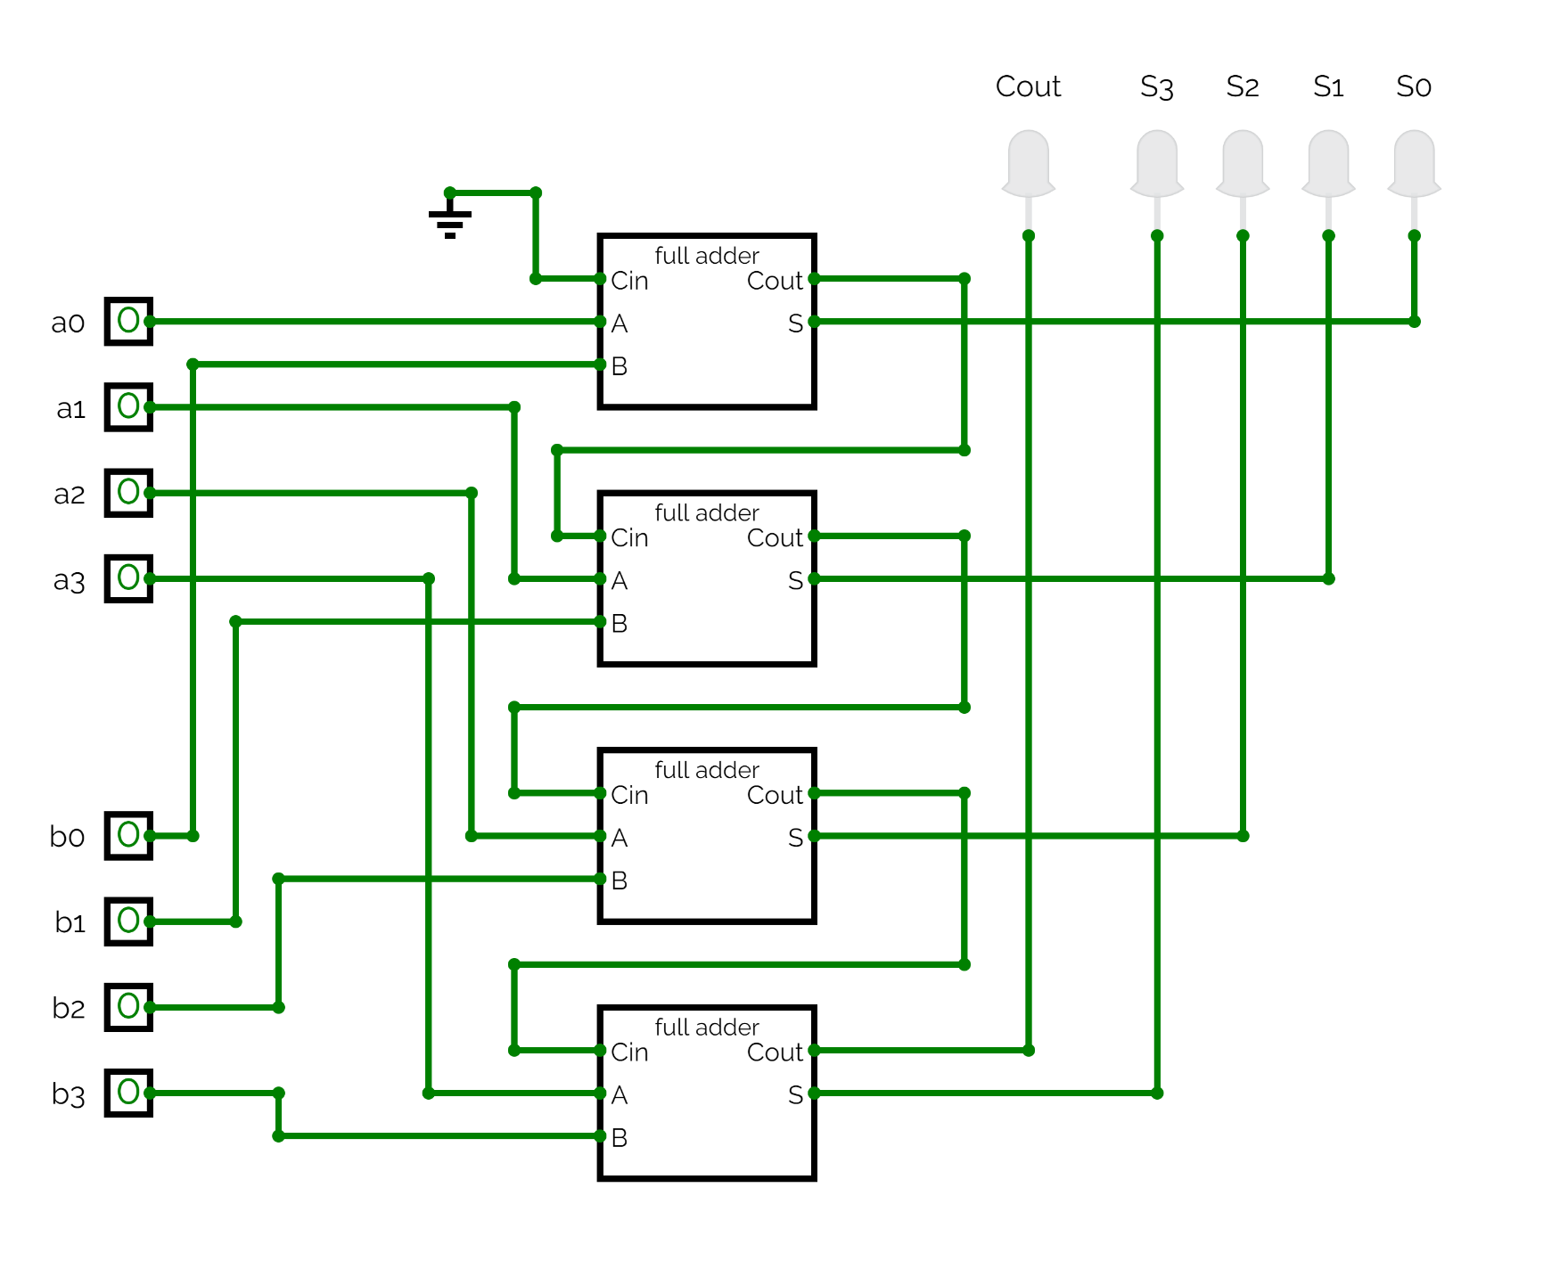
Simulator
https://circuitverse.org/simulator/embed/4-bitfulladder_with_ic

Slide 12
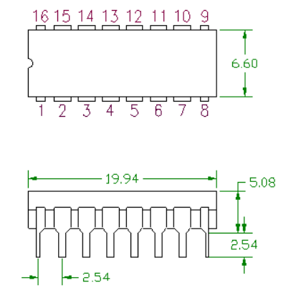
The data sheet information of the 4-bit full adder IC

Slide 13
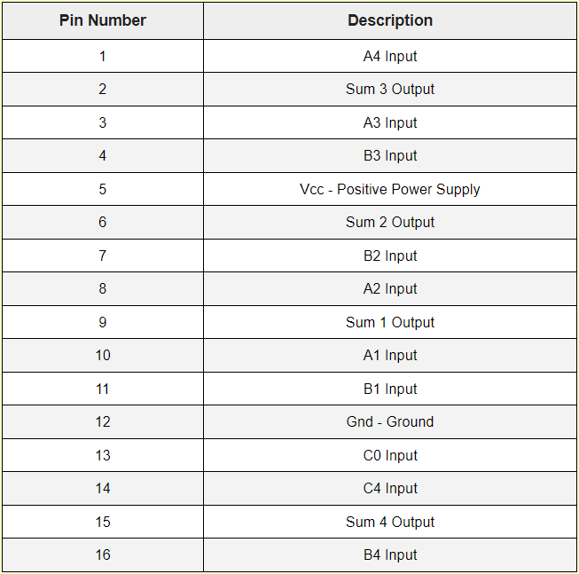
Hardware Data sheet

Slide 14
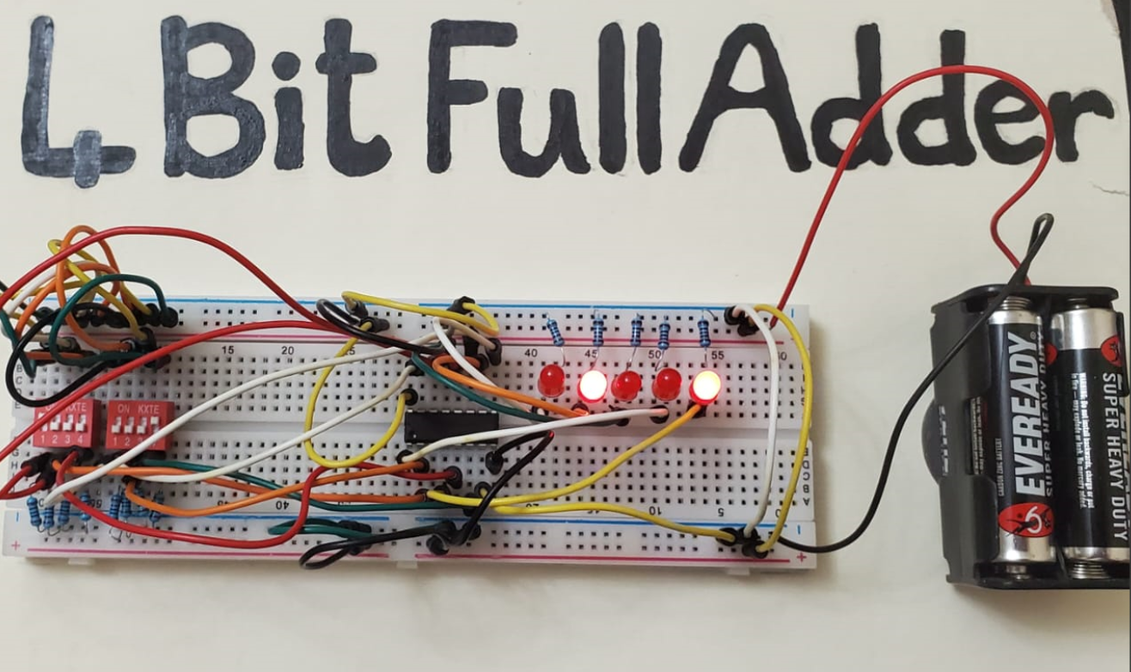
Hardware
The Hardware of 4-bit full adder consists of :
2 switches 4 bit
13 resistor 1k
IC of 4-bit full adder
A power supply of 6 volts
Connection wires
Breadboard

Slide 15
Thank you

