Slide 1
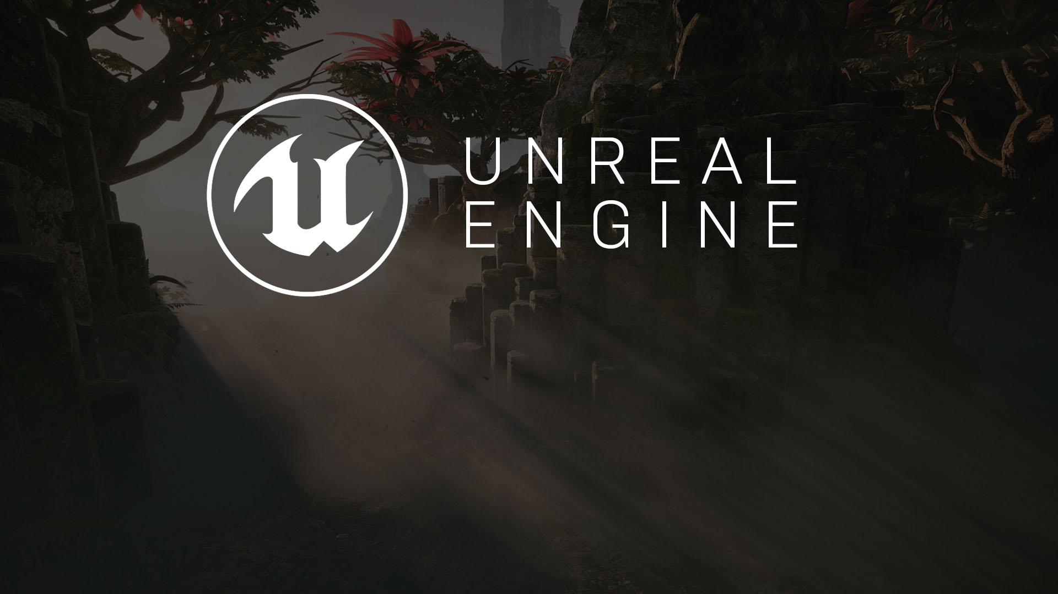
Lecture 2
Setting Up Your VR Headsets

Slide 2

Lecture Goals and Outccomes
Goals
Outcomes
Introduce you to the setup process for both the Oculus Rift and the HTC Vive.
Introduce you to setting up a basic scene in UE4 appropriate for VR use.
Show you the basic objects needed to support VR in your projects.
Understand one of the common stumbling blocks for new VR users in UE4.
After this lecture, you should have an understanding about how to create a basic VR scene with both the HTC Vive and the Oculus Rift.

Slide 3
Getting Started
Hardware
Notes:
VR exists through the melding of hardware and software. There are various devices and software solutions you need to be aware of when getting into creating VR content.

Slide 4
Getting Started
Before setting up UE4, you need to ensure that all VR hardware is set up properly to work with Unreal Engine.
The steps vary depending on the VR platform you’re targeting. We will focus on the Rift and the Vive, because they require the fewest number of steps to get started.

Slide 5
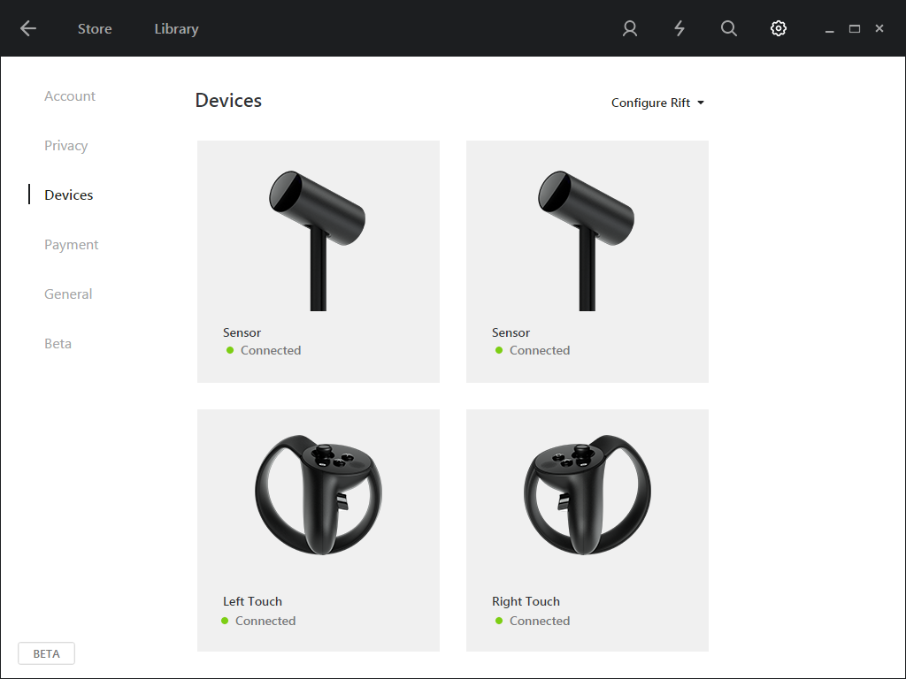
Rift Setup
When using the Rift, UE4 defaults to trying to use the Oculus runtime.
When using the Rift, you need to download the runtime and set up your Rift hardware the same way you would as a consumer.
You can find more in-depth steps in Epic’s documentation: https://docs.unrealengine.com/latest/INT/Platforms/Oculus/QuickStart/index.html

Slide 6
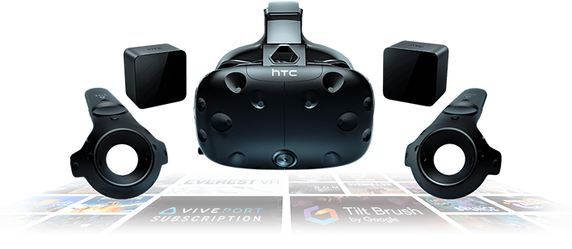
Vive Setup
When using the Vive with UE4, Steam VR will be used.
Install Steam VR and set up your Vive according to the specific instructions for your hardware.
You can find more in-depth steps in Epic’s documentation: https://docs.unrealengine.com/latest/INT/Platforms/SteamVR/QuickStart/index.html

Slide 7
Getting Started
Project Setup
Notes:
VR exists through the melding of hardware and software. There are various devices and software solutions you need to be aware of when getting into creating VR content.

Slide 8
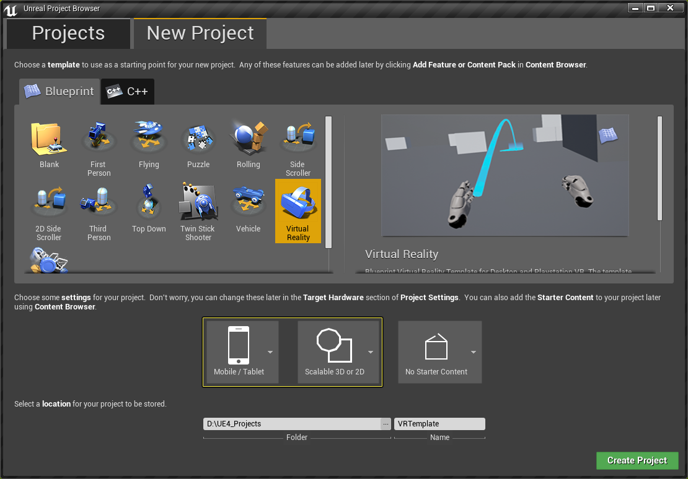
Project Setup
When creating a new project for this unit, set the target device to Mobile/Tablet and the scalability to Scalable 3D or 2D. Doing so ensures that some of the advanced features of UE4 will be off by default.
We will cover the importance in lecture 11.

Slide 9
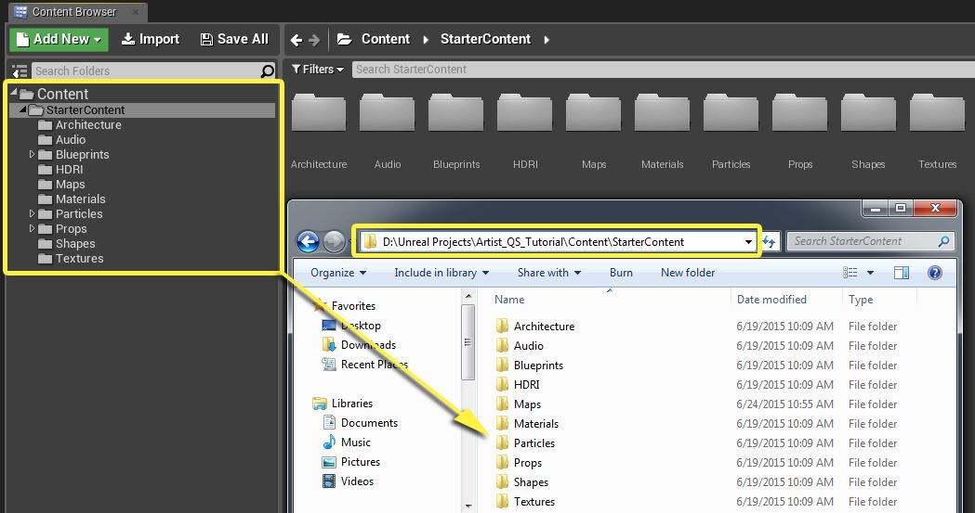
Folder Structure
Organization is important when creating games/experiences in UE4 (especially once you start working in teams).
It is important that you create a basic folder structure to hold common items that will be created for your project (such as Blueprints and Materials).
A basic folder structure like this is good enough for this course. For your own projects, you may wish to adopt a more in-depth style guide such as this http://ue4.style.

Slide 10
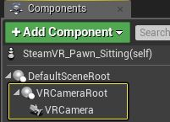
VR Pawn
A Pawn is an Actor in the world that a Player (or computer AI) can possess and control.
For us, a Pawn is the basic representation of our Player in the Game World.
To get the Pawn to render properly and replicate the player’s head movements, we must add two Components:
A Scene Component and a Camera Component.
The Scene Component acts as the root of our Camera and allows us to position the Camera anywhere in the Pawn.
The Camera Component represents the player’s viewport into the world.

Slide 11
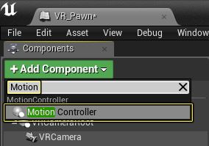
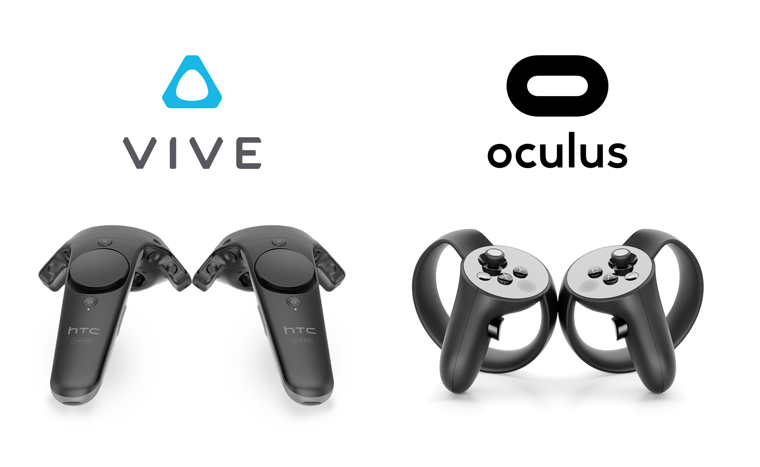
If you want to use motion controllers, you need to add them to your Pawn.
The Motion Controller Component allows you to create a representation of the players motion controllers in your project.
The Motion Controller Component allows you to set which hand you want to track (left/right). Once this is set, the position and rotation of this component is automatically set to match the player’s motion controllers.
The Motion Controller Component is also abstracted in such a way that the single component works with any motion controllers (whether it is the Oculus Touch, HTC Vive Controllers or even the Google Daydream Controller). This is accomplished through the engines generic Motion Controller Interface (more on interfaces in week 4).

Slide 12
The Game Mode defines the game being played.
They can also spawn the Player Pawn into the game world.
To create and use the Game Mode:
Create a newGame Mode Blueprint.
Open the new Game Mode Blueprint and select the Default Pawn class to use the VR Pawn you created.
Edit the Project Settings to use your newly created game mode.
Using a Game Mode will allow you to have different Pawns for different levels or game types.
After you select a Game Mode, when you hit play, the Game Mode spawns the Pawn at a random Player Start Actor in the level.

Slide 13
Getting Started
DEMO
Notes:
VR exists through the melding of hardware and software. There are various devices and software solutions you need to be aware of when getting into creating VR content.

Slide 14
Getting Started
Tracking Origin Setup
Notes:
VR exists through the melding of hardware and software. There are various devices and software solutions you need to be aware of when getting into creating VR content.

Slide 15
There are two main types of experience when creating VR content: seated and standing.
The difference between the two comes down to the origin of the positional tracking.
Seated content will have a dynamic tracking origin (as it depends how high the player’s seat is) and needs to be calibrated at runtime.
Standing content will have a tracking origin matched to the player’s real world floor. This allows you to align the game world with real world.
You can set tracking origin with the Set Tracking Origin function in Blueprints. UE4 names seated and standing origins, Eye Level and Floor Level respectively.
Note: the Vive defaults to a standing (Eye Level) origin, while the Rift defaults to seated (Floor Level).

Slide 16
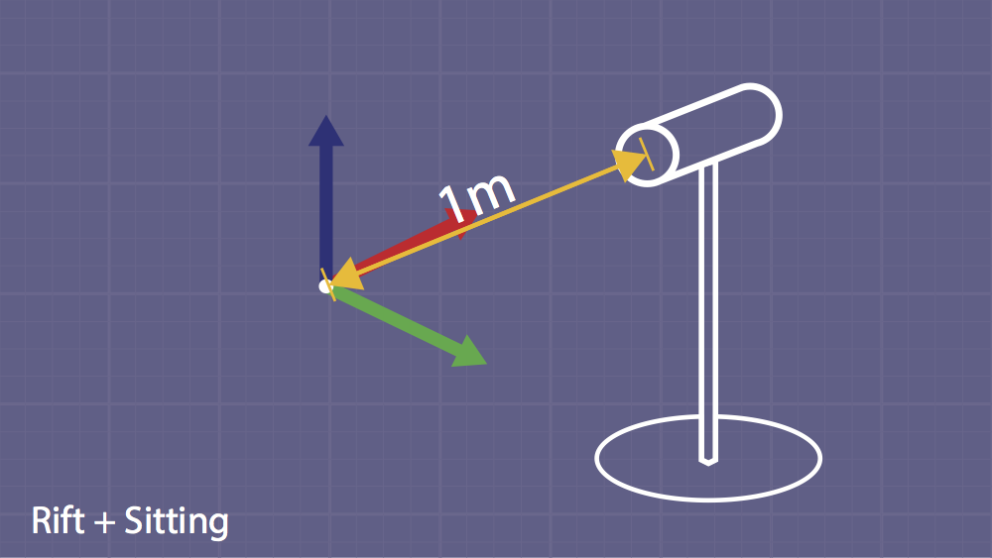
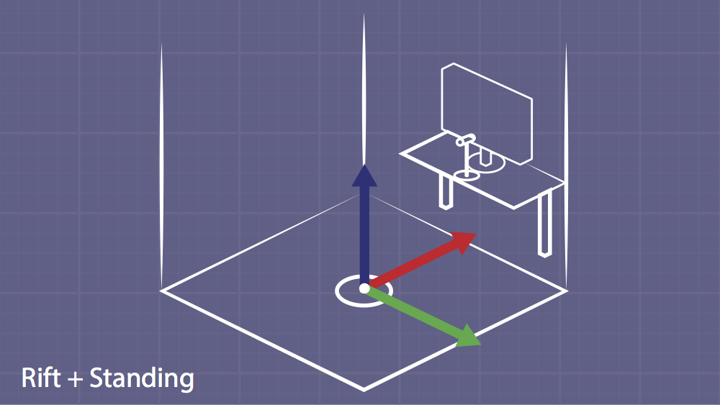
Tracking Origins: Rift
Rift’s seated tracking origin has the default camera location placed one meter horizontally in front of the tracking camera.
Rift’s standing tracking has the origin set to the floor that the user calibrated when setting up the Oculus runtime.

Slide 17
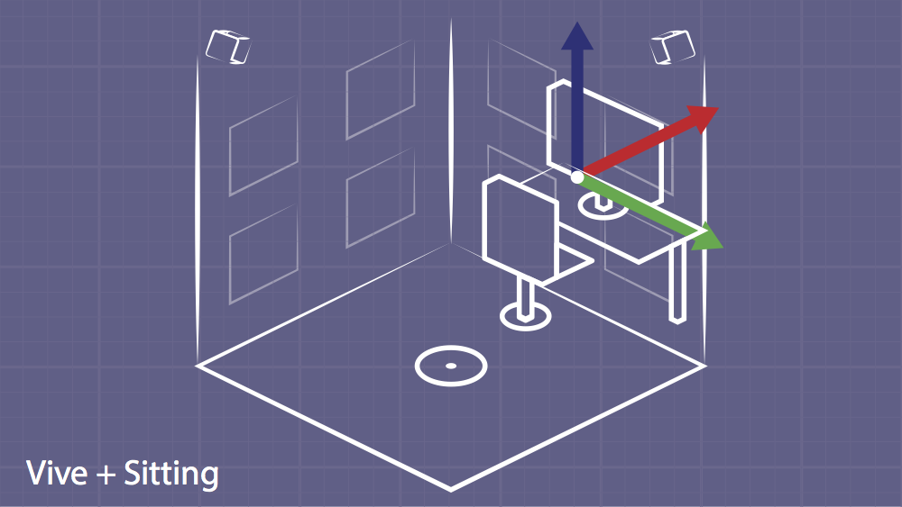
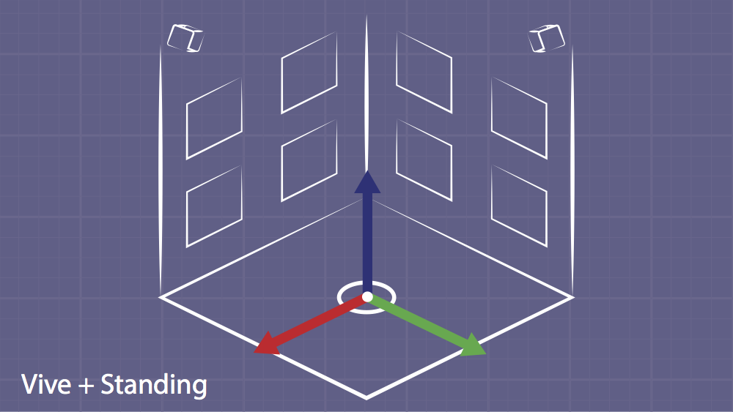
Tracking Origins: Vive
Vive’s seated tracking origin is by default in the middle of the monitor side of the user’s play space.
Vive’s standing tracking origin is located at the center of the users play space on the floor facing away from their monitor.

Slide 18
Summary
Getting started with VR and UE4 requires very little customization to get a working project.
A Pawn represents your player in the world and allows you to add camera and motion controllers.
You need to decide whether we are making a seated or standing experience and set the tracking origin accordingly.

