Slide 1


Welcome

Slide 2
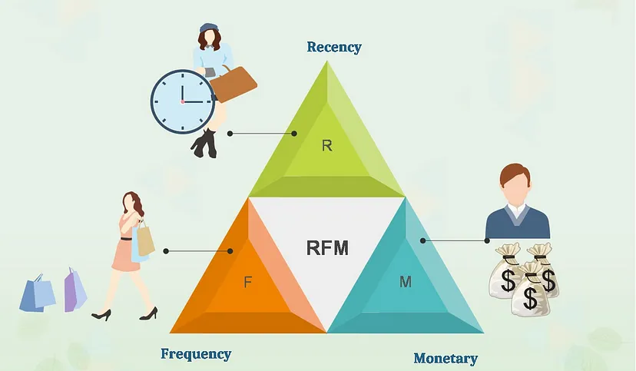

Slide 3
“RFM is a method used for analyzing customer value”.
It groups customers based on their transaction history :
Recency — How recently did the customer purchase?
Frequency — How often do they purchase?
Monetary Value — How much do they spend?

Slide 4
Customer segmentation(RFM)Model
Objective: The main objective of the RFM-based customer segmentation model is to group customers with similar behavior and characteristics together, enabling businesses to:
Customer Understanding: Gain insights into different customer segments and their purchasing patterns. This understanding can help identify high-value and loyal customers, as well as those who might need extra attention to increase their engagement and loyalty.
Personalized Marketing: Customize marketing strategies for each segment, addressing their unique needs, preferences, and behaviors. This leads to more effective campaigns and better customer engagement.
Retention and Loyalty: Develop targeted retention strategies by identifying at-risk customers and devising approaches to retain them. Loyal customers can also be rewarded and encouraged to make repeat purchases.
Cross-Selling and Upselling: Identify opportunities for cross-selling and upselling by analyzing the purchasing habits of different customer segments. This can lead to increased revenue and customer lifetime value.
Resource Allocation: Allocate resources more efficiently by focusing marketing efforts on segments that offer the highest potential for growth and profitability.

Slide 5
RFM Components
Recency (R): How recently a customer has made a purchase. More recent purchases might indicate higher engagement and activity.
Frequency (F): How often a customer makes purchases. Frequent buyers might represent loyal customers.
Monetary Value (M): The amount of money a customer has spent. Customers with higher monetary value are typically more valuable to the business

Slide 6
Segmentation Process
Data Preparation: Gather and clean customer transaction data, including purchase dates, purchase amounts, and customer IDs.
RFM Calculation: Calculate the RFM values for each customer based on their purchase history.
Segmentation: Use clustering algorithms (K-means, hierarchical clustering) or rule-based methods to group customers into segments based on their RFM values.
Interpretation: Interpret the segments to understand their characteristics, behaviors, and preferences. Assign meaningful labels to the segments.
Actionable Insights: Develop marketing strategies, campaigns, and initiatives tailored to each segment's needs and behaviors.
Monitoring and Refinement: Continuously monitor segment performance and refine the segmentation approach as customer behavior evolves.

Slide 7
RFM segmentation readily answers these questions for your business…
Who are my best customers?
Which customers are at the verge of churning?
Who are lost customers that you don’t need to pay much attention to?
Who are your loyal customers?
Which customers you must retain?
Who has the potential to be converted into more profitable customers?
Which group of customers is most likely to respond to your current campaign?

Slide 8
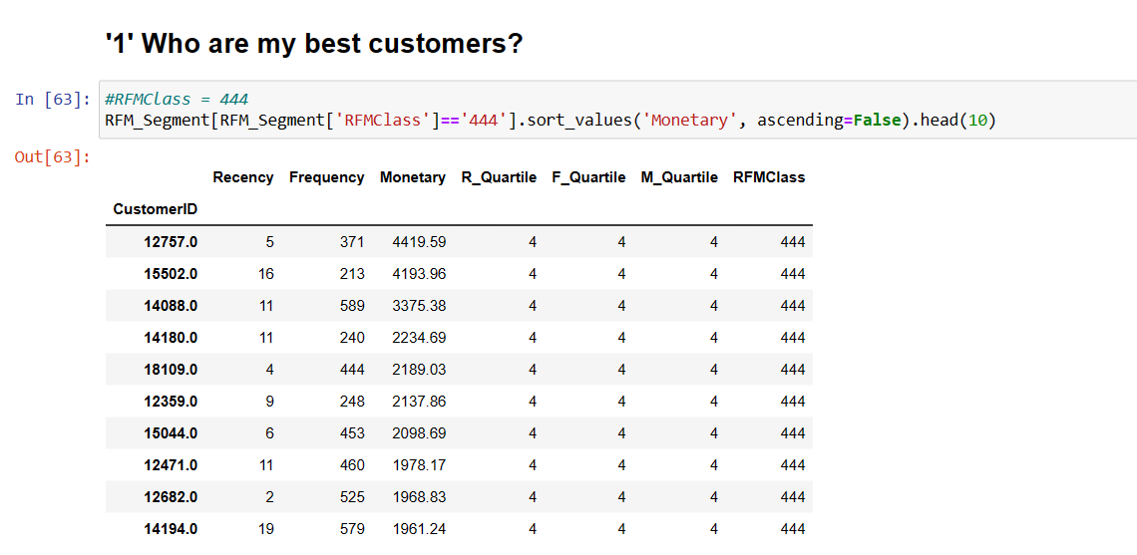
Who are my best customers?

Slide 9
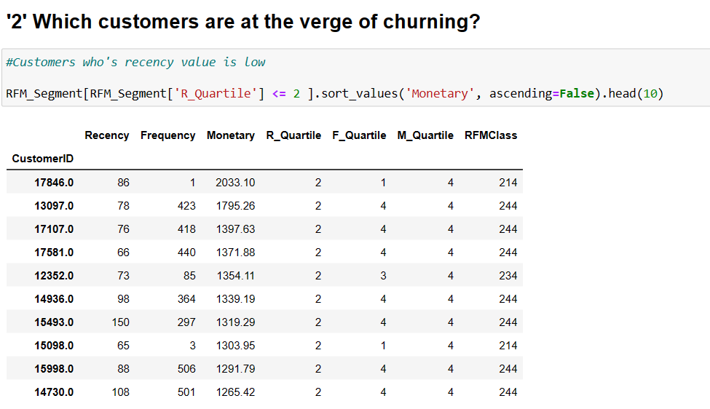
Which customers are at the verge of churning?

Slide 10
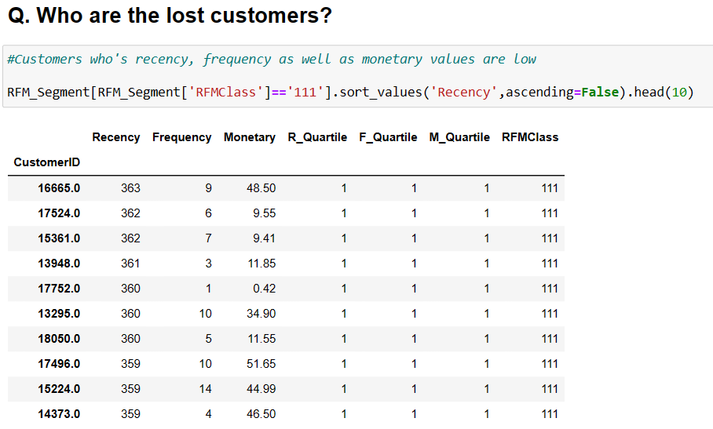
Q. Who are the lost customers?

Slide 11
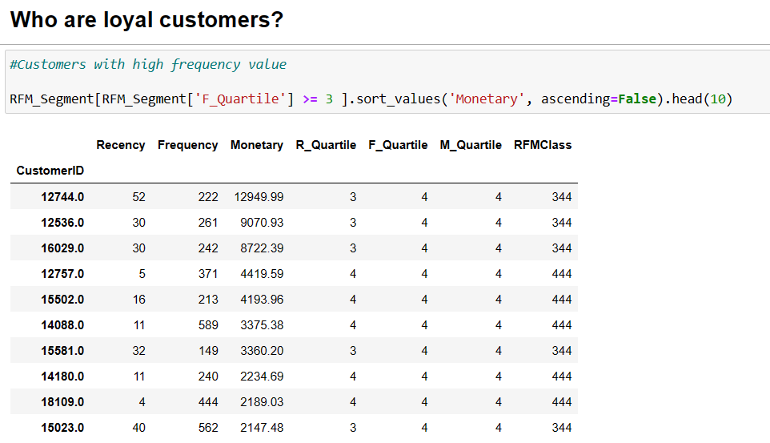
Who are loyal customers?

Slide 12
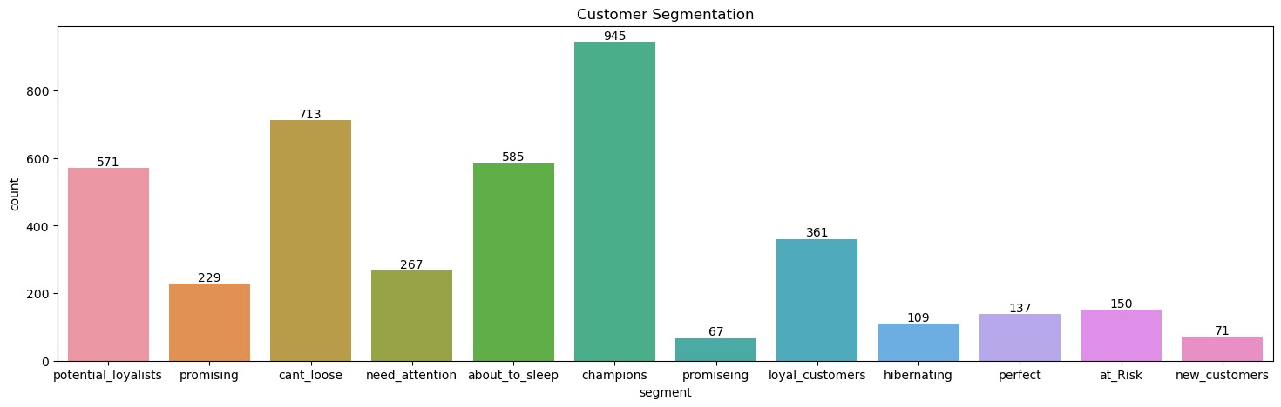
Segmentation

Slide 13
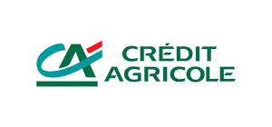
THANKS YOU…

