Slide 1
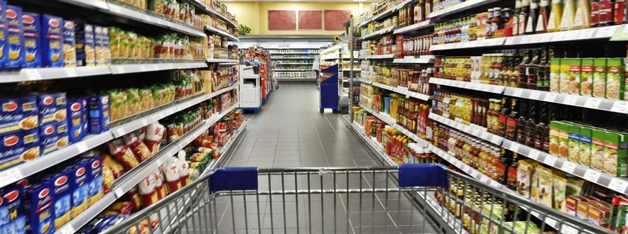
Sales -Super market
Powered by:Youssef Azam
Date :20-11-2023

Slide 2
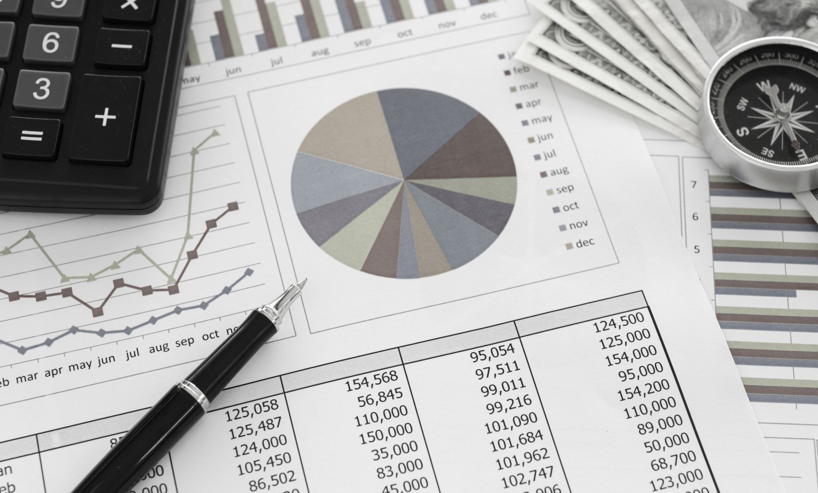
Project introduction
Invoice Analysis
The Invoice Analysis project! In this endeavor, we will delve into a dataset containing information about various invoices. The dataset encompasses crucial details such as Invoice ID, Branch, City, Customer Type, Gender, Product Line, Unit Price, Quantity, Tax (5%), Total Amount, Payment Method, and Customer Rating.

Slide 3

Objective
The primary goal of this project is to extract valuable insights from the provided invoice data. By applying data analysis techniques, we aim to uncover patterns, trends, and meaningful correlations within the dataset. This exploration will not only enhance our understanding of the business dynamics but also contribute to informed decision-making processes.

Slide 4
GOAL
We will try to answer the following Questions:
1-how many number of(cities and branches and products and payment method ).
2-we want to know the sum of total money.
3-we want to know the total quantity sold by every product
4-how many the product(Health and beauty) sold in branch(A)
5-we want to know the most payment method used by customers
6-how many males and females in each city
7-we want to know the average of rating for every product due to gender
8- we want to know the most product that females buy But only (females' members)

Slide 5

Dataset Details
Source: Kaggle.
Subject: Sales -Super market.
Link https://www.kaggle.com/datasets/aungpyaeap/supermarket-sales
Count of rows:1000
Count of columns : 12
Data of add in Kaggle : November 2022

Slide 6


Dataset Overview:
Invoice ID: Unique identifier for each invoice.
Branch: Indicates the branch associated with the transaction.
City: The city where the transaction occurred.
Customer Type: Specifies whether the customer is a member or a normal customer.
Gender: The gender of the customer.
Product Line: Describes the category of the purchased product.
Unit Price: Price per unit of the product.
Quantity: Number of units purchased.
Tax (5%): Tax amount calculated at a rate of 5%.
Total: The total amount including the product cost and tax.
Payment Method: The method used for payment.
Rating: Customer satisfaction rating associated with the transaction.

Slide 7
Data preparation
Data Cleaning: We will start by cleaning the dataset, addressing any missing or erroneous entries but my data it cleaned .
Exploratory Data Analysis (EDA): Conduct a thorough exploration of the data to identify patterns, outliers, and trends.
Descriptive Statistics: Compute key statistical measures to gain insights into the central tendencies and distributions of the data.
Visualization: Utilize charts and graphs to visually represent the findings and make the analysis more accessible using power bi .

Slide 8
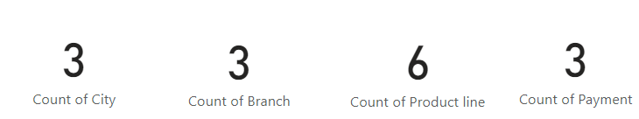
how many number of(cities and branches and products and payment method ) ?

Slide 9
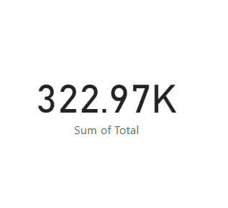
we want to know the sum of total money ?

Slide 10
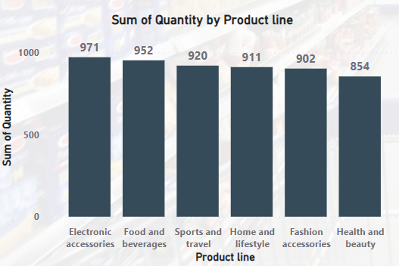
we want to know the total quantity sold by every product ?

Slide 11
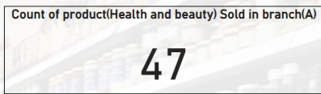
how many the product(Health and beauty) Sold in branch(A) ?

Slide 12
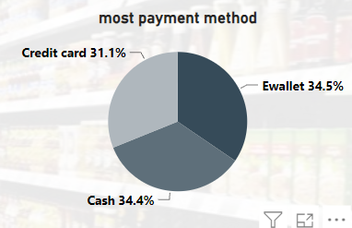
we want to know the most payment method used by customers ?

Slide 13
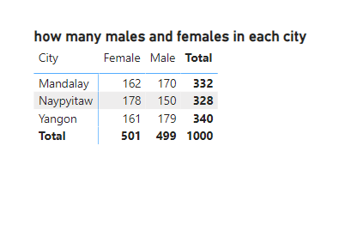
how many males and females in each city ?

Slide 14
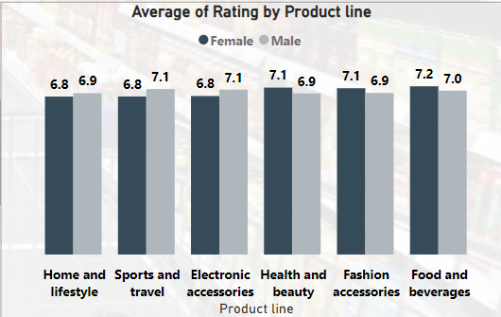
we want to know the average of rating for every product due to gender ?

Slide 15
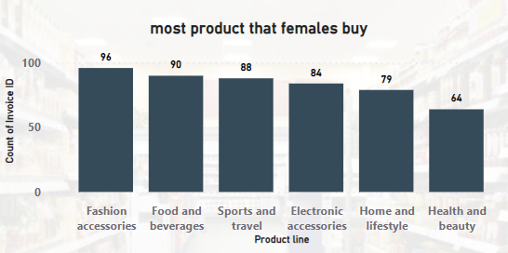
"What is the most purchased product category by female members in the dataset?"

Slide 16
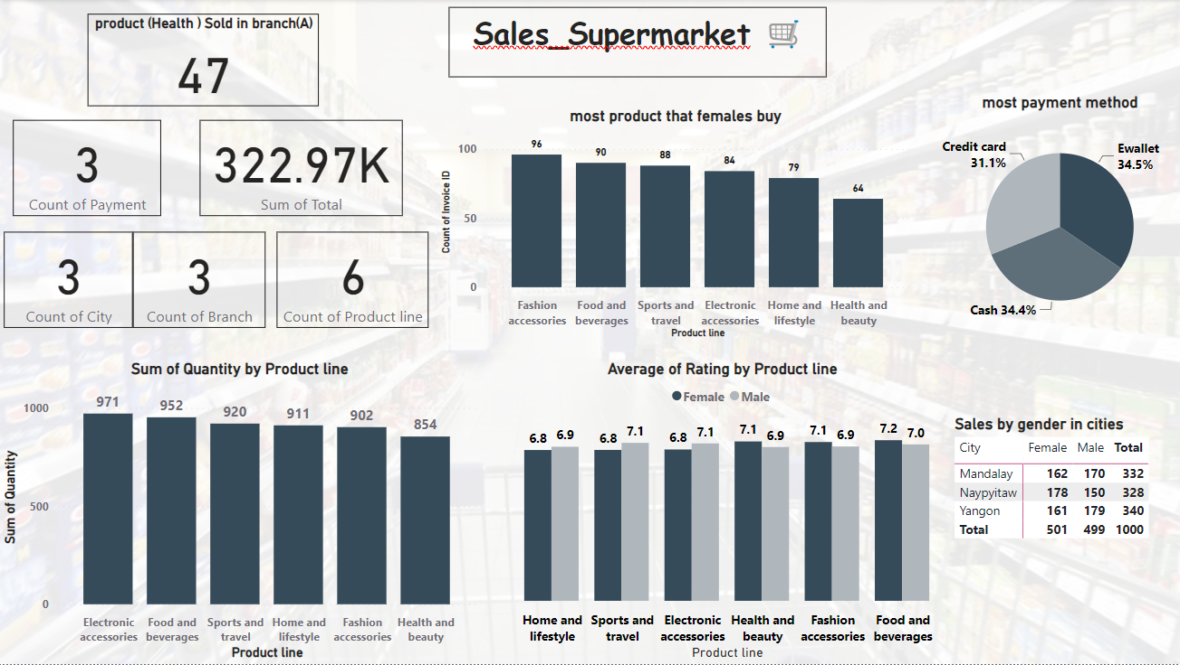
Dashboard

Slide 17
Conclusion
City, Branch, and Product Line Statistics:
Number of Cities: 3
Number of Branches: 3
Number of Product Lines: 6
Number of Payment Methods: 3
Sum of Total Amount: $322,970
Quantity Insights:
The largest quantity is associated with the product category "Electronic Accessories."
Branch-Specific Information:
In Branch "A," the quantity sold for the product category "Health and Beauty" is 47.

Slide 18
Conclusion
Payment Method Insights:
The most frequently used payment method is "Ewallet."
Gender Distribution:
The count of females is greater than males.
Gender Distribution by City:
The count of "Male" is largest in (Mandalay, Yangon).
The count of "Female" is largest in Naypyitaw.
Payment Method Usage:
All payment methods are observed to be very close in terms of usage.
Most Purchased Product by Females:
The most purchased product category by females is "Fashion Accessories."

