Slide 1
Facilitating Graph Exploration
By: Youssef Gerges Ramzy Mokhtar
Supervisor: Dr Marco Caminati

Slide 2
Contents
Project Description
Motivation
Technology Used
Project Influence
Demo
High-Level Architecture *
Graph Drawing Algorithm Used *
* topics will be discussed if we still have time remaining

Slide 3
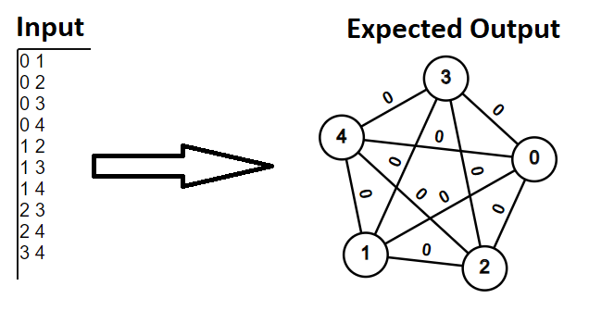
Project Description
The project has 2 main focuses
1st is displaying graphs in a visually appealing way
2nd is visualizing different graph algorithms (DFS, BFS, Dijkstra’s Shortest Path)

Slide 4
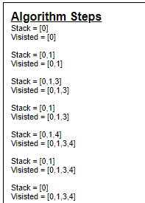
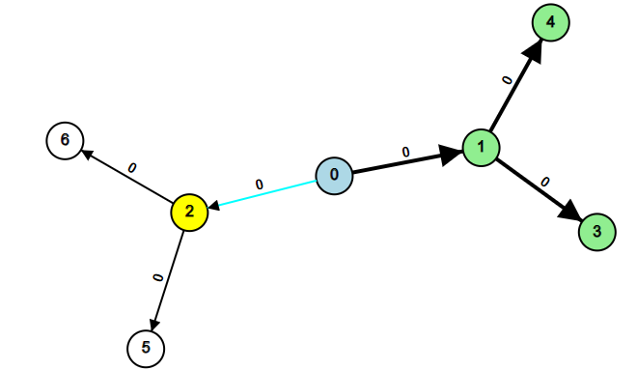
Project Description contd.
Execution of DFS on Binary Tree
Node Colors (not explained in report)
Green – node finished processing
Blue – node still being processed
Yellow – unvisited node will start to be processed

Slide 5
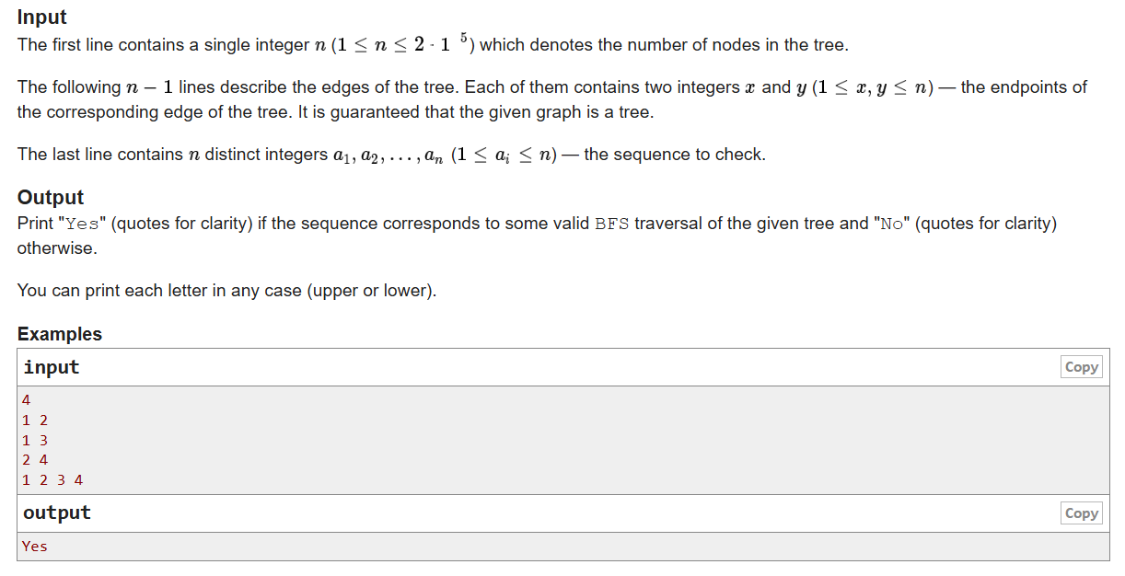
2. Motivation
curiosity – (main reason)
used tools like CS Academy Graph Editor and CS USFA
useful tool for competitive programmers
graph inputs for problems on websites like codeforces are generally given as edge list
useful tool for teachers and professors
Source: Problem - C - Codeforces

Slide 6
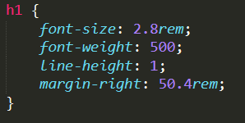

3. Technology Used
Project developed as a website
HTML & CSS – used for the User Interface (UI)
significant UI logic for the graph drawing and algorithm visualizations
Document Object Model (DOM) API is easy to use for managing the UI
CSS can quickly give nice-looking styling for the HTML elements

Slide 7
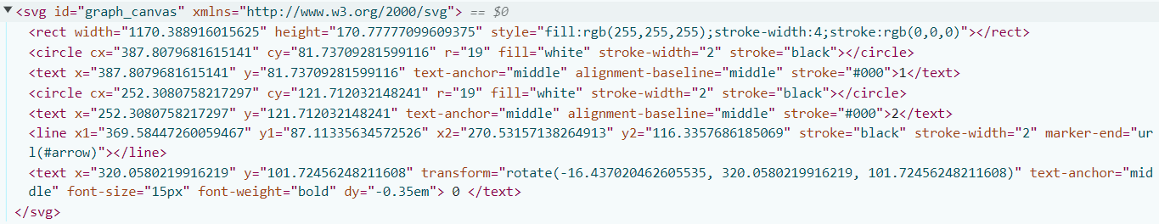
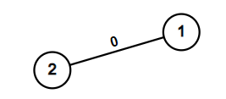
3. Technology Used contd.
JavaScript (JS) – programming language used for project logic
JS can run on web browsers and can manipulate HTML and CSS
JS was the first programming language I learnt although not my favorite :)
Scalable Vector Graphics (SVG) – technology used for displaying graph drawings
uses geometric shapes to render graphics
does not suffer pixelation
I found it easy to use, especially as it was my first time using SVG

Slide 8
4. Project Influence
the project will likely have little influence on others aside from myself
I am the main person influenced by the project
learned a lot during working on this project
several other websites offer similar and more features
being more user-friendly compared to the current project
working on the project beyond the module might make it influential
by influential I mean real users use the website

Slide 9
4. Project Influence contd.
the project unique feature compared to other projects is the ability to visualize graph algorithms while the graph is being drawn
I personally have not found any projects that combine both simultaneously

Slide 10
5. Demo
Time for project demo :)

Slide 11
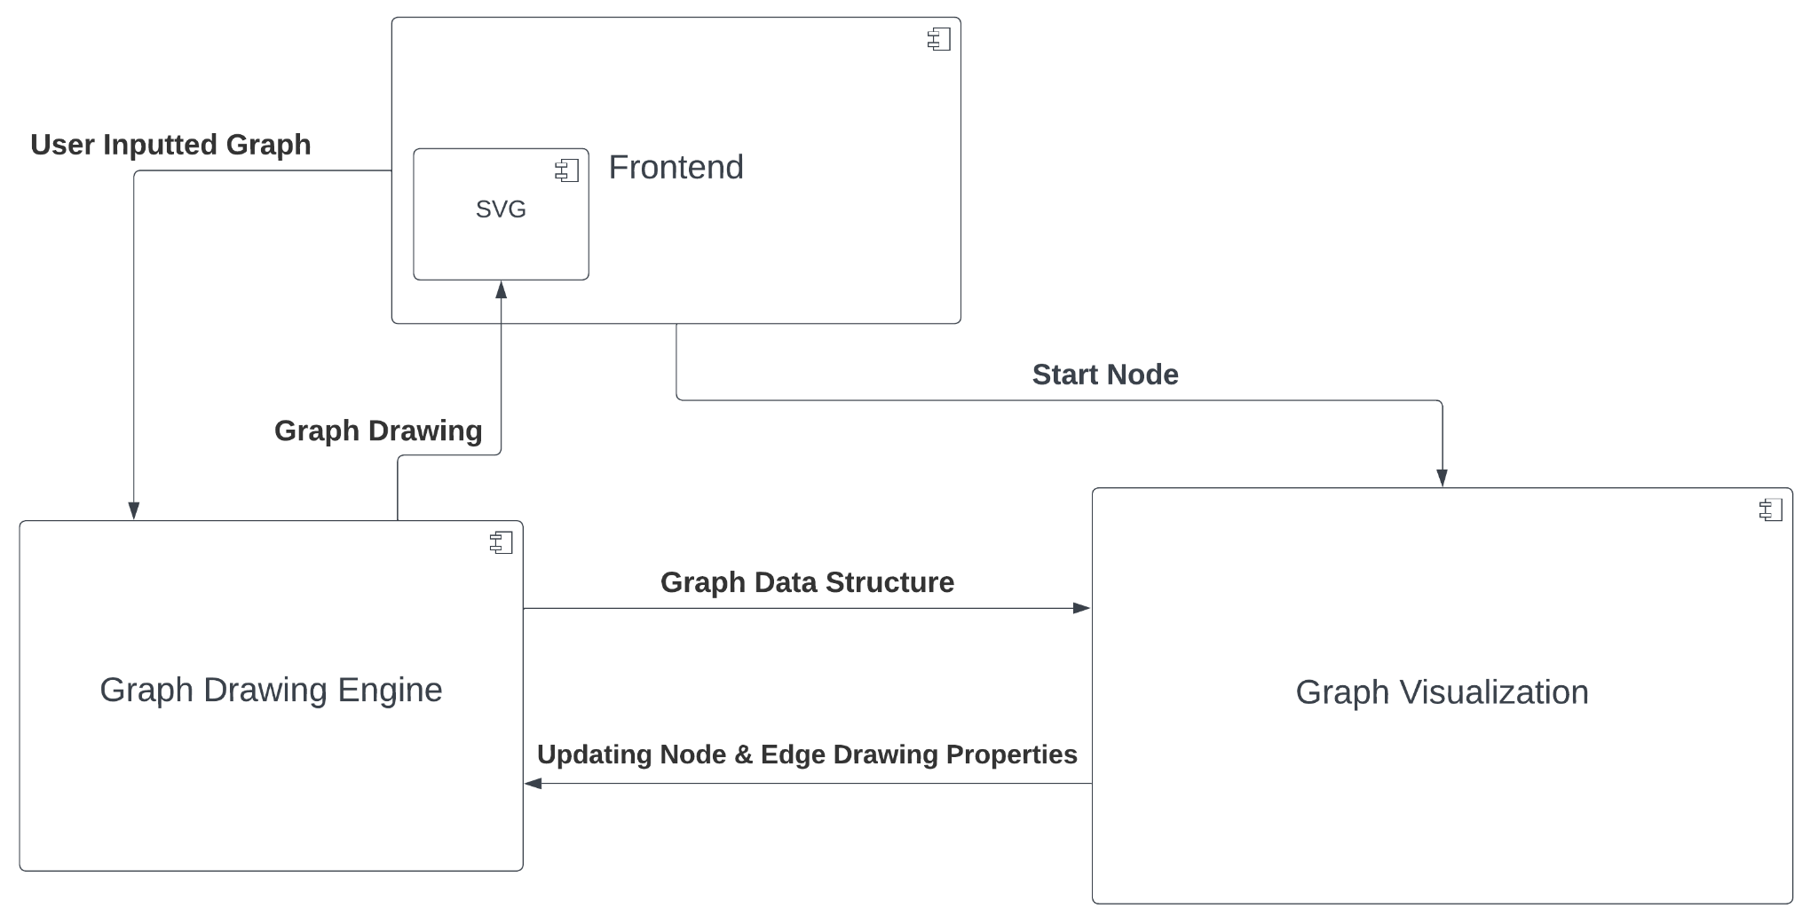
6. High-Level Architecture
the Frontend reads the graph from the user as text
the Frontend then converts this text into suitable graph representation
the graph is then passed to the Graph Drawing Engine

Slide 12
6. High-Level Architecture contd.
the Graph Drawing Engine draws the graph into the SVG container
the SVG component offers multiple classes to create shapes without needing knowledge of the underlying technology (i.e. DOM API)

Slide 13
6. High-Level Architecture contd.
when a user wants to visualize an algorithm he clicks on a node
the node is read by the Frontend and passed to the Graph Visualization Component

Slide 14
6. High-Level Architecture contd.
the Graph Visualization component reads the graph stored in the Graph Drawing Engine and runs the algorithm on it
the graph stored in the Graph Drawing Engine is the one currently shown on the screen

Slide 15
6. High-Level Architecture contd.
the Graph Visualization updates the visual properties of nodes and edges while the algorithm is running
recall SVG offers multiple high-level classes

Slide 16
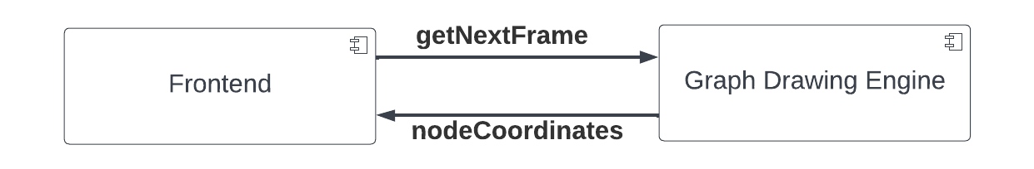
6. High-Level Architecture contd.
could we have done better? YES
the drawing process shouldn't have been the Graph Drawing Engine's responsibility
unnecessary coupling between the Frontend and the Graph Drawing Engine
drawing should have been delegated to the Frontend
would make it easier to test the Graph Drawing Engine functionality
HOW? By returning the current frame values to the Frontend from the Graph Drawing Engine
nodeCoordinates = {
node₁: (x₁, y₁)
node₂: (x₂, y₂)
.
.
nth_node: (x_{n}, y_{n})
}

Slide 17
7. Graph Drawing Algorithm Used
the Spring Embedder algorithm is used for displaying the graph
the algorithm belongs to the Force-Directed Algorithms family
force directed algorithms are algorithms that use physical simulations to display the graph
the algorithm is generally easy to implement
the algorithm generally yields good drawings with small graphs

Slide 18
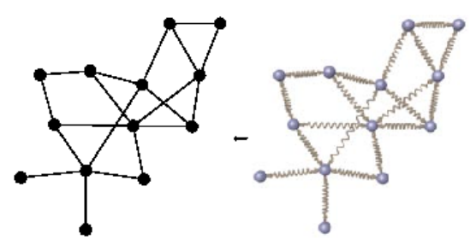
7. Graph Drawing Algorithm Used contd.
the algorithm treats graph nodes as charged particles
nodes repel each other
Coulomb's law is used for calculating repulsive force
the algorithm treats graph edges as springs
edges can compressed and stretched based on their length
Hooke's law is used for calculating spring force
Source: KIT - ITI Algorithmik

Slide 19
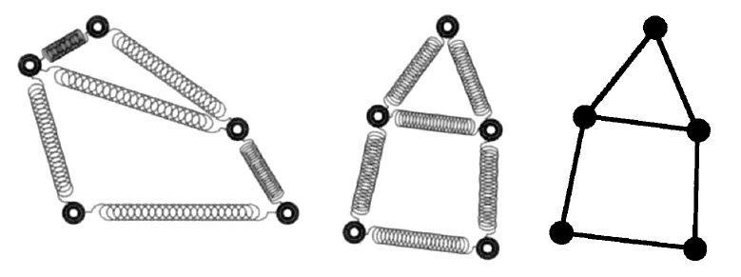
7. Graph Drawing Algorithm Used contd.
the force on a node is the sum of the following:
repulsive forces exerted by all neighbouring nodes
spring forces exerted on the node
the algorithm computes the force on each node and moves it a small fraction in the direction of the force
n.b. force is a vector it has a magnitude and a direction
Source: Graph Drawing: Algorithms for the Visualization of Graphs Book

Slide 20
7. Graph Drawing Algorithm Used contd.
the algorithm can be terminated using 3 different scenarios
stop once all nodes reach equilibrium (F = 0)
stop when the force on all nodes falls below a certain threshold (∀ v∊V, f(v) ≤ ε)
stop if the number of iterations exceeded a predefined limit
a combination of the above scenarios can be used together
the 3rd scenario is used for termination in the project

Slide 21
Q&A

