Slide 1
Citizen Voice
Bilingual review intelligence for UAE government apps
Youssef Hajri
Student ID 1425158
MAAI902 Natural Language Processing and LLMs | University of Wollongong in Dubai

Slide 2
What I will cover
AGENDA
01
02
03
The problem
Data and preprocessing
Models
Why app reviews matter and what is hard
Scraping Google Play, cleaning English and Arabic
Representations, sentiment, LoRA, emotion, NER
04
05
06
Findings
LLMs
Demo and conclusion
Issues people report and the releases that hurt
Prompt engineering and RAG
The app, limitations and next steps

Slide 3
The problem
01
Thousands of reviews, two languages, nobody reading them

Slide 4
Residents talk to government apps every day
01 THE PROBLEM
UAE PASS, RTA Dubai, DEWA, Dubai Police and DubaiNow get new reviews every day on Google Play.
Almost half are written in Arabic, many in Gulf dialect or mixed with English.
Most reviews are only a few words long.
Nobody can read them all, so problems are found late.
5,271
6
reviews after cleaning
government apps
41.5%
27.6%
written in Arabic
complaints (1 or 2 stars)
3 words
3.8
median review length
average star rating

Slide 5
Four questions an app team needs answered
01 THE PROBLEM
1
What is broken?
2
How upset are people?
Issue discovery: complaints grouped into topics and named in English and Arabic
Sentiment and emotion models, from a word list to a fine-tuned transformer
3
Which release caused it?
4
How should we answer?
A statistical test on every app version
An LLM assistant grounded in real reviews, and bilingual reply drafts

Slide 6
Data and preprocessing
02
Scraping Google Play and cleaning English and Arabic text

Slide 7
How the reviews are scraped from Google Play
02 DATA
1
2
3
4
5
Find the app
Request reviews
Page through
Skip known ids
Save
Check the package id on the UAE store, or search by name if it changed
→
google-play-scraper, country ae, newest first, once in English and once in Arabic
→
Pages of 200, up to 600 per app and language, retries with a growing delay
→
Reviews already saved are ignored, so every run is incremental
→
Parquet file, duplicates and empty texts removed, names replaced by a hash
Apps targeted
UAE PASS
DubaiNow
RTA Dubai
DEWA
Dubai Police
UAEICP
TAMM
MOHRE
For each review I keep the text, star rating, thumbs-up count, app version, date and the official reply. TAMM was not found on the store and the ICP and MOHRE searches returned other apps, so the data comes mostly from five large apps.

Slide 8
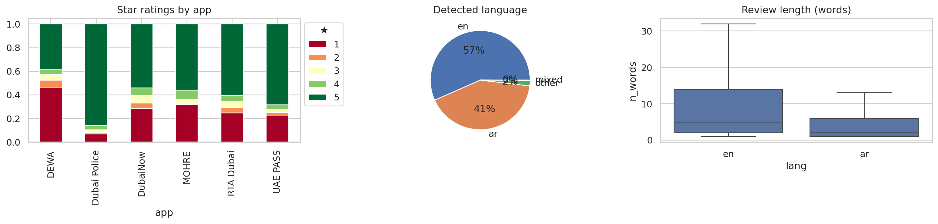
What the data looks like
02 DATA
Polarised
4,216 / 1,055
Weak labels
mostly 1 or 5 stars, so neutral is rare
stratified train and test split
1 to 2 stars negative, 3 neutral, 4 to 5 positive

Slide 9
From raw review to insight in five steps
02 PIPELINE
1
2
3
4
5
Collect
Clean
Represent
Analyse
Explain
Automatic Play Store scraper, English and Arabic
→
NLTK, spaCy, CAMeL Tools
→
BoW, TF-IDF, Word2Vec, BGE-M3
→
Sentiment, emotion, NER, issues, releases
→
Prompting, RAG with citations, replies
The whole pipeline runs in about five minutes on a free Colab T4 GPU, and the same code powers the Streamlit app and the dashboard.

Slide 10
Cleaning the text in two languages
02 PREPROCESSING
English
Arabic
Remove URLs, turn emoji into tokens
Lower-case, shorten repeated letters (soooo)
Tokenise with NLTK
Remove stop words, keep negations
Lemmatise with WordNet and spaCy
Compare Porter, Snowball and Lancaster stemmers
Normalise letters with CAMeL Tools (أ إ آ → ا, ى → ي, ة → ه)
Remove diacritics and tatweel
Map Arabic-Indic digits to 0 to 9
Remove stop words, keep negations (لا, لم, لن, ليس)
ISRI root stemmer or my light stemmer
Language detected from the share of Arabic letters
Key decision: negations stay in, otherwise "not working" becomes "working" and the sentiment flips.

Slide 11
Arabic stemming cuts the vocabulary in half
02 PREPROCESSING
1,456
Arabic word types after stemming, down from 3,106
Removing stop words changes little: they are frequent but few.
Many Arabic words share one root with prefixes and suffixes, so stemming merges them.
Stemming also merges different meanings, so I used lemmas as features.

Slide 12
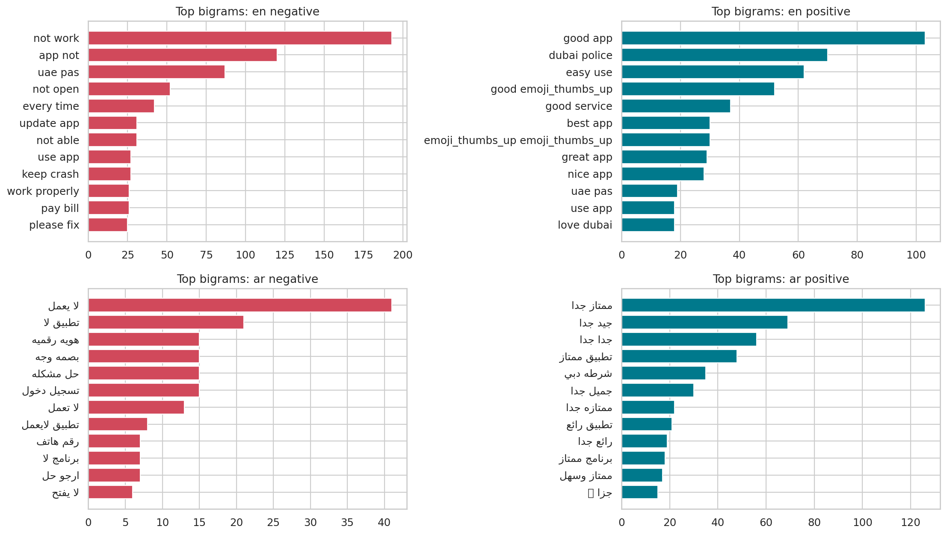
What people actually say
02 LINGUISTIC ANALYSIS
spaCy dependency rules
slow login
adjective modifier → login: slow
the app is useless
subject + complement → app: useless
the OTP never arrives
negated verb → otp: not arrive
Plus POS tags, Matcher patterns and subject-verb-object triples.

Slide 13
Models
03
Turning text into numbers and measuring how people feel

Slide 14
BGE-M3 is the best way to turn reviews into numbers
03 REPRESENTATIONS
0.866
precision@5 with BGE-M3, the best of the four
Same logistic regression classifier on every representation.
BoW and TF-IDF count words, Word2Vec was trained on my reviews.
BGE-M3 is pre-trained and multilingual, 1024 dimensions.

Slide 15
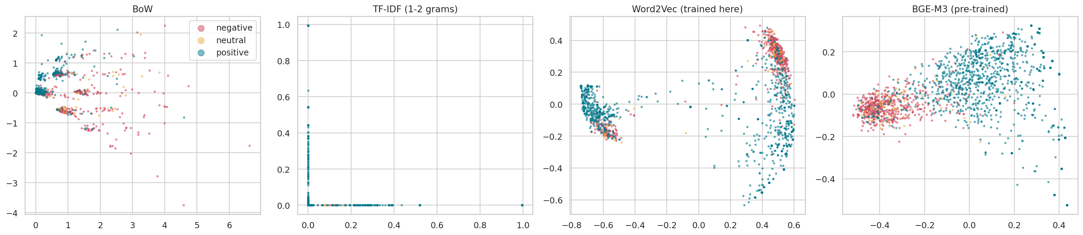
One meaning, two languages
03 REPRESENTATIONS
0.36 vs 0
20%
TF-IDF needs the same words, so English never finds Arabic. BGE-M3 matches by meaning.
top-10 overlap for the same question in English and Arabic
of results for an English query are Arabic reviews
This is why search, issue discovery and RAG are all built on BGE-M3.

Slide 16
From a word list to a fine-tuned transformer
03 SENTIMENT
0.90
best accuracy, XLM-R fine-tuned with LoRA
VADER (word list) only works for English: macro-F1 0.53.
Pre-trained transformers beat TF-IDF without seeing my data.
LoRA has the best accuracy but a lower macro-F1: it rarely predicts the small neutral class.

Slide 17
LoRA: fine-tuning on a free GPU
03 FINE-TUNING
0.42%
1.1 min
W
frozen
B
of weights trained
on a Colab T4
+
×
A
Base model: XLM-RoBERTa, pre-trained on 100 languages.
LoRA on the attention query and value layers.
3 epochs, AdamW, class-weighted loss, mixed precision.
Pre-training brings the languages, fine-tuning brings my domain.
The original weights stay frozen. Only two thin matrices of rank 16 and the classifier head are trained.

Slide 18
Low ratings are mostly sadness, not anger
03 EMOTION
46%
of complaints read as sadness
4%
read as anger
DistilRoBERTa for English, zero-shot mDeBERTa for Arabic. People sound tired and let down, so replies should be patient.

Slide 19
Who and what the reviews talk about
03 NAMED ENTITIES
0.64
0.27
LLM finds fewer, but more useful entities
entities per review, spaCy and CAMeLBERT
entities per review, LLM
Classical models
LLM with a JSON prompt
Mostly cities, dates and numbers. CAMeLBERT even tags "thank God" as an entity.
Domain types such as GOV_SERVICE (Salik, Emirates ID) and ERROR_MESSAGE (account is locked), plus relation triples.

Slide 20
Findings
04
What is broken and which releases made it worse

Slide 21
13 issues found automatically, named in two languages
04 ISSUES
11 of 13
issues mix English and Arabic reviews
k-means on BGE-M3 vectors, k chosen with the silhouette score.
Keywords from class-based TF-IDF.
The LLM writes a name in English and Arabic, e.g. مشكلة في تسجيل الدخول.

Slide 22
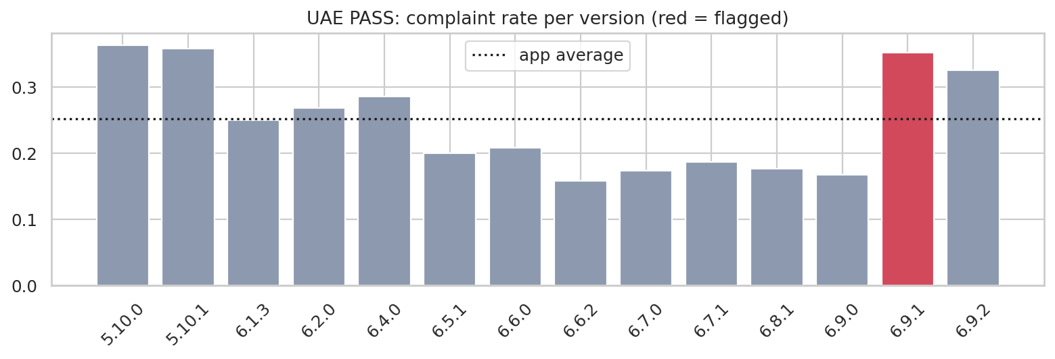
Which update made things worse?
04 RELEASES
App | Version | Complaints | Usual | q | Issue that grew
DEWA | 10.3.6 | 95% | 51% | 0.001 | App launch failure
RTA Dubai | 6.4.8 | 78% | 28% | <0.001 | App launch failure
RTA Dubai | 6.4.2 | 63% | 28% | <0.001 | UAE Pass login issue
UAE PASS | 6.9.1 | 35% | 23% | 0.011 | Login problem
Dubai Police | 7.0.5 | 20% | 7% | 0.039 | App crash on update
10 of 65
versions flagged after correction
Two-proportion z-test: each version against the rest of the app.
15 versions had p < 0.05, but some of that is chance.
Benjamini-Hochberg keeps false discoveries at 5%.
Six flags are RTA Dubai releases in a row.

Slide 23
LLMs
05
Prompt engineering and grounded answers

Slide 24
How you ask changes the answer
05 PROMPT ENGINEERING
0.66
macro-F1 with few-shot, the best prompt
Same 50 reviews, same free OpenRouter LLM, JSON output.
Few-shot shows six labelled bilingual examples first.
The LLM beats LoRA here, but it is slower and limited to about 50 requests a day.

Slide 25
RAG keeps the answers grounded in real reviews
05 RAG
1
2
3
4
Question
→
Retrieve
→
Answer
→
Judge
In English or Arabic
BGE-M3 finds the 12 most relevant reviews
The LLM answers only from them and cites [R1], [R2]
A second LLM call checks every claim
1.00
0.57
0
faithfulness with retrieval
faithfulness without retrieval
invalid citations
Like an open book exam: the model gets the evidence first, so it answers from real reviews instead of guessing.

Slide 26
The application
06
Everything in one Streamlit app

Slide 27
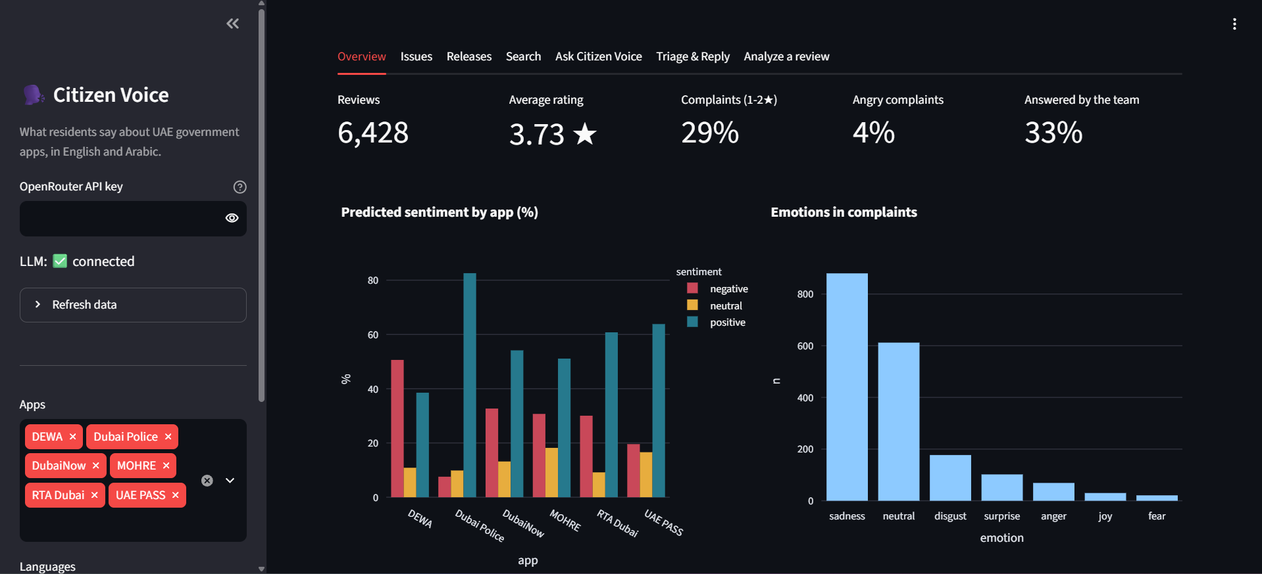
Overview: the key numbers at a glance
06 DEMO
Screenshots from a later run of the collector (6,428 reviews), so the numbers differ slightly from the evaluation run.

Slide 28
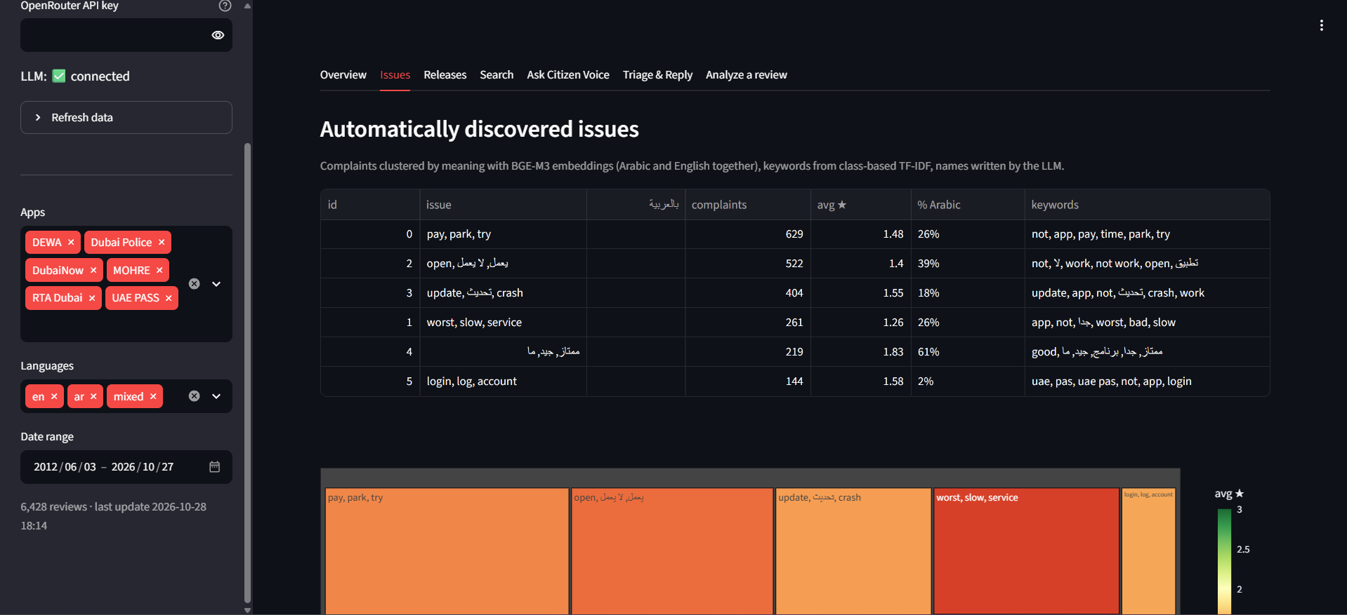
Issues: problems found automatically
06 DEMO
The Issues tab lists each cluster with its size, share of Arabic reviews and keywords.
Screenshots from a later run of the collector (6,428 reviews), so the numbers differ slightly from the evaluation run.

Slide 29
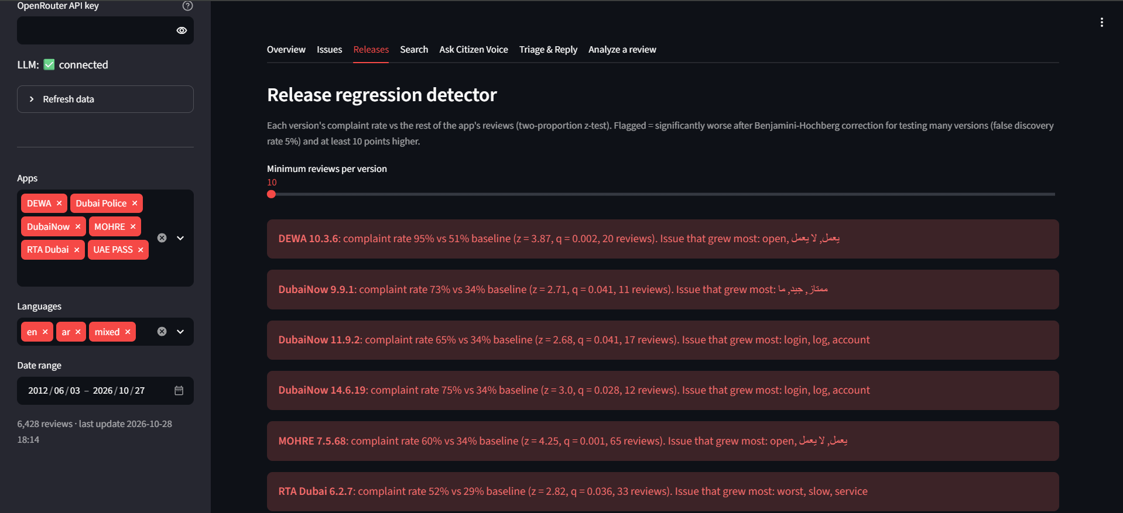
Releases: which update made things worse
06 DEMO
Flagged versions with their complaint rate, the usual rate and the issue that grew.
Screenshots from a later run of the collector (6,428 reviews), so the numbers differ slightly from the evaluation run.

Slide 30
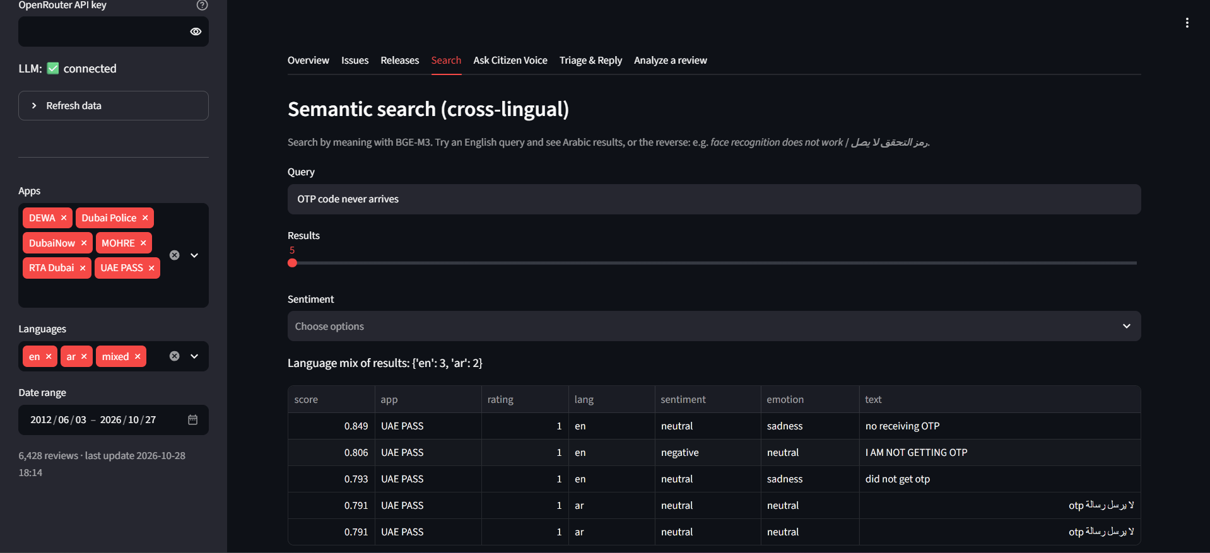
Search in English, find Arabic too
06 DEMO
An English query about the OTP code also returns Arabic reviews about the same problem.
Screenshots from a later run of the collector (6,428 reviews), so the numbers differ slightly from the evaluation run.

Slide 31
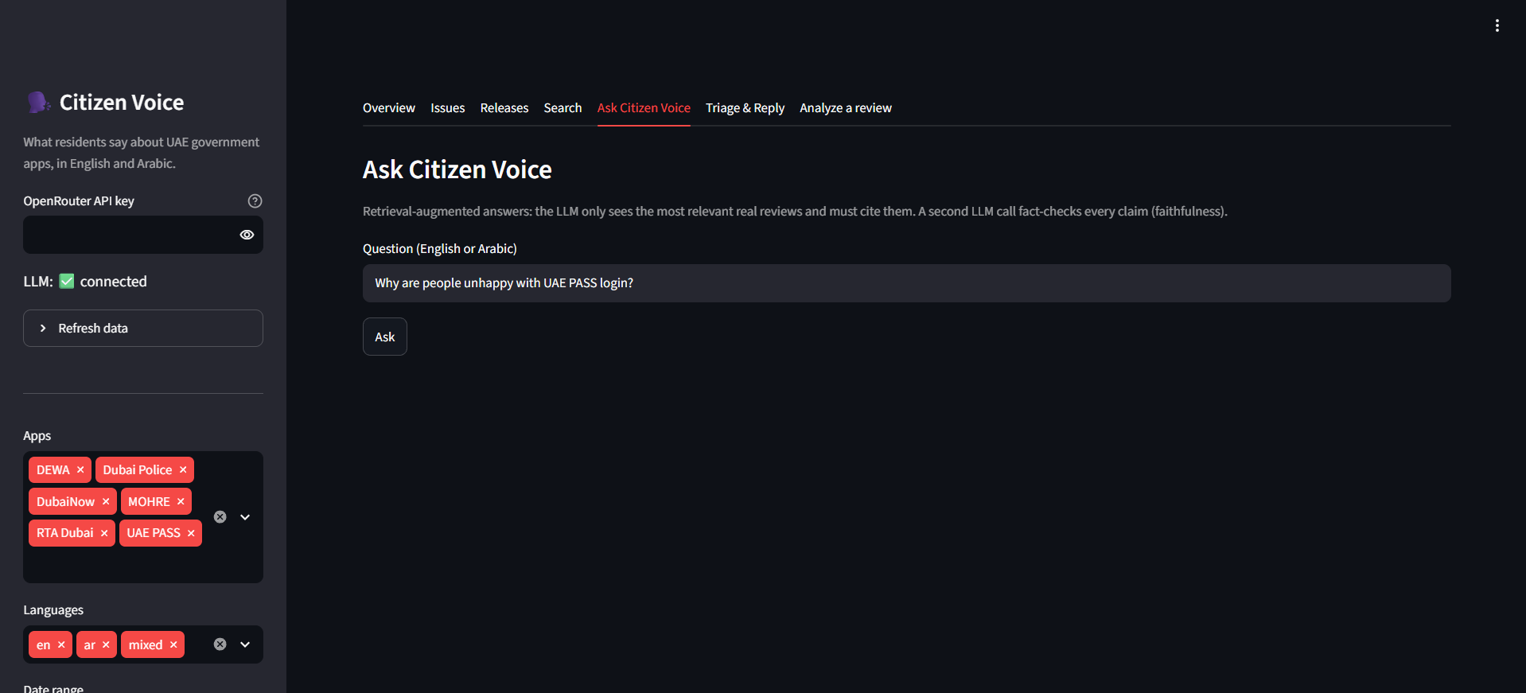
Ask: answers grounded in real reviews
06 DEMO
A question in English or Arabic is answered by RAG with citations and a faithfulness check.
Screenshots from a later run of the collector (6,428 reviews), so the numbers differ slightly from the evaluation run.

Slide 32
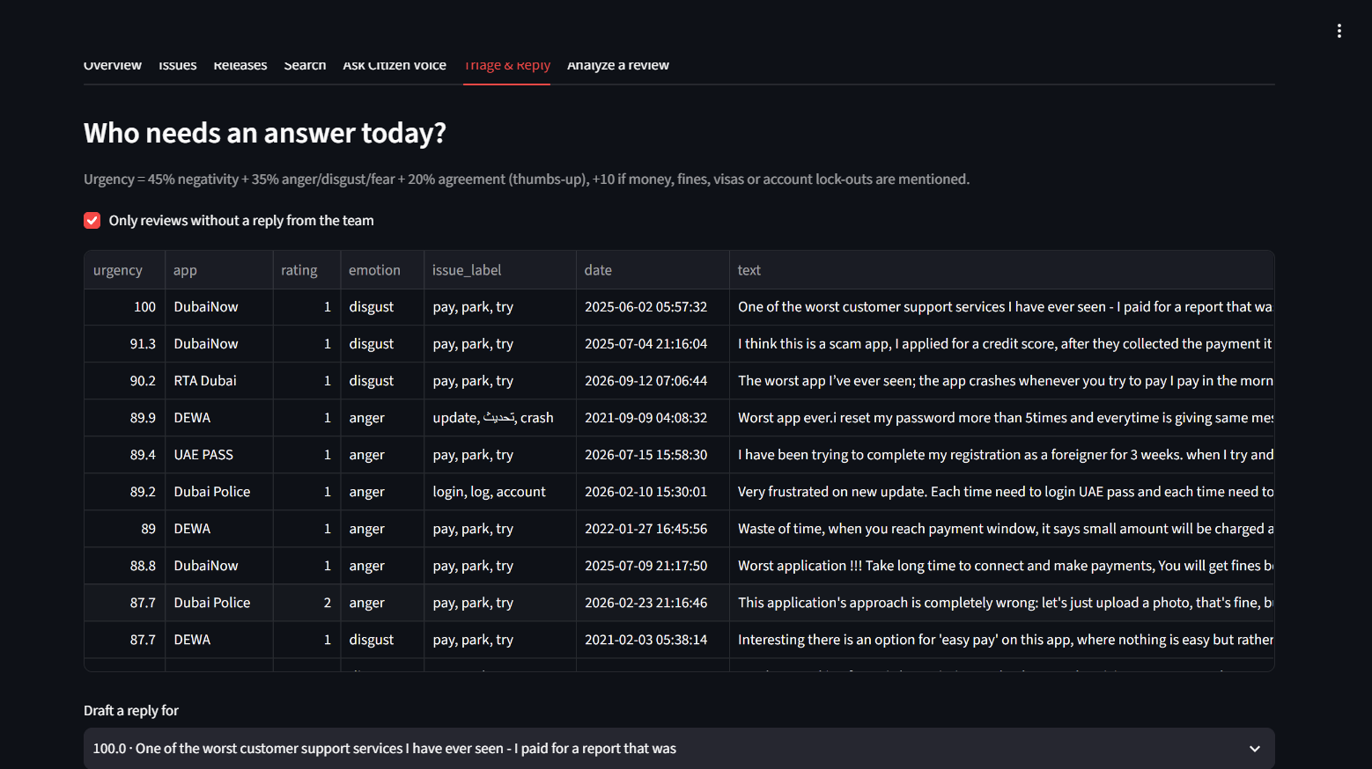
Triage and reply
06 DEMO
Unanswered reviews ranked by urgency, with a reply drafted in English and Arabic.
Screenshots from a later run of the collector (6,428 reviews), so the numbers differ slightly from the evaluation run.

Slide 33
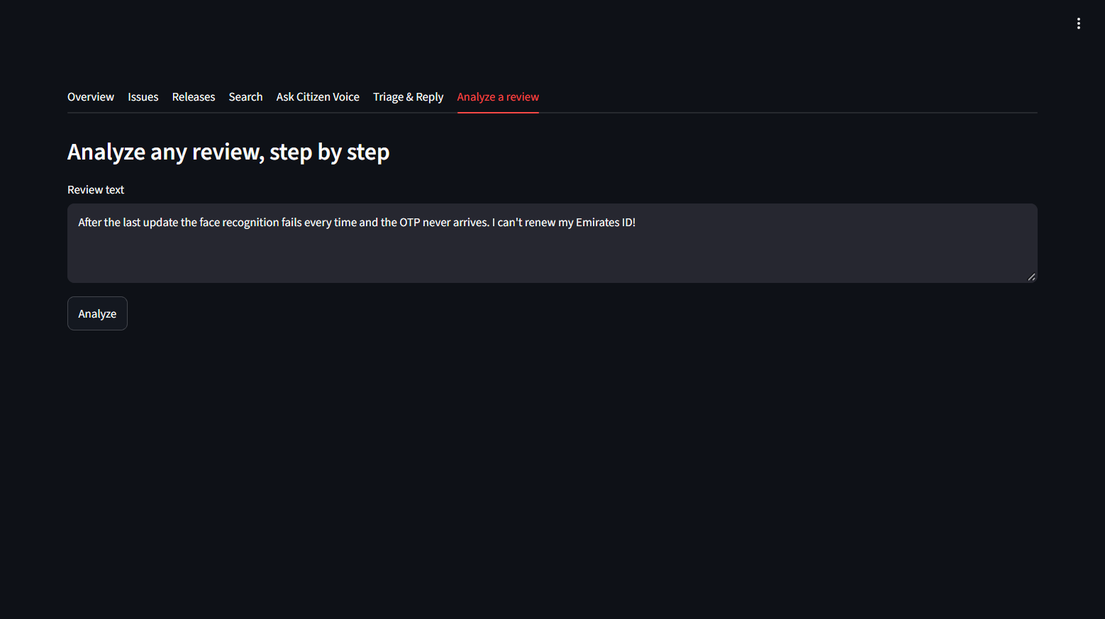
Analyze one review step by step
06 DEMO
Paste any review and see each preprocessing step and every model's output.
Screenshots from a later run of the collector (6,428 reviews), so the numbers differ slightly from the evaluation run.

Slide 34
Limitations and next steps
06 CONCLUSION
Limitations
Next steps
Star ratings are weak labels: some people praise and still give 1 star.
Reviews are very short (median 3 words).
Free LLM: about 50 requests a day.
The faithfulness judge is an LLM, not a human.
Label a few hundred reviews by hand.
Run the collector daily and alert on bad releases.
Add App Store reviews and an Arabic LLM such as Falcon.
Share the issue list with the app teams.

Slide 35
Citizen Voice answers the four questions
06 CONCLUSION
What is broken?
13 bilingual issues, led by payments and login
How upset are people?
28% complaints, mostly sad, LoRA at 0.90 accuracy
Which release caused it?
10 releases flagged after correction
How should we answer?
RAG with 1.00 faithfulness and bilingual replies

Slide 36
Thank you
Questions are welcome
Code, notebook and dashboard:
github.com/youssef-hjr/Citizen-Voice-Bilingual-Review-Intelligence-for-UAE-Government-Apps

