Slide 1
Citizen Voice
What residents say about UAE government apps, in English and Arabic
CV
Youssef Hajri
Student ID 1425158
MAAI902 Natural Language Processing and LLMs, University of Wollongong in Dubai
Notes:
Good morning. My project is Citizen Voice. It reads what people write about UAE government apps on Google Play, in English and in Arabic, and turns it into something an app team can act on: what is broken, how upset people are, which release caused it, and how to answer.

Slide 2
The problem: thousands of reviews, two languages
Residents review apps like UAE PASS, RTA Dubai and DEWA every day.
Almost half the reviews are in Arabic, many are only a few words long.
Nobody reads them all, so problems are found late.
My goal: collect them automatically and tell the team what to fix first.
5,271
6
reviews after cleaning
government apps
41.5%
27.6%
written in Arabic
negative (1 or 2 stars)
Median review length: 3 words. Average rating: 3.8.
Notes:
I collected 5,365 reviews with google-play-scraper and kept 5,271 after removing duplicates and empty text. 41.5 percent are Arabic, so Arabic could not be an afterthought. Reviews are very short, the median is three words, which makes the task harder than normal text classification.

Slide 3
How it works
1
2
3
4
5
Collect
Clean
Represent
Analyse
Explain
→
→
→
→
Google Play scraper, incremental, no personal data
NLTK, spaCy, CAMeL Tools for Arabic
BoW, TF-IDF, Word2Vec, BGE-M3
sentiment, emotion, NER, issues, releases
LLM prompts, RAG with citations, replies
Train and test split: 4,216 / 1,055 reviews. Labels come from star ratings (1 to 2 negative, 3 neutral, 4 to 5 positive). Whole pipeline runs in about 5 minutes on a Colab T4.
Notes:
This is the pipeline: collect, clean, represent, analyse and explain. I used the star rating as a free label, which is a weak label, and I come back to that in the limitations. Everything runs in one Colab notebook and the same code powers the Streamlit app.

Slide 4
Preprocessing: Arabic stemming cuts the vocabulary in half
Stop words removed, but I kept negation words in English and Arabic, so "not working" stays negative.
CAMeL Tools normalises Arabic letters, diacritics and stretched words.
The ISRI stemmer is aggressive: 3,106 → 1,456 Arabic types. Lemmas keep more meaning, so I used them for features.
Notes:
This chart shows vocabulary size after each preprocessing step. For English, stemming and lemmatising reduce the vocabulary moderately. For Arabic the ISRI stemmer more than halves it because Arabic packs prefixes and suffixes onto the root. I kept negation words in on purpose.

Slide 5
Representations: BGE-M3 wins in both languages
0.36 vs 0
cross-lingual overlap@10, BGE-M3 vs TF-IDF
An English query never finds an Arabic review with TF-IDF because the words differ. BGE-M3 puts both languages in one 1024-dimension space, so 20% of results for an English query are Arabic.
Notes:
I compared four representations with the same logistic regression classifier and the same search task. BGE-M3 is best on both, but the big difference is cross-lingual search: TF-IDF overlap is zero, BGE-M3 is 0.36.

Slide 6
Sentiment: pre-trained vs fine-tuned with LoRA
0.42%
of XLM-R weights trained with LoRA (r = 16), 1.1 minutes
LoRA gives the best accuracy (0.899) but not the best macro-F1: it rarely predicts the small neutral class. VADER only works for English (macro-F1 0.53).
Notes:
All numbers are on the full bilingual test set. Fine-tuning with LoRA reaches the highest accuracy, 0.899, while training less than half a percent of the weights in about a minute. Macro-F1 is a bit lower than plain XLM-R because neutral 3-star reviews are rare and the fine-tuned model leans to the majority classes. That is why I report macro-F1 and not only accuracy.

Slide 7
Emotion: low ratings are mostly sadness, not anger
46%
of complaints read as sadness
4%
read as anger
People sound tired and let down, so replies should be patient, not defensive.
Notes:
Emotion comes from DistilRoBERTa for English and zero-shot multilingual NLI for Arabic. I expected angry complaints, but most low-rated reviews read as sadness or disappointment. Joy rises steadily with the rating, which is a sanity check that the emotion model behaves sensibly.

Slide 8
Issues found automatically, named in English and Arabic
13
clusters (k-means on BGE-M3, chosen by silhouette)
11
of them mix English and Arabic reviews
Keywords from class-based TF-IDF, names written by the LLM, for example:
مشكلة في تسجيل الدخول
Notes:
I clustered the complaint embeddings with k-means and chose the number of clusters with the silhouette score. Each cluster gets keywords from class-based TF-IDF and the LLM names it in both languages. 11 of 13 clusters contain both English and Arabic reviews, which only happens because the embeddings are multilingual. The biggest problems are parking payments, customer service and payment failures.

Slide 9
Which release made things worse?
App | Version | Complaints | Usual | q | Issue that grew
DEWA | 10.3.6 | 95% | 51% | 0.001 | App launch failure
RTA Dubai | 6.4.8 | 78% | 28% | <0.001 | App launch failure
RTA Dubai | 6.4.2 | 63% | 28% | <0.001 | UAE Pass login issue
UAE PASS | 6.9.1 | 35% | 23% | 0.011 | Login problem
Dubai Police | 7.0.5 | 20% | 7% | 0.039 | App crash on update
65 → 10
versions tested → flagged after Benjamini-Hochberg
Two-proportion z-test per version against the rest of the app. 15 versions had p < 0.05 alone, but with 65 tests some of that is chance, so I control the false discovery rate at 5%. Six flags are RTA Dubai releases in a row.
Notes:
For each app version I compare its complaint rate with the rest of that app's reviews using a two-proportion z-test. Because I test 65 versions, I correct with Benjamini-Hochberg. 15 versions pass at p below 0.05, and 10 survive the correction. The table shows a selection. Many consecutive RTA Dubai releases are flagged, which points to a lasting problem rather than one bad update.

Slide 10
Prompt engineering: few-shot beats zero-shot
Same 50 test reviews, free OpenRouter model, JSON output.
Adding a role and label definitions helps a little (0.57 → 0.59).
Six labelled examples help most (0.66).
On this small sample the LLM beats my fine-tuned model, but it is slower and has a daily limit.
Notes:
I tested three prompting strategies on the same 50 reviews. Few-shot prompting is clearly the best. On these 50 reviews it even beats my LoRA model, but the sample is small and the free API allows about 50 requests per day, so the fine-tuned model is still what I use for the full dataset.

Slide 11
RAG keeps the answers grounded
1.00
0.57
0
faithfulness with retrieval
faithfulness without retrieval
invalid citations
Ask Citizen Voice: question → retrieve top reviews with BGE-M3 → LLM answers only from them and cites [R#].
A second LLM call checks every claim (LLM as a judge).
Entity extraction: spaCy and CAMeLBERT found 0.64 entities per review, the LLM 0.27, but the LLM finds domain types like GOV_SERVICE and ERROR_MESSAGE.
Arabic questions work too, through the same index.
Notes:
Without retrieval the model answers from general knowledge and only 57 percent of its claims are supported. With retrieval and citations every checked claim is supported and no citation points to a review that does not exist. The judge is itself an LLM, so this is an automatic check, not a human evaluation.

Slide 12
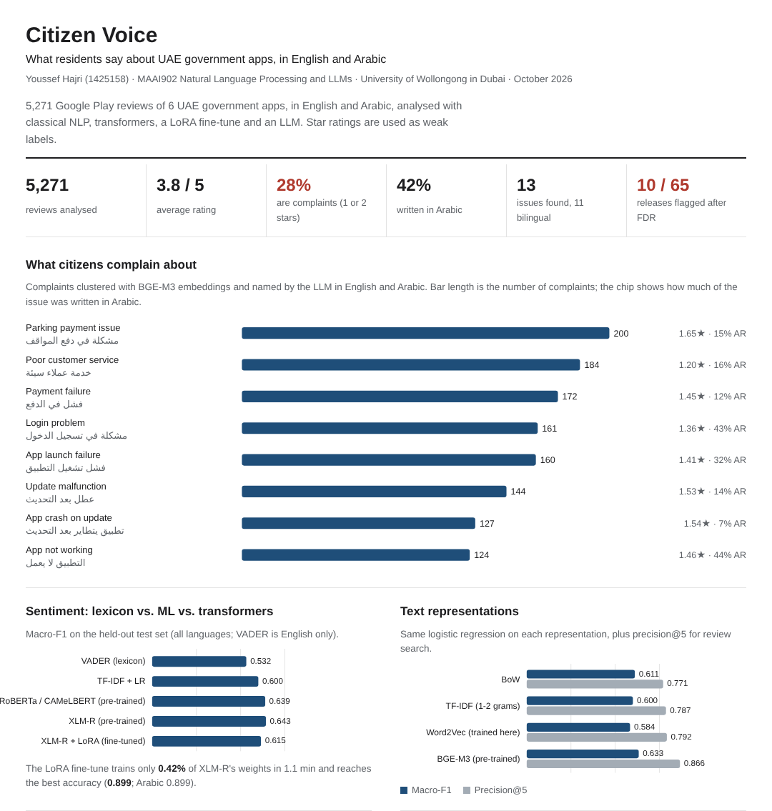
The Citizen Voice app and dashboard
Streamlit app with tabs: Overview, Issues, Releases, Search, Ask, Triage and Reply, Analyze a review.
Search in English, get Arabic results too (for example "OTP code never arrives").
Drafts polite replies in both languages for the most urgent reviews.
A static HTML dashboard summarises every result for readers who do not run the code.
Notes:
Here I switch to the live demo. I show the overview, the issue clusters with Arabic names, a flagged release, a cross-lingual search, a RAG question with citations, and a drafted reply. The dashboard on the left is the HTML version that I also submitted.

Slide 13
Limitations and next steps
Limitations
Next steps
Star ratings are a weak label: some people write praise and give 1 star.
Reviews are very short (median 3 words).
Free LLM: about 50 requests a day, so prompting tests use 50 reviews.
The judge is an LLM, not a human.
Label a few hundred reviews by hand to check the models.
Run the collector daily and alert on new release regressions.
Add iOS App Store reviews.
Share the issue list with the app teams.
Notes:
The main limitation is the label: star ratings are free but noisy. The next step is a small hand-labelled set. I would also like to schedule the collector so the release detector warns the team the day a bad update ships.

Slide 14
Thank you
Questions are welcome
Code: github.com/youssef-hjr/Citizen-Voice-Bilingual-Review-Intelligence-for-UAE-Government-Apps
Youssef Hajri, Student ID 1425158
Notes:
Thank you. The code, the Colab notebook and the dashboard are in the repository on this slide. I am happy to take questions.

