Slide 1
Machine Translation

Slide 2
Members:
Ahmed Nazeh
Youssef Kamel
Peter Hany
Aya Osama
Youssef Gerges
Mohamed Farhat
Nada Gamal

Slide 3
Introduction
Machine translation is a technology that automatically converts text from one language to another using software. It works by analyzing large amounts of bilingual text to find patterns. There are two main types: statistical methods and neural networks, which offer more natural translations. While it's useful for many applications, like travel and e-commerce, it can struggle with accuracy and cultural nuances. As technology advances, its accuracy and understanding are expected to improve.

Slide 4
Types of Machine Translation: Rule-Based Translation (RBMT): Relies on predefined linguistic rules and dictionaries. Pros: High accuracy for structured texts; Cons: Labor-intensive to create rules. Statistical Machine Translation (SMT): Analyzes bilingual text to find statistical correlations between source and target languages. Pros: Better adaptability; Cons: May produce awkward translations. Neural Machine Translation (NMT): Utilizes deep learning models to capture context and produce more natural translations. Pros: Improved fluency and coherence; Cons: Requires large datasets and computing power.

Slide 5
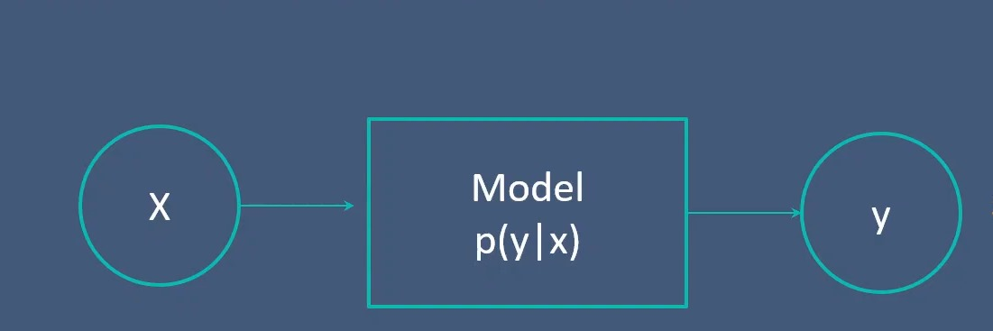

Slide 6
ENCODER:
An encoder is a device or program that converts information from one format or code to another, often to prepare it for transmission or storage. For example, in digital communication, an encoder might convert analog signals into digital data.
DECODER:
A decoder does the opposite; it converts encoded data back into its original format. For instance, in video streaming, a decoder takes compressed video data and transforms it into a format that can be displayed on a screen.

Slide 7
Transformer:
Transformer in Natural Language Processing
The transformer model is a groundbreaking architecture introduced in the paper "Attention is All You Need" by Vaswani et al. in 2017. It has since become the foundation for many state-of-the-art models in NLP.
Key Components:
Self-Attention Mechanism:
This mechanism allows the model to weigh the significance of each word relative to others in the input sequence, helping it capture context and relationships effectively.
It computes attention scores to decide how much focus to put on different words when encoding a particular word.
Multi-Head Attention:
The model employs multiple attention heads to capture different aspects of relationships between words. Each head learns to focus on different parts of the input, providing richer representations.
Positional Encoding:
Since transformers process input in parallel, they use positional encodings to retain the order of words. These encodings are added to the input embeddings to provide information about word positions.
Feed-Forward Neural Networks:
Each attention output is passed through a feed-forward neural network (the same one for each position) to introduce non-linearity and further transform the data.
Layer Normalization and Residual Connections:
Layer normalization helps stabilize training, while residual connections allow gradients to flow better through the network, facilitating deeper architectures.

Slide 8
Architecture:
Encoder-Decoder Structure:
The encoder consists of multiple identical layers (usually 6 or more) that process the input sequence.
The decoder is similarly structured but includes mechanisms to ensure that predictions for the next word only depend on previous words (masked attention).
Applications:
Transformers have been instrumental in various NLP tasks, including:
Machine Translation: Translating text from one language to another.
Text Summarization: Condensing articles or documents into shorter summaries.
Sentiment Analysis: Classifying text based on sentiment (positive, negative, neutral).
Question Answering: Providing answers to questions based on a given context.
Text Generation: Creating coherent and contextually relevant text, as seen in chatbots and writing assistants.

Slide 9
M2M-100 model from Facebook:
The M2M-100 model from Facebook AI Research is a multilingual machine translation model designed to translate text between multiple languages without relying on English as an intermediate step. Here’s a breakdown of its key features:
Key Features
Multilingual Capabilities: M2M-100 supports direct translation between 100 different languages. This is significant because many previous models translated into English first, which can lead to loss of nuance and accuracy.
End-to-End Learning: The model is trained in an end-to-end manner on a large multilingual dataset, allowing it to learn translations between languages directly.
Zero-Shot Translation: M2M-100 can perform translations for language pairs that it hasn't explicitly seen during training, known as zero-shot translation. For example, if it has been trained on both Spanish and Italian, it can translate directly between them even if it hasn't seen Spanish-Italian pairs.
Performance: The model has shown competitive performance on various benchmarks, often outperforming previous state-of-the-art models in specific language pairs.
Data: The training data for M2M-100 comes from a diverse set of sources, including web data, making it robust across different domains and topics.

Slide 10
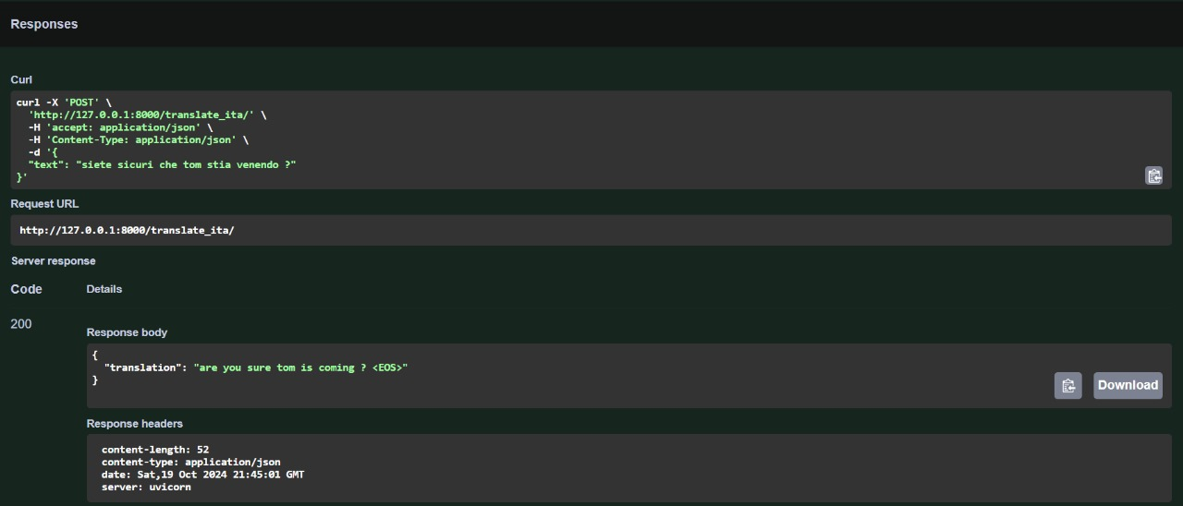

Slide 11
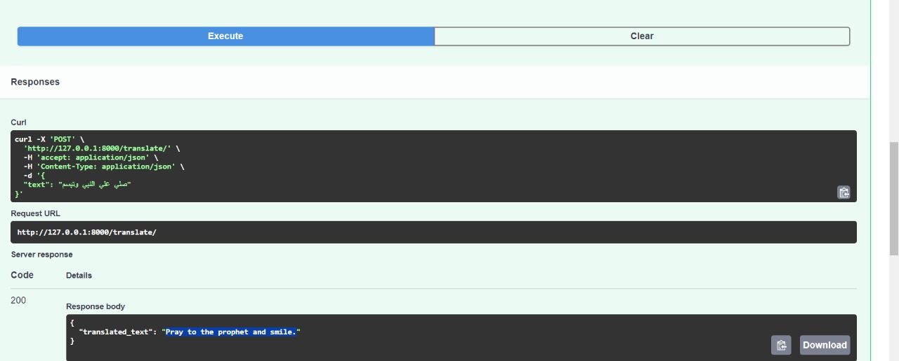

Slide 12
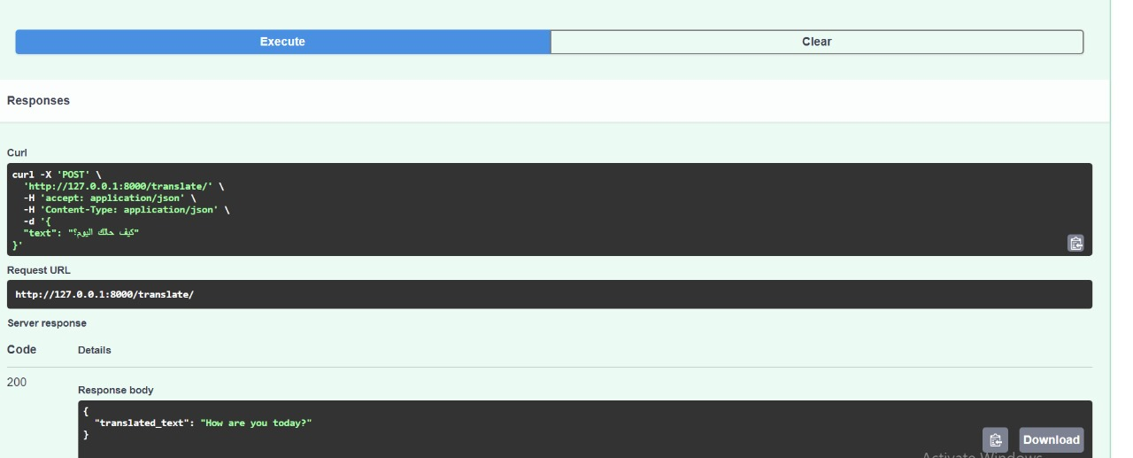

Slide 13


Slide 14


Slide 15


Slide 16


Slide 17
Thank You

