Slide 1
Stateless & Stateful
Flutter Course

Slide 2
Stateless weight

Slide 3

Abstract

Slide 4
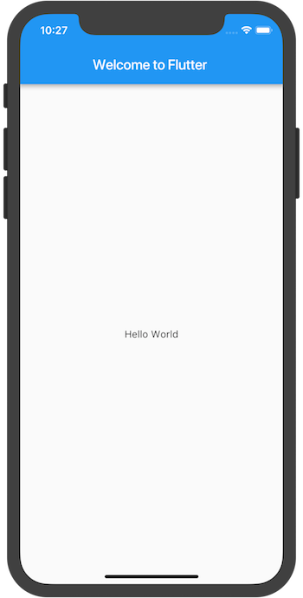
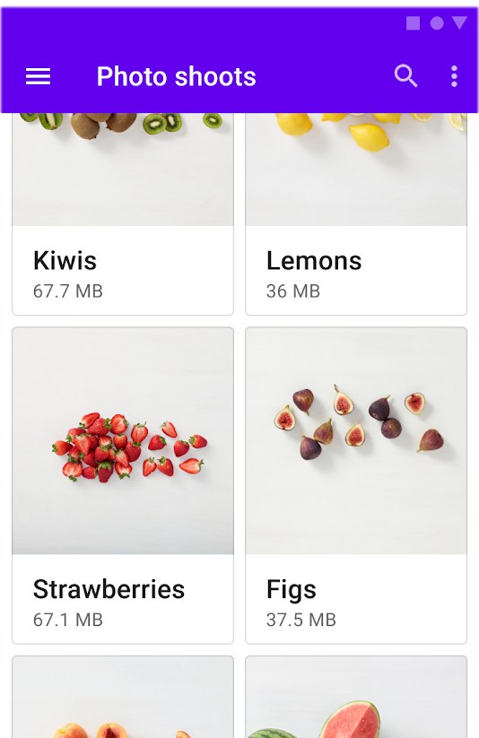
Example

Slide 5
Stateless Lifecycle
Constructor
Build

Slide 6

Build Context

Slide 7
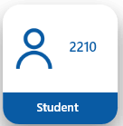
Example Code

Slide 8
break

Slide 9
Stateful weight

Slide 10
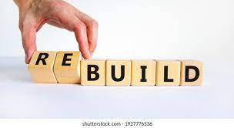
Abstract

Slide 11
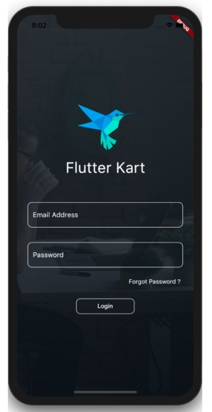
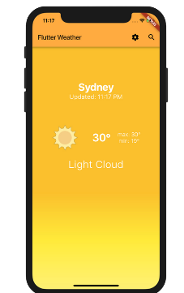
Examples

Slide 12
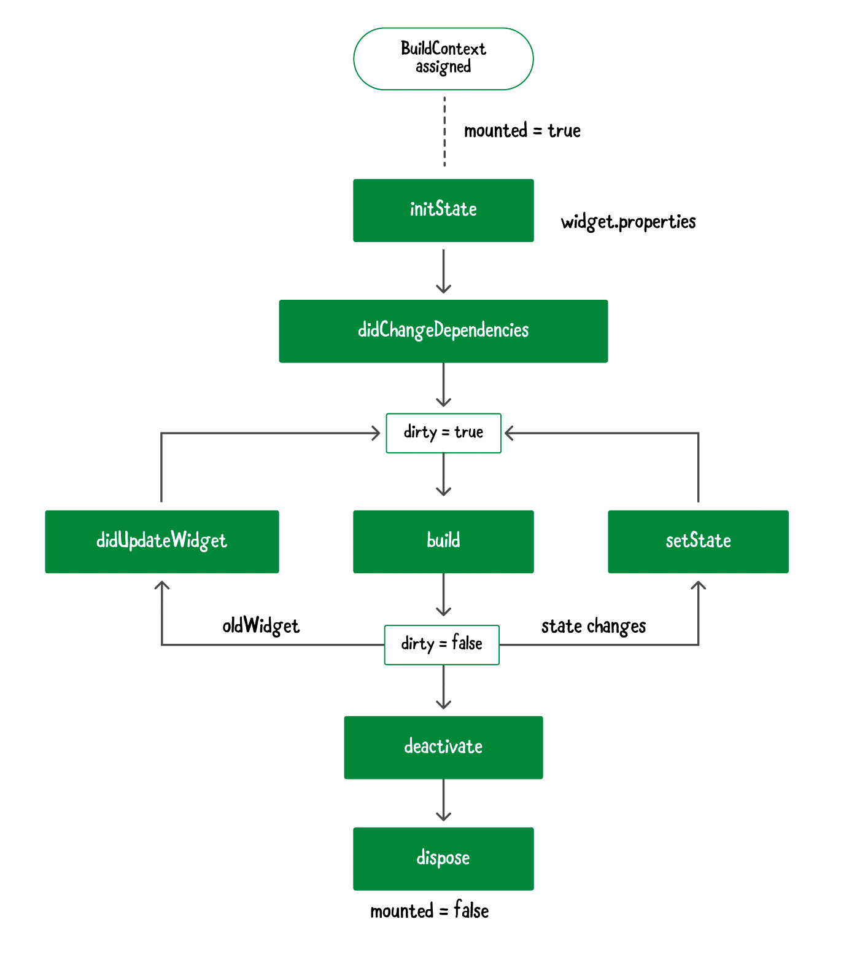
Stateful Lifecycle

Slide 13
Stateful Lifecycle

Slide 14
Example Code

