Slide 1
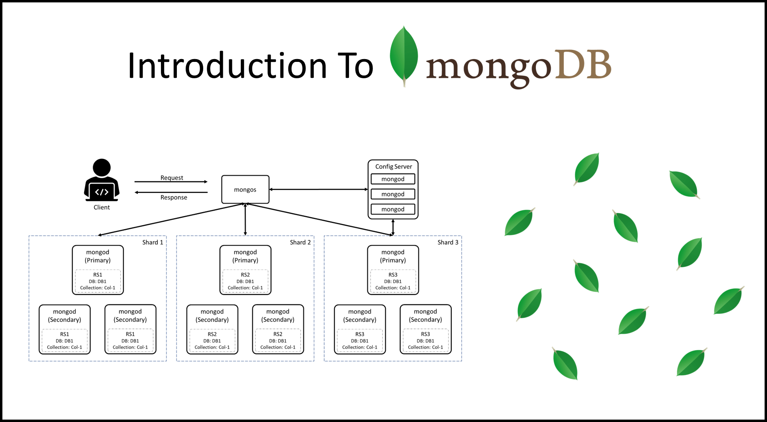
:
Title: Comparing MongoDB and SQL
Introduction to NoSQL and SQL databases:
SQL databases use structured query language (SQL) and have a predefined schema. NoSQL databases have dynamic schemas for unstructured data.
SQL databases are vertically scalable, while NoSQL databases are horizontally scalable.
SQL normalizes data as schemas and tables, and every table has a fixed structure. Instead of using tables and rows as in relational databases, as a NoSQL database, the MongoDB architecture is made up of collections and documents. Documents are made up of Key-value pairs -- MongoDB's basic unit of data.

Slide 2
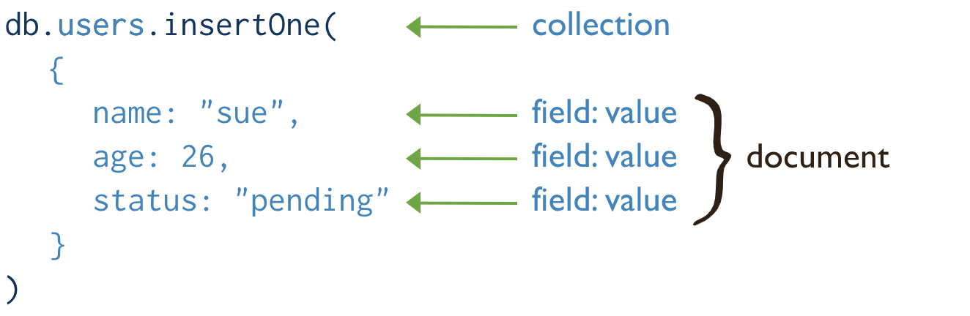
Title: MongoDB
NoSQL data base:
NoSQL databases use a variety of data models for accessing and managing data. These types of databases are optimized specifically for applications that require flexible data models, large data volume, and low latency, which are achieved by relaxing some of the data consistency restrictions of relational databases.
Stores data in flexible, JSON-like documents:
MongoDB is a type of database that stores data in a flexible way using documents that are like JSON files. This means that the structure of the data doesn't have to be decided beforehand, making it easy to adjust as needed

Slide 3
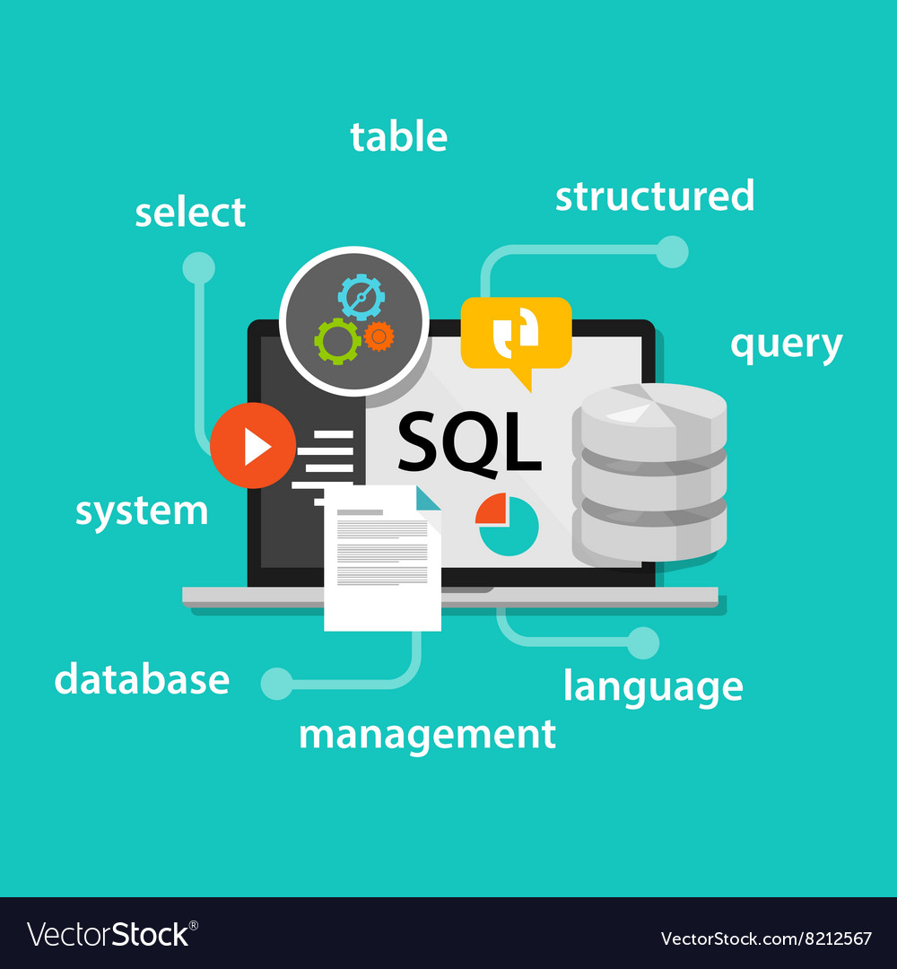
Title: SQL
Relational database management system (RDBMS):
A relational database management system (RDBMS) is a collection of programs and capabilities that enable IT teams and others to create, update, administer and otherwise interact with a relational database. RDBMSes store data in the form of tables, with most commercial relational database management systems using Structured Query Language (SQL) to access the database. However, since SQL was invented after the initial development of the relational model, it is not necessary for RDBMS use.
Structured Query Language:
Structured query language (SQL) is a programming language for storing and processing information in a relational database. A relational database stores information in tabular form, with rows and columns representing different data attributes and the various relationships between the data values.
Stores data in tables with predefined schemas:
Relational databases use structured tables with predefined schemas to store data, while non-relational databases are more flexible, often using unstructured or semi-structured data models for scalability and diverse data types.

Slide 4
Title: Schema Flexibility
A multi-tenant database system for Software as a Service (SaaS) should offer schemas that are flexible in that they can be extended different versions of the application and dynamically modified while the system is on-line. This paper presents an experimental comparison of five techniques for implementing flexible schemas for SaaS. In three of these techniques, the database "owns" the schema in that its structure is explicitly defined in DDL. Included here is the commonly-used mapping where each tenant is given their own private tables, which we take as the baseline, and a mapping that employs Sparse Columns in Microsoft SQL Server
MongoDB:
Schema Evolution refers to the ability to modify the schema of a database or data storage system without disrupting existing data or applications. It allows for the seamless addition, modification, or removal of fields, tables, or data structures within the schema.
SQL:
Structured query language (SQL) is a standard language for database creation and manipulation. MySQL is a relational database program that uses SQL queries. While SQL commands are defined by international standards, the MySQL software undergoes continual upgrades and improvements.

Slide 5
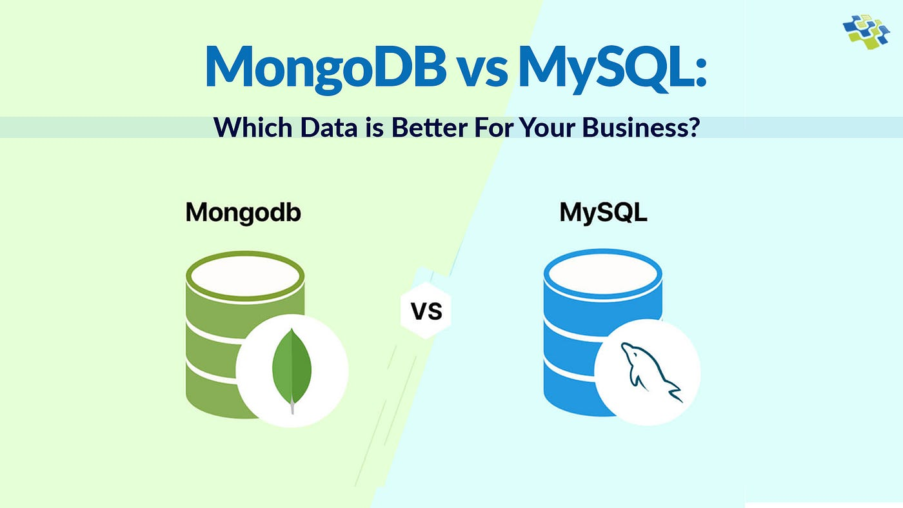
Title: Conclusion
Summary of key differences between MongoDB and SQL
MongoDB is a cross-platform, free, and open-source document-oriented database application. It is a NoSQL database tool that employs JSON-like documents with schemas. SQL (Structured Query Language) is a domain-specific language developed for managing data stored in a :Relational Database Management System (RDBMS)
Summary of key differences between
In comparison to the SQL server, MongoDB is faster and more scalable. While the SQL server supports JOIN and Global transactions, MongoDB does not. The MS SQL server does not accommodate large amounts of data, however MongoDB doesn MongoDB and SQL

