Slide 1
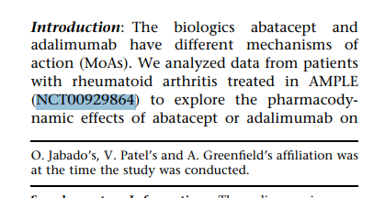
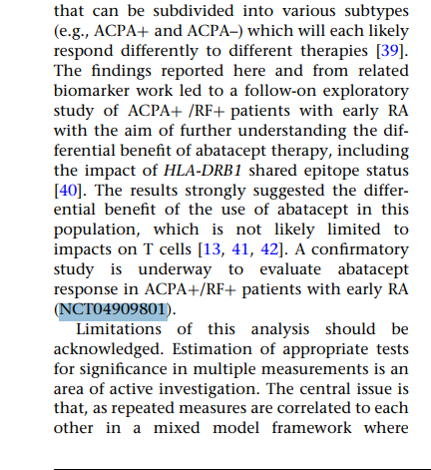
The clinical trial mentioned in the given Excel file
The clinical trial extracted by the function using Regex
Question: Why was the clinical trial NCT04909801 not included in the original excel file ? How do we prioritize one clinical trial over the other ?
The two trial numbers present in the paper

Slide 2
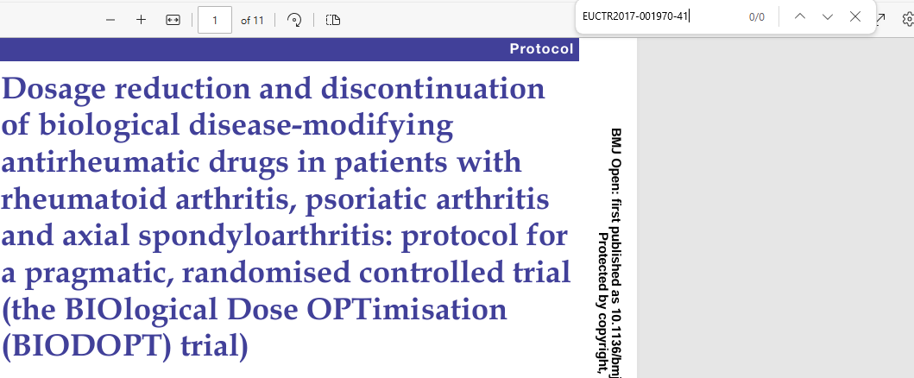
Some records in the original excel file has records for clinical trial number, when the trial number does not exist in the original research paper
PDF research paper for the id 9741586
Question 1. How was the clinical trial extracted when there is no clinical trial in the PDF file 2. Was EUCTR added manually in this case? Is there any logic behind adding prefixes or suffixes?

