Slide 1
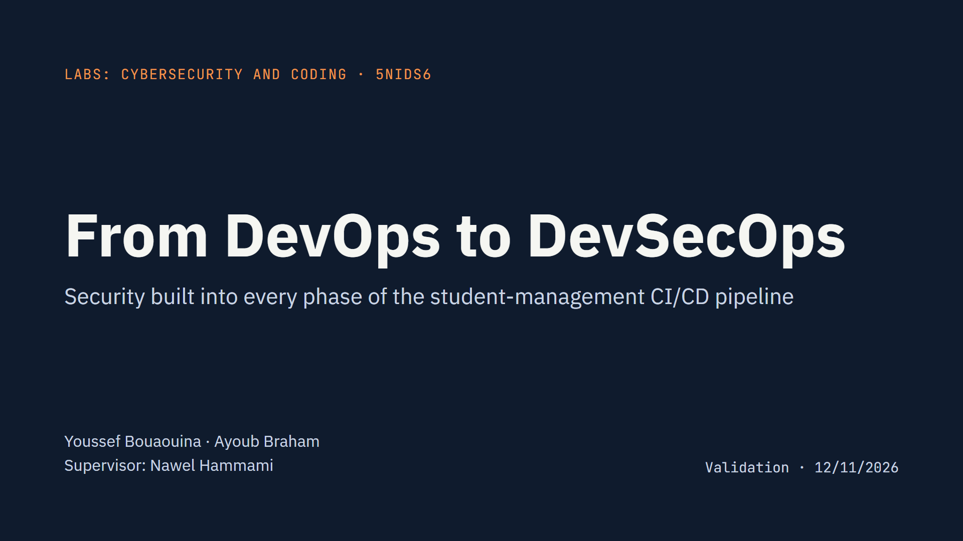
Notes:
Introduce the team and the goal: we took the CI/CD pipeline we built in 4th year (Jenkins, SonarQube, Docker, Kubernetes, Prometheus) and turned it into a DevSecOps pipeline, adding security to the four phases of the course: Development, Acceptance, Production and Operations. All three course labs run inside the pipeline.

Slide 2
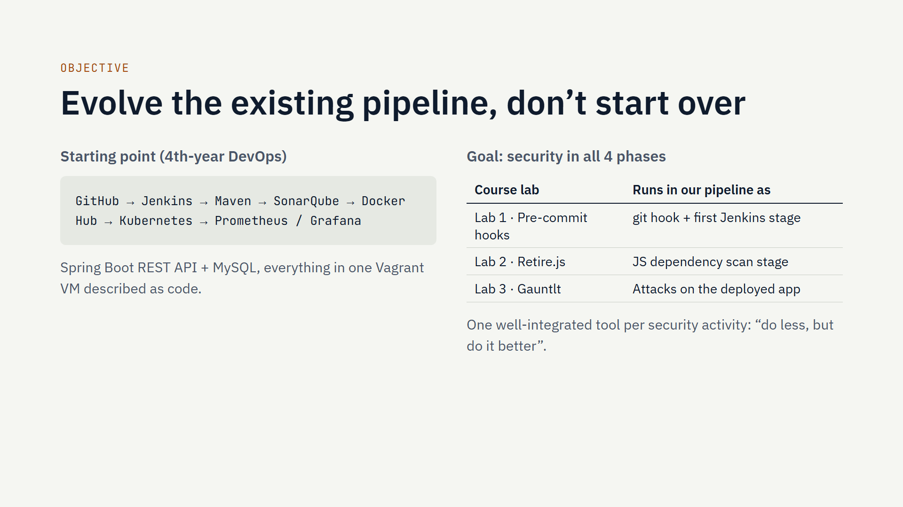
Notes:
The project is 100% of the grade. The prerequisite was a working CI/CD pipeline from 4th year, which we had. We did not rebuild it; we added security tools to it, phase by phase, following the four course phases. Every tool runs automatically on each git push, and every report is archived by Jenkins.

Slide 3
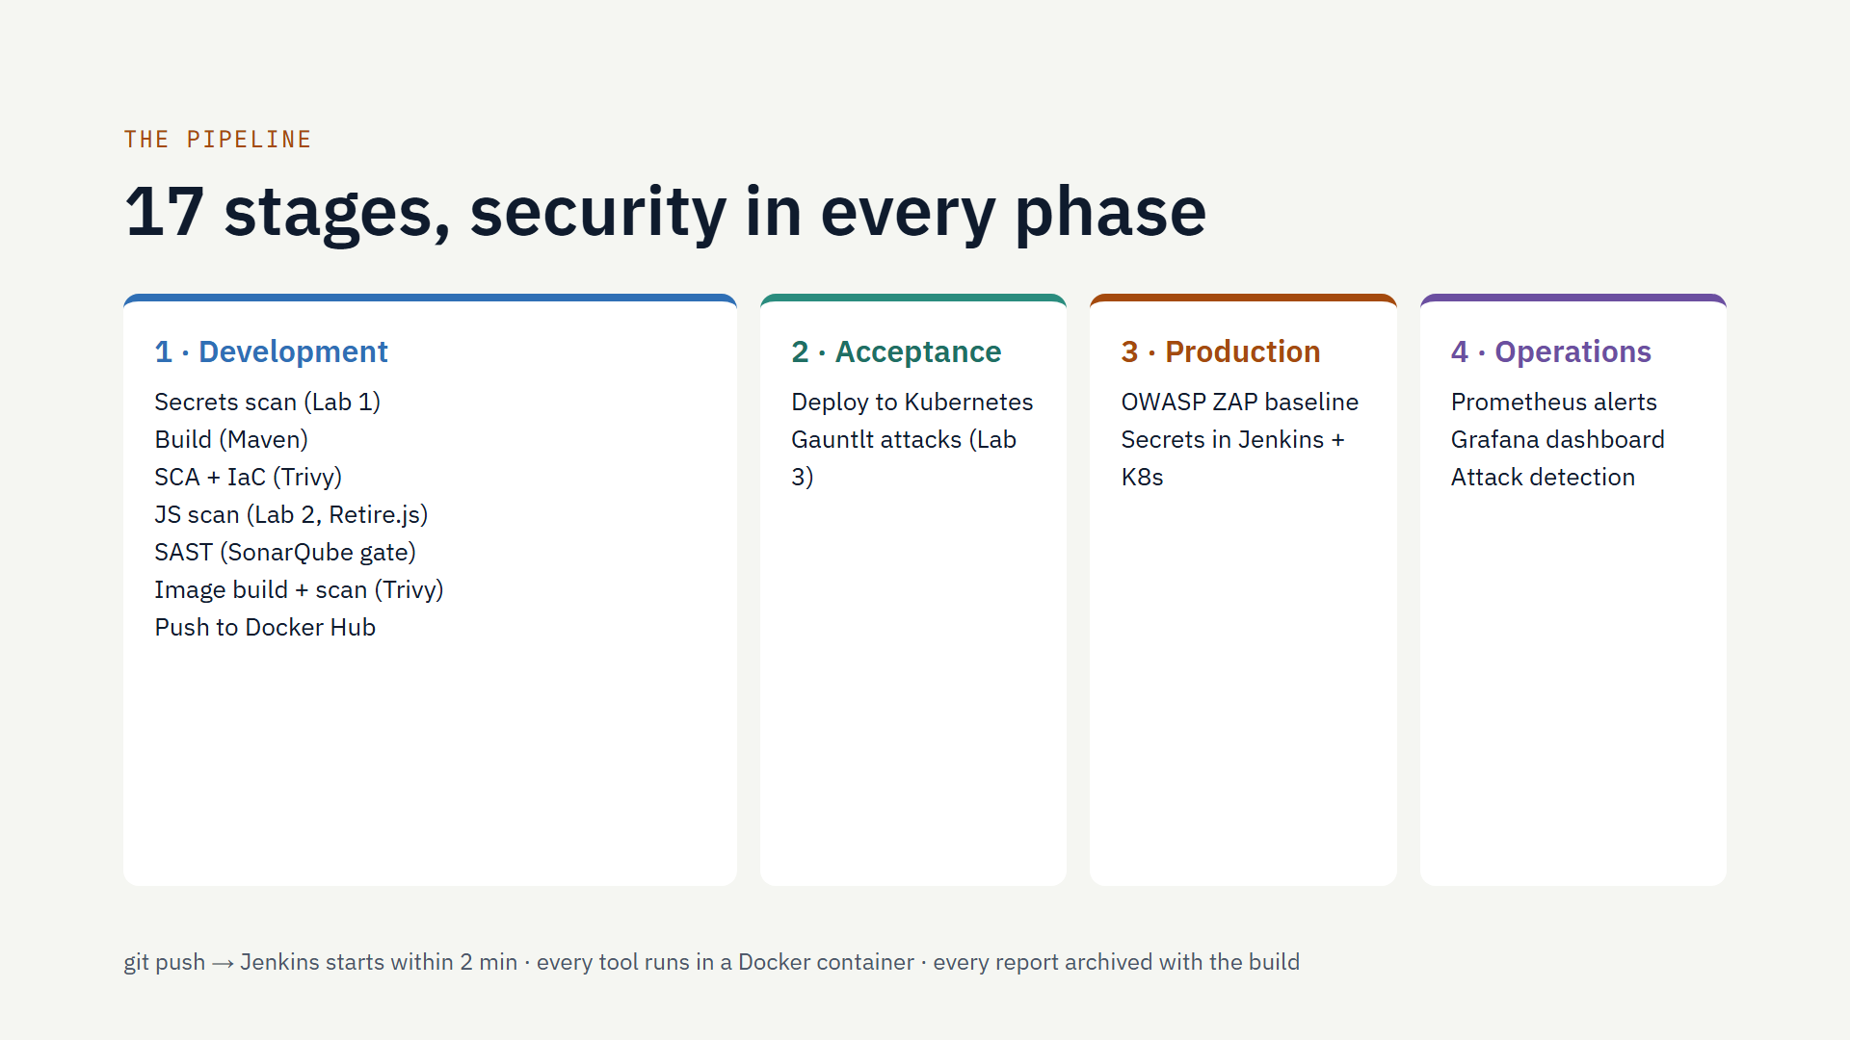
Notes:
Walk left to right. Development is the largest phase: secrets scan first, so a leaked key stops everything; then dependency, infrastructure-as-code and JavaScript scans; SonarQube now blocks the build if its quality gate fails; the image is scanned before it is pushed. After deployment, Gauntlt attacks the running app, ZAP does a security smoke test, and the last stage checks that monitoring detects an attack. No tool is installed on the Jenkins VM: each runs in a container.

Slide 4
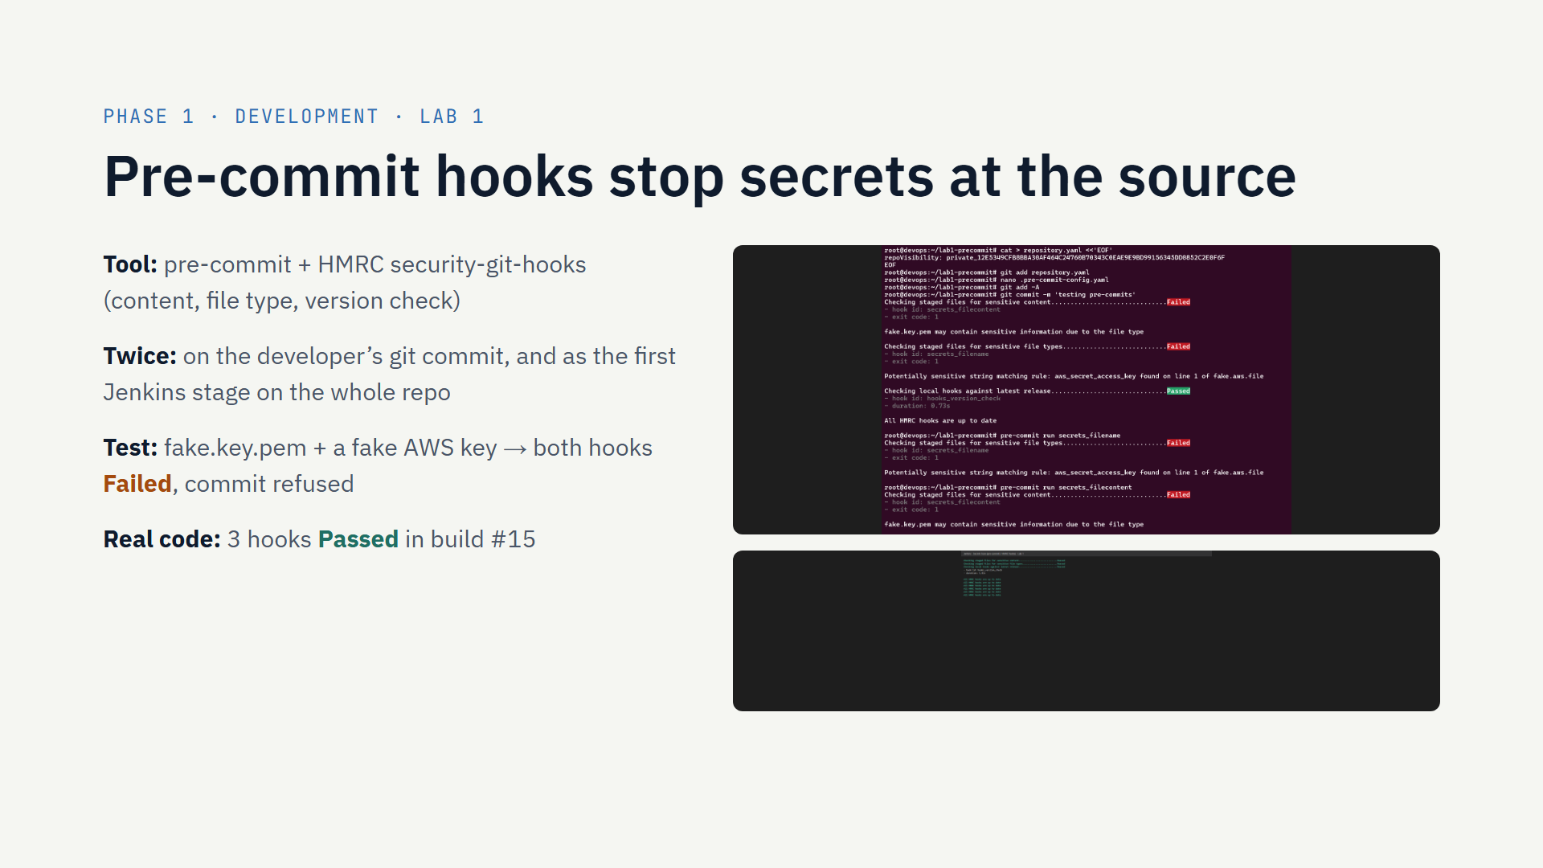
Notes:
Lab 1 asked us to install pre-commit with the HMRC hooks and prove they block a secret. We did the lab exercise, then went further: the configuration is committed in the repository, so every developer gets it with pre-commit install, and the same hooks run as the first Jenkins stage, so even a commit made without the local hook is caught. Top screenshot: the planted fake key blocks the commit. Bottom: on the real code all hooks pass.

Slide 5
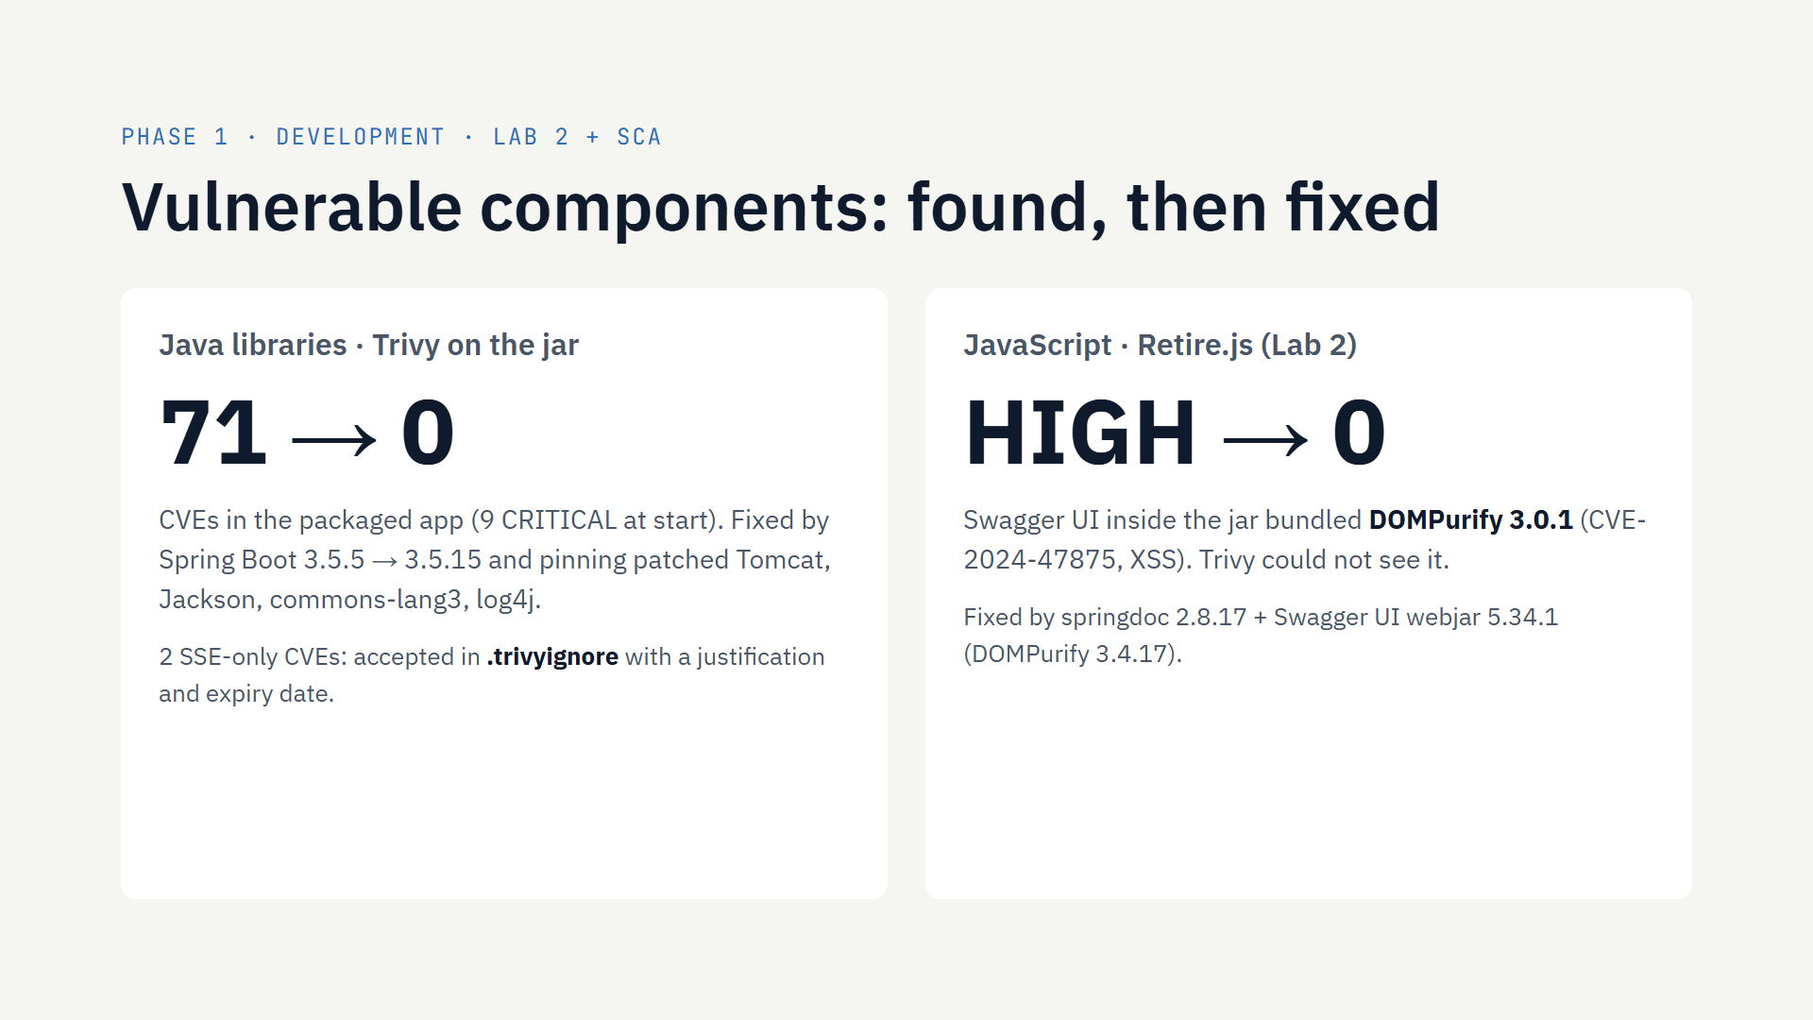
Notes:
Retire.js only reads JavaScript, and our app is Java. But the Swagger UI documentation page ships JavaScript inside a library in the jar. Our retire.sh script extracts those files and Retire.js found DOMPurify 3.0.1 with a HIGH XSS vulnerability. Trivy, which scans Java libraries, missed it: the two tools are complementary. For the Java side, Trivy found 71 CVEs including 9 critical; upgrading Spring Boot and pinning four patched libraries brought it to zero. Two CVEs about Server-Sent Events need Spring Boot 4; the app has no SSE endpoint, so we documented them as accepted risks with an expiry date.

Slide 6
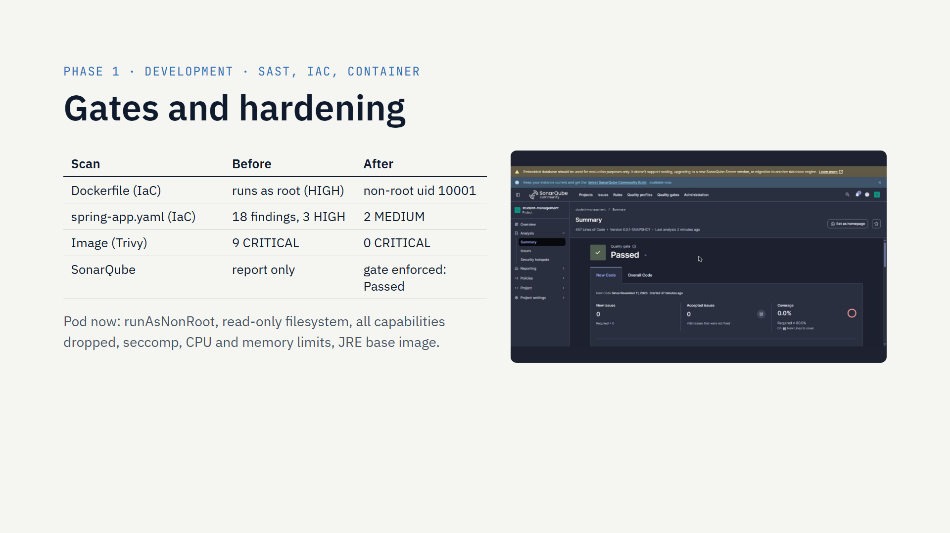
Notes:
SonarQube was already in the pipeline but only reported; now the build waits for the quality gate and stops if it fails. Trivy also checks the Dockerfile and Kubernetes manifests: the container ran as root and the pod had no security context or limits. We fixed both, and the hardened pod deploys and runs. The image is scanned before it goes to Docker Hub; no critical vulnerability is left. MySQL keeps some findings because the official image needs root at start-up; it is listed in our next steps.

Slide 7
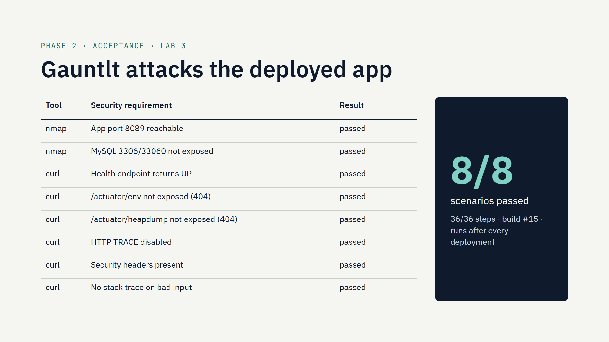
Notes:
Lab 3: Gauntlt turns security requirements into executable BDD scenarios. We wrote two attack files for our own app: nmap checks network exposure, the app port must be open and MySQL must not be reachable from outside; curl checks the HTTP side: sensitive actuator endpoints hidden, TRACE disabled, security headers present, no stack trace leaks. They run in Jenkins against the deployed application after every deployment. Gauntlt is old, so we built our own image on Ruby 3.1.

Slide 8
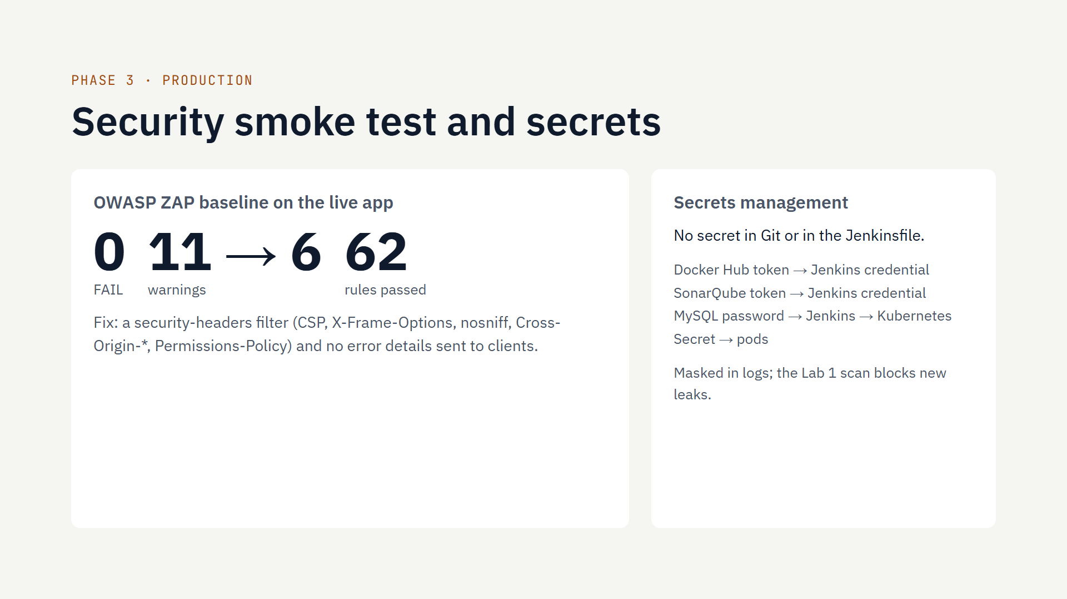
Notes:
Production phase: after each release, OWASP ZAP runs a baseline scan of the running application, the "security smoke test" from the course. The first run had 11 warnings, mostly missing security headers and error details. We added a servlet filter that sets the headers and turned off error details; now there are 6 warnings, none failing, and the remaining ones are explained in the report. Secrets: none in the code; Jenkins stores them and the MySQL password reaches the pods as a Kubernetes Secret.

Slide 9
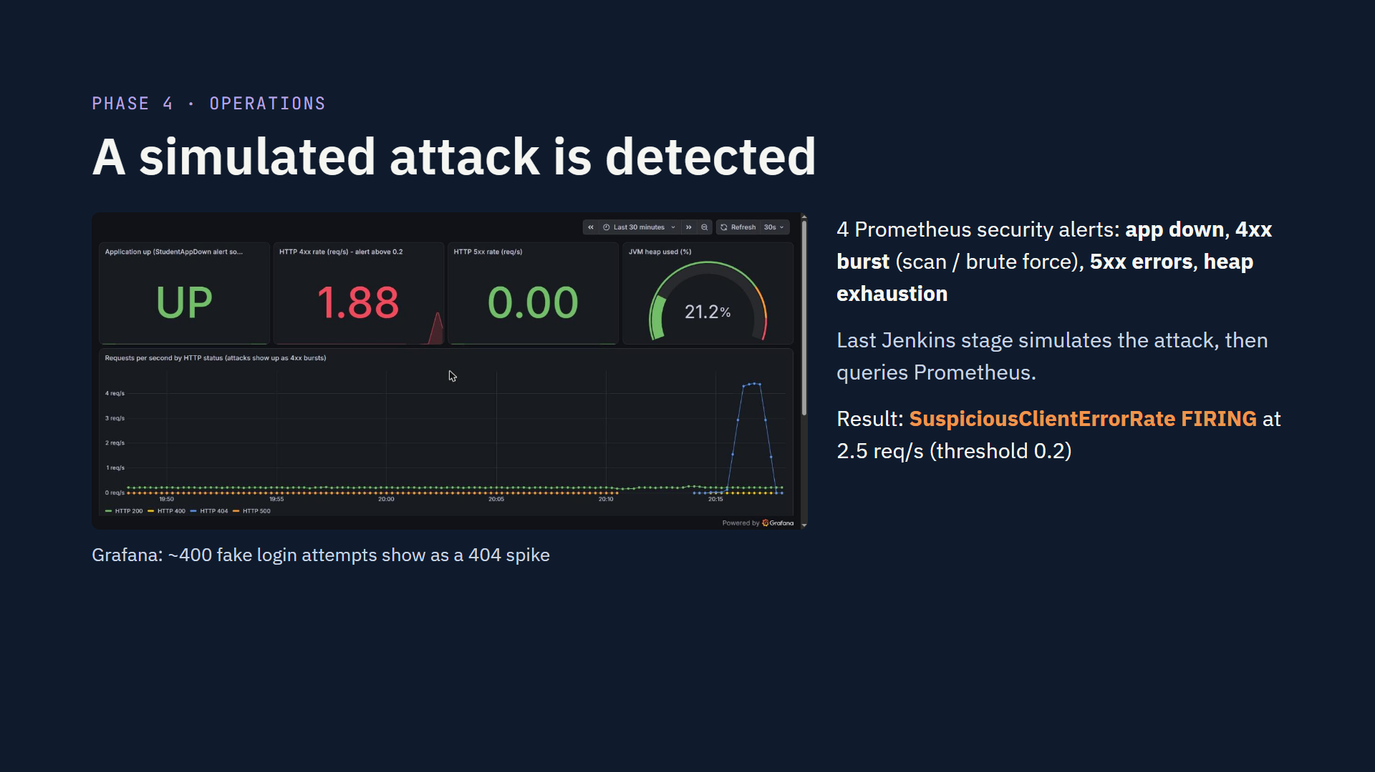
Notes:
Operations means shifting security right: watching the running application. Prometheus already scraped the app; we added four security alert rules and a Grafana dashboard stored in the repository. To prove it works, the last pipeline stage sends about 400 requests to a fake admin login page, the pattern of a scanner or brute force, then checks Prometheus: the SuspiciousClientErrorRate alert fired. The screenshot shows the spike on the dashboard.

Slide 10
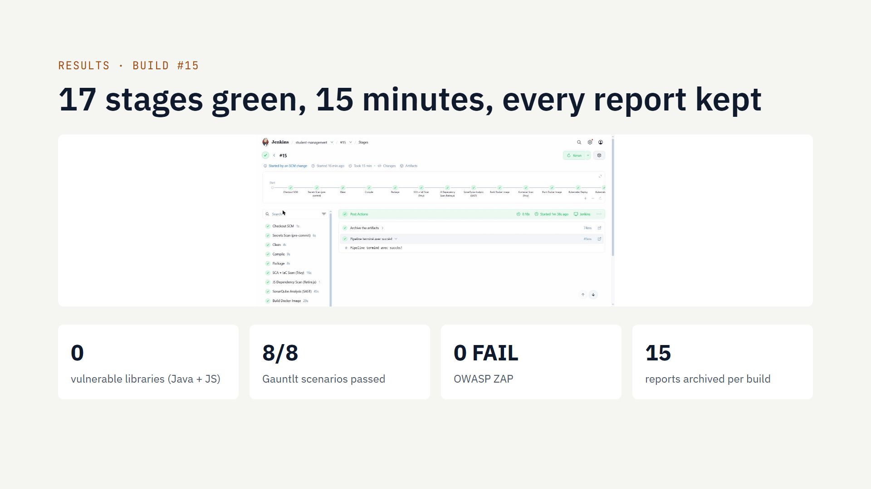
Notes:
Build 15 is the reference run: started by a git push, all 17 stages green in 15 minutes. Each build archives 15 report files: secrets scan, Trivy SCA, IaC and image reports, Retire.js, Gauntlt, ZAP in three formats, and the monitoring check. A copy of this build's evidence is in docs/evidence/build-15 in the repository. If time allows, show it live: open Jenkins, the build page, and one report.

Slide 11
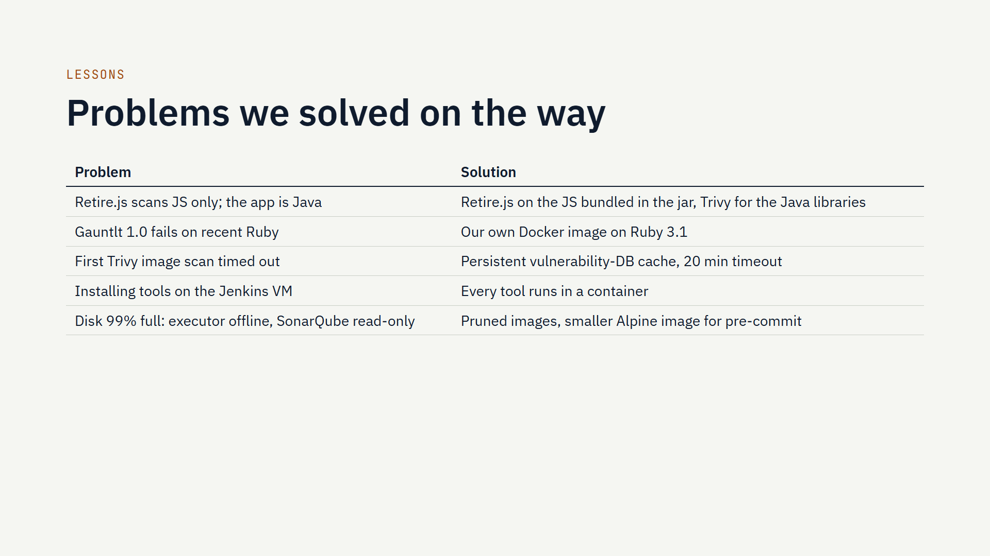
Notes:
Be honest about what went wrong; it shows understanding. The most interesting one: Retire.js and Trivy each see a different part of the dependency tree, so we needed both. The disk issue taught us that security tooling has a cost: images like ZAP are several gigabytes, and SonarQube's Elasticsearch locks itself read-only above 95% disk use.

Slide 12
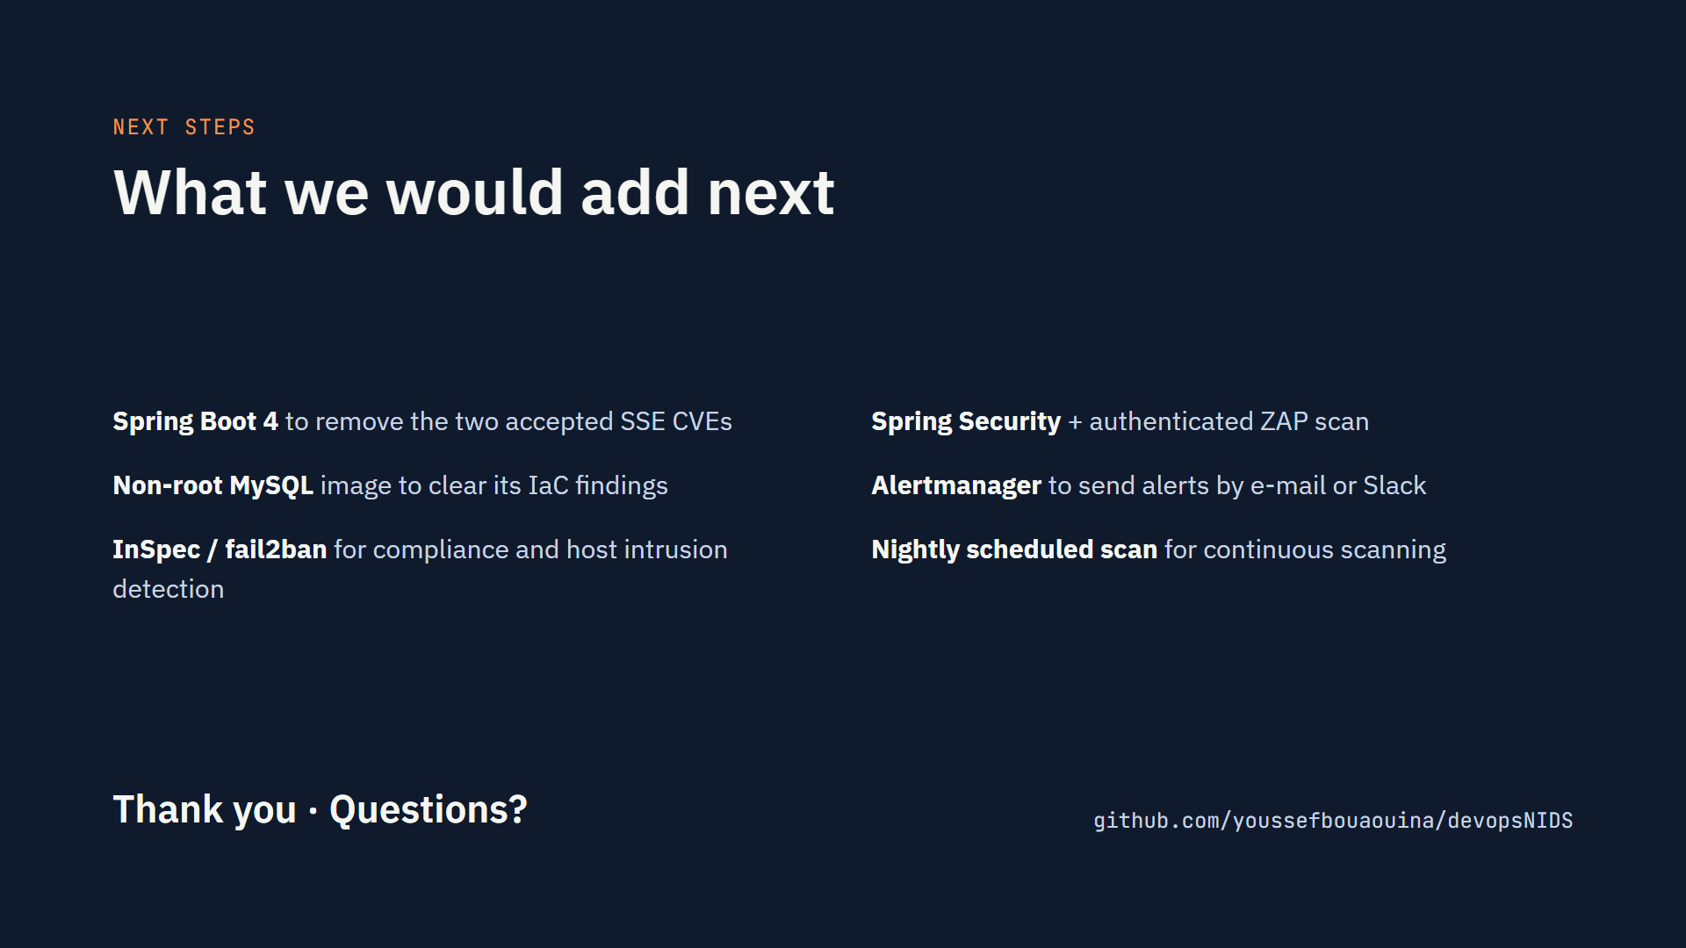
Notes:
Close with the limits: they show we know what is missing. Then offer a live demo if there is time: a git push starts the pipeline; show the Jenkins stage view, one report, the Prometheus alert and the Grafana dashboard. Repository branch: devsecops/lab1-pre-commit.

