Slide 1
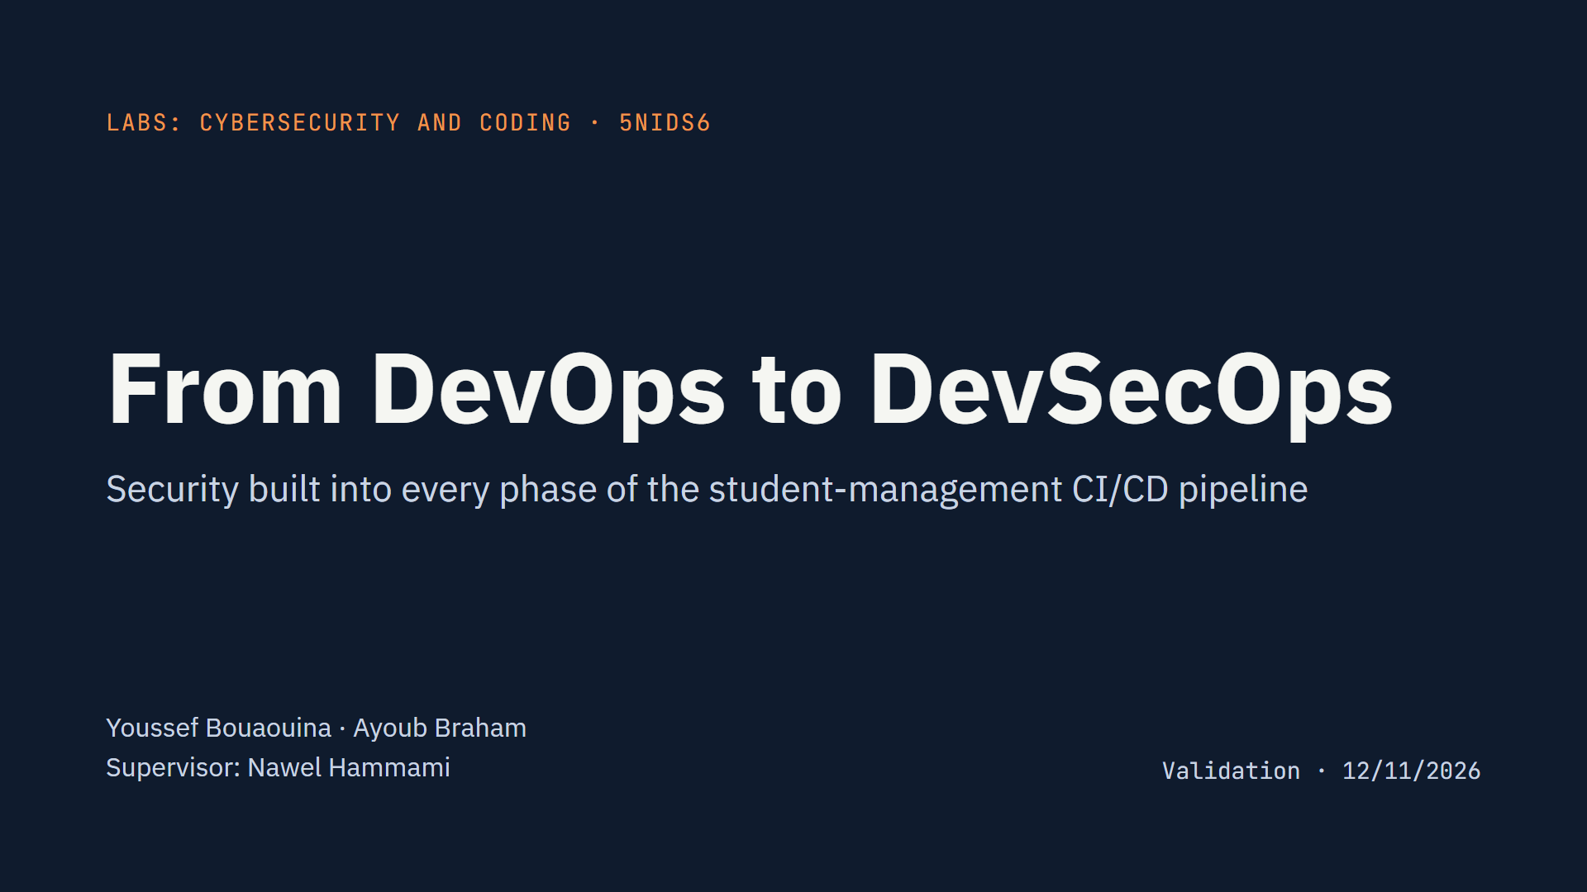
Notes:
Introduce the team and the goal: we took the CI/CD pipeline we built in 4th year (Jenkins, SonarQube, Docker, Kubernetes, Prometheus) and turned it into a DevSecOps pipeline, adding security to the four phases of the course: Development, Acceptance, Production and Operations. All three course labs run inside the pipeline.

Slide 2
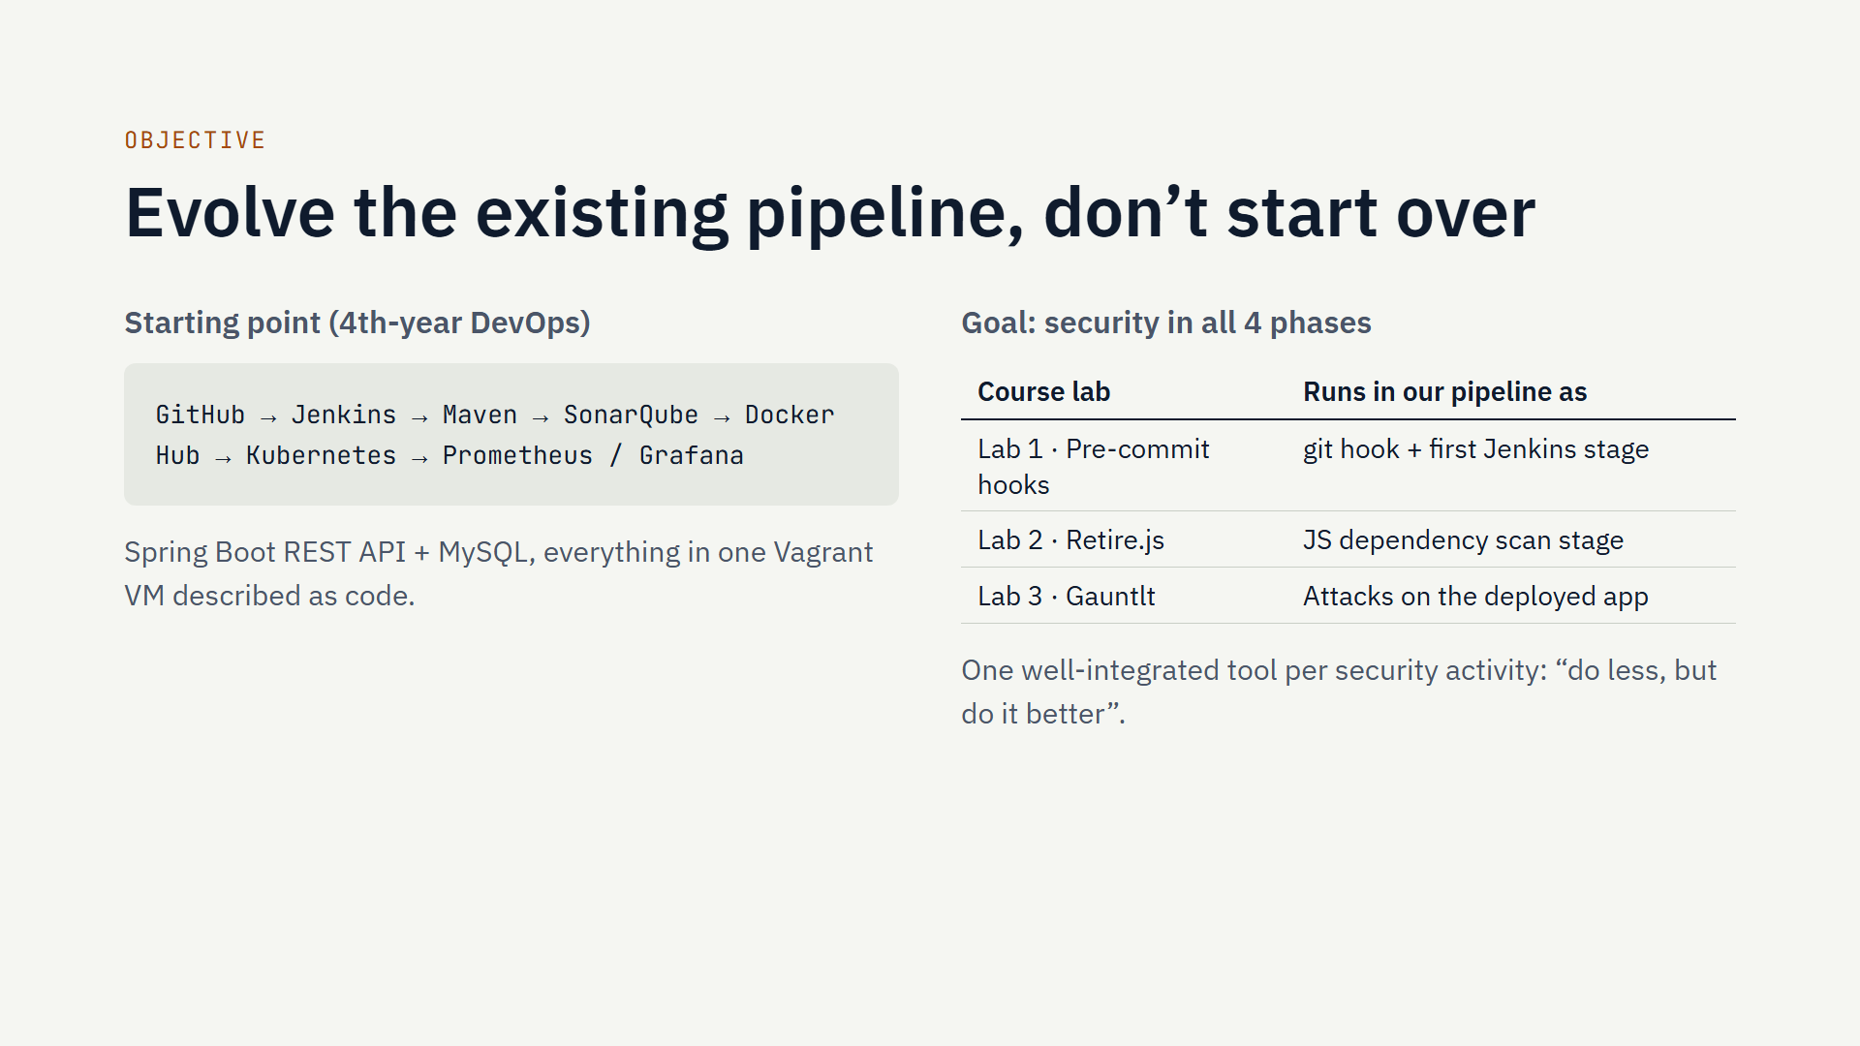
Notes:
The project is 100% of the grade. The prerequisite was a working CI/CD pipeline from 4th year, which we had. We did not rebuild it; we added security tools to it, phase by phase, following the four course phases. Every tool runs automatically on each git push, and every report is archived by Jenkins.

Slide 3
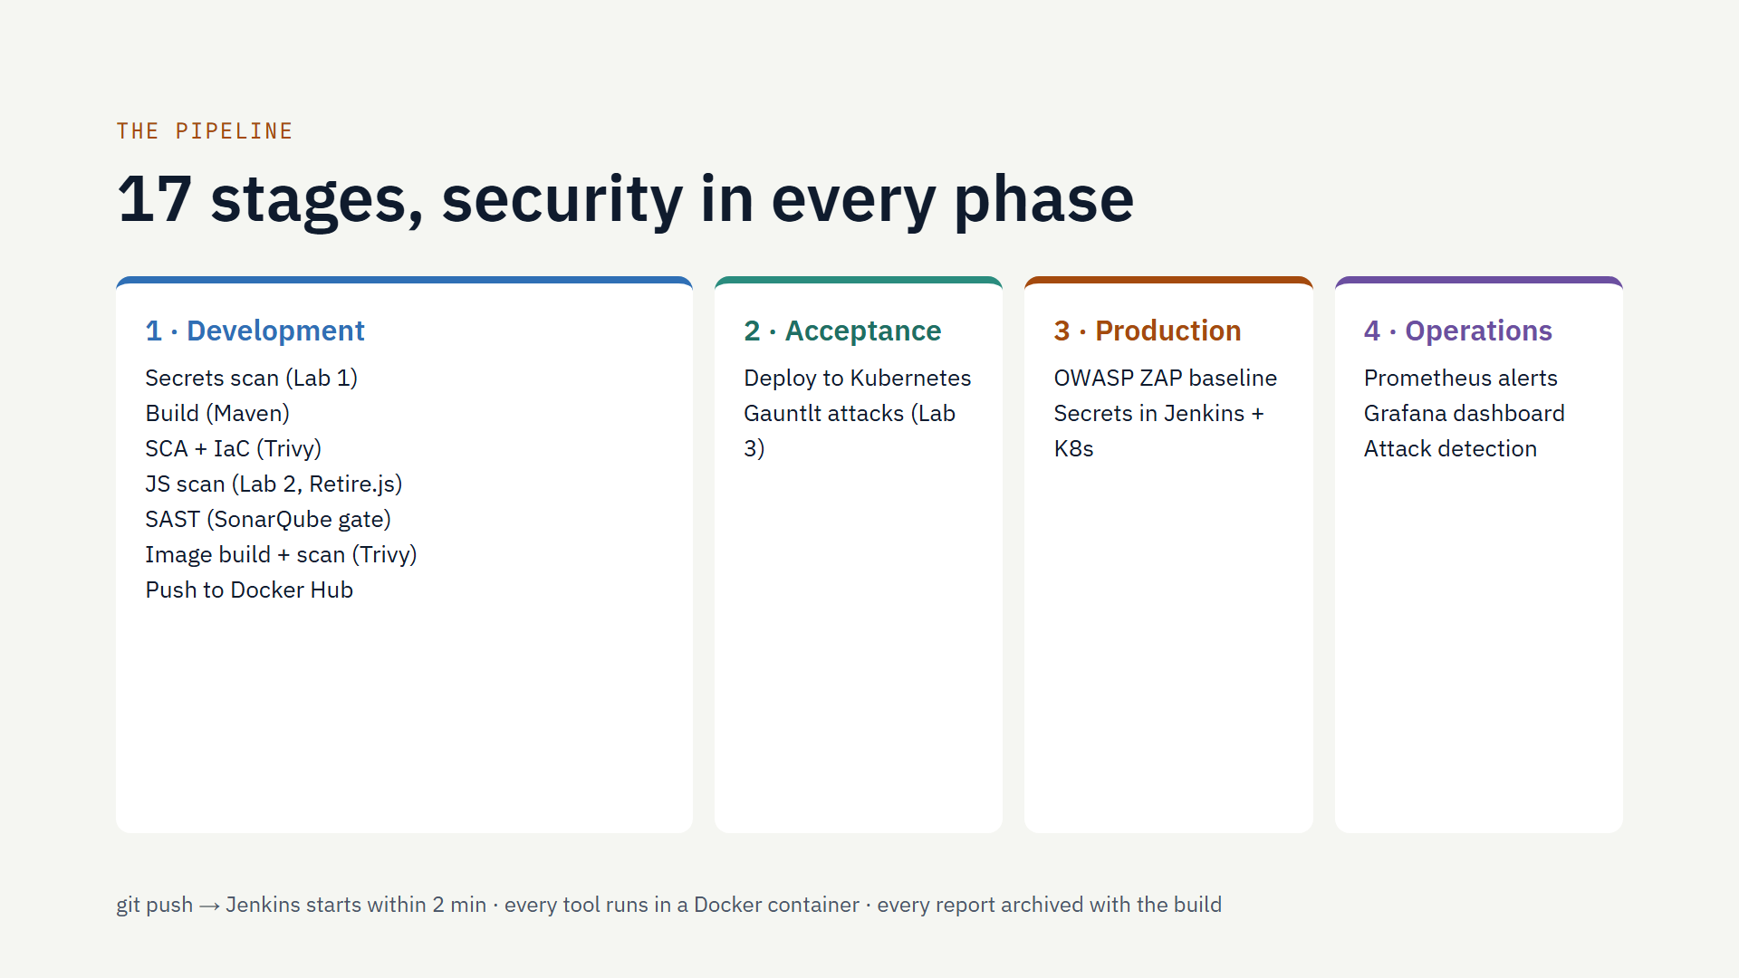
Notes:
Walk left to right. Development is the largest phase: secrets scan first, so a leaked key stops everything; then dependency, infrastructure-as-code and JavaScript scans; SonarQube now blocks the build if its quality gate fails; the image is scanned before it is pushed. After deployment, Gauntlt attacks the running app, ZAP does a security smoke test, and the last stage checks that monitoring detects an attack. No tool is installed on the Jenkins VM: each runs in a container.

Slide 4
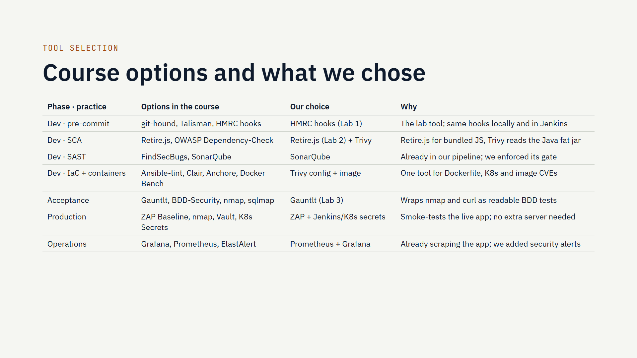
Notes:
The email asks us to select the relevant tools for each phase. Each course chapter lists several options; this table shows what we picked and why. Our rule: reuse what the pipeline already had where possible (SonarQube, Prometheus, Grafana), use the lab tools (HMRC hooks, Retire.js, Gauntlt), and prefer one tool that covers several practices (Trivy covers dependencies, infrastructure as code and container images). Everything runs in Docker containers, so nothing extra is installed on the Jenkins server.

Slide 5
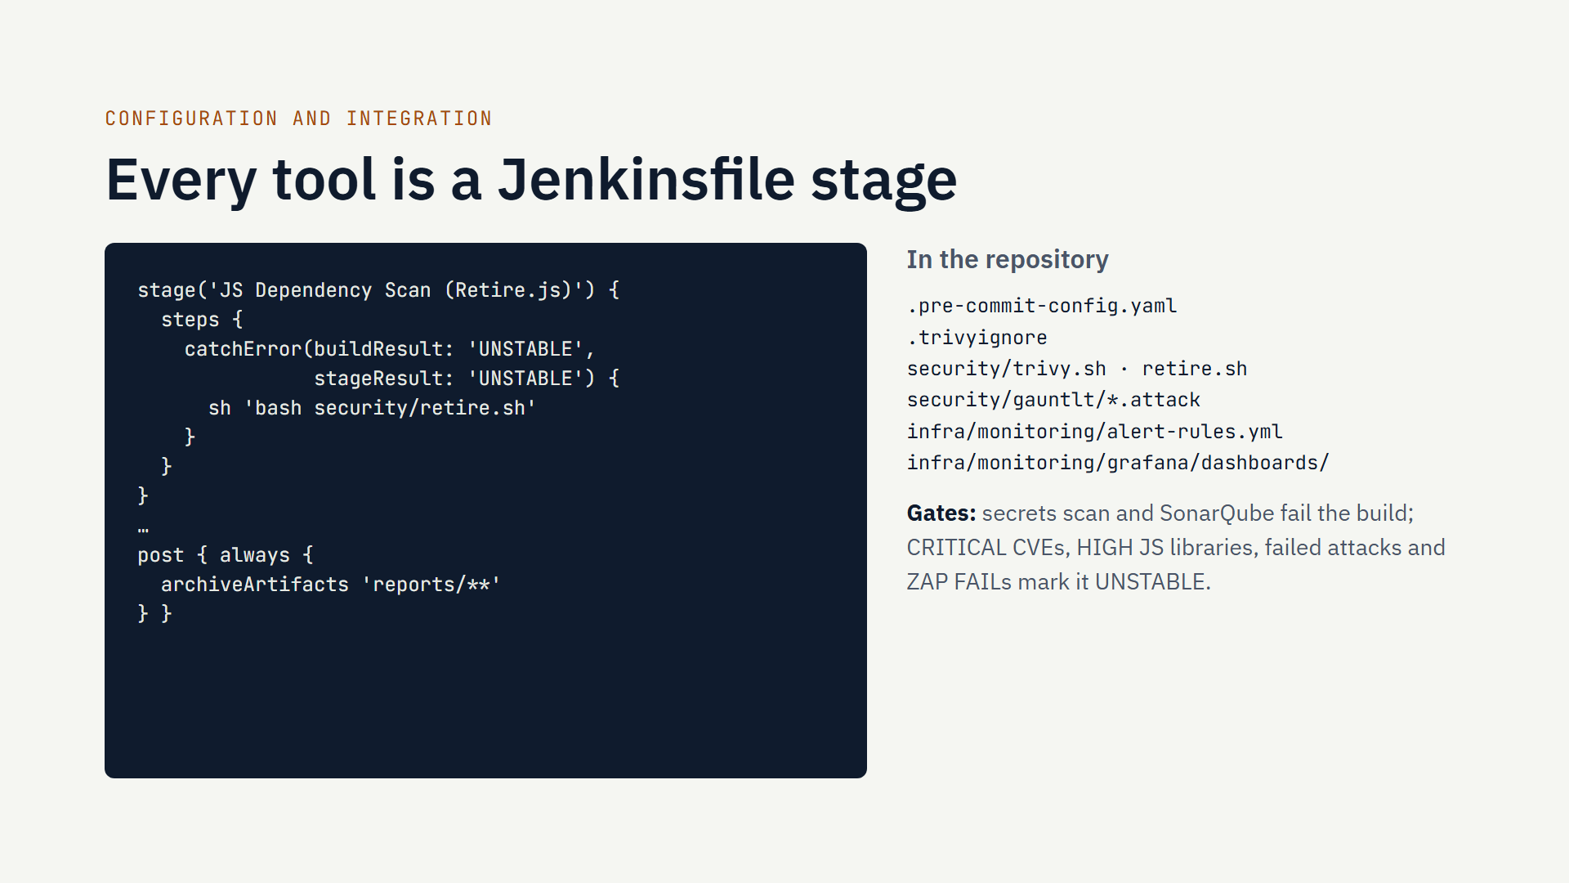
Notes:
How it is integrated: each security tool is a stage in the Jenkinsfile, and its configuration lives in the repository next to the code, so it is versioned and reviewed like code. The left example is the Retire.js stage: it calls a script, and catchError turns a finding into an UNSTABLE build instead of stopping everything. The post block archives every report. Blocking gates: the secrets scan and the SonarQube quality gate stop the pipeline; scan findings mark it unstable so the team still gets the deployment and the reports.

Slide 6
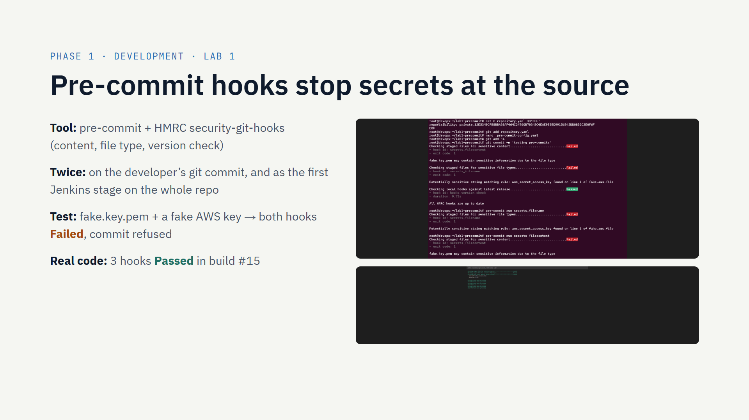
Notes:
Lab 1 asked us to install pre-commit with the HMRC hooks and prove they block a secret. We did the lab exercise, then went further: the configuration is committed in the repository, so every developer gets it with pre-commit install, and the same hooks run as the first Jenkins stage, so even a commit made without the local hook is caught. Top screenshot: the planted fake key blocks the commit. Bottom: on the real code all hooks pass.

Slide 7
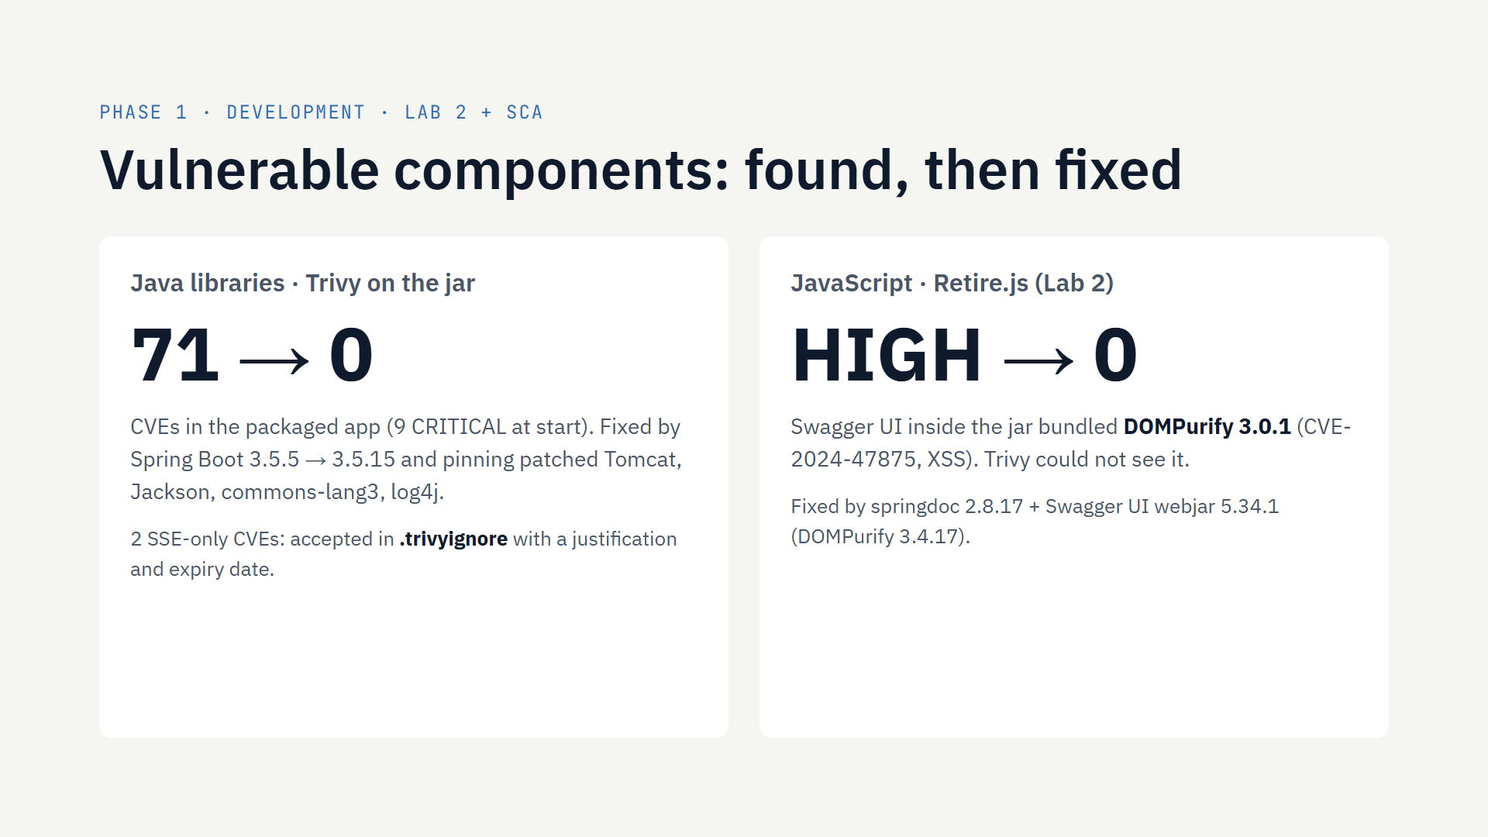
Notes:
Retire.js only reads JavaScript, and our app is Java. But the Swagger UI documentation page ships JavaScript inside a library in the jar. Our retire.sh script extracts those files and Retire.js found DOMPurify 3.0.1 with a HIGH XSS vulnerability. Trivy, which scans Java libraries, missed it: the two tools are complementary. For the Java side, Trivy found 71 CVEs including 9 critical; upgrading Spring Boot and pinning four patched libraries brought it to zero. Two CVEs about Server-Sent Events need Spring Boot 4; the app has no SSE endpoint, so we documented them as accepted risks with an expiry date.

Slide 8
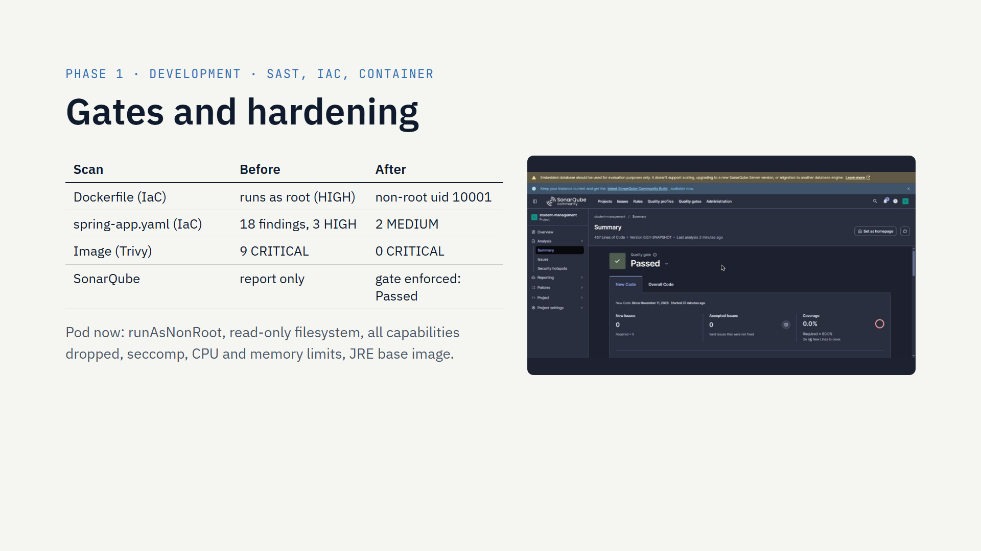
Notes:
SonarQube was already in the pipeline but only reported; now the build waits for the quality gate and stops if it fails. Trivy also checks the Dockerfile and Kubernetes manifests: the container ran as root and the pod had no security context or limits. We fixed both, and the hardened pod deploys and runs. The image is scanned before it goes to Docker Hub; no critical vulnerability is left. MySQL keeps some findings because the official image needs root at start-up; it is listed in our next steps.

Slide 9
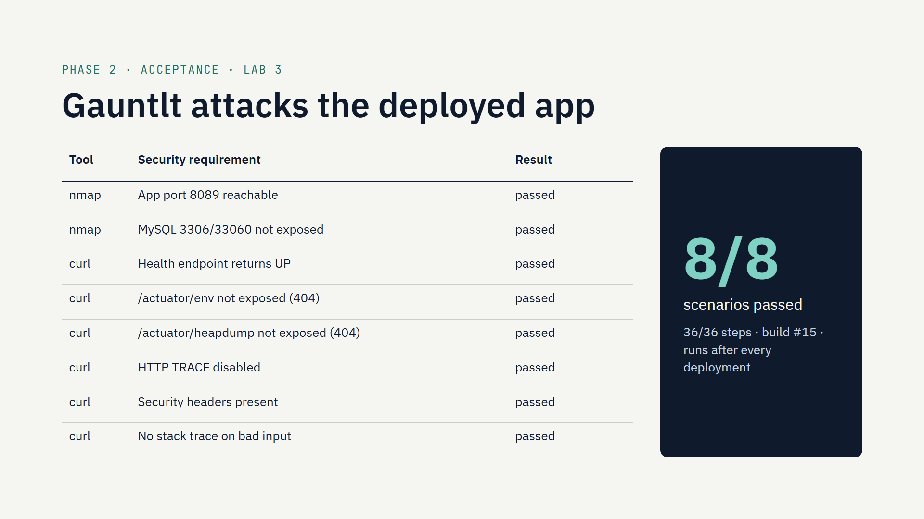
Notes:
Lab 3: Gauntlt turns security requirements into executable BDD scenarios. We wrote two attack files for our own app: nmap checks network exposure, the app port must be open and MySQL must not be reachable from outside; curl checks the HTTP side: sensitive actuator endpoints hidden, TRACE disabled, security headers present, no stack trace leaks. They run in Jenkins against the deployed application after every deployment. Gauntlt is old, so we built our own image on Ruby 3.1.

Slide 10
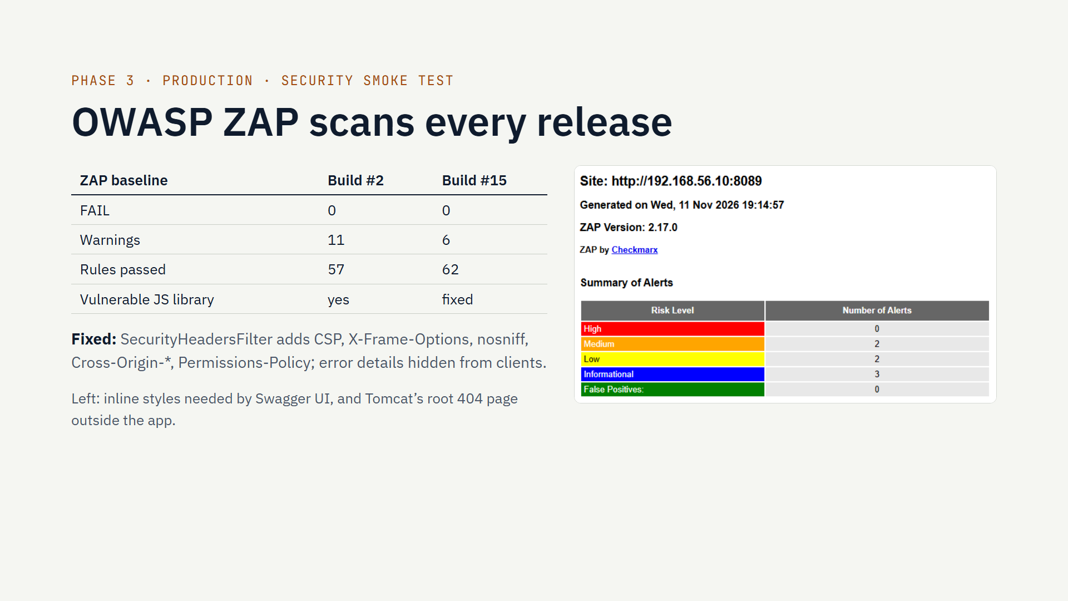
Notes:
The Production chapter recommends security smoke tests after each release, with ZAP baseline scan as the example tool. Our stage spiders the deployed application from Swagger UI for two minutes and applies ZAP's passive rules, writing HTML, JSON and Markdown reports. The first run found 11 warnings, mainly missing security headers and error details; we fixed them in the application with a servlet filter and error settings, and Gauntlt now checks those headers too. No High alert remains; the remaining mediums are explained and acceptable for a documentation page.

Slide 11
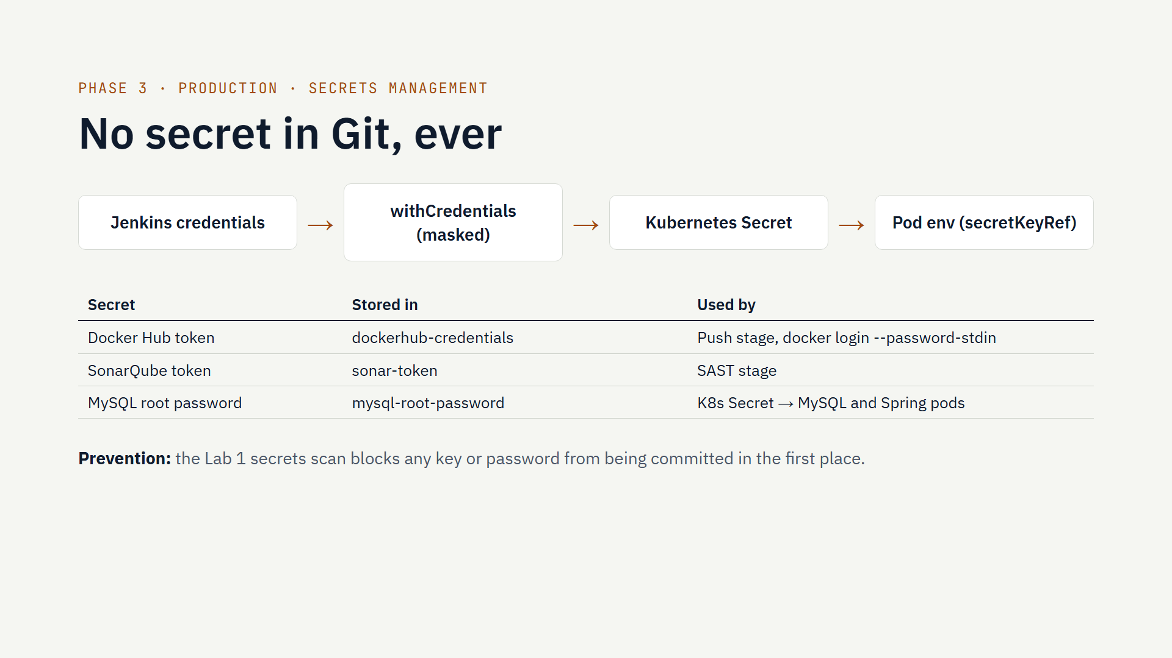
Notes:
Secrets management is the second Production practice. There is no password or token in the repository or in the Jenkinsfile. The three secrets live in Jenkins credentials; the pipeline reads them with withCredentials, so Jenkins masks them as stars in the console. The Docker Hub login reads the token from standard input, so it never appears in the process list. The MySQL password becomes a Kubernetes Secret at deploy time and reaches the pods by reference, never baked into an image. Together with the Lab 1 hooks, a secret can neither be committed nor leak through the pipeline.

Slide 12
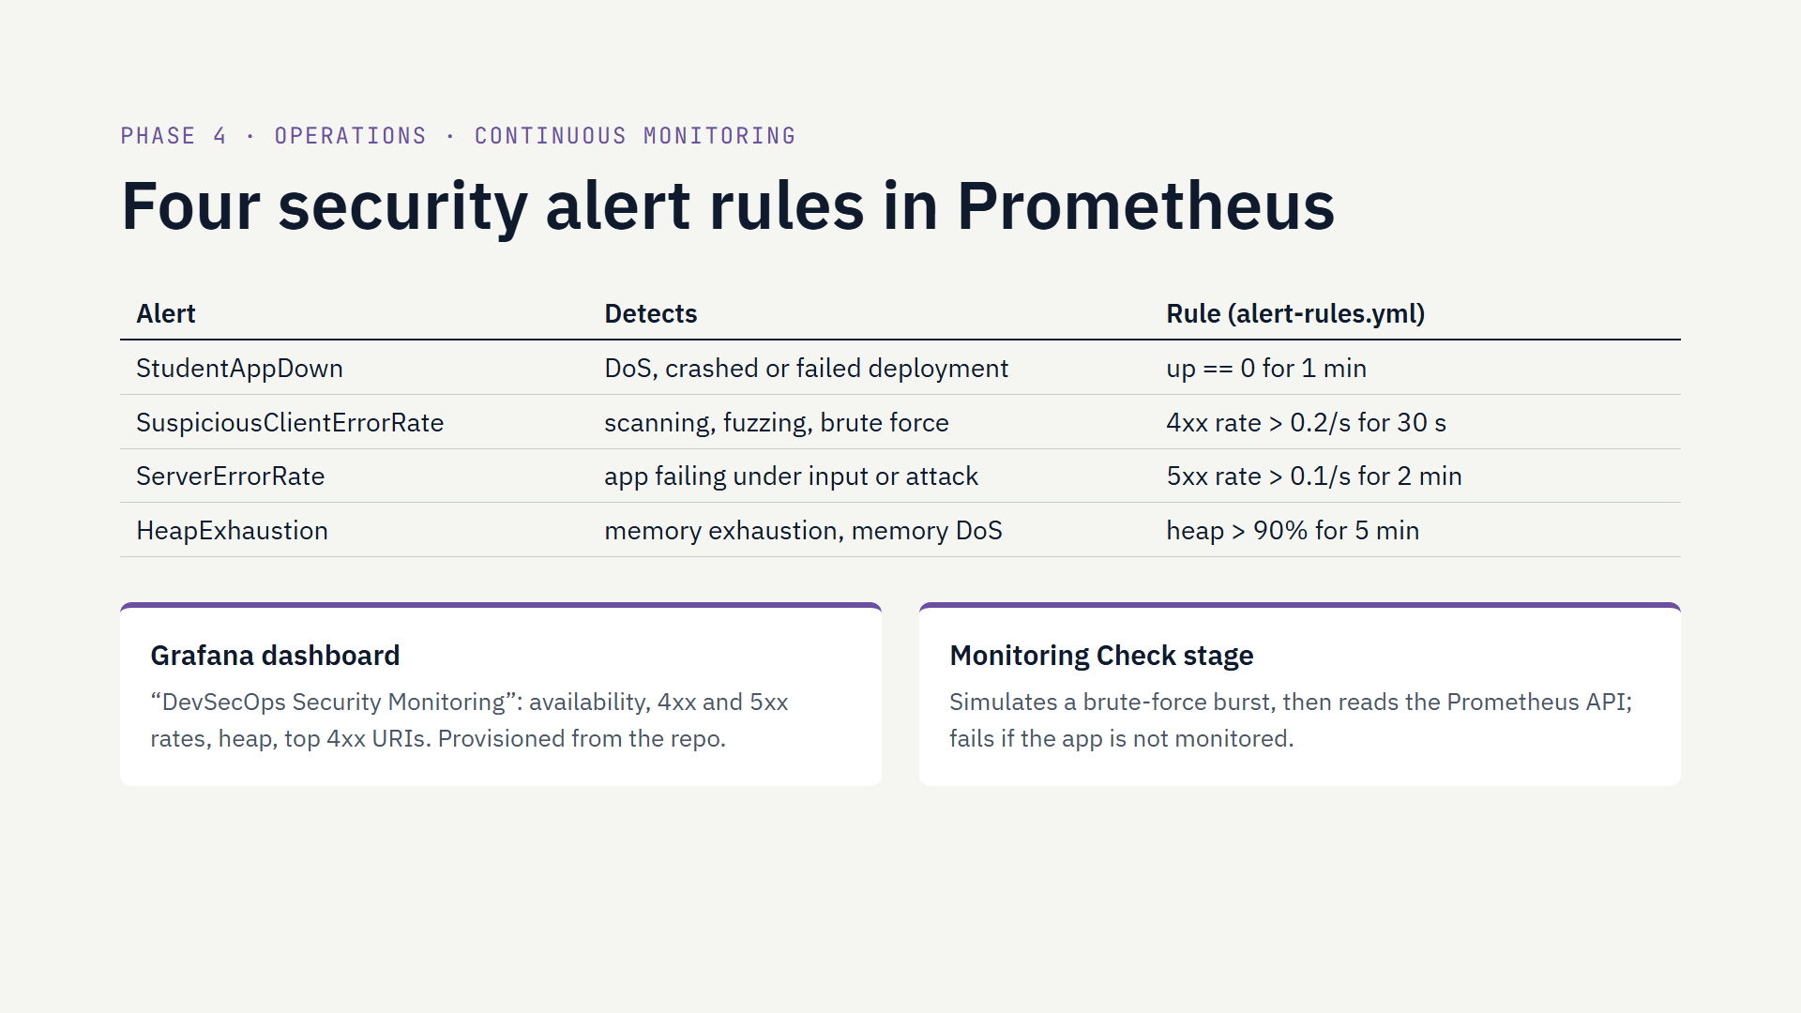
Notes:
Operations is about shifting right: security keeps working after deployment. The course lists Prometheus and Grafana for continuous monitoring. Prometheus was already scraping the application, so we wrote four security alert rules, versioned in the repository, and a Grafana dashboard that is loaded automatically. The last pipeline stage checks the whole chain: it sends a burst of requests to a fake admin login page and verifies in Prometheus that the alert fires. Next slide shows the result.

Slide 13
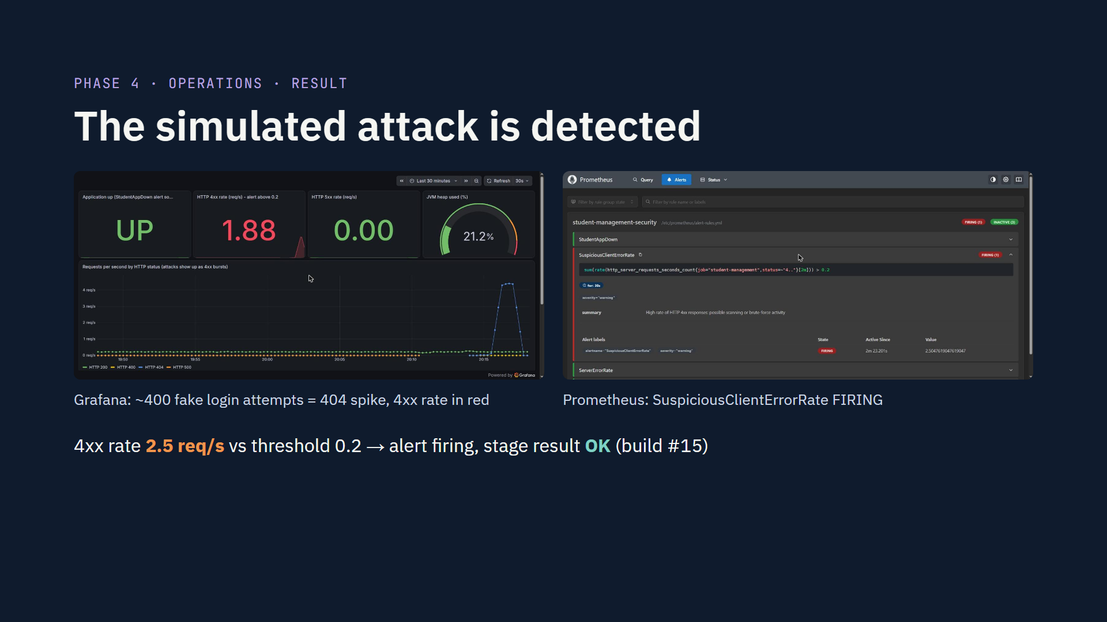
Notes:
This is the proof that monitoring works. During build 15 the last stage sent about 400 requests to a non-existent admin login page. On the left, Grafana shows the 404 spike and the 4xx rate panel turning red; on the right, Prometheus shows the SuspiciousClientErrorRate alert firing at about 2.5 requests per second, far above the 0.2 threshold. In a real team this alert would go to Alertmanager and then to e-mail or Slack; that is in our next steps.

Slide 14
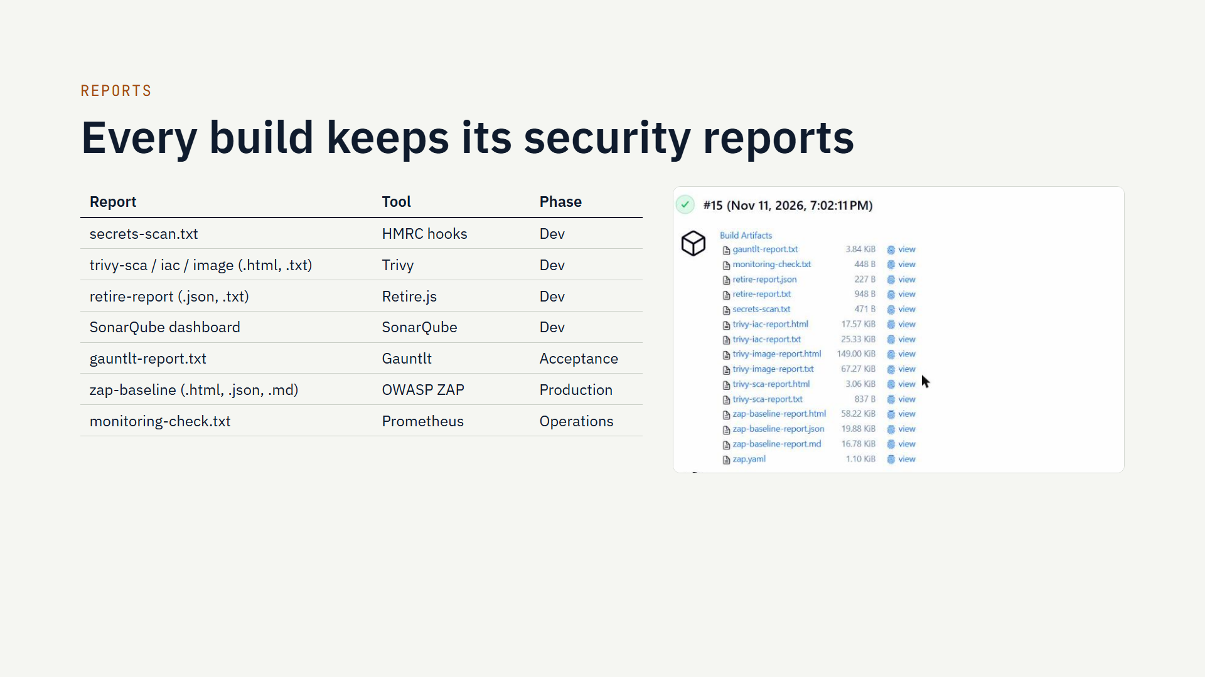
Notes:
The email asks us to generate and keep the reports of every tool. Each stage writes into a reports folder, and the post block archives it with the build: 15 files per build, downloadable from Jenkins as shown. A copy of the final build's reports and console log is in docs/evidence/build-15 in the repository, and the final report includes screenshots of each.

Slide 15
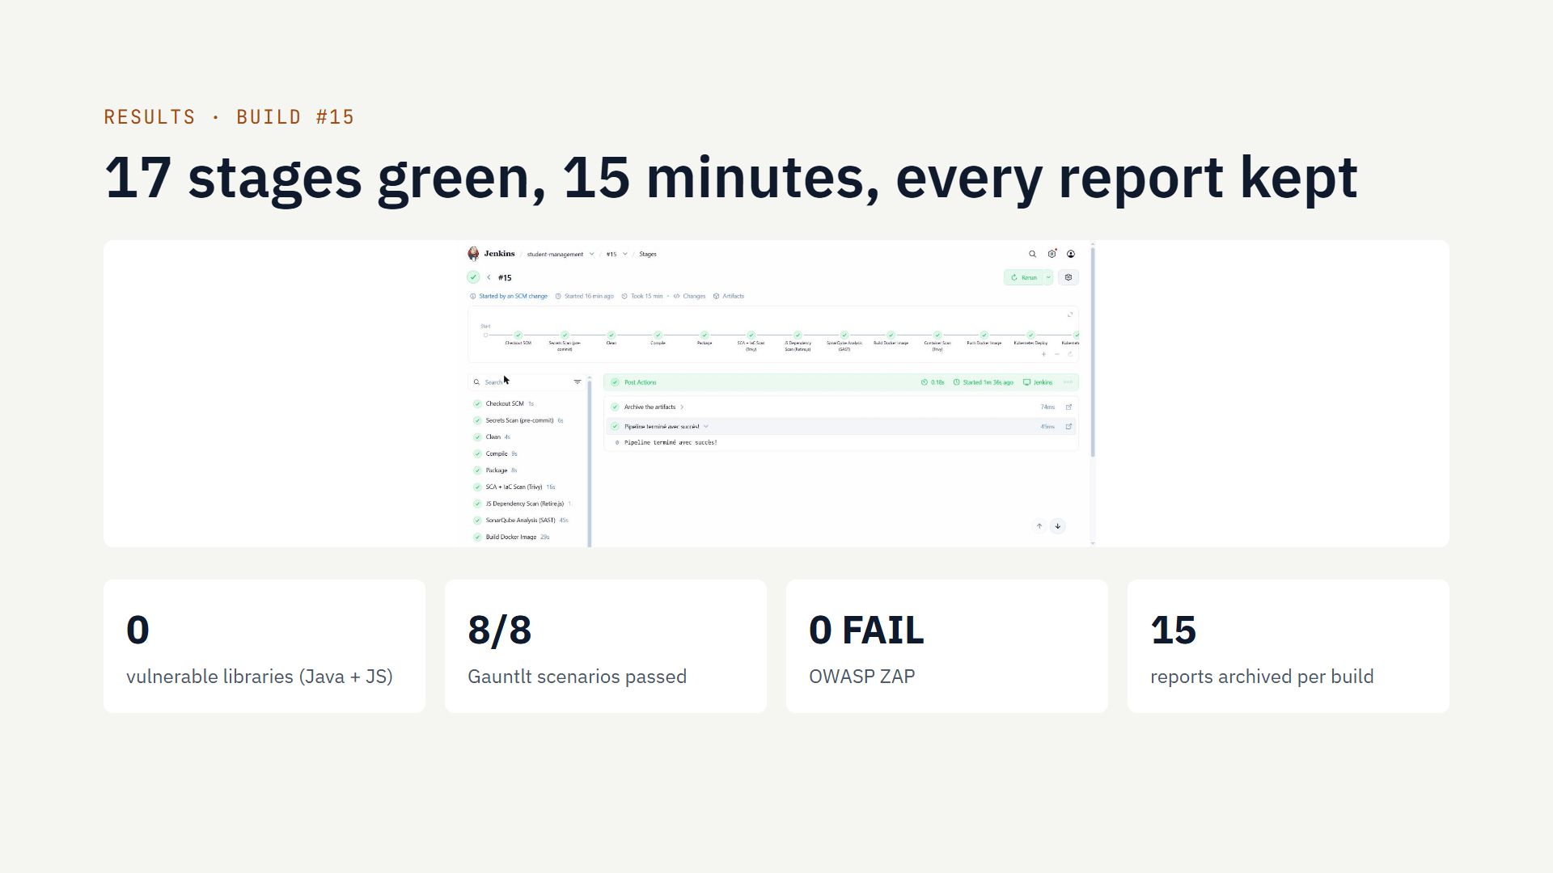
Notes:
Build 15 is the reference run: started by a git push, all 17 stages green in 15 minutes. Each build archives 15 report files: secrets scan, Trivy SCA, IaC and image reports, Retire.js, Gauntlt, ZAP in three formats, and the monitoring check. A copy of this build's evidence is in docs/evidence/build-15 in the repository. If time allows, show it live: open Jenkins, the build page, and one report.

Slide 16
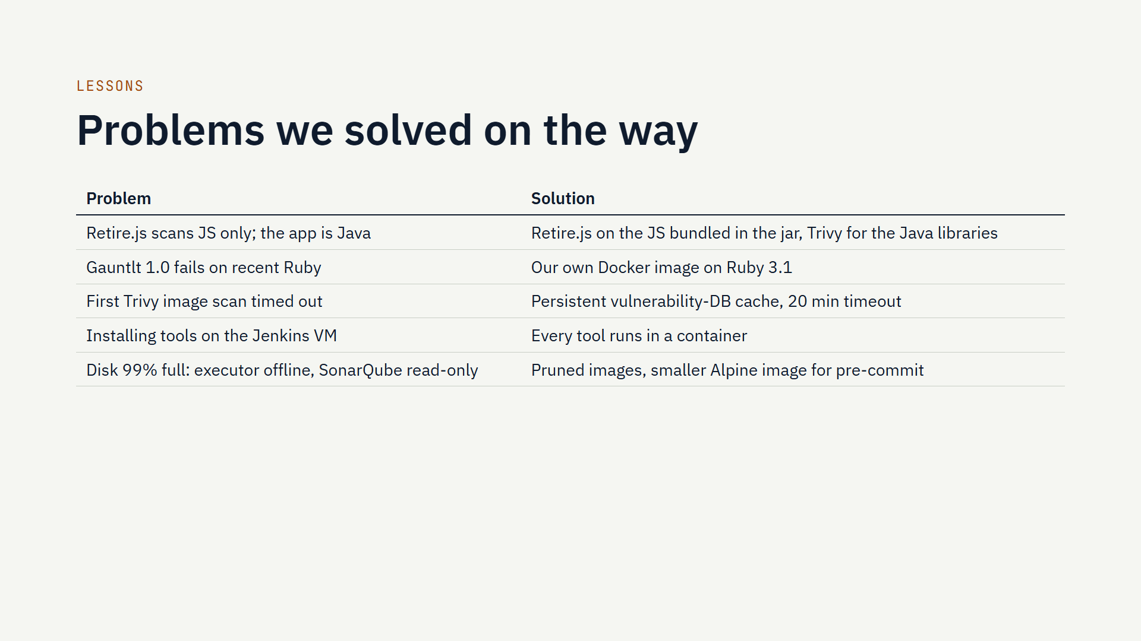
Notes:
Be honest about what went wrong; it shows understanding. The most interesting one: Retire.js and Trivy each see a different part of the dependency tree, so we needed both. The disk issue taught us that security tooling has a cost: images like ZAP are several gigabytes, and SonarQube's Elasticsearch locks itself read-only above 95% disk use.

Slide 17
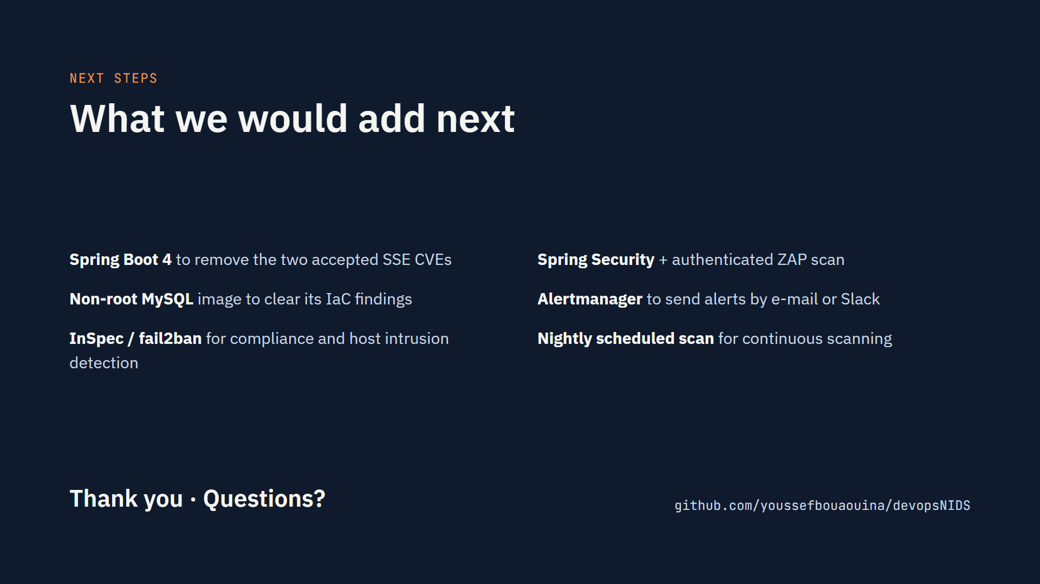
Notes:
Close with the limits: they show we know what is missing. Then offer a live demo if there is time: a git push starts the pipeline; show the Jenkins stage view, one report, the Prometheus alert and the Grafana dashboard. Repository branch: devsecops/lab1-pre-commit.

