Slide 1
Assembly Language Workshop
Club :SecuriNets ENIS 22/11/2023

Slide 2

Introduction to Computer science
What is a computer ?
an electronic device for storing and processing data, typically in binary form, according to instructions given to it in a variable program.

Slide 3
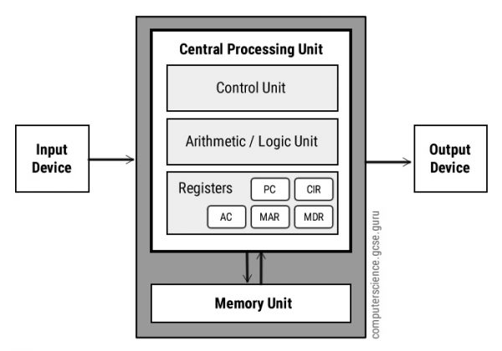
Von Neumann Architecture

Slide 4
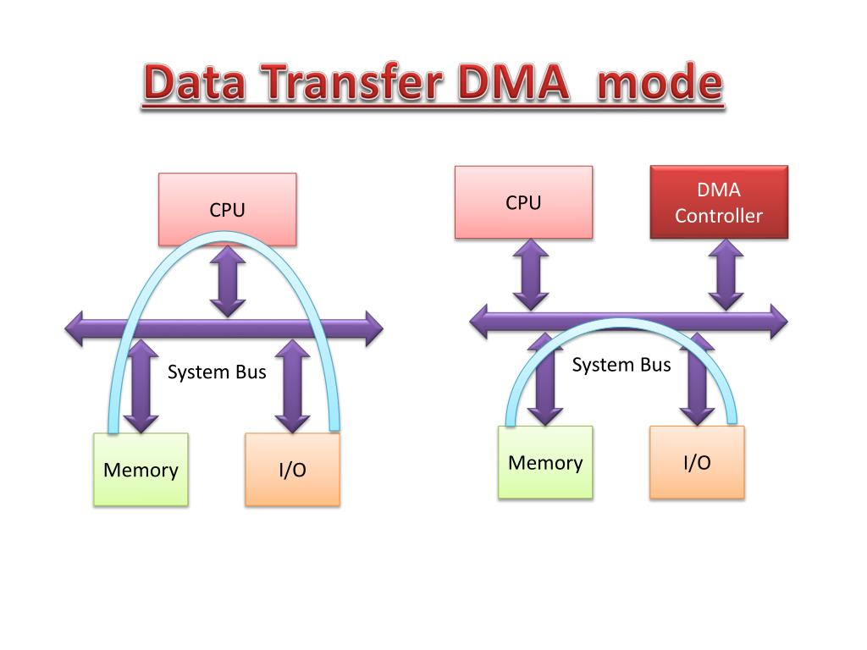
Architectural Enhancements

Slide 5
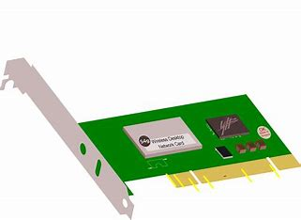
Architectural Enhancements

Slide 6
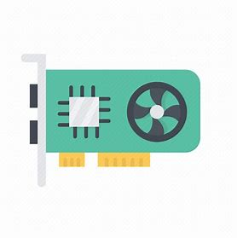
Architectural Enhancements

Slide 7
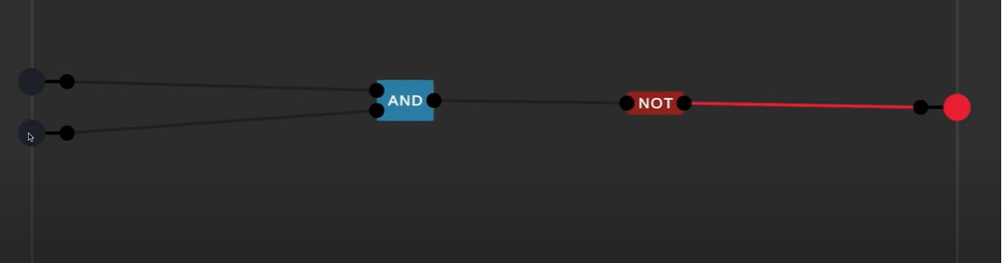
Now let’s build an ALU
1. NAND

Slide 8
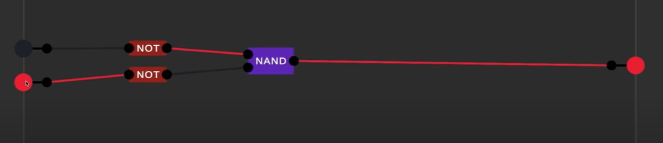
Now let’s build an ALU
2. OR

Slide 9
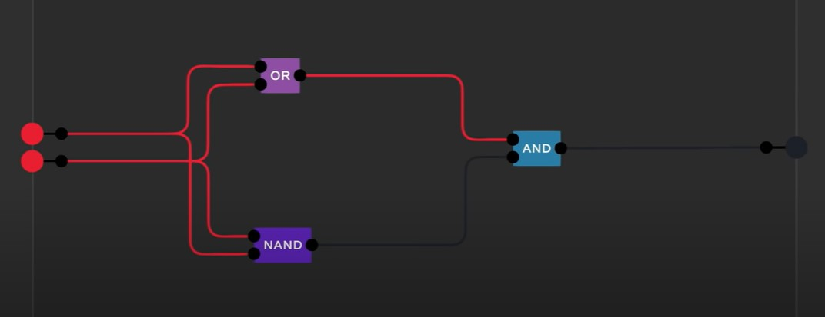
Now let’s build an ALU
3. XOR

Slide 10
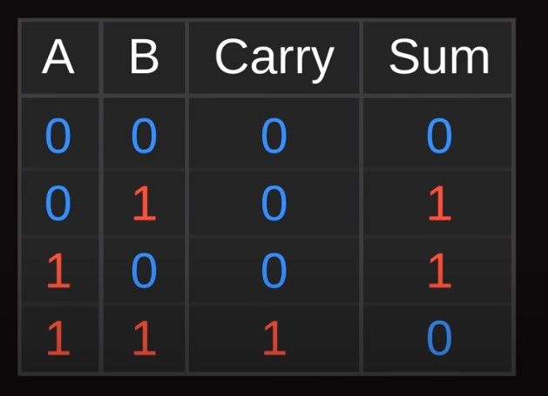
Now let’s build an ALU
4. Adder 1 bit

Slide 11
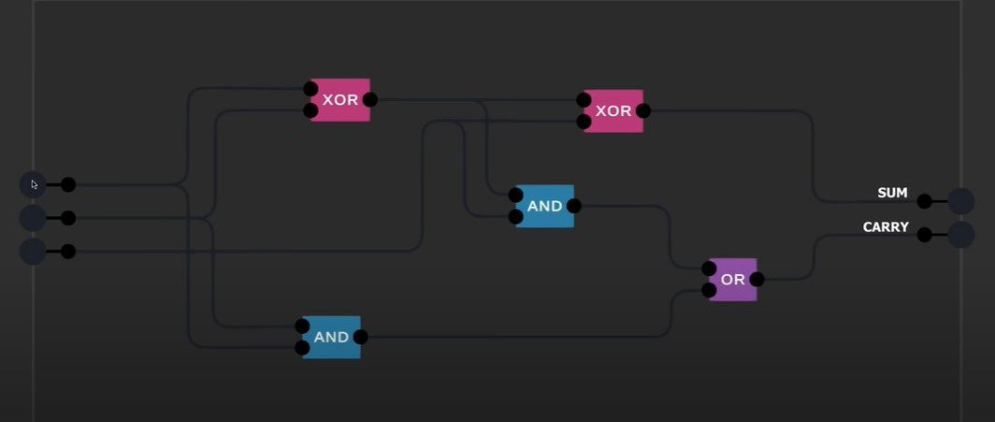
Now let’s build an ALU
4. Adder 1 bit

Slide 12
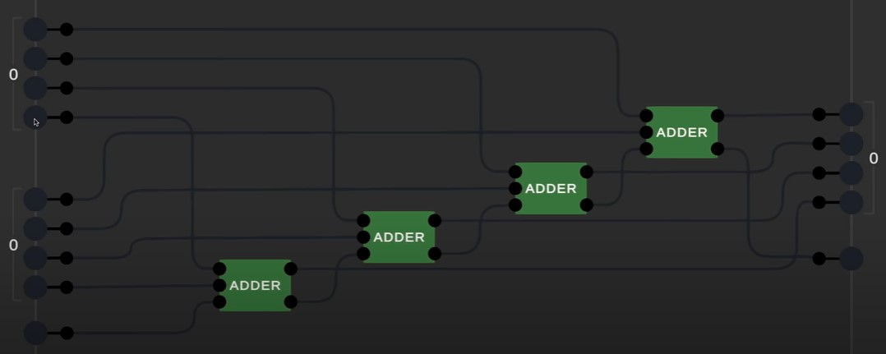
Now let’s build an ALU
5. Adder 4 bits

Slide 13
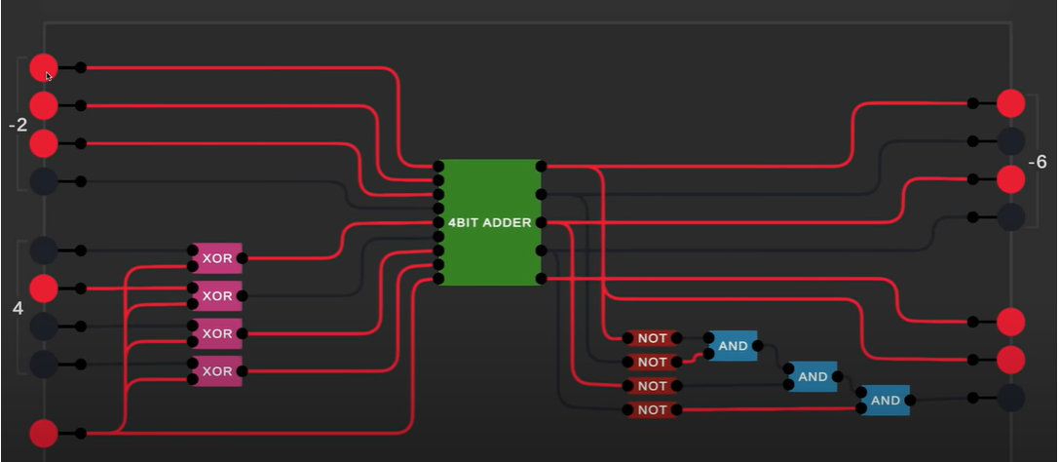
Now let’s build an ALU
6. ALU

Slide 14
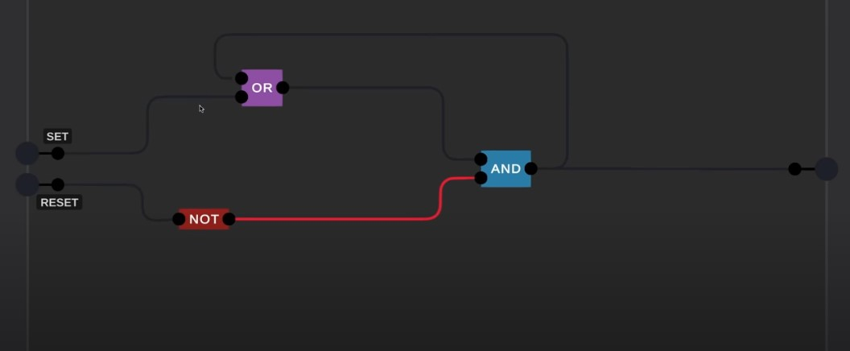
Now let’s build a Register
1. How the computer remember

Slide 15
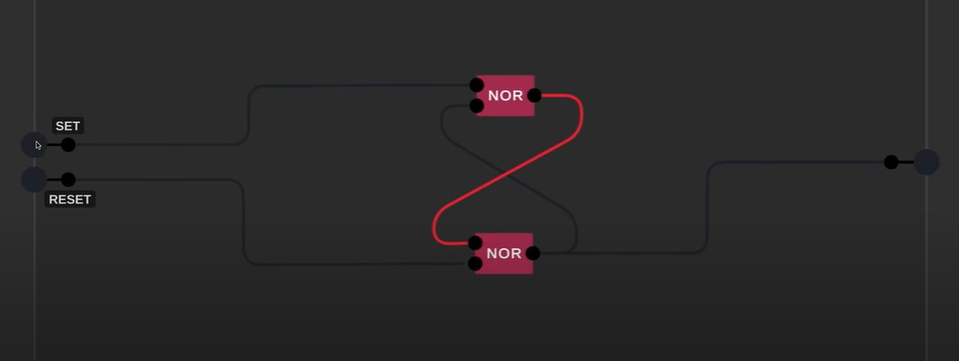
Now let’s build a Register
2. How the computer remember

Slide 16
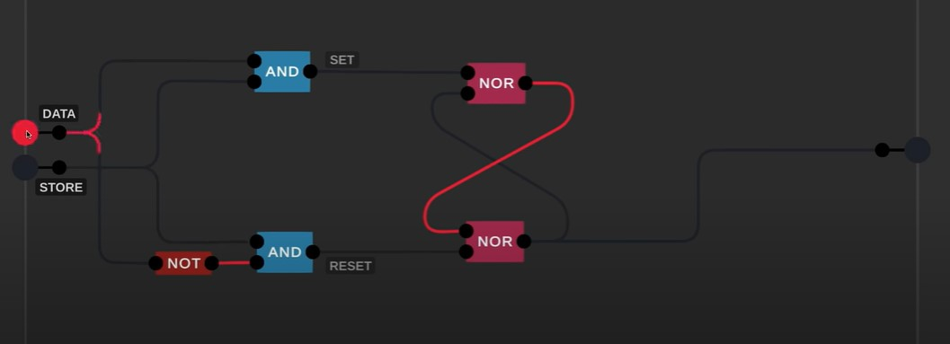
Now let’s build a Register
3. D latch

Slide 17
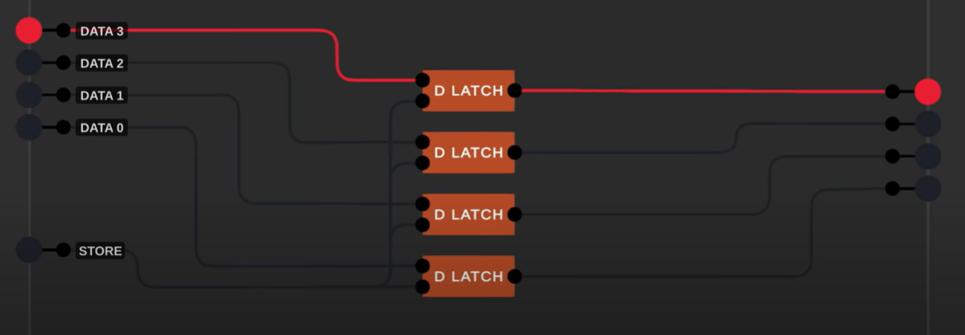
Now let’s build a Register
5.Register

Slide 18
Now let’s build a Register
For the synchronous Register: https://youtu.be/I0-izyq6q5s

