Slide 1
Register
Registers are the CPU's storage medium. The CPU can access data from the registers quicker than any other storage medium; however, its limited size means it has to be used effectively. For this purpose, the registers are divided into the following different types:
Instruction Pointer
General Purpose Registers
Status Flag Registers
Segment Registers
Let's go through each of these registers one by one below:

Slide 2
Instruction Pointer
The Instruction Pointer is a register that contains the address of the next instruction to be executed by the CPU. It is also called the Program Counter. It was originally a 16-bit register in the Intel 8086 processor (from where the term x86 originated) and was abbreviated as IP. In 32-bit processors, the Instruction Pointer became a 32-bit register called the EIP or the Extended Instruction Pointer. In 64-bit systems, this register became a 64-bit register called RIP (the R here stands for register).

Slide 3
EAX
This is the Accumulator Register. Results of arithmetic operations are often stored in this register. In 32-bit systems, a 32-bit EAX register is present, while a 64-bit RAX register is present in 64-bit systems. The last 16 bits of this register can be accessed by addressing AX. Similarly, it can also be addressed in 8 bits by using AL for the lower 8 bits and AH for the higher 8 bits.

Slide 4
EBX
This register is also called the Base Register, which is often used to store the Base address for referencing an offset. Similar to the EAX/RAX, it can be addressed as 64-bit RBX, 32-bit EBX, 16-bit BX, and 8-bit BH and BL registers.

Slide 5
ECX
This register is also called the Counter Register and is often used in counting operations such as loops, etc. Similar to the above two registers, it can be addressed as 64-bit RCX, 32-bit ECX, 16-bit CX, and 8-bit CH and CL registers.

Slide 6
EDX
This register is also called the Data Register. It is often used in multiplication/division operations. Similar to the above registers, it can be addressed as 64-bit RDX, 32-bit EDX, 16-bit DX, and 8-bit DH and DL registers.

Slide 7
ESP
This register is called the Stack Pointer. It points to the top of the stack and is used in conjunction with the Stack Segment register. It is a 32-bit register called ESP in 32-bit systems and a 64-bit register called RSP in 64-bit systems. It can not be addressed as smaller registers.

Slide 8
EBP
This register is called the Base Pointer. It is used to access parameters passed by the stack. It is also used in conjunction with the Stack Segment register. It is a 32-bit register called EBP in 32-bit systems and a 64-bit register called RBP in 64-bit systems.

Slide 9
ESI
This register is called the Source Index register. It is used for string operations. It is used with the Data Segment (DS) register as an offset. It is a 32-bit register called ESI in 32-bit systems and a 64-bit register called RSI in 64-bit systems.

Slide 10
EDI
This register is called the Destination Index register. It is also used for string operations. It is used with the Extra Segment (ES) register as an offset. It is a 32-bit register called EDI in 32-bit systems and a 64-bit register called RDI in 64-bit systems.

Slide 11
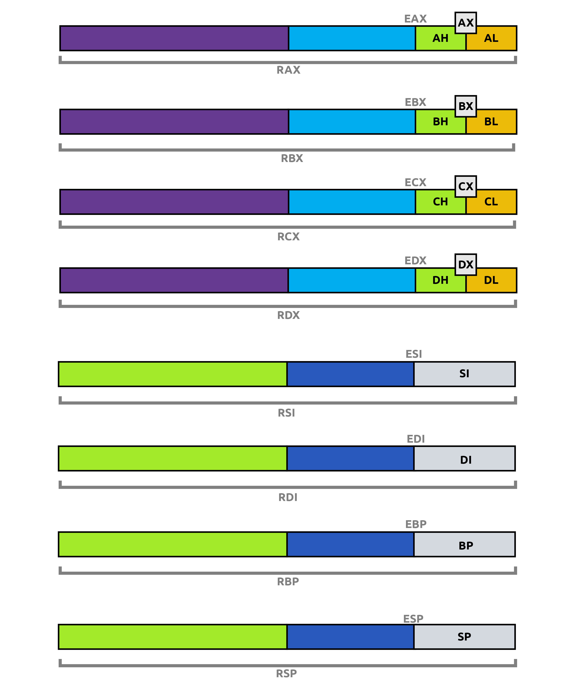

Slide 12
Status Flag Registers
Zero Flag:
Denoted by ZF, the Zero Flag indicates when the result of the last executed instruction was zero. For example, if an instruction is executed that subtracts a RAX from itself, the result will be 0. In this situation, the ZF will be set to 1.
Carry Flag:
Denoted by CF, the Carry Flag indicates when the last executed instruction resulted in a number too big or too small for the destination. For example, if we add 0xFFFFFFFF and 0x00000001 and store the result in a 64-bit register, the result will be too big for the register. In this case, CF will be set to 1.
Sign Flag:
The Sign Flag or SF indicates if the result of an operation is negative or the most significant bit is set to 1. If these conditions are met, the SF is set to 1; otherwise, it is set to 0.
Trap Flag:
The Trap Flag or TF indicates if the processor is in debugging mode. When the TF is set, the CPU will execute one instruction at a time for debugging purposes. This can be used by malware to identify if they are being run in a debugger.

Slide 13
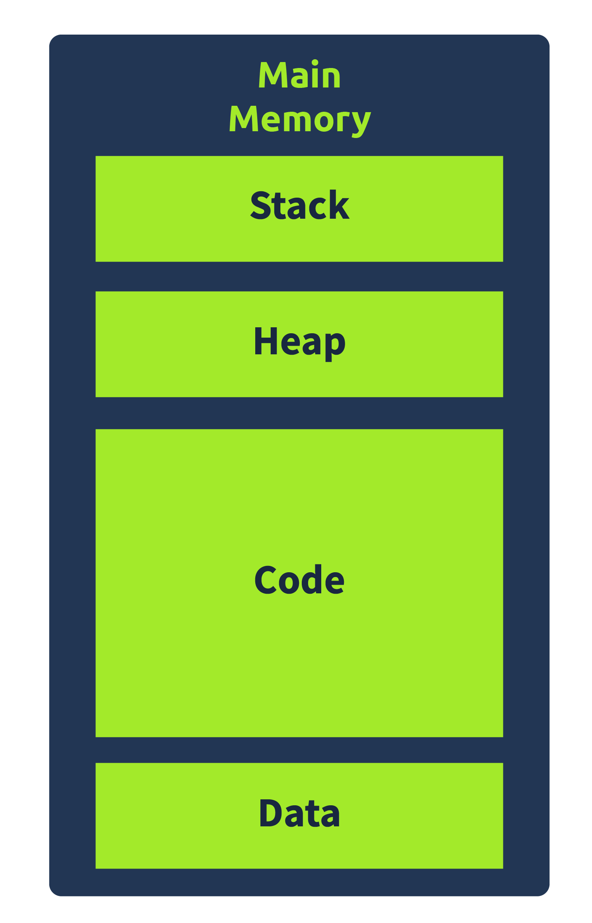

Slide 14
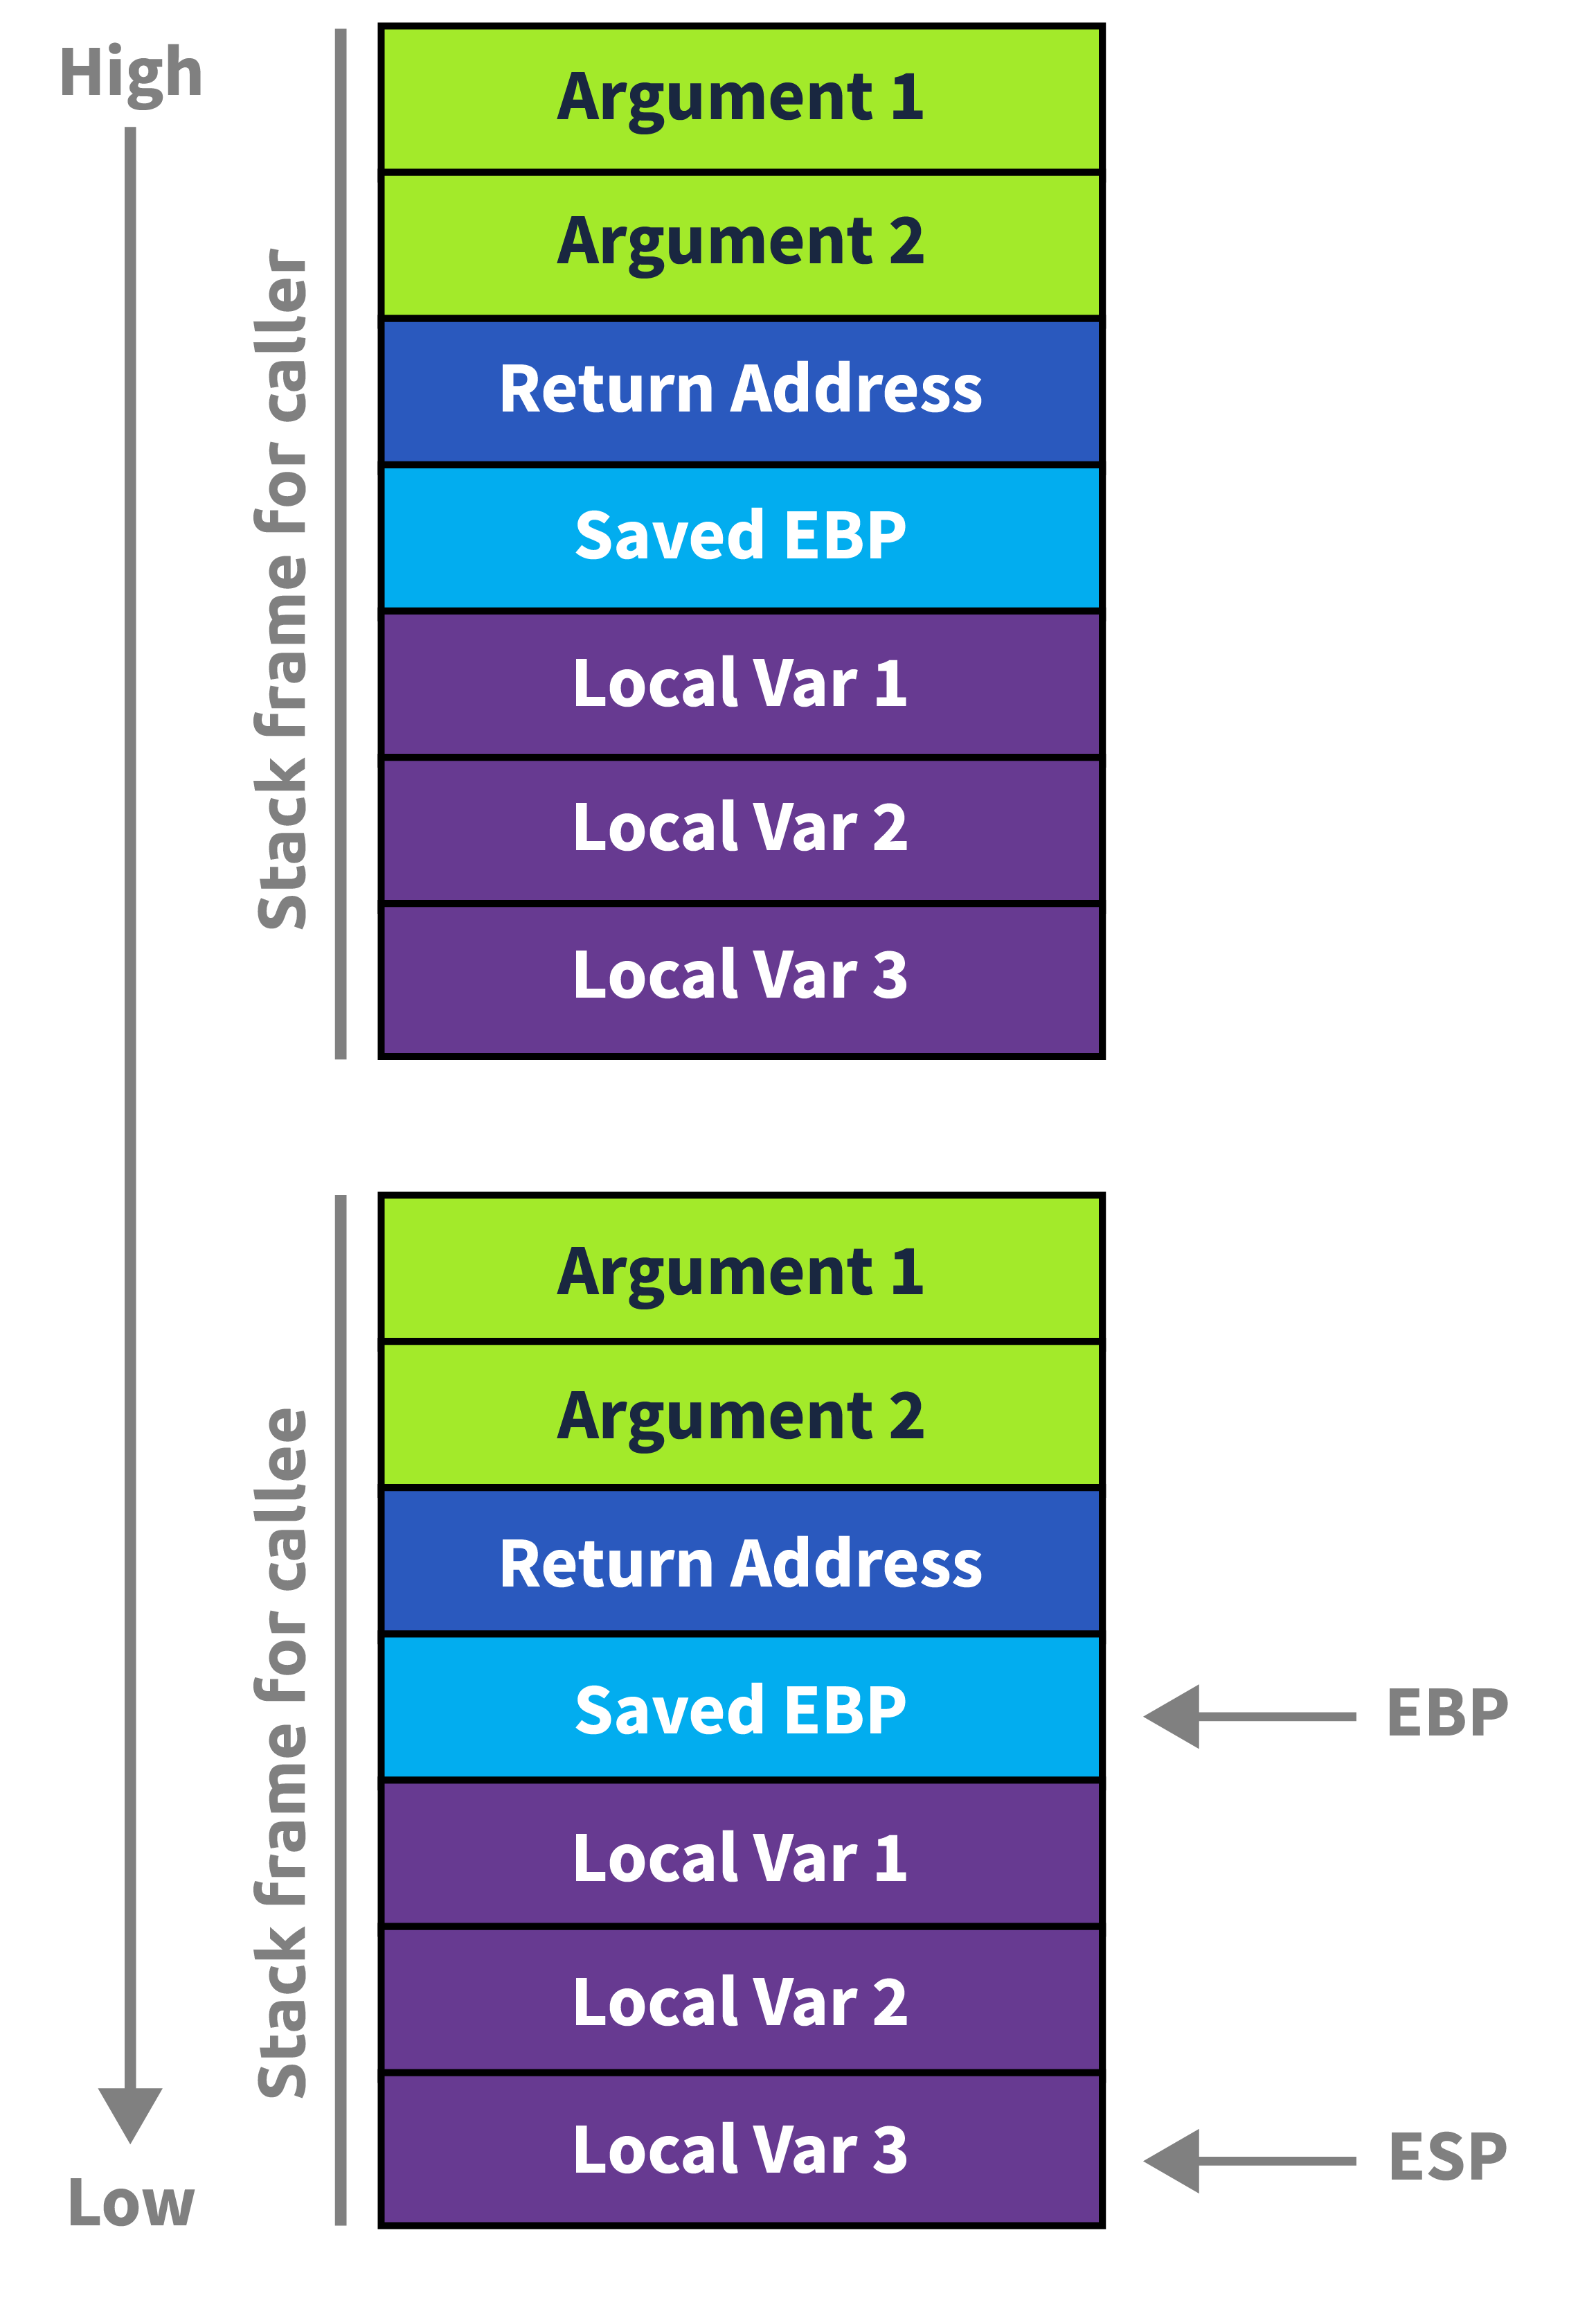

Slide 15
Instruction
Instructions for Data Processing
The following instructions manipulate data. This can be arithmetic operations that perform math functions, comparison operations, or data movement.
Addition (ADD)
Addition (ADD) adds R2 to R1 and puts the result in R0. Addition with Carry (ADC) adds R2 to R1, along with the carry flag. This is used when dealing with numbers larger than a single 32 bit word.
ADD R0, R1, R2
ADC R0, R1, R2
Subtraction (SUB)
Subtraction (SUB) subtracts R2 from R1 and puts the result in R0. Subtraction with Carry (SBC) subtracts R2 from R1 and, if the carry flag is cleared, subtracts one from the result. This is equivalent to borrowing in arithmetic and ensures that multi-word subtraction works correctly.
SUB R0, R1, R2
SBC R0, R1, R2
Compare (CMP) and Compare Negative (CMN)
Compare (CMP) and Compare Negative (CMN) compare two operands. CMP subtracts R1 from R0 and CMN adds R2 to R1, and then the status flags are updated according to the result of the addition or subtraction.

Slide 16
Instruction
CMP R0, R1
CMN R1, R2
Move (MOV)
The Move (MOV) operation does exactly what it sounds like. It moves data from one place to another. Below, R1 is copied into R0. The second line puts the immediate value 8 into R0.
MOV R0, R1
MOV R0, #8
Move Negative (MVN)
Move negative (MVN) performs a similar operation, but complements (inverts) the data first. This is useful when performing operations with negative numbers, in particular with two's complement notation. The instruction below puts NOT 8, better known as –9, into R0. Add one to that result and you have performed the two's complement and obtained -8.
MVN R0, #8
AND performs the bitwise AND of R2 and R1 and puts the result in R0. An immediate value can be used instead of R2.
AND R0, R1, R2

Slide 17
Instruction
ORR and EOR
ORR and EOR perform the bitwise OR and XOR, respectively, of R2 and R1.
ORR R0, R1, R2
EOR R0, R1, R2
Bit Clear (BIC)
Bit Clear (BIC) performs a bitwise AND of R2 and R1, but first complements the bits in R2. This operation is often used with immediate values, as in the second line, where the immediate value, 0xFF, is inverted and subsequently ANDed with R1. ANDing eight zeros with the first byte of R1 will clear those bits, i.e., set them equal to zero, and the result will be put in R0.
BIC R0, R1, R2
BIC R0, R1, #0xFF
Test Bits (TST) and Test Equivalence (TEQ)
TeST Bits (TST) and Test Equivalence (TEQ) exist to test the bits located in registers. These instructions do not use a destination register, but simply update the status register based on the result. TST essentially performs a bitwise AND of the two operands. By using a mask for operand two, we can test if an individual bit in R0 is set.

Slide 18
Instruction
In this case, we check bit 3 (bitmask = 1000b = 8) and set the Z flag based on the outcome. TEQ performs a similar function to exclusive or and is great for checking whether two registers are equal. This updates the N and Z flag, therefore it also works on signed numbers; N is set to one if their signs are different.
TST R0, #8
TEQ R1, R2
Multiplication (MUL)
Multiplication (MUL) multiplies R1 by R2 and puts the result in R0. Multiplication cannot be used with an immediate value.
MUL R0, R1, R2
Instructions for Shifting and Rotating
Logical Shift Left (LSL)
Logical Shift Left (LSL) shifts the bits in R1 by a shift value. In this case, the immediate value 3, and drops the most significant bits. The last bit that was shifted out is put into the carry flag, and the least significant bits are filled with zeros. Below, R1 gets shifted left by the immediate value 3, or a value between 0 and 31 in R2, and put in R0. One logical left shift multiplies a value by two. This is an inexpensive way to do simple multiplication.
LSL R0, R1, #3
LSL R0, R1, R2

Slide 19
Instruction
Logical Shift Right (LSR)
Logical Shift Right (LSR) works in the reverse fashion as LSL and effectively divides a value by two. The most significant bits are filled with zeros, and the last least significant bit is put into the carry flag.
LSR R0, R1, #2
Arithmetic Shift Right (ASR)
Arithmetic Shift Right (ASR) performs the same work as LSR but is designed for signed numbers. It copies the sign bit back into the last position on the left.
ASR R0, R1, #4
Rotate Right (ROR)
Rotate Right (ROR) rotates all the bits in a word by some value. Instead of filling the bits on the left with zeros, the bits shifted out are simply put back into the other end.
ROR R0, R1, #5
Instructions for Branching Operations
One important function of a processor is the ability to choose between two code paths based on a set of inputs. This is exactly what branching operations do. A processor normally executes one instruction after the other by incrementing R15, the program counter (PC), by four bytes (i.e., the length of a single instruction). Branching changes the PC to another location denoted by a label that represents that part of the assembly code.

Slide 20
Instruction
Branch (B)
Branch (B) moves the PC to an address specified by a label. The label (“loop” in the example below) represents a section of code that you want the processor to execute next. Labels are just text, usually a meaningful word.
B loop
Branch Link (BL)
Branch Link (BL) performs a similar operation, but it copies the address of the next instruction into R14, the link register (LR). This works great when performing subroutine/procedure calls, because as soon as the section of code at the label is finished we can use the LR to get back to where we branched. Below, we branch to the label “subroutine” and then use the link register to get back to the next instruction.
BL subroutine
…
subroutine:
…
…
MOV PC, LR
We use a MOV instruction to put the link register back into the program counter. This returns the program to the spot right after our subroutine call, here labeled . Notice the use of LR and PC above. ARM assemblers recognize these as R14 and R15, respectively. This provides a convenient reminder to the programmer about the operation being performed.

Slide 21
Instruction
Instructions for Load and Store
A computer's memory stores data that is needed by the processor. This data is accessed by using an address. By first putting an address into a register, we can then access the data at that address. This is why we use load and store operations.
Load Register (LDR)
Load register (LDR) loads the data located at an address into the destination register. The brackets around R1 signify that the register contains an address. By using the brackets we put the data at that address into R0, instead of the address itself. We can also use this notation to locate data offset from a certain address, as shown on the second line. R0 would contain the data two words away from whatever address R1 contains.
LDR R0, [R1]
LDR R0, [R1, #8]
We can also use labels to represent an address, and the corresponding data can then be loaded into a register. The first line below loads the address of the label “info” into R0. The value stored at that address is then accessed and put into R1 in the second line.
LDR R0, =info
LDR R1, [R0]

Slide 22
Instruction
Store (STR)
Store (STR) performs the complementary operation to load. STR puts the contents of a register into a memory location. The code below stores the data in R1 at the address in R0. Again, the brackets signify that R0 holds an address, and we want to modify the data at that address.
STR R1, [R0]
Load and Store Types: Byte (B), Halfword (H), Word (Omitted), Signed (SB), Unsigned (B)
Both load and store can be written with a type appended to them. This type signifies whether the instruction will manipulate a byte (B), halfword (H), or word (omitted) and whether the data is signed (SB) or unsigned (B).
One place this may come in handy is for string manipulation, as ASCII characters have a length of one byte. These operations also allow for the use of offsets when loading or storing, as seen in the last line.
LDR R0, =text @ load a 32 bit address into R0
STRB R1, [R0] @ store byte at address in memory
STRB R1, [R0, + R2] @ store byte at address + offset R2

Slide 23
Instruction
; Example: Calculate the sum of two numbers in assembly
section .text ; Code section
global _start ; Entry point for the program
_start:
; Initialize variables
mov eax, 5 ; Load the first number (5) into register EAX
mov ebx, 7 ; Load the second number (7) into register EBX
; Perform arithmetic operations
add eax, ebx ; Add the contents of register EBX to register EAX (result in EAX)
sub eax, 3 ; Subtract 3 from the contents of register EAX (result in EAX)
mul ebx ; Multiply the contents of register EBX with register EAX (result in EAX)
; Increment a value
inc eax ; Increment the contents of register EAX by 1

Slide 24
; Compare values
cmp eax, 100 ; Compare the contents of register EAX with the value 100
; Conditional jump
jge exit_program ; Jump to 'exit_program' if the result is greater than or equal to 100
; Continue with more instructions if the jump condition is not met
exit_program:
; Exit the program (for simplicity, assuming a Linux system call for exit)
mov eax, 1 ; System call number for exit
xor ebx, ebx ; Exit code 0
int 0x80 ; Make the system call

Slide 25
Exercice: Can you figure out what is in the eax register?
<+0>: endbr64
<+4>: push rbp
<+5>: mov rbp,rsp
<+8>: mov DWORD PTR [rbp-0x4],edi
<+11>: mov QWORD PTR [rbp-0x10],rsi
<+15>: mov eax,0x30
<+20>: pop rbp
<+21>: ret

Slide 26
Exercice 2: Can you figure out what is in the eax register?
<+0>: endbr64
<+4>: push rbp
<+5>: mov rbp,rsp
<+8>: mov DWORD PTR [rbp-0x14],edi
<+11>: mov QWORD PTR [rbp-0x20],rsi
<+15>: mov DWORD PTR [rbp-0x4],0x9fe1a
<+22>: mov eax,DWORD PTR [rbp-0x4]
<+25>: pop rbp
<+26>: ret

Slide 27
Exercice 3 Can you figure out what is in the eax register?
<+0>: endbr64
<+4>: push rbp
<+5>: mov rbp,rsp
<+8>: mov DWORD PTR [rbp-0x14],edi
<+11>: mov QWORD PTR [rbp-0x20],rsi
<+15>: mov DWORD PTR [rbp-0x4],0x9fe1a
<+22>: cmp DWORD PTR [rbp-0x4],0x2710
<+29>: jle 0x55555555514e <main+37>
<+31>: sub DWORD PTR [rbp-0x4],0x65
<+35>: jmp 0x555555555152 <main+41>
<+37>: add DWORD PTR [rbp-0x4],0x65
<+41>: mov eax,DWORD PTR [rbp-0x4]
<+44>: pop rbp
<+45>: ret

Slide 28
Project : Can you create the “vaches&taureaux game in asm ?

