Slide 1

Introduction to CS fundamentals (Hardware) WORKSHOP
Notes:
Hello everyone, and welcome to to OLIVE-TALKS
So today workshop is :
How hardware concepts impact software performance

Slide 2
Workshop Plan
PART1 : how modern computers execute code efficiently
Modern Computing Architectures
CPU Instruction Pipeline
Memory Hierarchy & Caching Principle
Other computer architecture enhancements: DMA, NIC , APU
QA
PART2 : how computers store data and perform calculations at the circuit level (Let’s build a simple computer)
How Do Computers Remember (SR LATCH)
Data Store(D LATCH)
Data Store(4 BIT REGISTER)
1 BIT ADDER
4 BIT ADDER
ALU
QA
OLIVE-LEARN
Notes:
Here is our plan for today
So We have 2 main parts :
Part 1: We will talk about modern computer designs, how CPUs work fast with pipelines, memory and caching, and some extra hardware features. Then we will have questions.
And Part 2: We will build simple computer parts from scratch
So how computers remember data
how they add/sub numbers
and how the ALU works.
Then the Q/A

Slide 3
Hardware vs Software Boundary
Why hardware matters to programmers
Same code ≠ same speed
Hardware decides:
Parallelism
Memory access speed
Instruction execution cost
Notes:
The same code can run fast on one computer and slow on another. Why?
Because hardware is different.
Hardware decides :
How much work can happen at the same time (parallelism)
How fast we can get data from memory
How expensive each instruction is

Slide 4
Modern Computing Architectures
Modern computing architectures mainly rely on two architectural approaches:
Modified Von Neumann architectures (inspired by Harvard, used by CPUs)
Massively parallel SIMD/SIMT architectures (used by GPUs)
System type | Architecture
PCs / laptops | Modified Von Neumann
Smartphones | Modified Von Neumann
Microcontrollers | Modified Von Neumann
GPUs/TPUs Note : GPUs/TPUs are not standalone machines (They are components of PCs, laptops, or servers, just like:RAM, Disk, Network card) | Highly parallel, not pure Von Neumann
Notes:
Today, almost all devices use one of two main designs
First:
Modified Von Neumann architecture.
This is used in PCs, smartphones, and microcontrollers.
Second: Massively parallel architectures.
These are used in GPUs, TPUs, and NPUs. They are called accelerators or co-processors And we can consider them as a special hardware helpers inside PCs or servers that speed up specific tasks

Slide 5
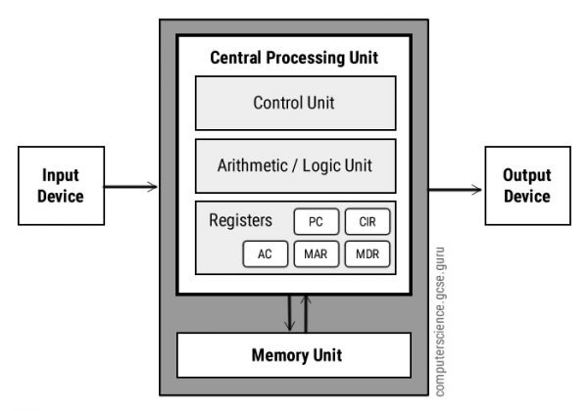
Von Neumann Architecture
Key characteristics
A single memory unit Stores both program instructions and data.
Central Processing Unit (CPU), composed of:
Arithmetic Logic Unit (ALU) Performs arithmetic operations and logical comparisons.
Control Unit (CU) Fetches instructions from memory and orchestrates the flow of data between memory, registers, and the ALU.
Registers Small, fast storage locations used during instruction execution (e.g., PC, MAR, MDR, CIR, ACC).
A single shared bus Used to transfer data and instructions between the CPU and memory → leads to the Von Neumann bottleneck.
Sequential execution model Instructions follow the fetch → decode → execute cycle.
Notes:
The classic design is called Von Neumann.
It has one memory that stores both program instructions and data. The CPU has two main parts: the ALU for calculations and the Control Unit that manages everything. There are small fast registers, and one shared bus for everything. Problem: this shared bus creates a bottleneck – everything waits for the bus. Instructions run one after another: fetch, decode, execute

Slide 6
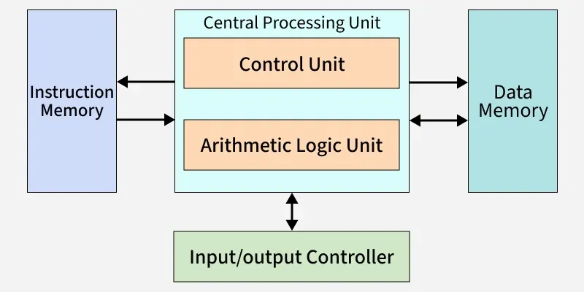
Harvard Architecture
Key characteristics
Two distinct memory units:
Instruction Memory → stores program instructions
Data Memory → stores data only
Central Processing Unit (CPU), composed of:
Control Unit (CU) Emphasizes instruction fetching from instruction memory.
Arithmetic Logic Unit (ALU) Executes operations using operands from data memory.
Registers Hold instructions, addresses, and intermediate results during execution.
Separate buses for data and instructions → allows simultaneous access to instructions and data.
Higher throughput than pure Von Neumann → no Von Neumann bottleneck.
Notes:
Harvard architecture is different.
It has two separate memos:
one only for instructions
one only for data
And two separate buses
This means the CPU can fetch an instruction and read data at the same time.
No bottleneck. Higher speed. So this architecture will open to us the pipeline optimization so we can execute instruction in // in the cpu.

Slide 7
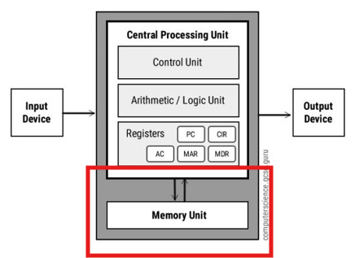
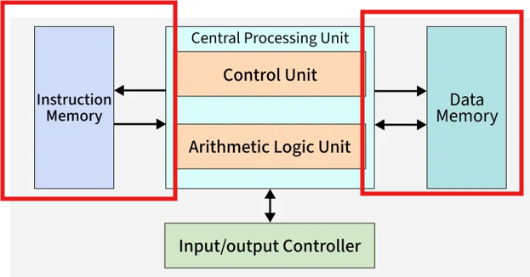
Von Neumann vs Harvard
A single shared path for both instructions and data
Two separate paths for simultaneous access
Code impact: performance is primarily limited by data movement speed rather than computation speed
Notes:
Key point for programmers: performance is usually limited by how fast we move data, not by how fast we calculate
And that is it
any question about this module ?

Slide 8
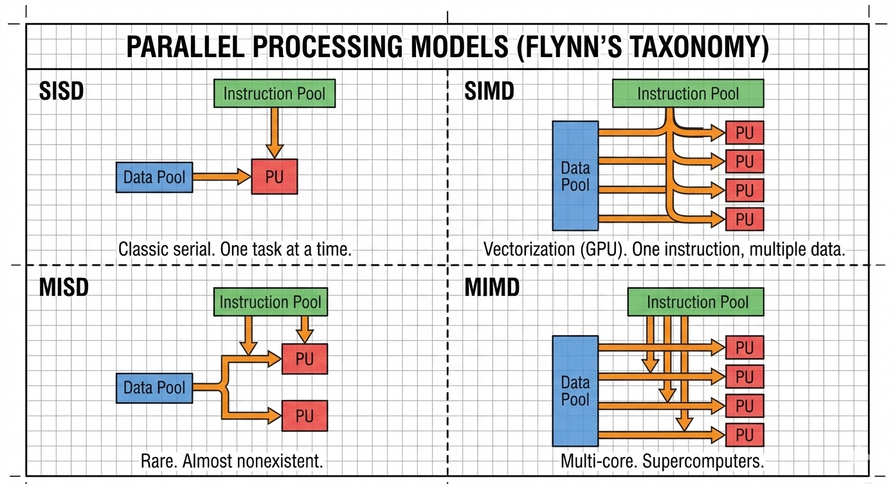
Parallel processing models (SISD, SIMD, MISD, MIMD)
Notes:
Okay so next is PPM
We classify the possible computing models by how they handle the data and the instructions
SISD: one instruction, one data – normal old serial computer.
SIMD: one instruction, many data – perfect for images and graphics, used in GPUs.
MISD: very rare, almost no examples.
MIMD: many instructions, many data – used in multi-core CPUs

Slide 9
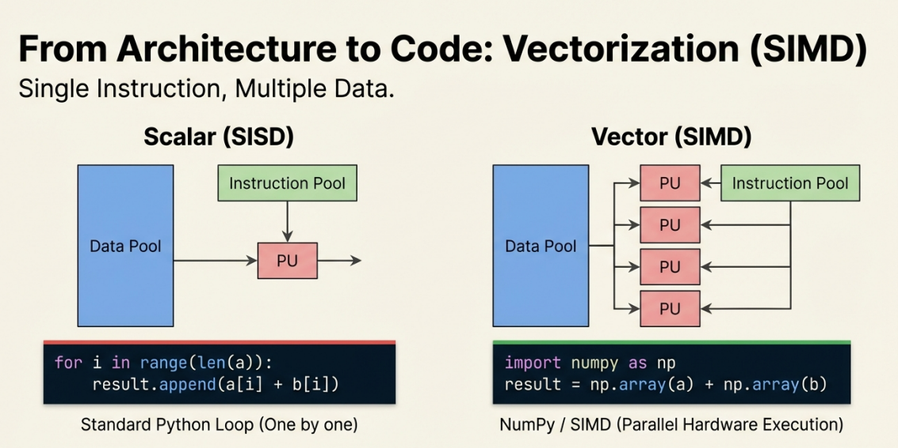
Parallel processing models (SISD, SIMD, MISD, MIMD)
Code impact:
SIMD (GPUs) : structure algorithms to expose parallelism & use vectorized operations
MIMD (multi-core CPUs) : Task/thread parallelism
Notes:
So we will see the impact of this in our code :
On GPUs write vectorized code.
CPUs (MIMD), use threads.

Slide 10
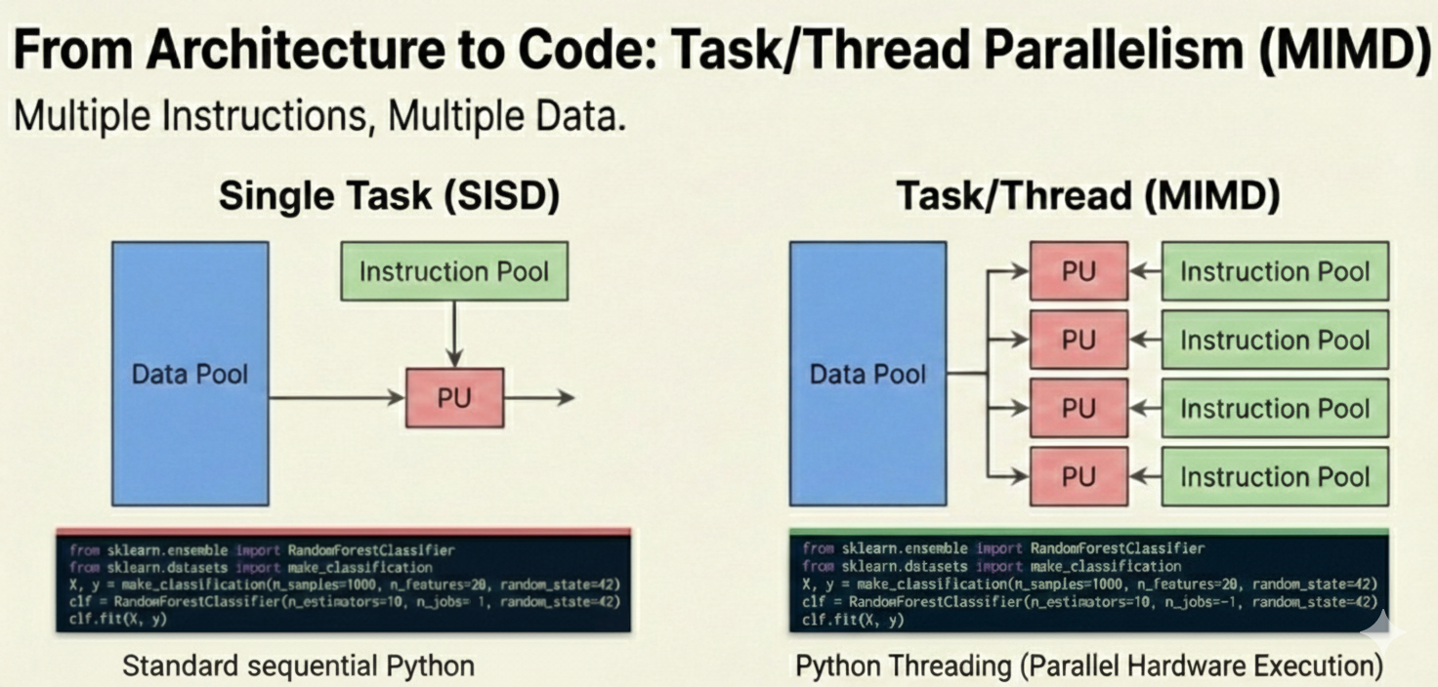
Parallel processing models (SISD, SIMD, MISD, MIMD)
Code impact:
SIMD (GPUs) : structure algorithms to expose parallelism & use vectorized operations
MIMD (multi-core CPUs) : Task/thread parallelism
Notes:
So we will see the impact of this in our code :
On GPUs write vectorized code.
CPUs (MIMD), use threads.

Slide 11
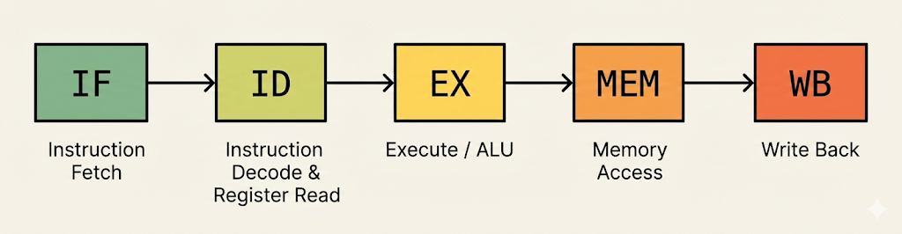
CPU Instruction Pipeline
Modern processors typically use a multi-stage instruction pipeline to improve throughput by overlapping work on multiple instructions. A widely used model has five main stages:
Notes:
In this part
We will talk about the possibility of making CPUs faster using the havard architecture
we use pipelining
Just like a factory assembly line, we overlap work
standard model has five stages: Fetch, Decode, Execute, Memory Access, and Write Back. While one instruction is being executed, the next one is already being decoded
After ADD R1, R2, R3 → write result into R1 After LOAD R1, [R2] → write the loaded value into R1

Slide 12
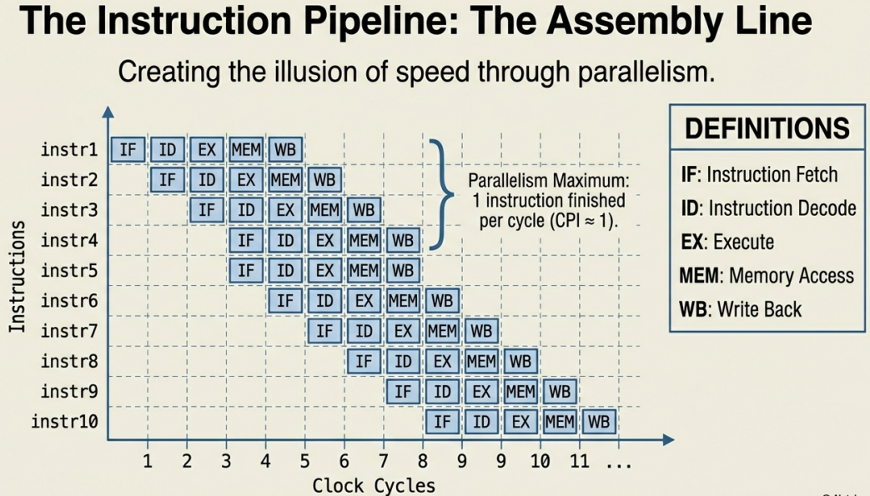
Benefits of Instruction Pipelining
Key benefits
Higher throughput After the pipeline is filled, the CPU completes 1 instruction per clock cycle.
Reduced CPI (Cycles Per Instruction)
Unpipelined execution: CPI ≈ 5
Ideal pipelined execution: CPI ≈ 1
Better hardware utilization Multiple pipeline stages (IF, ID, EX, MEM, WB) operate in parallel.
Notes:
The benefits are big:
Much higher speed – one instruction per cycle instead of five cycles.
Lower CPI – cycles per instruction drops from about 5 to about 1.
All parts of the CPU stay busy

Slide 13
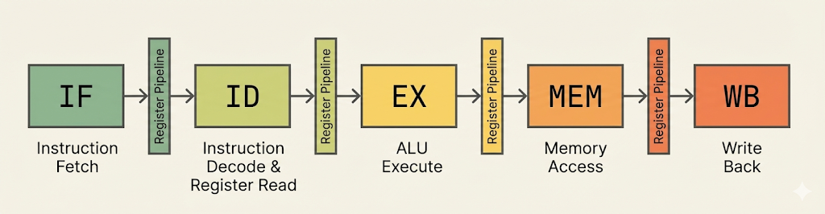
Pipeline Implementation
Pipelining is implemented by adding registers between stages.
Pipeline registers temporarily hold data and control signals produced in an early stage for use in later stages.
Signals last for only one clock cycle.
Signals needed in later stages must pass through all intermediate pipeline registers.
Before Pipelining
After Pipelining
Notes:
We add registers between stages to hold data for one cycle. This lets stages work at the same time. Look at the diagram: before pipelining – slow. After pipelining – fast and overlapping

Slide 14
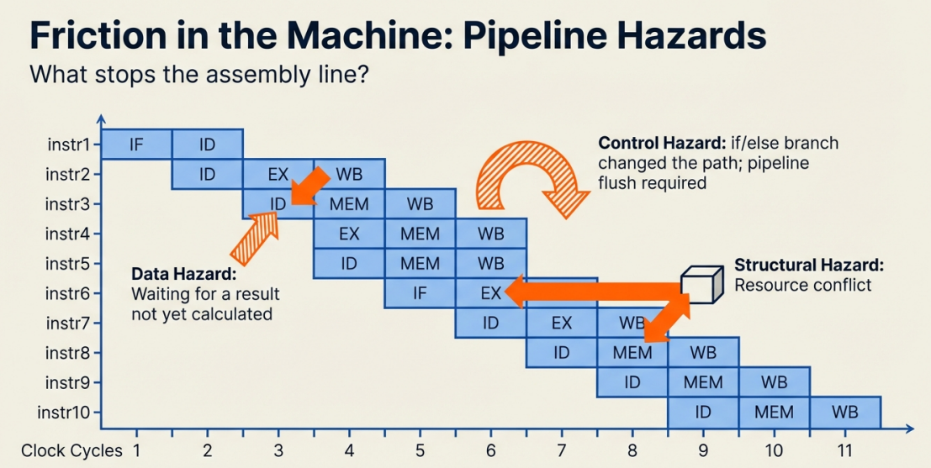
Obstacles to Pipelining
Data Hazards :
X=1+2
Y=X+1
Control Hazards :
if (Y == 0) :
X = X + 1
else :
X=X-1
Structural Hazards:
if (Y == 0) :
X = X + 1
else :
X=X-1
X = X + 1
Notes:
But pipelining has problems called hazards.
Data hazards: an instruction needs a result that is not ready yet.
Control hazards: branches and jumps change the next instruction.
Structural hazards: two instructions want the same hardware at the same time

Slide 15
Obstacles to Pipelining
Manufacturer | Processor Generation | Microarchitecture | Pipeline Stages / Mispredict Penalty (Cycles)
Intel | Pentium 4 (Early) | NetBurst (Northwood) | 20
 | Pentium 4 (Late) | NetBurst (Prescott) | 31
AMD | Ryzen 1000 / 2000 | Zen / Zen+ | 19
 | Ryzen 3000 | Zen 2 | 19
 | Ryzen 5000 / 7000 | Zen 3 / Zen 4 | 11–14
 | Ryzen 9000 | Zen 5 | 11–14
Apple | M1 / M2 Series | Firestorm / Avalanche | 13–16
 | M3 / M4 Series | Everest / Donan | 14–16
ARM | Cortex-X1 | Cortex-X1 | 13
 | Cortex-X3 | Cortex-X3 | 9–10
Code Impact:
Data Hazards
Avoid splitting operations on the same variable across multiple dependent instructions just for readability.
Prefer compact expressions that keep dependent operations close together.
Use clear comments to explain complex formulas, so performance is preserved without sacrificing code readability.
Notes:
Modern PC CPUs typically have 14 to 31 pipeline stages

Slide 16
Obstacles to Pipelining
Manufacturer | Processor Generation | Microarchitecture | Pipeline Stages / Mispredict Penalty (Cycles)
Intel | Pentium 4 (Early) | NetBurst (Northwood) | 20
 | Pentium 4 (Late) | NetBurst (Prescott) | 31
AMD | Ryzen 1000 / 2000 | Zen / Zen+ | 19
 | Ryzen 3000 | Zen 2 | 19
 | Ryzen 5000 / 7000 | Zen 3 / Zen 4 | 11–14
 | Ryzen 9000 | Zen 5 | 11–14
Apple | M1 / M2 Series | Firestorm / Avalanche | 13–16
 | M3 / M4 Series | Everest / Donan | 14–16
ARM | Cortex-X1 | Cortex-X1 | 13
 | Cortex-X3 | Cortex-X3 | 9–10
Code Impact:
Control Hazards
Minimize branches (if/else, switch) when possible.
Replace branches with branch-free arithmetic or boolean expressions to keep the pipeline full.
# Branch-based
if Y == 0:
X = X + 1
else:
X = X - 1
# Branch-free
X = X + 1 - 2 * (Y != 0)
Notes:
Modern PC CPUs typically have 14 to 31 pipeline stages

Slide 17
Obstacles to Pipelining
Manufacturer | Processor Generation | Microarchitecture | Pipeline Stages / Mispredict Penalty (Cycles)
Intel | Pentium 4 (Early) | NetBurst (Northwood) | 20
 | Pentium 4 (Late) | NetBurst (Prescott) | 31
AMD | Ryzen 1000 / 2000 | Zen / Zen+ | 19
 | Ryzen 3000 | Zen 2 | 19
 | Ryzen 5000 / 7000 | Zen 3 / Zen 4 | 11–14
 | Ryzen 9000 | Zen 5 | 11–14
Apple | M1 / M2 Series | Firestorm / Avalanche | 13–16
 | M3 / M4 Series | Everest / Donan | 14–16
ARM | Cortex-X1 | Cortex-X1 | 13
 | Cortex-X3 | Cortex-X3 | 9–10
Code Impact:
Control Hazards
Minimize branches (if/else, switch) when possible.
Replace branches with branch-free arithmetic or boolean expressions to keep the pipeline full.
def count_positive_bad(data):
count = 0
for x in data:
if x > 0:
count += 1
return count
def count_positive_good(data):
return sum(x > 0 for x in data)
Notes:
Modern PC CPUs typically have 14 to 31 pipeline stages

Slide 18
Obstacles to Pipelining
Manufacturer | Processor Generation | Microarchitecture | Pipeline Stages / Mispredict Penalty (Cycles)
Intel | Pentium 4 (Early) | NetBurst (Northwood) | 20
 | Pentium 4 (Late) | NetBurst (Prescott) | 31
AMD | Ryzen 1000 / 2000 | Zen / Zen+ | 19
 | Ryzen 3000 | Zen 2 | 19
 | Ryzen 5000 / 7000 | Zen 3 / Zen 4 | 11–14
 | Ryzen 9000 | Zen 5 | 11–14
Apple | M1 / M2 Series | Firestorm / Avalanche | 13–16
 | M3 / M4 Series | Everest / Donan | 14–16
ARM | Cortex-X1 | Cortex-X1 | 13
 | Cortex-X3 | Cortex-X3 | 9–10
Code Impact:
Structural Hazards
Avoid designing code that forces multiple operations to compete for the same hardware resource at the same time
Reduce back-to-back instructions that:
access memory repeatedly
use the same specialized unit (example :division)
# repeated_divisions
for i in range(N):
result[i] = data[i] / divisor
# single_division
inv_divisor = 1.0 / divisor # one division
for i in range(N):
result[i] = data[i] * inv_divisor
Notes:
Modern PC CPUs typically have 14 to 31 pipeline stages

Slide 19
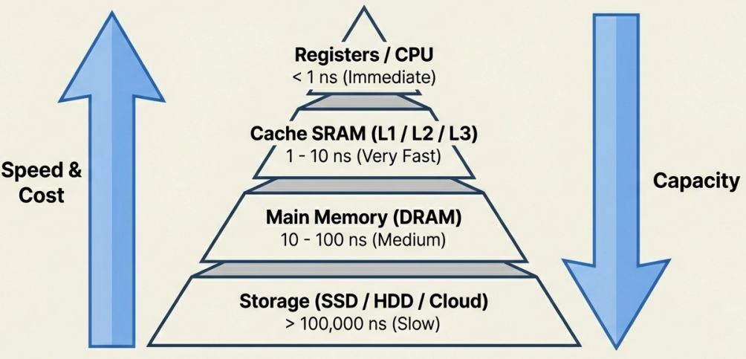
Memory Hierarchy & Caching Principle
Computer memory is organized in a hierarchy to balance three critical factors: Speed, Capacity, and Cost:
Higher in Hierarchy
Speed: Very Fast (e.g., CPU Registers)
Cost: Very Expensive
Capacity: Very Small
Lower in Hierarchy
Speed: Much Slower (e.g., Hard Drive)
Cost: Very Cheap
Capacity: Very Large
The Goal of Caching: keep the most frequently used data at the tip of the pyramid
Notes:
Memory is organized like a pyramid. Top: registers – very fast, very small, expensive. Then caches, then RAM, then disk – slow, huge, cheap. The goal of caching: keep the data you use most as close to the CPU as possible

Slide 20
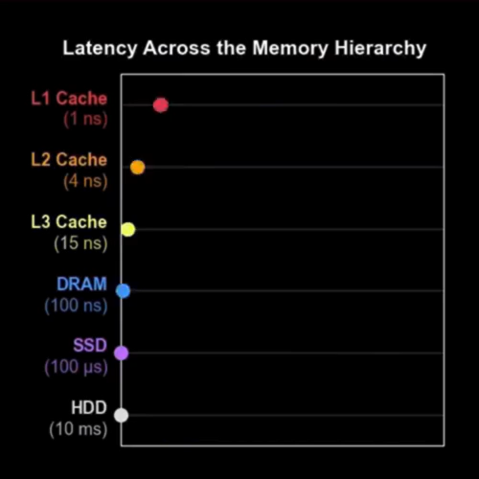
A Snapshot in Time: The State of Memory
Notes:
Here is a video that shows how big the speed difference is. Register access: almost instant. RAM: hundreds of times slower. Disk: millions of times slower. (Play the video) This is why cache misses hurt performance so much

Slide 21
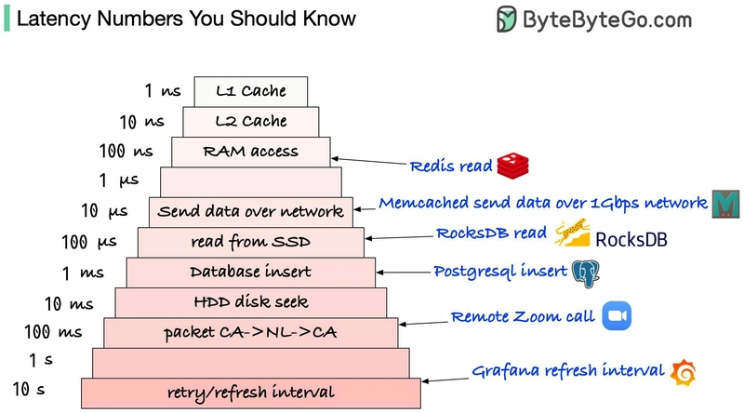
A Snapshot in Time: The State of Memory

Slide 22
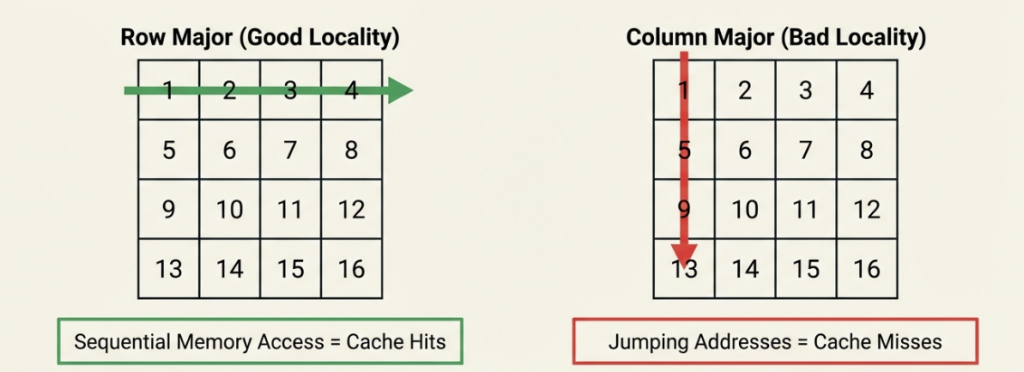
Code impact: Code should maximize cache locality and minimize slow memory access:
batch I/O, reuse data, and prefer contiguous structures to avoid costly cache misses and disk access
Example 1: Data Locality
for i in range(n):
for j in range(n):
# access a[i][j]
We fix a row i
We iterate through j = 0 → n-1
We access a[i][0], a[i][1], a[i][2], ...
-> These elements are adjacent in memory (Same Array)
Result:
Cache lines are fully used
Fast execution
Notes:
Look at these two loops over a 2D array. First loop: go row by row – fast, because data is next to each other in memory. Cache loves it. Second loop: go column by column – slow, many cache misses. Same algorithm, same big-O, very different real speed

Slide 23
Code impact: Code should maximize cache locality and minimize slow memory access:
batch I/O, reuse data, and prefer contiguous structures to avoid costly cache misses and disk access
Example 1: Data Locality
for j in range(n):
for i in range(n):
# access a[i][j]
We fix a column j
We iterate rows
a[0][j], a[1][j], a[2][j], ...
-> These elements are far apart in memory (different Arrays)
Result:
Each access likely loads a new cache line
Cache lines are barely reused
Many cache misses
poor spatial locality
Slow execution

Slide 24
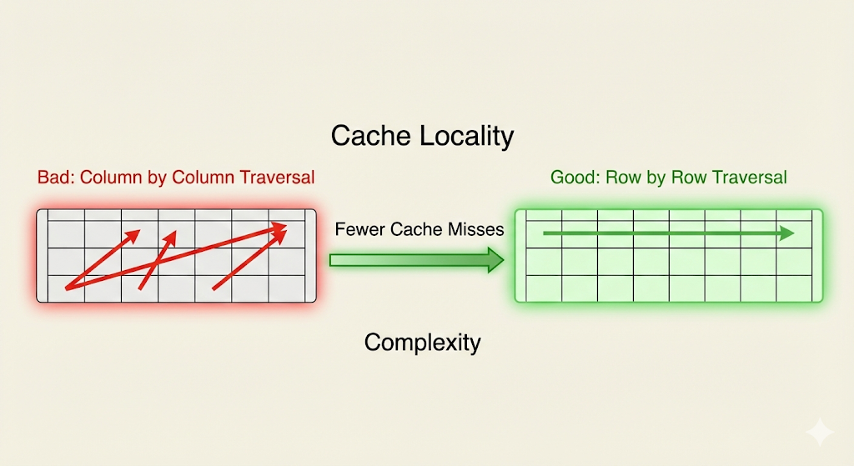
Code impact: Code should maximize cache locality and minimize slow memory access:
batch I/O, reuse data, and prefer contiguous structures to avoid costly cache misses and disk access
Example 1: Data Locality
Why this matters (code impact)
Same algorithm
Same complexity O(n²)
Very different performance due to memory access patterns

Slide 25
Code impact: Code should maximize cache locality and minimize slow memory access:
batch I/O, reuse data, and prefer contiguous structures to avoid costly cache misses and disk access
Example 2: Data caching
# Naive: Pure recursion (exponential work, no caching) O(2^n)
def fib(n):
if n <= 1:
return n
return fib(n-1) + fib(n-2)
# Optimized: Memoization (caching results) O(n)
from functools import lru_cache
@lru_cache(maxsize=128)
def fib_cached(n):
if n <= 1:
return n
return fib_cached(n-1) + fib_cached(n-2)
lru_cache (Least Recently Used cache) stores the params of function call and the result of it
When a function is called, Python checks the cache:
Hit → return stored result (no recomputation)
Miss → compute, store result in cache
The cache has a fixed size (maxsize)
When full, it evicts the least recently used entry (the one not accessed for the longest time)
Notes:
Another example: Fibonacci. Naive recursion computes the same values again and again – very slow. With memoization – we cache results – becomes fast and linear. Python’s @lru_cache does this automatically. Lesson: reuse data when possible

Slide 26
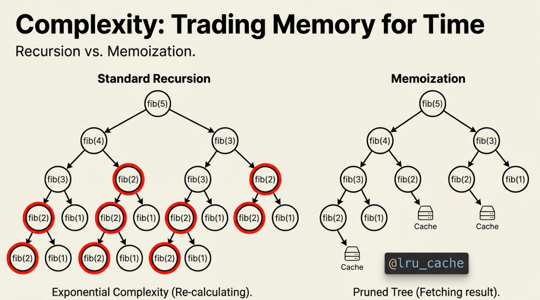
Code impact: Code should maximize cache locality and minimize slow memory access:
batch I/O, reuse data, and prefer contiguous structures to avoid costly cache misses and disk access
Example 2: Data caching
# Naive: Pure recursion (exponential work, no caching) O(2^n)
def fib(n):
if n <= 1:
return n
return fib(n-1) + fib(n-2)
# Optimized: Memoization (caching results) O(n)
from functools import lru_cache
@lru_cache(maxsize=None)
def fib_cached(n):
if n <= 1:
return n
return fib_cached(n-1) + fib_cached(n-2)

Slide 27
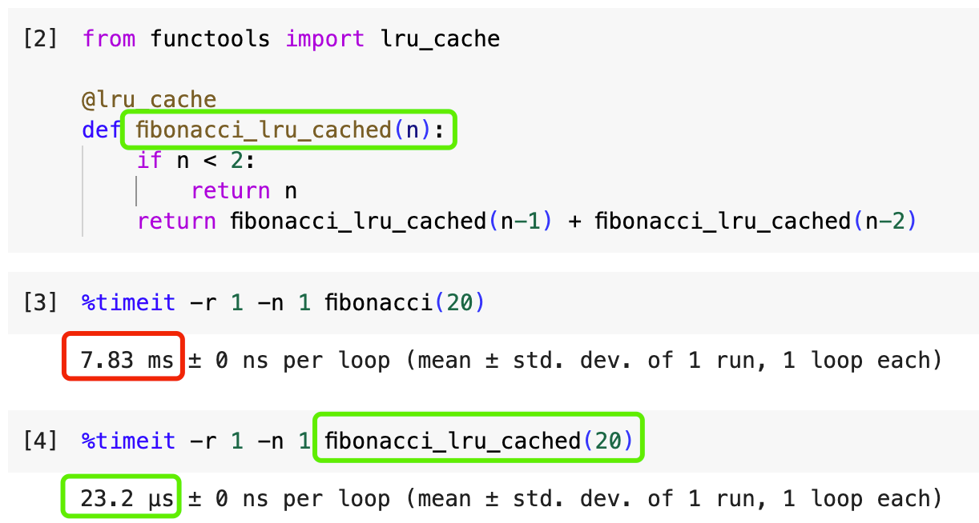
Code impact: Code should maximize cache locality and minimize slow memory access:
batch I/O, reuse data, and prefer contiguous structures to avoid costly cache misses and disk access
Example 2: Data caching

Slide 28
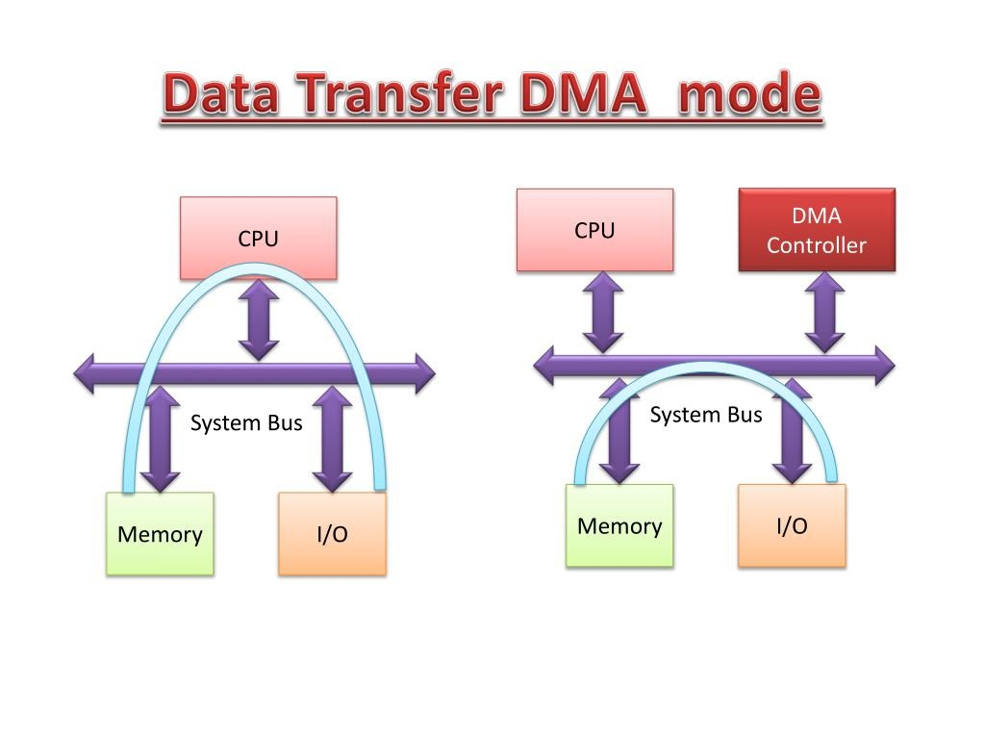
Other computer architecture enhancements: DMA
Notes:
Modern computers have many helpers:
DMA: moves data without bothering the CPU.

Slide 29
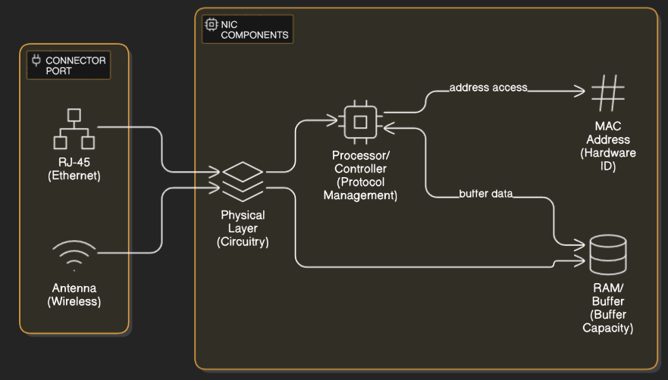
Other computer architecture enhancements: Network Interface Card (NIC)
Notes:
NIC: network card does its own work.

Slide 30
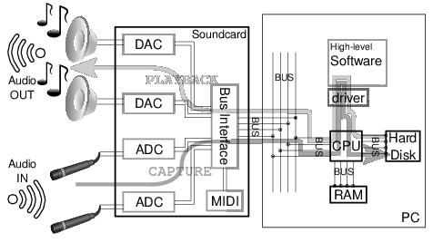
Other computer architecture enhancements: Sound Card (Audio Processing Unit)
Notes:
Sound cards and APUs: handle audio fast. The CPU is not doing everything alone anymore

Slide 31
Q&A

Slide 32
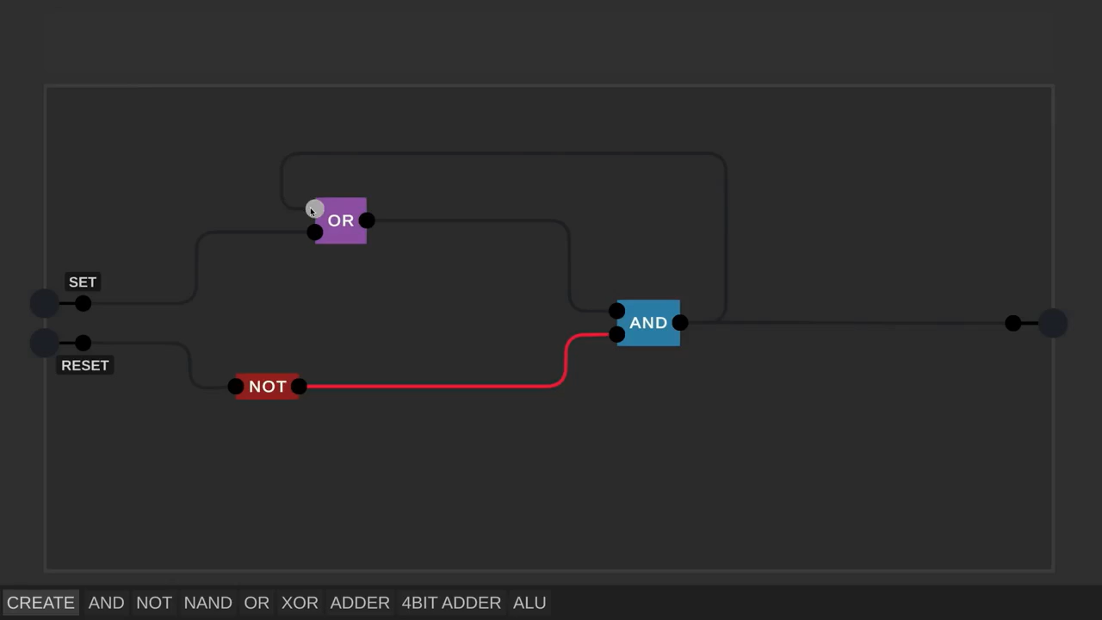
How Do Computers Remember (SR LATCH)
Notes:
Now we move to Part 2. We will build real computer parts from basic gates. We start with the simplest question: How do computers remember even one bit?
Set–Reset
Data latch
Latch : قفل مؤقت

Slide 33
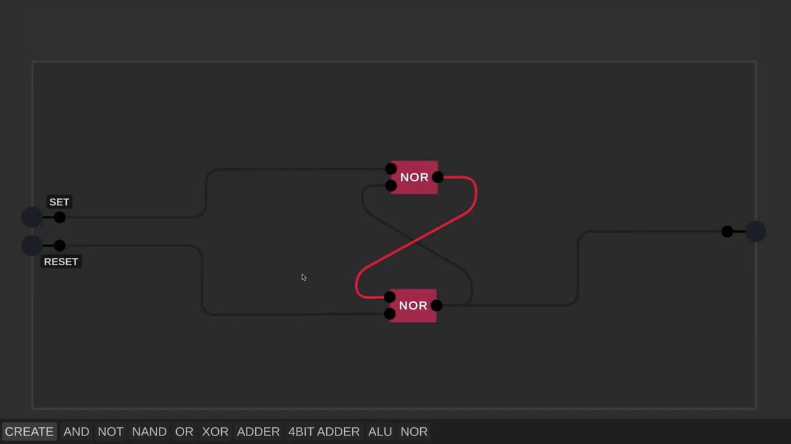
How Do Computers Remember (SR LATCH)

Slide 34
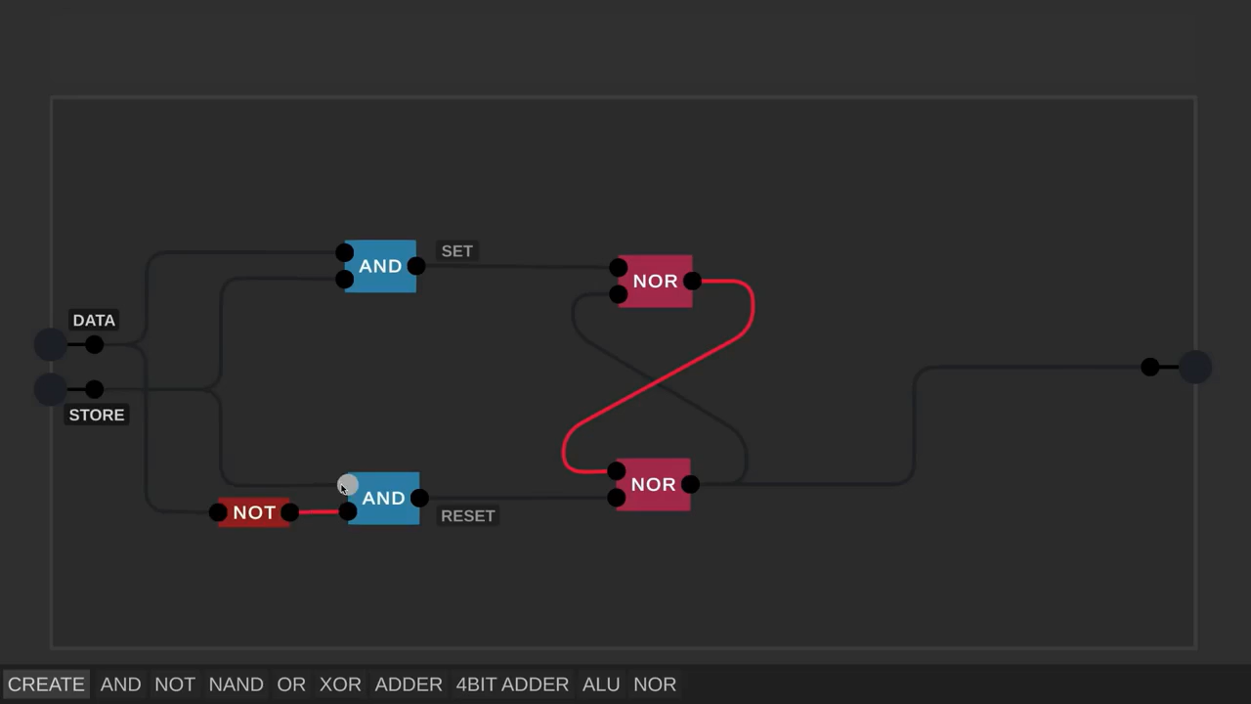
Data Store(D LATCH)

Slide 35
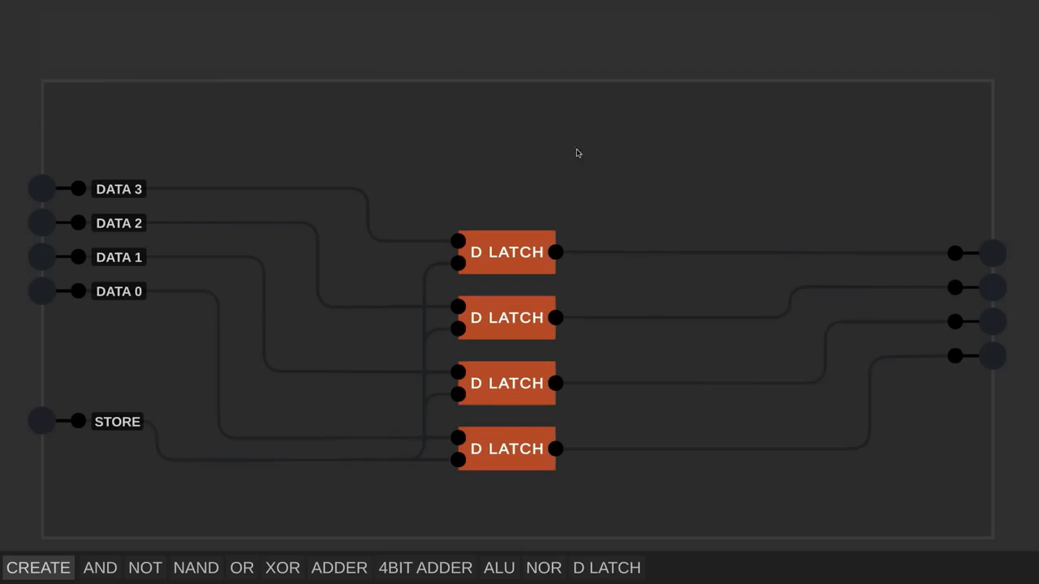
Data Store(4 BIT REGISTER)
Notes:
This is an Asynchronous 4-bit Register. Why?
Because it relies on an input trigger. If you used a clock instead, it would become a Synchronous Register. Simple as that

Slide 36
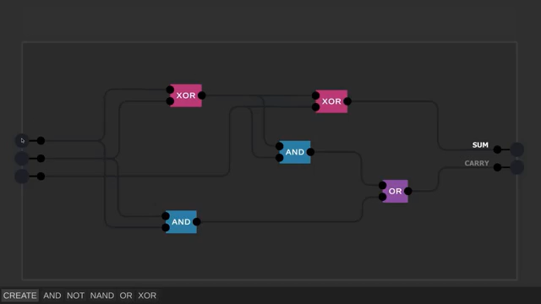
1 BIT ADDER
Notes:
Here we can say we have completed the data part from how the pc remember to building a 4 bit register .
Now lets build a 1 BIT ADDER

Slide 37
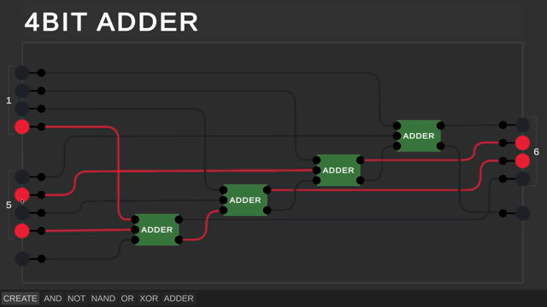
4 BIT ADDER

Slide 38
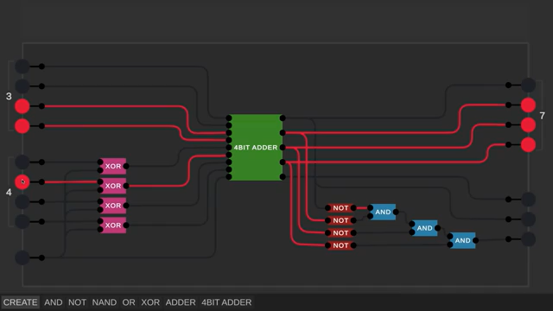
ALU

Slide 39
Q&A
Notes:
Welcome everyone to the very first edition of the OLIVE-LEARN workshop. Today, we are diving into Computer Architecture Fundamentals. This session is designed to bridge the gap between high-level coding and the underlying hardware that executes it

Slide 40
OLIVE-LEARN

Slide 41
Thank you for your attention ☺

