Slide 1

CSE 321 – Project Based Learning
Human Activities Recognition

Slide 2
PRESENTED BY
PRESENTED TO
Dr. Walid Gomaa

Slide 3

Human Activities Recognition
I. Introduction
II. Methodology
III. Data Representation

Slide 4
I. Introduction
The project's core objective is to utilize machine learning for Human Activity Recognition (HAR) and develop an Artificial Gym Coaching system.
The dataset we collected from people is for compound exercises:
Squat
Push-up
Jumping Jacks
Plank
Alternating Lunges

Slide 5
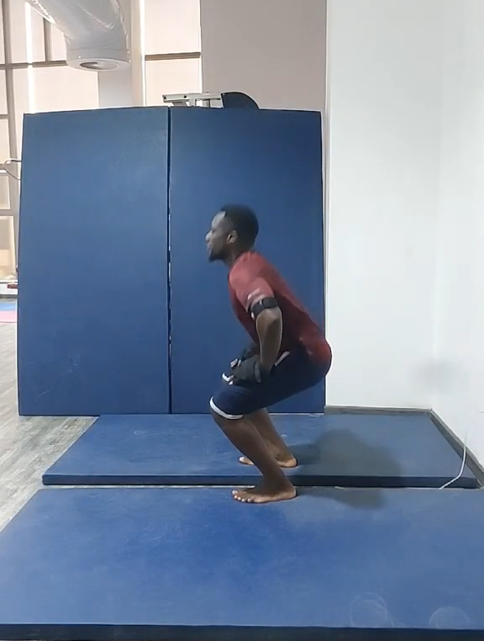
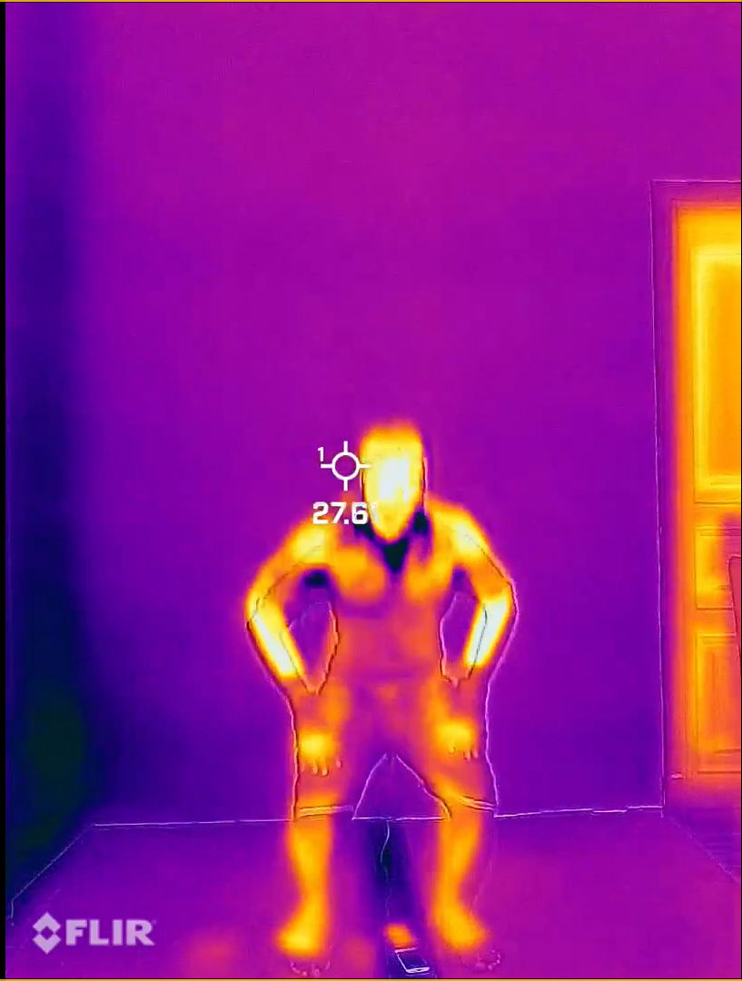
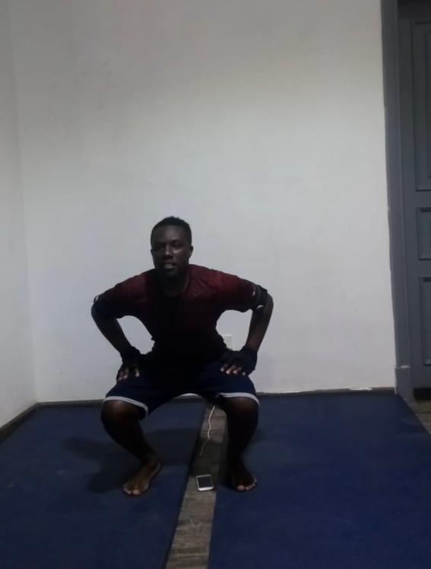
II. Methodology
We captured trainers using three cameras:
FLIR Thermal Camera
RGB Front Camera
RGB Side Camera

Slide 6
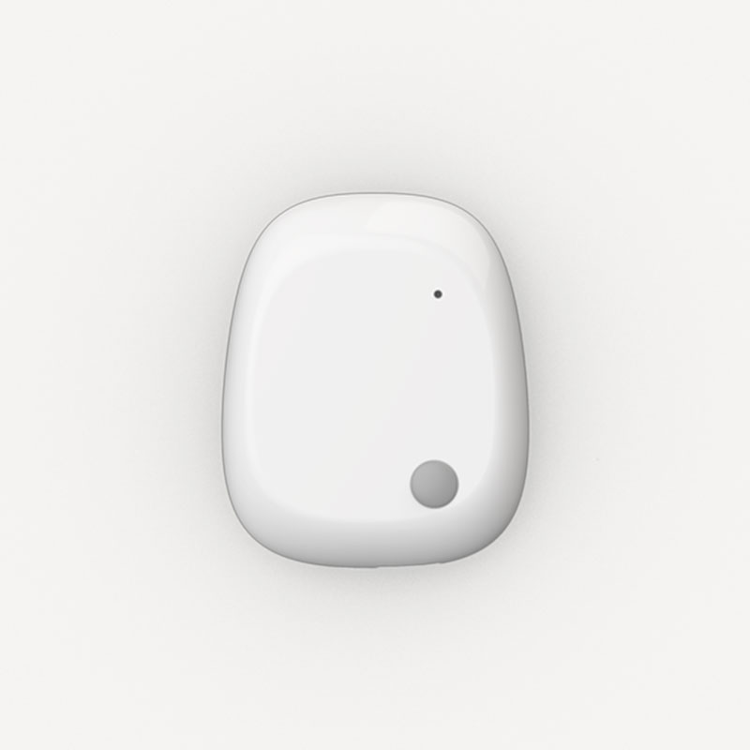
II. Methodology
We used an IMU unit called “MetaMotion”. It includes many sensors.
We used two sensors in collecting data:
Accelerometer
Gyroscope
The IMUs are attached to upper arms and thighs of the trainer.

Slide 7
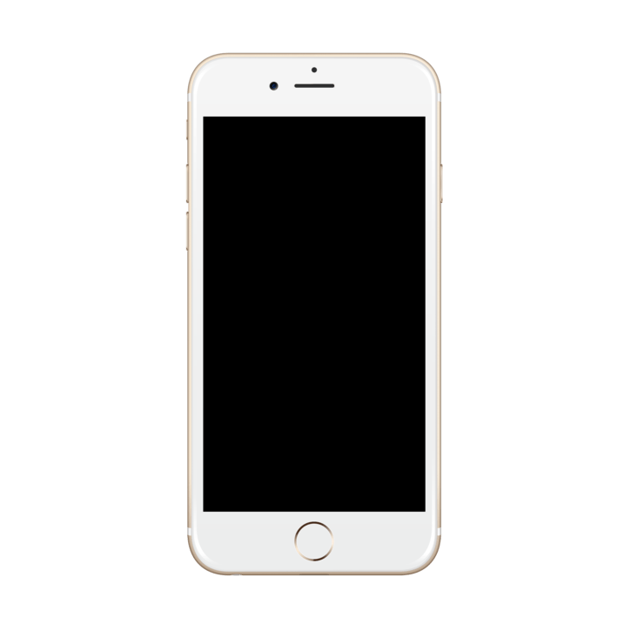
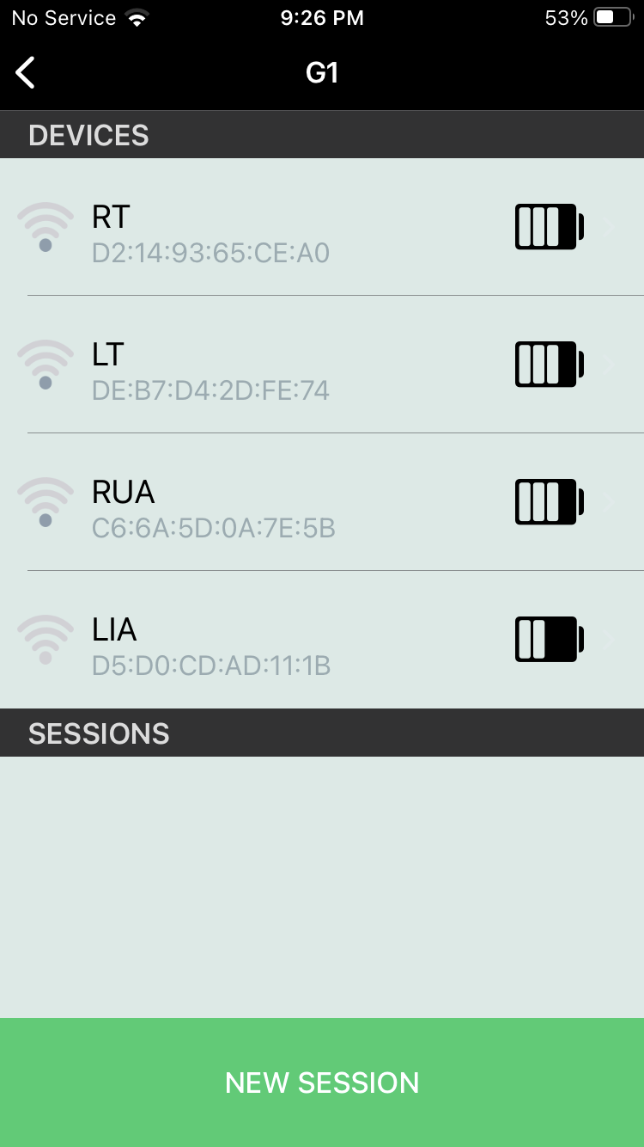
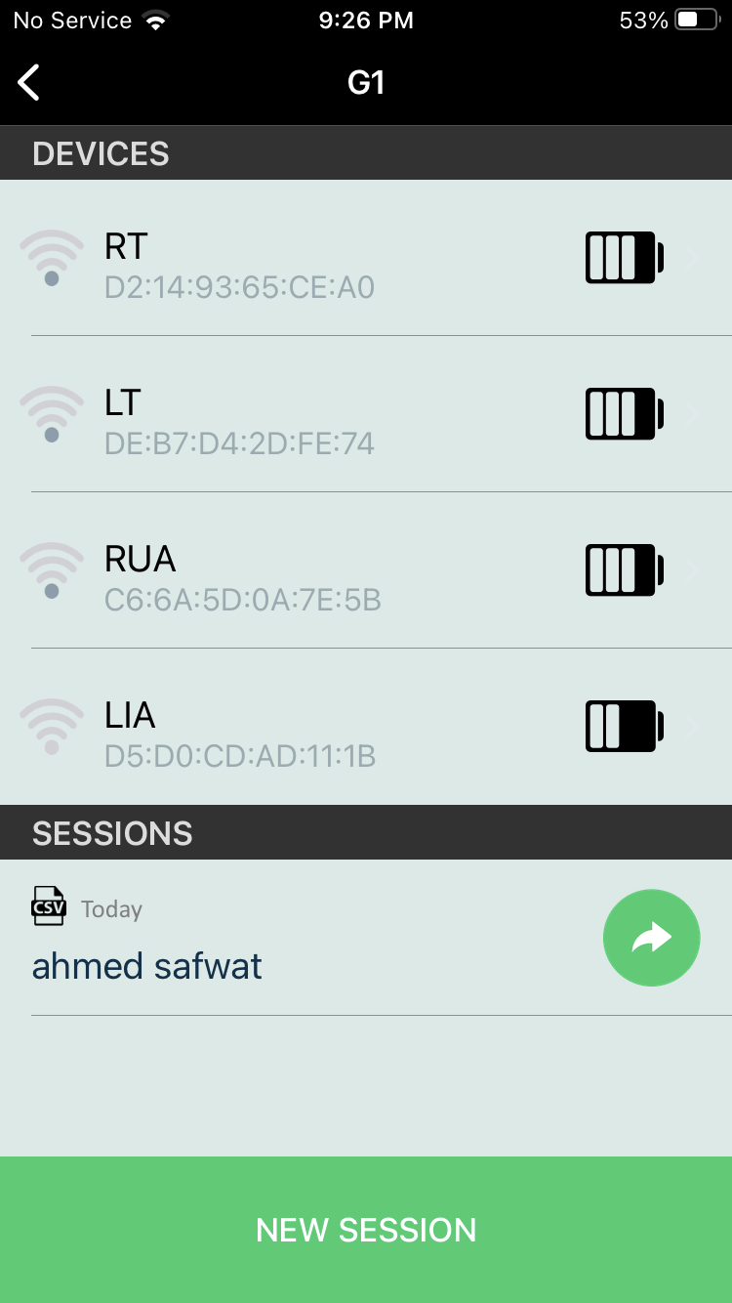
II. Methodology
The data produced by sensor is stored as CSV files in “MetaBase” application after being transferred via Bluetooth.

Slide 8
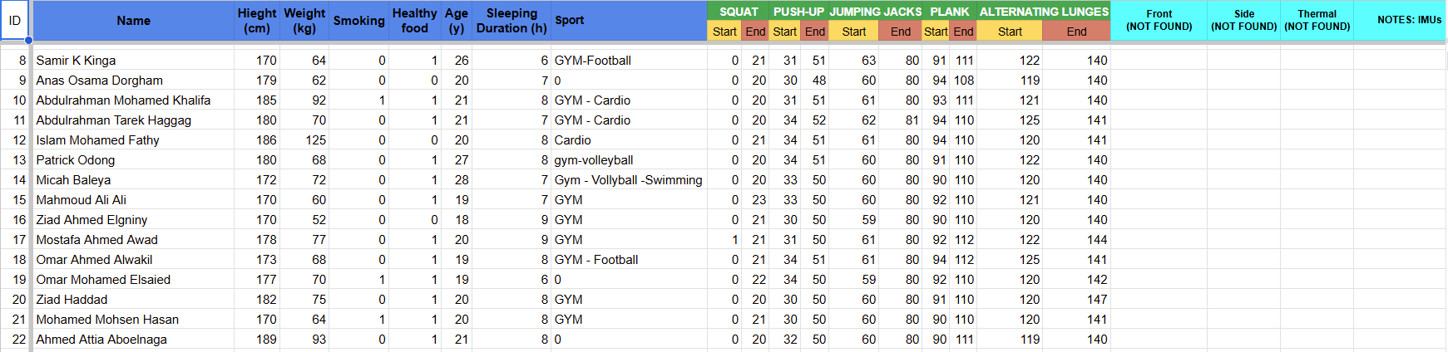
III. Data Representation
III.I. Spreadsheet
We created a spreadsheet in which we stored the data of people we collected the data from and their exercises data.

Slide 9
III. Data Representation
III.I. Spreadsheet
Here is the metadata of the exercisers:

Slide 10
III. Data Representation
III.I. Spreadsheet
We annotated the starting and ending times of each exercise in seconds:

Slide 11
III. Data Representation
III.I. Spreadsheet
We logged any missing data in the sheet:

Slide 12
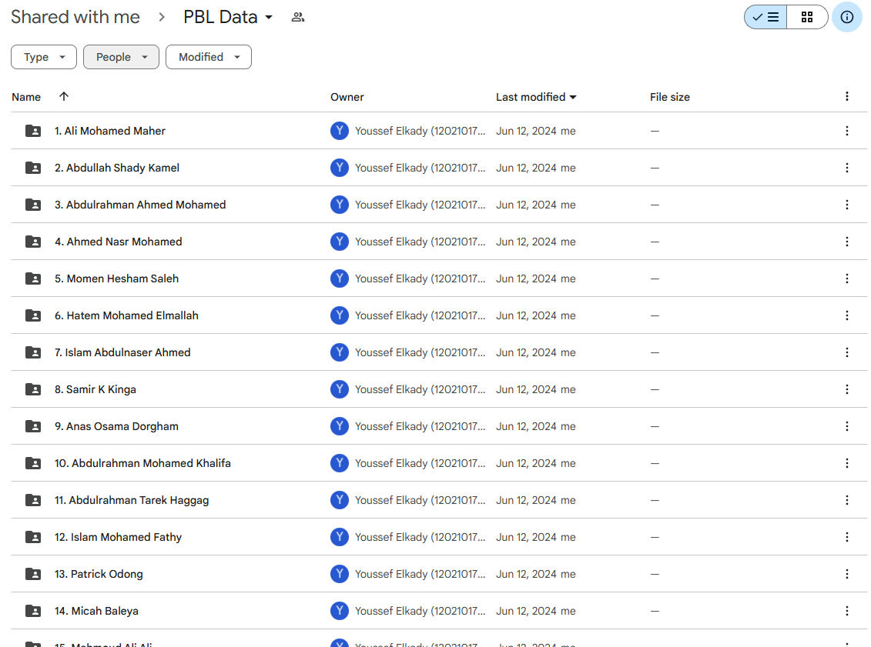
III. Data Representation
III.II. Google Drive
The dataset is stored at a drive on Google Drive as shown.

Slide 13
III. Data Representation
III.II. Google Drive
Each exerciser is named in the form:
#. Name
Where # represents the ID of the exerciser in the spreadsheet.

Slide 14
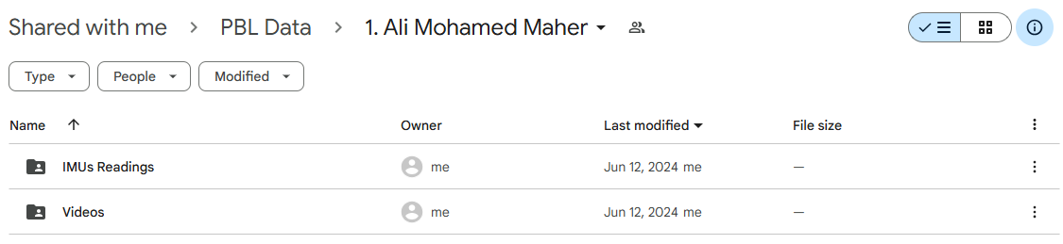
III. Data Representation
III.II. Google Drive
Inside each directory there are two sub-directories:
IMUs Readings
Videos

Slide 15
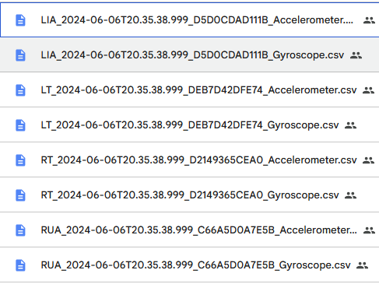
III. Data Representation
III.II. Google Drive
“IMUs Readings” should contain 8 files. 4 for each sensor (Accelerometer and Gyroscope). Each of the four files is for a specific muscle.

Slide 16
III. Data Representation
III.II. Google Drive
We used two groups of IMUs.
The mapping of CSV files’ names for Group 1:
RUA_date_time_..._sensor
LIA_date_time_..._sensor
RT_date_time_..._sensor
LT_date_time_..._sensor
Right Upper-Arm
Left Upper-Arm
Right Thigh
Left Thigh

Slide 17
III. Data Representation
III.II. Google Drive
We used two groups of IMUs.
The mapping of CSV files’ names for Group 2:
RUA2_date_time_..._sensor
LUA2_date_time_..._sensor
RT2_date_time_..._sensor
LR2_date_time_..._sensor
Right Upper-Arm
Left Upper-Arm
Right Thigh
Left Thigh

Slide 18
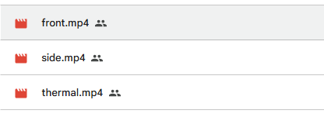
III. Data Representation
III.II. Google Drive
In Videos Directory, there are 3 video files for each camera (with extension mp4, MOV, or any video extension) as shown below.

Slide 19
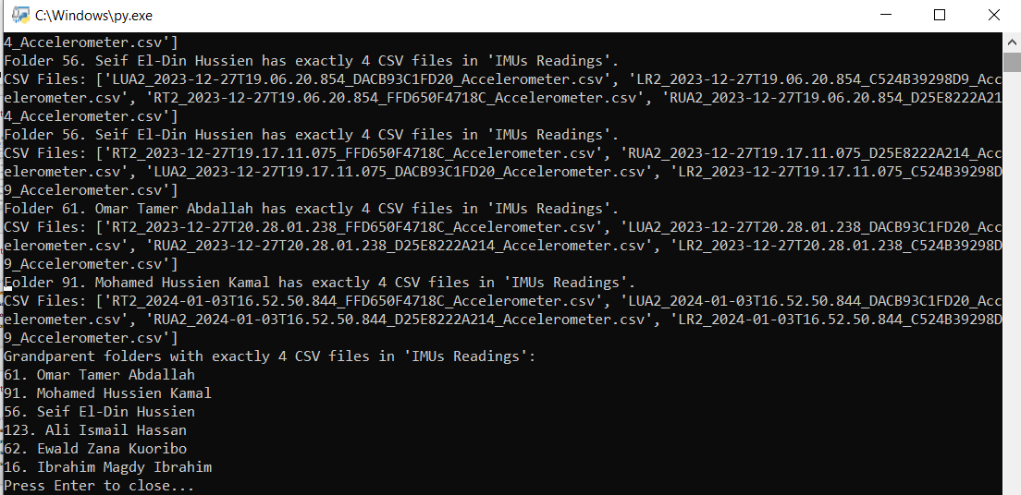
III. Data Representation
III.III. Missing data
Since we are human beings and could do mistakes, we revised the data to check if there missing data from IMUs using scripts to ensure that we logged any missing sensors data in the spread sheet.
Semester 5:

Slide 20
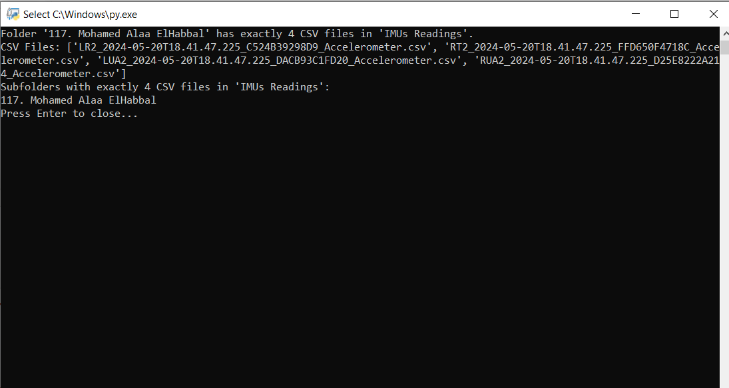
III. Data Representation
III.III. Missing data
Since we are human beings and could do mistakes, we revised the data to check if there missing data from IMUs using scripts to ensure that we logged any missing sensors data in the spread sheet.
Semester 6:

Slide 21
Thank you for listening!

