Slide 1


studyhub
AI
website and mobile application for university students ,
Presented by : Youssef Elshazly

Slide 2



ABOUT
PROJECT
Website
Study planning and
study tools.
Mobile App
\
Study tools on
mobile.
AI
PDF summaries
and questions.

Slide 3

PROJECT
SCENARIO
StudyHub AI is designed around the needs of busy university students
University students can have lectures,
assignments, notes, deadlines and
study material spread across different
places.
e
The idea
The main user is a university
student who wants a simple way to
organise study work and access
study tools.
A
The Scenairo
B
The idea
C
The user
StudyHub AI brings useful study-
management tools together in one
simple website and mobile
application.

Slide 4


PROBLEM AND
SOLUTON
The project focuses on making university study management simpler.
A
The problem
B
The solution
Students can have study files, tasks, schedules and
questions in different places. This can make it harder to
stay organised and find information quickly.
StudyHub AI combines study organisation and study-
support features into one system, with both a website
and a mobile app.

Slide 5


PROJECT
GOALS
what the website and the app are intended to achieve
A
Organise
B
Study
Help students manage tasks
and study plans.
Provide tools for files, Summaries
and questions.
C
Access
D
Simplify
Make study tools available on
both web and mobile.
Keep the interface simple and easy to use.

Slide 6
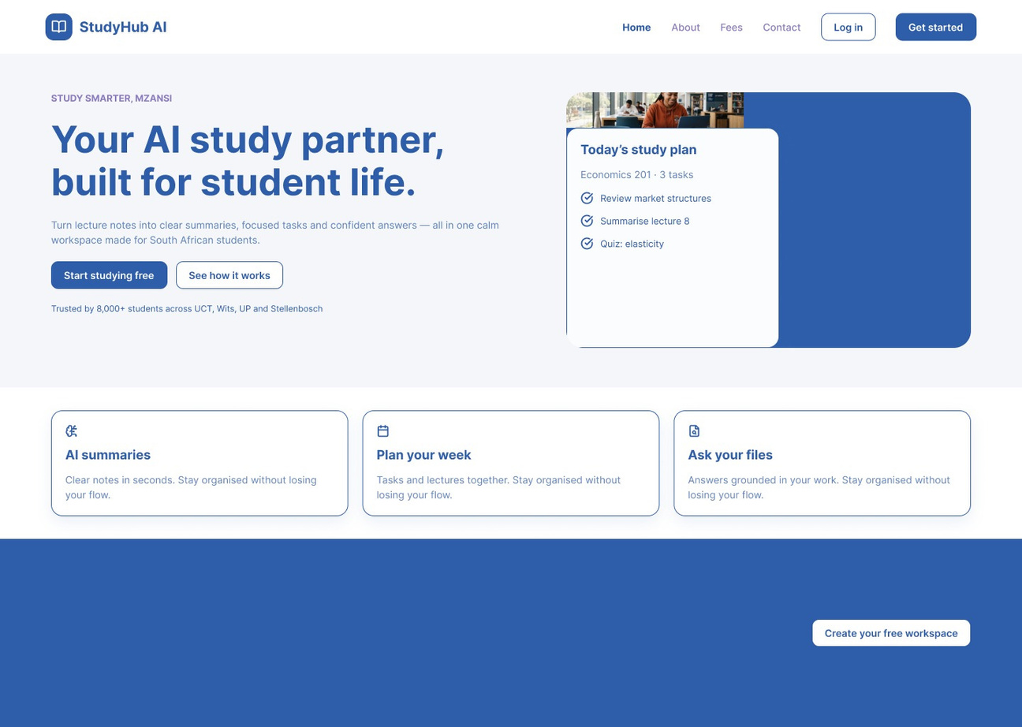
WIREFRAMES
FOR THE WEBSITE
1.
Home Page
Header :
Contains the logo,navigation links (Home, About,Fees,Contact and buttoms for “log in” and “get started”.
Hero Section :
Displays the main headline followed by a short description explaining the platform’s purpose and includes two buttons: Start studying free and See how it works.
Feature cards
AI summaries: Generate clear notes instantly.
Plan your week: Organize tasks and lectures.
Ask your files: Get answers based on uploaded materials.

Slide 7
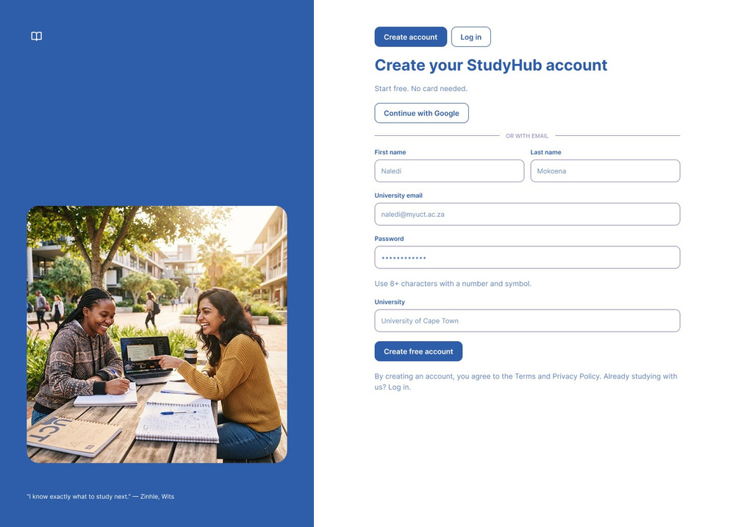
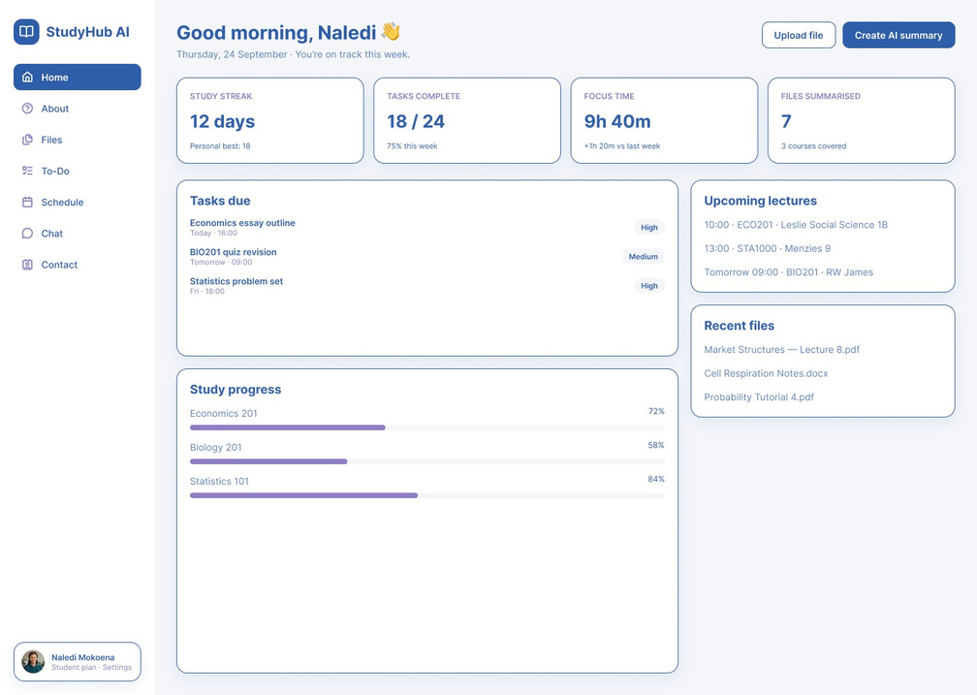
WIREFRAMES
FOR THE WEBSITE
2.Sign up/ Log in Page
3.Dashboard
A simple form to create an account with your email
A home screen after log in, that shows your progress

Slide 8
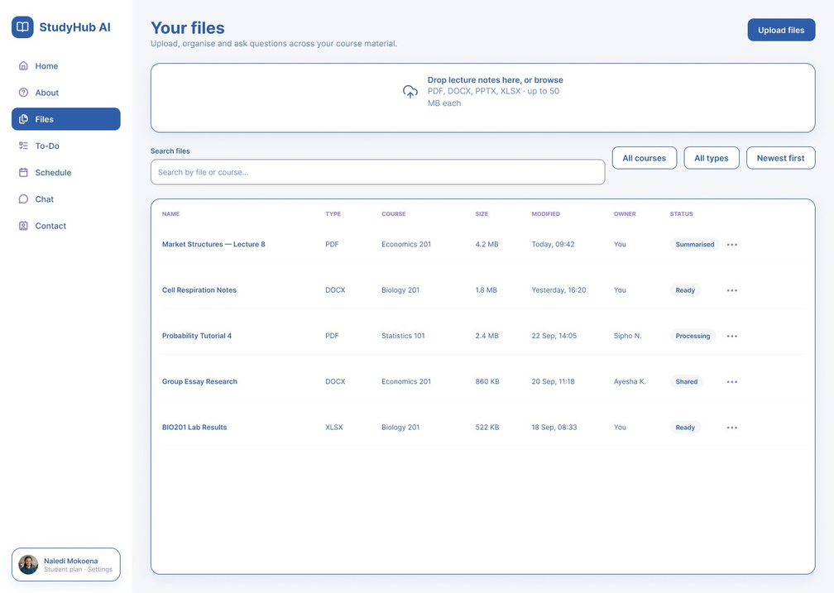
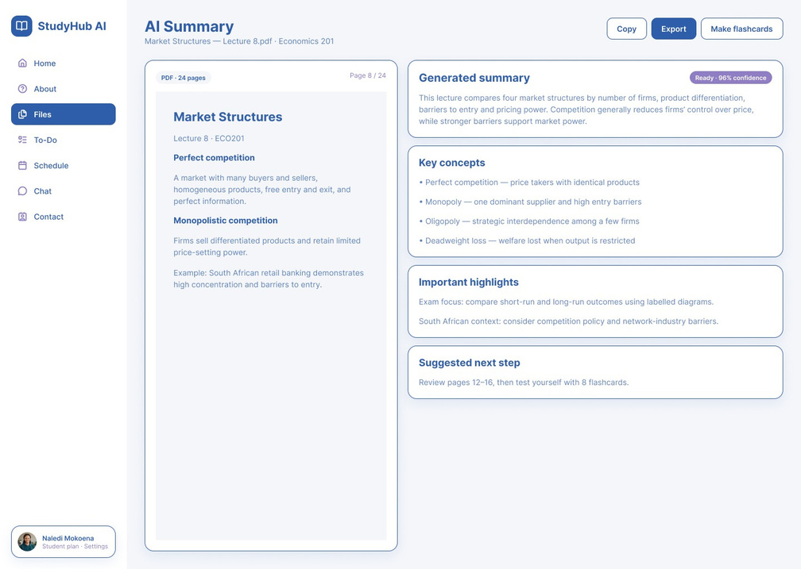
WIREFRAMES
FOR THE WEBSITE
4.Files Page
5.AI Summary
Where students upload their lecture notes like: (PDFs , DOCs....etc)
A table shows each file’s course, size and status, with search and filters.
The original document on the left
The AI shows the summary ,key concepts and important highlights
Student can copy export and make flash cards

Slide 9
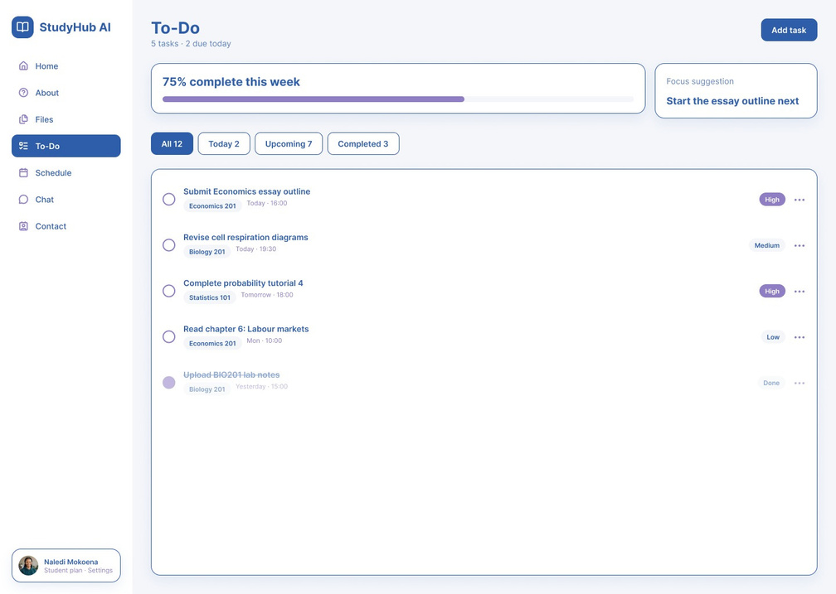
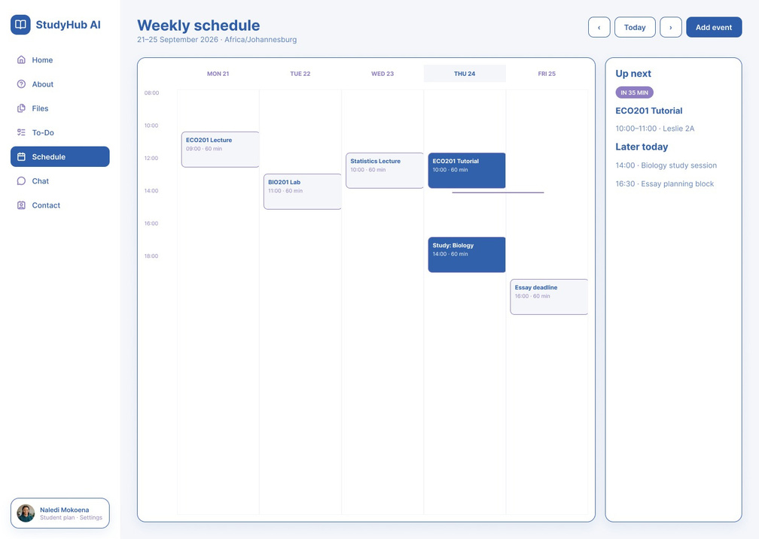
WIREFRAMES
FOR THE WEBSITE
6.To DO List
7.schedule
A task list with priority labels(High,Meduim,Low), A weekly progress bar and an AI (focus suggestion) for what to do next.
A weekly calendar of lectures, labs, study sessions and deadlines, with an “Up next” panel for the next event.

Slide 10
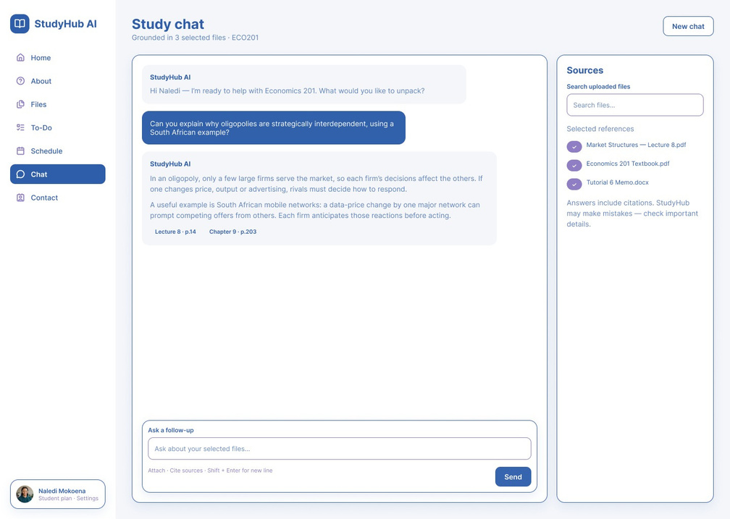
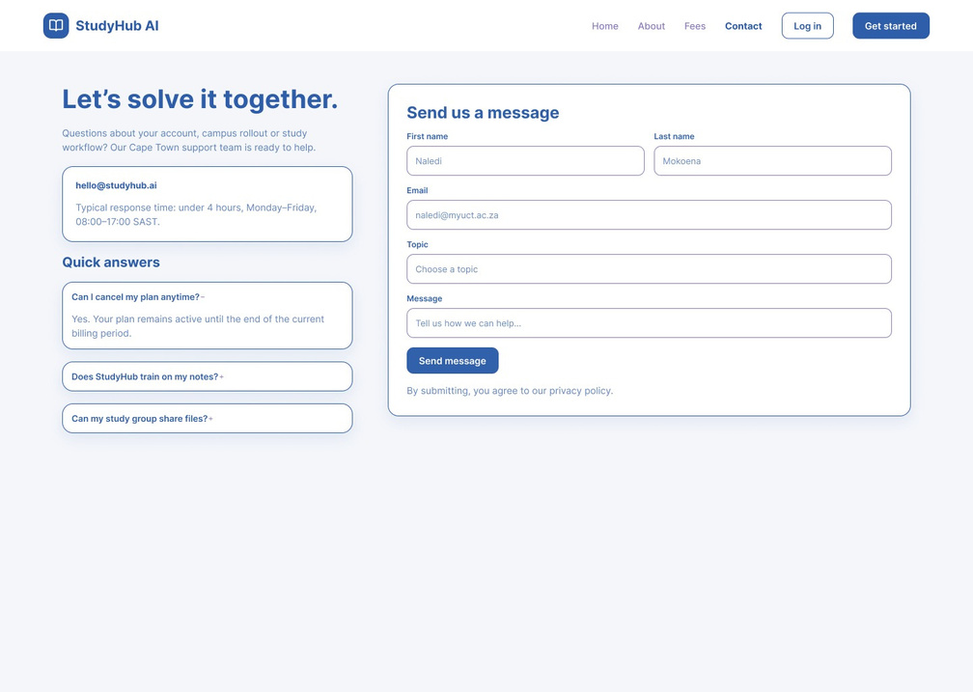
WIREFRAMES
FOR THE WEBSITE
8.Study Chat
9.Contact Page
Students ask the AI questions and get answers based on their own uploaded files, with citations.
A side panel lets them choose which files the AI uses.
A message form on the right and a quick FAQ on the left (cancelling a plan, data privacy, sharing files).

Slide 11
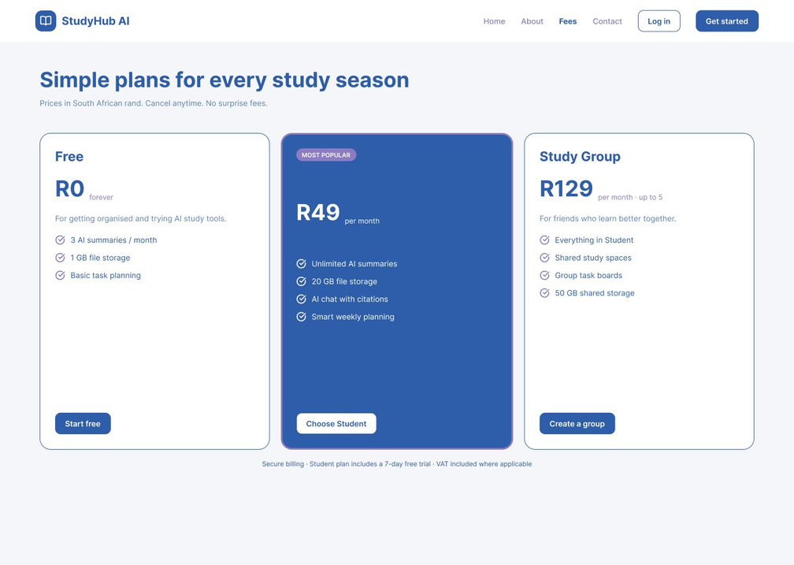
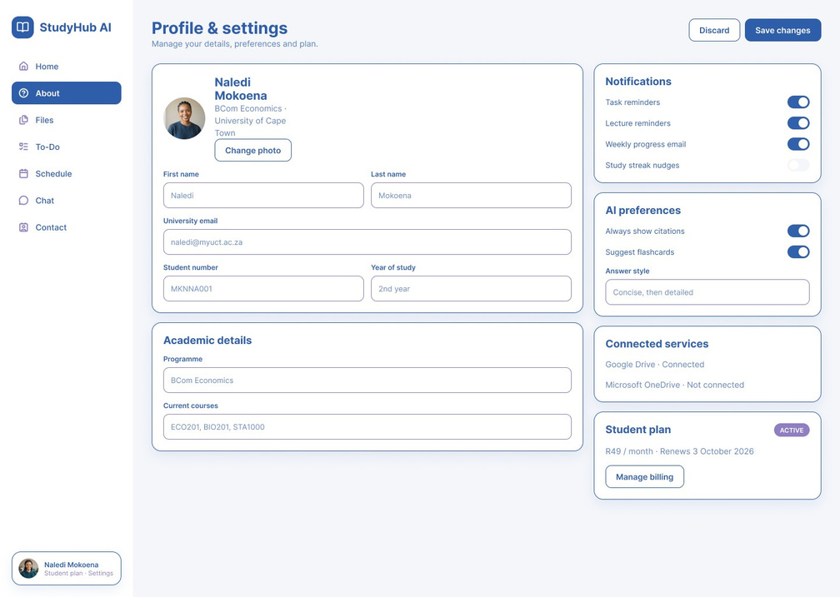
WIREFRAMES
FOR THE WEBSITE
10.Fees Page
11.Profile & settings
Three pricing plans in South African rand:
  Free: R0, for trying the tools
  Student: R49/month, the most popular plan
  Study Group: R129/month, up to 5 people
Personal and academic details, notification toggles, AI preferences, connected services and subscription management.

Slide 12
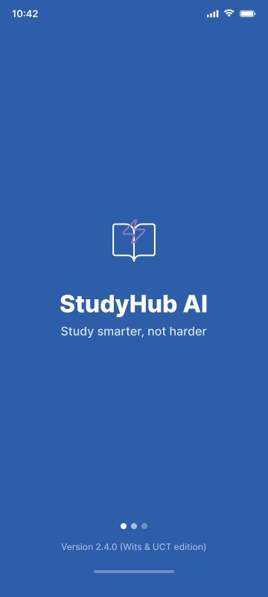
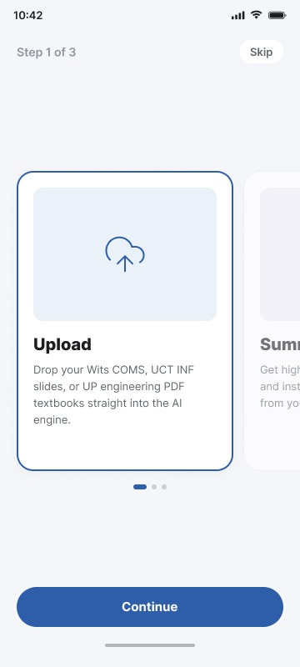
WIREFRAMES
FOR THE APP
1.Splash Screen
2.Onboarding
Screen
It shows the logo
and the slogan
“Study smarter , not harder
A 3-step intro.
Step 1 explains that students
can upload their notes and slides.

Slide 13
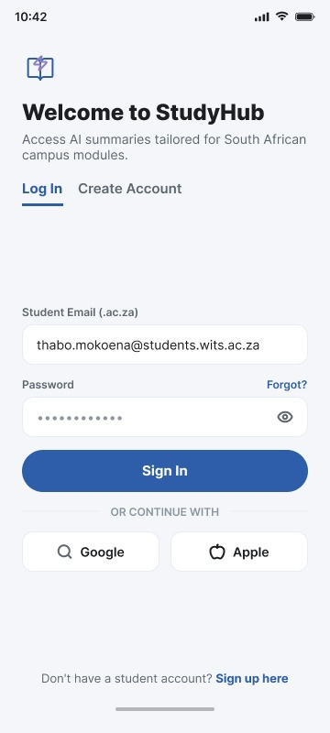
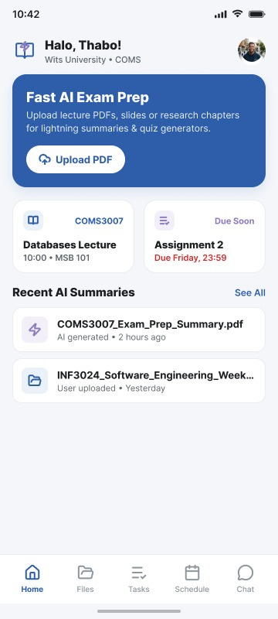
WIREFRAMES
FOR THE APP
3.Log in / Create account Screen
4.Home
A greeting, a button to upload a PDF, the next lecture, the next deadline, and recent AI summaries.
Sign in with a student email, Google, or Apple.

Slide 14
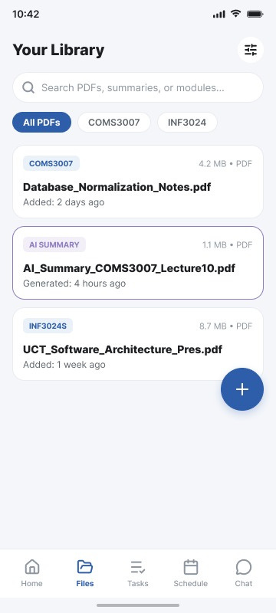
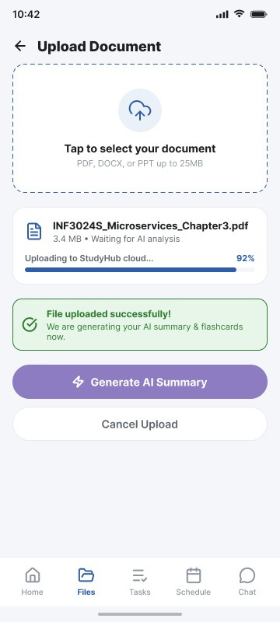
WIREFRAMES
FOR THE APP
5.Your Library
Screen
6.Upload Document
All uploaded PDFs and AI summaries,
with search and course filters.
Pick a file, watch the upload progress, then tap “Generate AI Summary.”

Slide 15
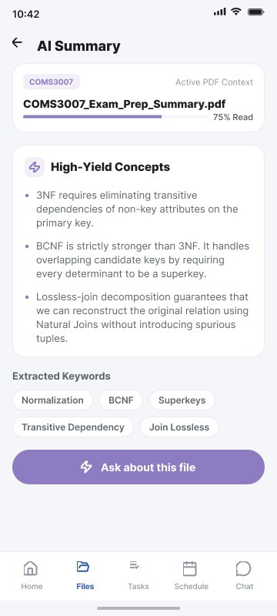
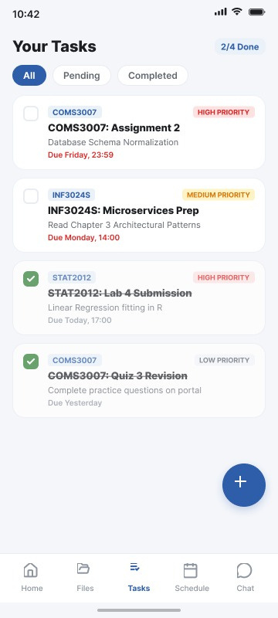
WIREFRAMES
FOR THE APP
7.AI Summary
8. Tasks
Shows the key concepts and keywords from a file, with a button to ask the AI about it.
A to-do list with priority labels (High, Medium, Low) and a done counter.

Slide 16
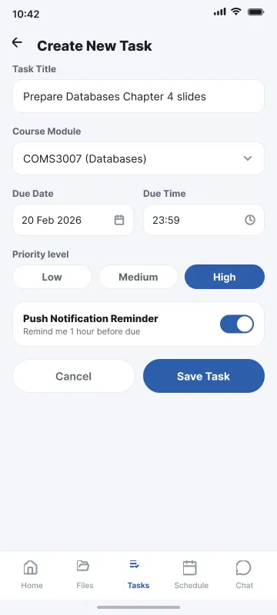
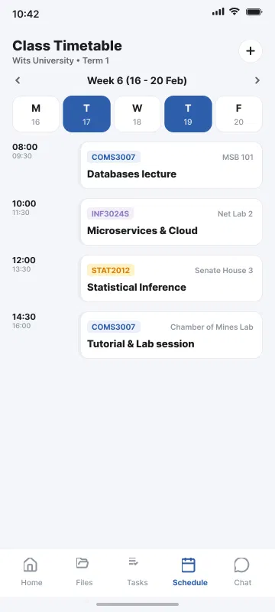
WIREFRAMES
FOR THE APP
9.Create Task
10.Schedule
A form to add a task with a title, course, due date, priority, and reminder.
A weekly class timetable showing time, room, and course.

Slide 17
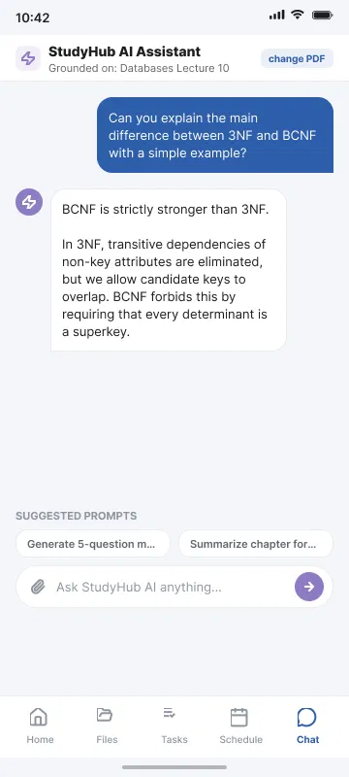
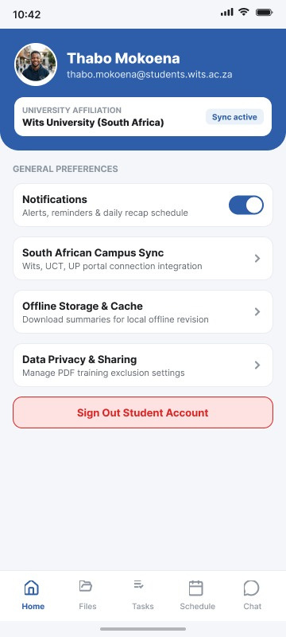
WIREFRAMES
FOR THE APP
11. Chat
12. Profile
Students ask the AI questions about the selected PDF.
Student details, notifications, offline storage, privacy settings, and sign out.

Slide 18

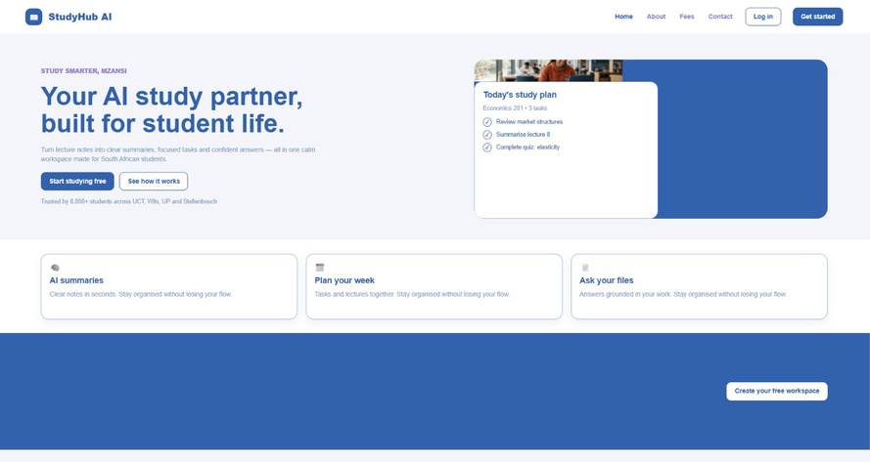
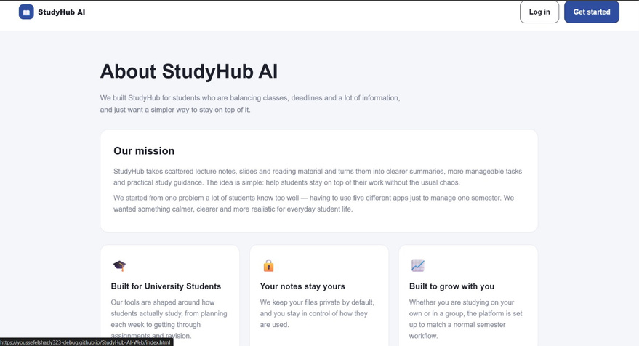
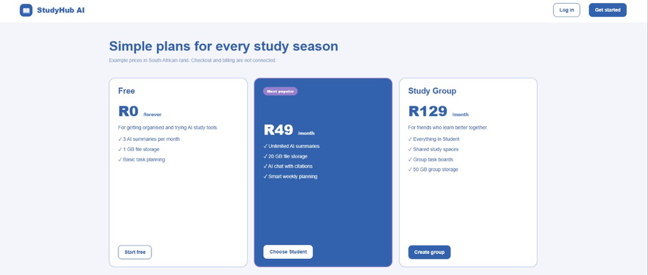
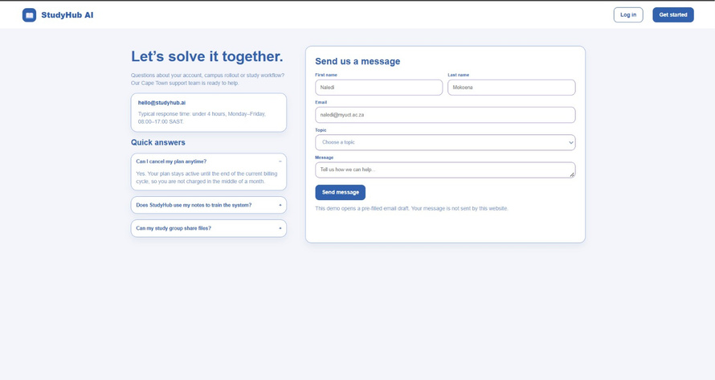
FINAL DESIGN
AND BRANDING
The final design uses a clean study focused visual style.

Slide 19

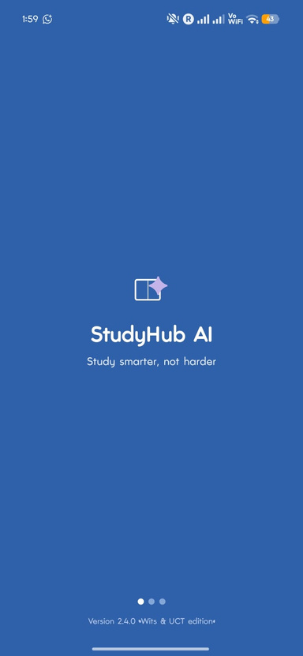
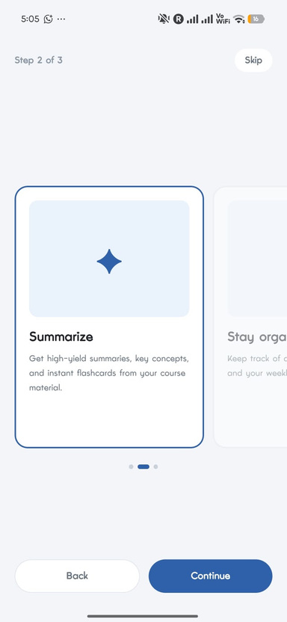
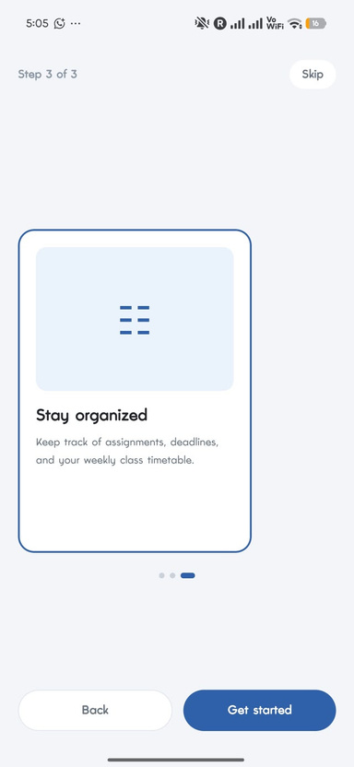
FINAL DESIGN
AND BRANDING
The final design uses a clean study focused visual style.

Slide 20


FINAL DESIGN
AND BRANDING
A
Logo
B
Colours
C
Layout
The StudyHub AI identity is used across the project to keep the website and app connected.
Main project colours include blue, dark blue, purple and a light background.
The interface focuses on clear navigation, readable content and simple study actions.

Slide 21

MAIN
FEATURES
Core features shown across the StudyHub AI website and mobile application.
A
B
C
To-Do List
Schedule
PDF Files
Manage study tasks and track what needs to be completed.
Keep lecture and study planning information organised.
Upload and manage study documents.
D
AI Summaries
E
F
Chat
Mobile Access
Summarise uploaded study material for faster revision.
Ask questions about uploaded study material.
Use study tools through the mobile application.

Slide 22


UPDATES AND
CHANGES
FINAL IMPLEMENTATION
FROM PLANNING TO IMPLEMENTATION
WHAT I WILL EXPLAIN
I improved task editing and navigation because the Task Editor needed to know exactly which task the user selected. I added the task ID to the navigation process so the correct task is loaded instead of editing the wrong task. I also fixed Expo, React Native, Worklets and Reanimated dependency versions because incompatible package versions were causing Android build problems. On the website, I separated the desktop and mobile navigation because the navigation links, especially the Fees link, were not displaying correctly on desktop.
I improved the AI chat server by adding input validation and request limits because invalid or very large requests could cause problems. I added better error handling and an offline demo mode so the website can still respond when the AI service or API connection is unavailable. I also added the OpenAI configuration because the AI chat needs an API key and selected model to generate study answers. Finally, I will explain how these changes made my project more reliable, easier to use and closer to the original StudyHub AI idea.
I moved from the original planning and wireframes to a working Android application and website. I added AsyncStorage because tasks, files and schedules were being kept only in the app state and could be lost when the app was closed. I connected the Schedule screen to the shared StudyHubContext so the schedule uses the same data as the rest of the application instead of keeping separate schedule data.

Slide 23

LIVE WEBSITE
DEMO
A
Published Website
https://youssefelshazly323-debug.github.io/StudyHub-AI-Web/
B
Website GitHub Repository
https://github.com/youssefelshazly323-debug/StudyHub-AI-Web

Slide 24

LIVE MOBILE
APP DEMO
A
Mobile App GitHub Repository
https://github.com/youssefelshazly323-debug/StudyHub-AI-app.git
B
Mobile App Video
https://youtube.com/shorts/wQhATG9lUiY

Slide 25

MAIN PROJECT LINKS FOR THE
WEBSITE, APP, FIGMA AND VIDEOS
Website
https://youssefelshazly323-debug.github.io/StudyHub-AI-Web
Website GitHub
https://github.com/youssefelshazly323-debug/StudyHub-AI-Web
Mobile App GitHub
https://github.com/youssefelshazly323-debug/StudyHub-AI-app

Slide 26
MAIN PROJECT LINKS FOR THE
WEBSITE, APP, FIGMA AND VIDEOS.
Figma Website Design
Figma App Design
https://www.figma.com/design/xwjpMeX74GcLcbv5TQthxN/Untitled?node-id=0-1&t=JSpUPN8iymDv37cu-1
https://www.figma.com/design/fktdV3MbsEKxYTVgstc4zi/Untitled?node-id=0-1&t=nvn42JoOQrKv9QER-1
YouTube Website Video
YouTube App Video
https://youtu.be/aVfj2vlHIsE
https://youtube.com/shorts/wQhATG9lUiY
YouTube Main Video
https://youtu.be/eNbMOLTOmCU

Slide 27


THANK
YOU!
Thank you for exploring the essential steps and considerations in a programmer's project.

