Slide 1
Small office Network Design and implementation
Youssef hussain
Dania Momen Hamama

Slide 2
Network Security and VLAN Implementation
Table of Contents
Summary
Network Requirements
Network Topology
IP Addressing Scheme
Security Consideration
Conclusion

Slide 3
01
02
03
04
Overview of the network design for small office
Four VLANs for traffic segmentation
Each department has its own VLAN + Voice VLAN
Cisco 2811 router for internet access and VLAN gateway
Static IPs for critical devices, dynamic IPs for end-user devices

Slide 4
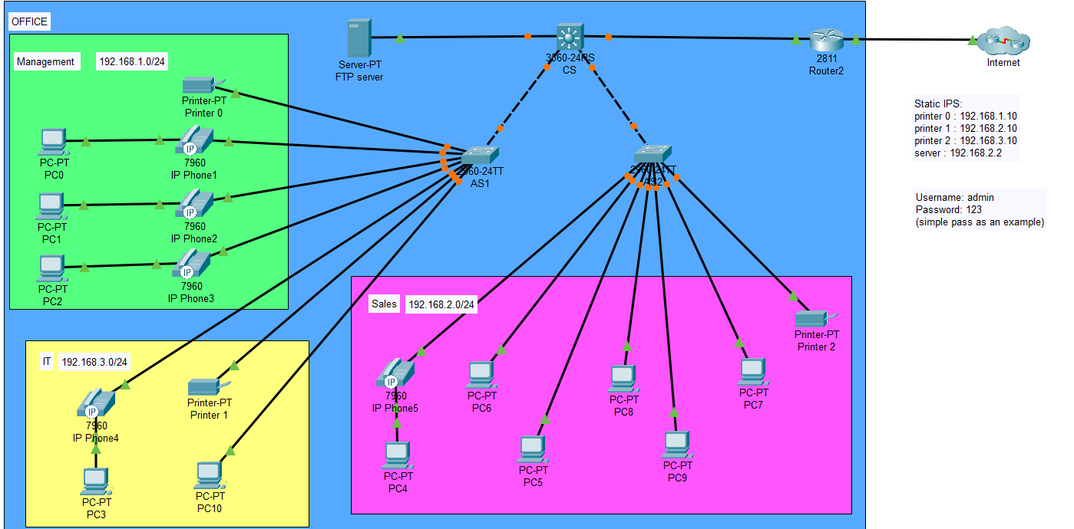

Slide 5
Goals for scalable, secure, and efficient network solution
Supporting different departments with isolated traffic
Secure internet access
VLAN segmentation for enhanced security
Simplify routing and traffic management through IP subnets and DHCP

Slide 6

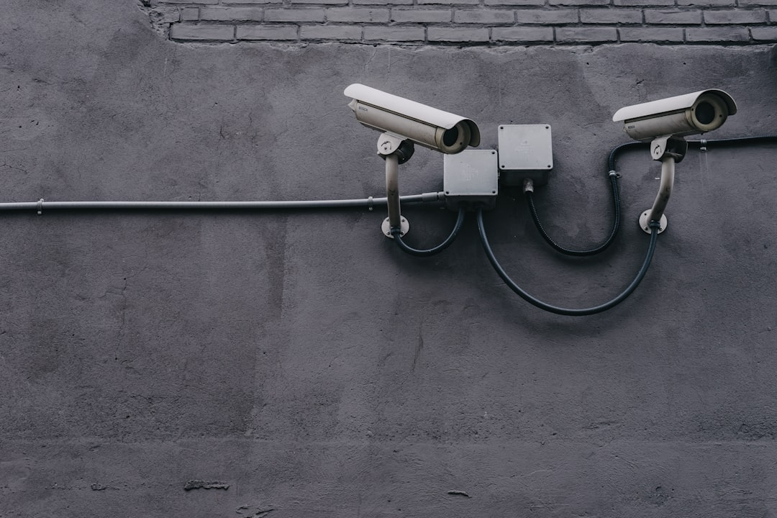
Network Requirements
Number of users and devices
The small office network consists of 11 users and 24 devices.
The network needs to support the connectivity requirements of all users and devices.

Slide 7
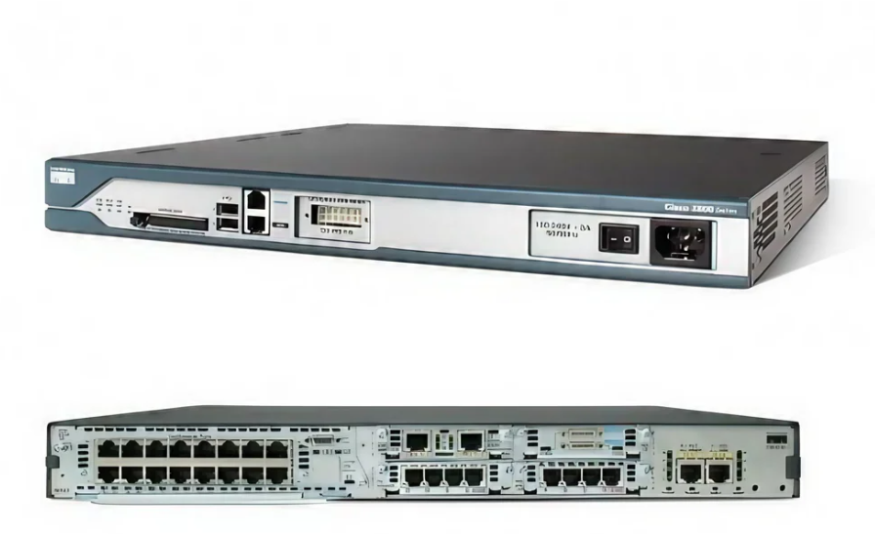
Network Requirements
Internet Connectivity
The internet connectivity for the small office network is provided by a Cisco 2811 Router.
The Cisco 2811 Router also serves as the gateway for The 4 Vlans

Slide 8
Network Topology
VLAN CONFIGURATION AND SEGMENTATION
VLANs are configured to segment traffic for Management, IT, and Sales departments
Each department has its own VLAN and subnet for isolated traffic and enhanced security
Reduces broadcast domains and allows for efficient traffic management

Slide 9
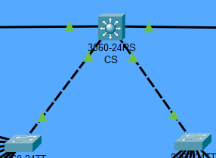
Network Tepology
ROUTER AND SWITCH CONNECTIONS
Cisco 2811 router is connected to two Cisco 2960 Access switches in the network topology
Those switches are used to connect different departments and their devices through VLANs
Router provides internet access and serves as the gateway for all VLANs

Slide 10



IP Addressing Scheme
SUBNET OVERVIEW AND IP ASSIGNMENT
The network design includes 4 VLANs, each with its own subnet for simplified routing and traffic management.
Static IPs are assigned to critical devices such as printers, servers, and routers to ensure consistent addressing.
End-user devices like PCs and phones will obtain dynamic IPs via DHCP from the server for ease of management and scalability.

Slide 11
SECURITY CONSIDERATION
VLAN segmentation
Implement VLAN segmentation to separate network traffic from different departments or groups of devices.
Use VLANs to reduce broadcast traffic and enhance security by isolating traffic.
Incorporate VLANs in the network design to improve security and network management.

Slide 12


Security Consideration
SSH ACCESS
Enabled Secure Shell (SSH) access on switches and router for secure remote management
Utilize SSH to establish a secure connection for remote administration of network devices

Slide 13


Security Consideration STRONG PASSWORD AND ENCRYPTION
Enforce the use of strong passwords for device logins, such as for VTY lines, to enhance security.
Implement encryption for device logins to protect sensitive information and enhance overall network security.

Slide 14
Conclusion SUMMARY OF NETOWRK DESING AND IT’S BENEFITS
The network design incorporates VLAN segmentation, IP addressing, and secure internet connectivity to provide a scalable and efficient solution.
VLAN segmentation allows for departmental separation, efficient traffic management, and secure access to shared resources.
The design supports different departments with isolated traffic, enhancing security and network performance.
The scalable nature of the network design ensures it can accommodate future expansion if needed.

