Slide 1
Kampala PM2.5 · Smart City Capstone
draftTwo
Kampala PM2.5 Defense Split
Opening line
The project is not just a PM2.5 model. It is an honest test of whether cheap data can support planning decisions at places without dense sensors.
Five presenters · one coherent research story · honest model decisions
Problem → Features → NOW → FUTURE → Audit
25 min
5 × 5
k=4
LSTM
total presentation
five people, five minutes
accepted NOW / safety
accepted FUTURE headline
Notes:
Introduce this as the draftTwo split requested by research stage. Each person owns a complete story.

Slide 2
Kampala PM2.5 · Smart City Capstone
presentation flow
25-Minute Flow
Each presenter owns a complete research stage, not a random set of files.
Person 1
Person 2
Person 3
Person 4
Person 5
Problem, Data & Stage 1
Why the project exists and what the data shows.
Stage 2 Features
How raw data became model-ready.
NOW Prediction
New-site prediction, categorization, safety tiers.
FUTURE Forecasting
Forecast horizons, LSTM, RF and rolling challengers.
Prototype & Audit
Tool, k=6 rejection, final recommendations.
Target: 5 minutes per person · each section ends with one key message

Slide 3
Kampala PM2.5 · Smart City Capstone
Person 1 · Stage 1
Why This Project Exists
Kampala needs air-quality insight where sensors are sparse.
Research question
PM2.5
15 µg/m³
~94%
Can free data give a planner trustworthy PM2.5 where there is no sensor, and a few days ahead?
fine particles linked to health risk
WHO 24-hour guideline
days above WHO guideline
Random splits answer gap-filling, not real deployment.
The honest NOW test hides whole sensor sites.
The honest FUTURE test predicts later dates chronologically.

Slide 4
Kampala PM2.5 · Smart City Capstone
Person 1 · data
Data Sources and Dataset Shape
One site-day table joins pollution, weather, satellite, and location signals.
39
13,944
38.2
2019-05-23 → 2020-12-31
AirQo sensor sites
site-days
mean PM2.5 µg/m³
study period
AirQo sensors
ERA5 weather
Satellite LST
Geospatial data
Ground truth daily PM2.5 readings across 39 Kampala-area sites.
Temperature, dewpoint, wind, pressure, and precipitation.
Land-surface temperature was carried, but cloud gaps and low value limited adoption.
Road density, distance to major roads, elevation, and building-density experiments.

Slide 5
Kampala PM2.5 · Smart City Capstone
Person 1 · explore & frame
Stage 1 Findings: Pollution Is Structured but Hard
The exploration explains why a naive model fails.
MNAR idea
94%
81%
84%
LST gaps are not random: clouds hide the surface and also relate to pollution/weather regimes.
site-days above WHO 15
daytime LST missing/gapped
night LST missing/gapped
PM2.5 distribution is skewed and frequently unsafe.
Seasonality and temporal patterns matter.
Correlation analysis showed no single easy predictor solves the task.
LST missingness contains information but LST itself was not adopted as a core lever.
Key message
Before building models, we proved pollution is seasonal, difficult to predict, and that LST missingness carries information.

Slide 6
Kampala PM2.5 · Smart City Capstone
Person 2 · Stage 2
From Raw Rows to Model-Ready Features
Stage 2 is about the site-day grain and repeatable feature construction.
Site-day grain
Shared feature module
Model-ready table
Each row is one sensor site on one day. This keeps NOW and FUTURE validation aligned with deployment.
`analysis/features.py` centralizes loading, engineered weather, category assignment, and lag panels.
The model sees weather, location, calendar, geodata, and only deployable PM2.5 history when allowed.
Temperature and dewpoint support relative humidity.
Wind u/v becomes wind speed, a ventilation signal.
Month and day-of-week capture calendar patterns.
FUTURE uses calendar-aware lags and rolling averages.

Slide 7
Kampala PM2.5 · Smart City Capstone
Person 2 · features
Features Are Also a Deployment Contract
Every input must be classified by whether a real planner can obtain it.
Zero deploy
Short deploy
Research only
Lat/lon, calendar, ERA5 weather, OSM roads, elevation, and static geodata can be used without a PM2.5 sensor.
First N days of PM2.5 history can infer a site category, then evaluation must start after that window.
Full-history category uses the held-out site’s complete PM2.5 behavior and is an oracle upper bound.
Success driver
Presenter key message
The project succeeds because features are engineered and evaluated carefully, not because one fancy learner solves everything.
Feature engineering and deployability are the scientific backbone of the model claims.

Slide 8
Kampala PM2.5 · Smart City Capstone
Person 2 · leakage guardrails
Banned Features and Leakage Guardrails
The model is not allowed to use information unavailable at prediction time.
PM10 banned
n_obs banned
Category caution
Same-instrument pollutant and highly target-coupled. It would inflate performance unrealistically.
A by-product of the daily mean, not an input available at a sensor-less place.
A PM2.5-derived category is safe only when the deployment setting supplies the PM2.5 history.
Train/test splits must hide whole sites for NOW.
Chronological splits must respect forecast target dates for FUTURE.
Category priors must be fit inside folds or rejected.
Random split numbers are diagnostic only.

Slide 9
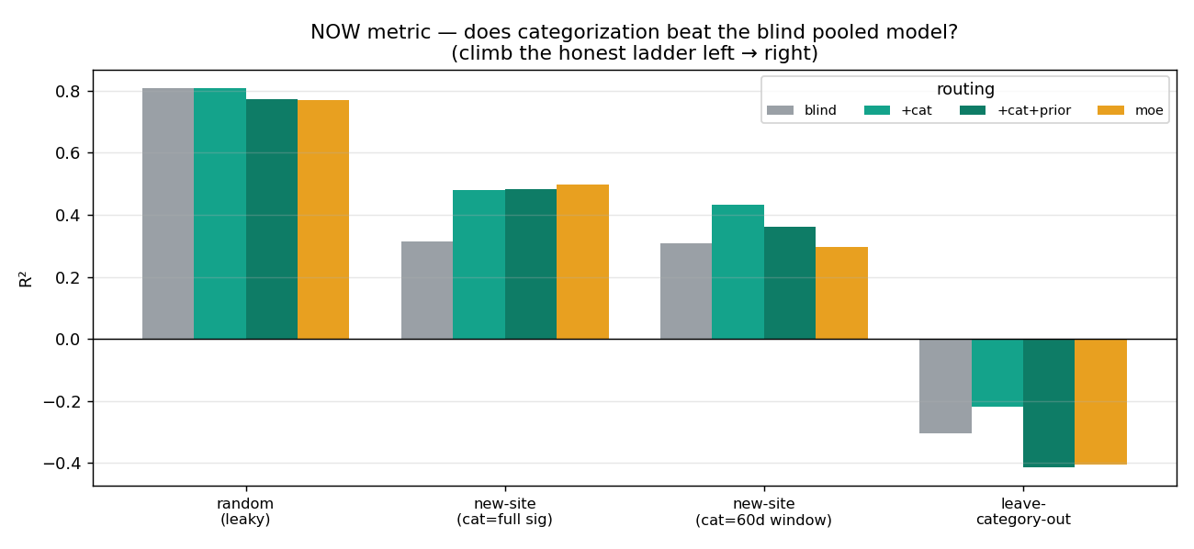
Kampala PM2.5 · Smart City Capstone
Person 3 · NOW
NOW Prediction: New Locations, Not Random Rows
Estimate current PM2.5 where no air-quality sensor exists.
Goal
Why random split misleads
Honest validation
Predict today’s PM2.5 pollution level at a location without a sensor.
A random split trains and tests on rows from the same monitoring sites, so the model can look better than it will in deployment.
Leave-Sites-Out removes entire monitoring sites from training and tests on those unseen locations.
~0.32
~0.48
blind leave-site-out R²
+category R²
Transition
The question becomes: how can the model understand what kind of place a new site is?
Notes:
Up until this point, we have discussed the problem, the data sources, and the feature engineering process.
My part focuses on the first major prediction task in the project, which we call NOW prediction.
The goal of NOW prediction is to estimate the current PM2.5 pollution level at a location where no air-quality sensor exists.
At first glance, predicting pollution might seem straightforward. We have weather information, location information, and historical measurements. However, there is a major challenge.
Most machine learning projects use a random train-test split. The problem is that a random split allows the model to train and test on data from the same monitoring sites. This can produce overly optimistic results.
In reality, if we deploy the model, we want to predict pollution at a completely new location. To simulate this real-world scenario, the project uses a much stricter validation approach called Leave-Sites-Out validation. This means that entire monitoring sites are removed from training and only used for testing.

Slide 10
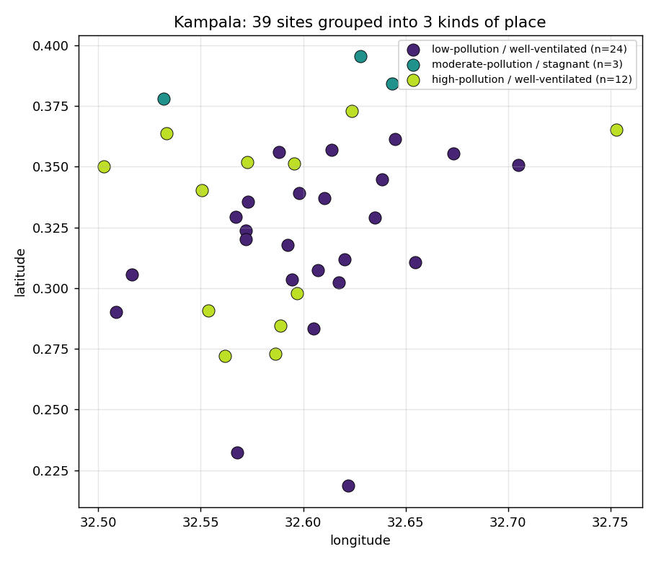
Kampala PM2.5 · Smart City Capstone
Person 3 · categorization
Key Insight: Group Sites by Pollution Regime
The model improves when it learns that different locations behave differently.
Behavioral signature
Pollution regimes
Average PM2.5, variability, seasonal behavior, and weather conditions describe each site.
Some sites are consistently low, some are traffic/urban hotspots, and some fluctuate strongly.
Accepted model: k=4
Audit result: k=6
k=4 gives the best balance between performance, robustness, and deployability.
k=6 captures meaningful finer regimes, but small groups and full-history assignment make it fragile.
Bottom line: k=6 remains a research direction; accepted production remains k=4.
Notes:
The biggest contribution of the NOW model is the idea of site categorization.
We observed that not all monitoring locations behave the same way. Some sites consistently have low pollution levels. Others are heavily affected by traffic or urban activity. Others experience large fluctuations throughout the year.
Instead of treating all sites identically, the project first groups sites into behavioral categories, or pollution regimes.
To create these categories, the system analyzes characteristics such as average PM2.5 levels, pollution variability, seasonal behavior, and weather conditions.
Initially, the project used four categories, known as k=4 categorization. During the improvement audit, we investigated a more detailed six-category approach, called k=6 categorization.
The results showed that k=6 captured meaningful pollution regimes and sometimes achieved higher scores. However, it was also more fragile, with some categories containing only a few sites.
Most importantly, the strongest k=6 results required information that would not be available for a truly new site. Therefore, although k=6 remains an interesting research direction, the accepted production model remains k=4.

Slide 11
Kampala PM2.5 · Smart City Capstone
Person 3 · pipeline + safety
Model Pipeline and Safety Tiers
After estimating PM2.5, the output becomes easier to act on.
1 · assign category
2 · add features
3 · predict PM2.5
4 · convert to tier
Use the site’s pollution regime as a model feature.
Weather, location, calendar, and external geospatial features.
Tested XGBoost, Random Forest, LightGBM, and CatBoost.
Elevated, High, or Dangerous for planner decisions.
~0.55
68%
98.5%
Core finding
Feature engineering and site categorization mattered more than simply switching algorithms.
Category + Geodata R²
exact safety tier
within one tier
Conclusion
NOW prediction estimates pollution at unsensed locations; k=4 categorization remains accepted because it balances performance, robustness, and deployability.
Notes:
Once a site category is assigned, the model combines that information with other features such as weather data, geographic location, calendar information, and external geospatial features.
The project tested several modeling approaches, including XGBoost, Random Forest, LightGBM, and CatBoost.
One important finding was that feature engineering and site categorization contributed more to performance than simply switching machine learning algorithms. In other words, understanding the behavior of locations was more important than choosing a different model.
After predicting PM2.5, the system converts the prediction into a safety category. Instead of focusing only on an exact pollution value, the model also provides operational safety levels: Elevated, High, and Dangerous.
This makes the output easier to interpret for planners and decision makers. The project also evaluated safety-tier accuracy and dangerous-day detection, since these are often more useful in practice than a small improvement in regression accuracy.
To summarize, the NOW prediction task focuses on estimating pollution at locations without sensors. The project's main contribution is the introduction of site categorization, which allows the model to learn different pollution regimes across Kampala.
Although more complex categorization strategies were explored, the final recommendation remains the k=4 approach because it provides the best balance between performance, robustness, and deployability.

Slide 12
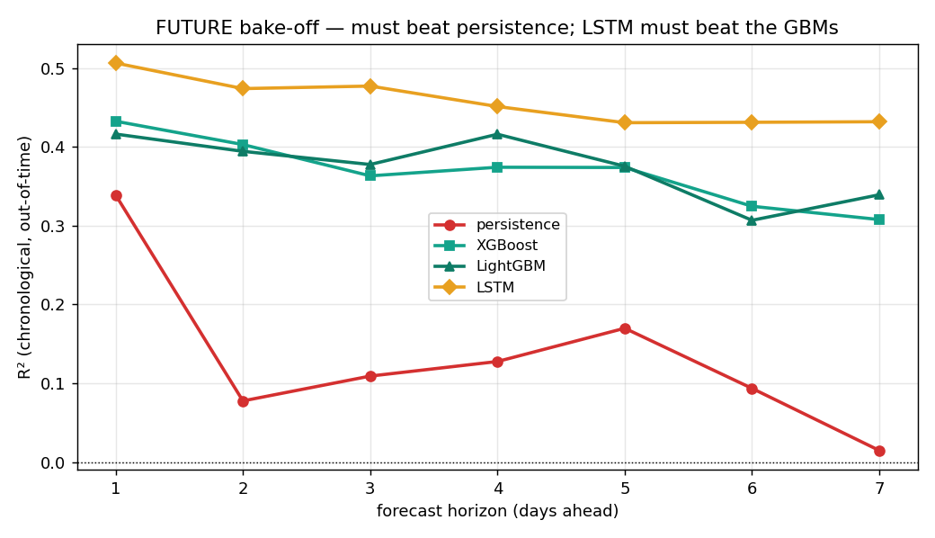
Kampala PM2.5 · Smart City Capstone
Person 4 · FUTURE
FUTURE: Forecast Several Days Ahead
This task is known-site forecasting, not zero-deploy new-site prediction.
+1, +3, +5, +7 days
Lag features
Persistence baseline
Learners
Forecast horizons are evaluated separately because difficulty changes with time.
PM2.5 lag 1/2/3/7 and rolling means carry recent pollution memory.
The model must beat “same as yesterday” and rolling-window baselines.
XGBoost, LightGBM, LSTM, RF challenger.

Slide 13
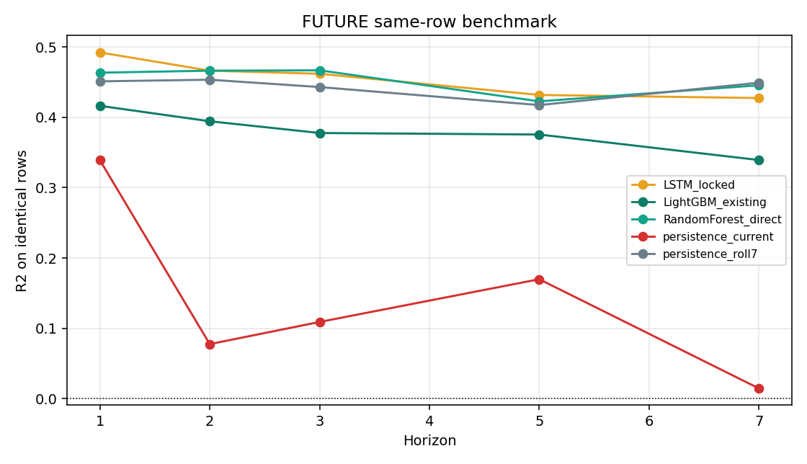
Kampala PM2.5 · Smart City Capstone
Person 4 · challengers
LSTM Remains Headline, Challengers Matter
The latest fair benchmark keeps the claim honest.
Accepted headline
LSTM remains strongest overall and is the accepted FUTURE model for the capstone.
Latest audit
Random Forest and rolling-7 are competitive at some horizons, especially longer ones.
What not to say
Do not claim RF beats LSTM overall. It is a challenger baseline.

Slide 14
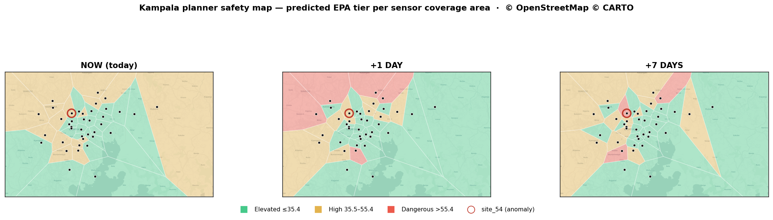
Kampala PM2.5 · Smart City Capstone
Person 5 · prototype
Interactive Prototype: The Planner View
The project is packaged as browser-facing evidence, not only scripts.
Safety map
Coverage cells show predicted EPA tier for monitored areas and forecast views.
Predict location
A planner can enter a location and see predicted tier, PM2.5 estimate, uncertainty, and alert logic.
Uncertainty
Conformal-style bands communicate that new-site prediction is harder than seen-site prediction.
Important page: pages/kampala_planner_prototype.html

Slide 15
Kampala PM2.5 · Smart City Capstone
Person 5 · final audit
Final Audit: The Honest Recommendation
The strongest contribution is rejecting improvements that cannot realistically deploy.
≈0.58
≈0.51
≈0.56
LSTM
k=6 full-history upper bound
best deployable k=6
accepted k=4
accepted FUTURE headline
Research integrity
Final conclusion
Separate oracle upper bounds from deployable models. Label leakage risks. Keep negative results.
Accepted NOW = k=4. Accepted FUTURE = LSTM. RF = challenger. k=6 = research direction.
Closing line: “The project is academically valuable because it is honest about what works, what does not, and what cannot be deployed.”

