Slide 1
Kampala PM2.5 · Smart City Capstone
draftOne
Trustworthy PM2.5 Where There Is No Sensor
Core defense line
We did not replace the model just because one score looked better. The final recommendation separates deployable models from oracle upper bounds.
A five-person capstone defense flow for the Kampala air-quality project
NOW: k=4 accepted
FUTURE: LSTM headline
k=6: research only
39
13,944
68%
98.5%
AirQo sensor sites
site-days
NOW exact safety tier
within one tier
Notes:
Opening: state that this is a 25-minute group defense split into five 5-minute parts.

Slide 2
Kampala PM2.5 · Smart City Capstone
5 presenters
Who Presents What
Each person owns one clear part of the research story.
Person 1 · Problem + Data
Person 2 · NOW Model
Person 3 · Planner Tool
Person 4 · FUTURE Forecast
Person 5 · Final Audit
Why random-split PM2.5 models fail at new sites.
Categorize-then-predict and why k=4 remains accepted.
Geodata, EPA safety tiers, and the prototype.
LSTM headline and RF / rolling-7 challengers.
What to claim, what not to claim, final recommendation.
Timing target: 5 minutes per presenter · 25 minutes total

Slide 3
Kampala PM2.5 · Smart City Capstone
Person 1
The Real Question Is Generalization
The project is about whether the model works at places and times it has not seen.
Defense point
0.81
0.316
+1…+7
A planner needs PM2.5 at a sensor-less location, not just gap-filling at sensors already seen during training.
leaky random split R²
honest new-site R²
future forecast horizons
NOW: predict today at a held-out site.
FUTURE: forecast ahead at known sites using past history.
Different question, different honest test, different accepted model.

Slide 4
Kampala PM2.5 · Smart City Capstone
Person 1
Data and Feature Rules
The strongest defense starts with what the model was allowed to know.
39
2019–2020
~84%
sensor sites
daily PM2.5 panel
daily coverage
Allowed inputs
Banned inputs
Key distinction
Weather, location, calendar, road density, distance to major road, elevation, and optional PM2.5 history for deploy windows.
pm10 and n_obs are target-coupled or unavailable at a sensor-less site. Using them would manufacture a fake win.
Zero-deploy features are available immediately. Short-deploy features require temporary PM2.5 observations.

Slide 5
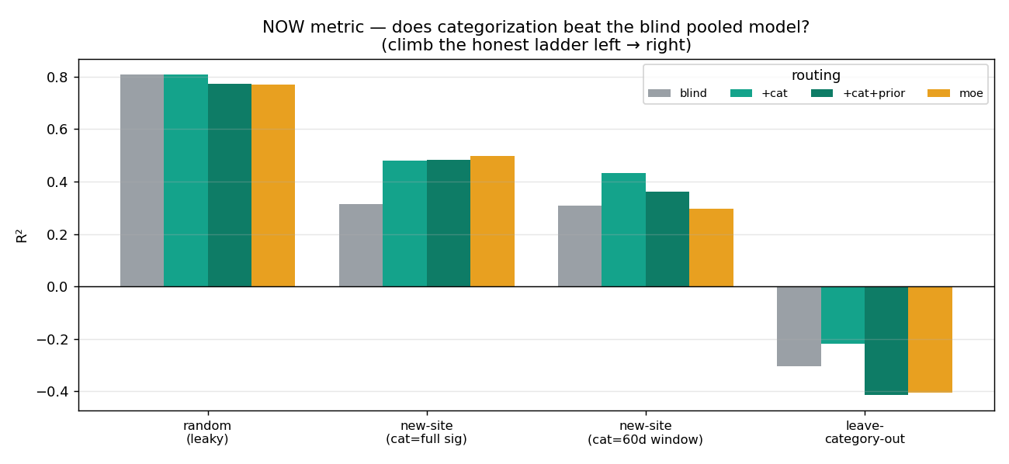
Kampala PM2.5 · Smart City Capstone
Person 2
Categorize, Then Predict
A new site becomes a kind of place, not a stranger.
Mechanism
Kampala weather is near-uniform. The blind model misses site baseline level; category gives a learned regime intercept.
Result
Categorization lifts honest new-site performance versus the blind pooled model. Mixture-of-experts collapses under noisy category assignment.
Presenter handoff: “Now we know categorization helps. But how many categories should we trust?”

Slide 6
Kampala PM2.5 · Smart City Capstone
Person 2
Why k=4 Stays Accepted
k=6 is scientifically interesting, but not production-ready.
k=4
k=6
0.506
No
accepted NOW / safety baseline
meaningful but fragile
best deployable k=6, 45 days
production replacement
What k=6 teaches
Final decision
It splits finer pollution regimes by level, volatility, ventilation, and humidity. But with only 39 sites, some groups become tiny.
Full-history k=6 uses held-out PM2.5 behavior, so it is a non-deployable upper bound. Deployable k=6 does not beat k=4.

Slide 7
Kampala PM2.5 · Smart City Capstone
Person 3
Geodata Makes the Tool Practical
Free urban data gives a zero-deploy signal, but not the whole category.
Interpretation
0.421
0.547
0.538
Geodata helps regression directly, but it cannot reliably name the pollution regime.
geodata-only new-site R²
category + geodata R²
geodata→category accuracy
OSM road density and distance to major road capture traffic exposure.
SRTM elevation adds static terrain signal.
Building density was tested and documented as a small/negative lever.

Slide 8
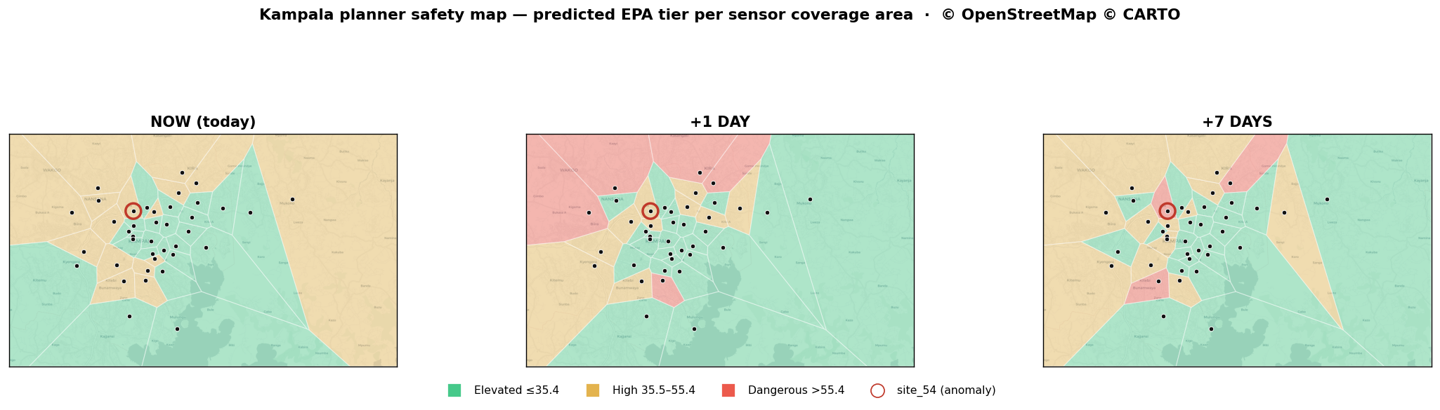
Kampala PM2.5 · Smart City Capstone
Person 3
From Regression to Planner Safety Tiers
The deliverable is a decision tool, not just a score table.
68%
98.5%
exact NOW safety tier
within one tier
EPA bands
Elevated ≤35.4 · High 35.5–55.4 · Dangerous >55.4 µg/m³.
Prototype
The browser tool shows the safety map, prediction form, bands, and planner-tunable danger alert.

Slide 9
Kampala PM2.5 · Smart City Capstone
Person 4
FUTURE Forecasting Is a Separate Task
Known-site forecasting uses history, so it has a different deployment setting.
0.506
0.477
0.432
0.015
LSTM +1 day R²
LSTM +3 day R²
LSTM +7 day R²
+7 current persistence R²
Why LSTM earned headline status
Deployability boundary
It uses PM2.5 lag structure and category embedding, and it beats the original persistence / GBM-on-lags benchmark across horizons.
FUTURE models are not zero-deploy new-site models. They require known-site PM2.5 history.

Slide 10
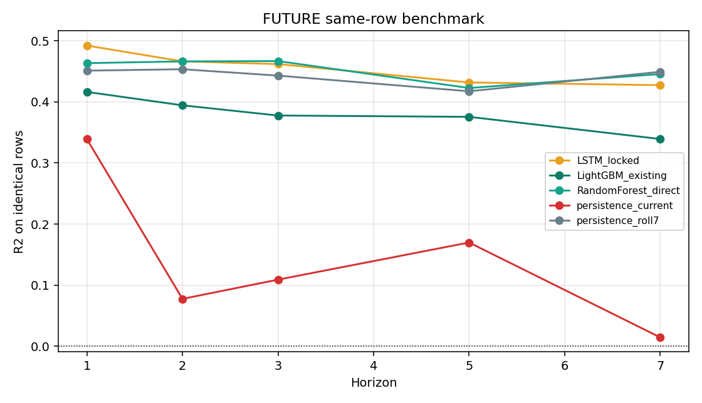
Kampala PM2.5 · Smart City Capstone
Person 4
RF and Rolling-7 Are Challengers
The fair same-row benchmark narrows the claim without replacing the headline.
What changed
On identical rows, RF and rolling-7 are competitive and can win or tie at some horizons.
What did not change
They do not justify a headline replacement. LSTM remains the accepted FUTURE model; RF/rolling-7 become formal challengers.
Do not claim
“RF beats LSTM overall.” That is not supported.

Slide 11
Kampala PM2.5 · Smart City Capstone
Person 5
Final Honest Audit
The audit improved the capstone by refusing unsupported upgrades.
We separated deployable models from oracle upper bounds
We did not replace the model just because one score looked better
Full-history category assignment can be useful scientifically, but it is not available at a new site.
k=6 full-history looked strong, but deployable k=6 did not beat accepted k=4.
What not to claim
Defense evidence
Do not claim k=6 is production. Do not claim RF beats LSTM overall. Do not claim random split performance is real-world performance.
Use final_model_decision_table.csv, professor_summary.md, presentation_talking_points.md, and full_repository_audit.md.

Slide 12
Kampala PM2.5 · Smart City Capstone
Final
Final Recommendation
Keep the accepted pipeline, present challengers honestly, and defend the limits.
Keep
Keep
Reject
Track
NOW k=4 / safety
FUTURE LSTM headline
k=6 as production
RF / rolling-7 challengers
One-sentence close
This project is strongest because it proves useful PM2.5 decision support while clearly separating honest deployable results from attractive but non-deployable upper bounds.
End with: “The accepted model remains k=4 for NOW/safety, LSTM remains the FUTURE headline, and the audit shows restraint rather than score-chasing.”

