Slide 1

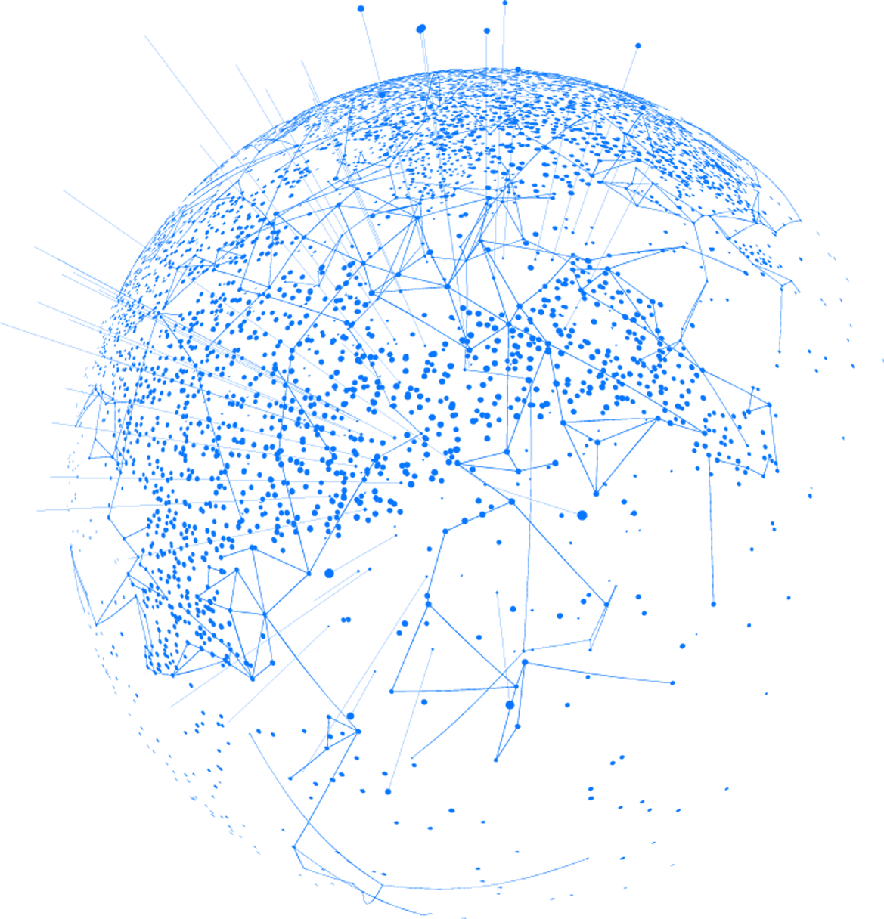
INDUSTRIAL IOT SMART GRID SIMULATION & CYBERSECURITY TESTBED
PRESENTED BY YOUSSEF ELSHENAWY

Slide 2

THREE LAYER ARCHEITECTURE
Control Room/Grid Control Center
3. Human Monitoring and Support/ Grid Operator Health Monitoring
2. Field Sensor Network / Remote Grid Monitoring Stations

Slide 3
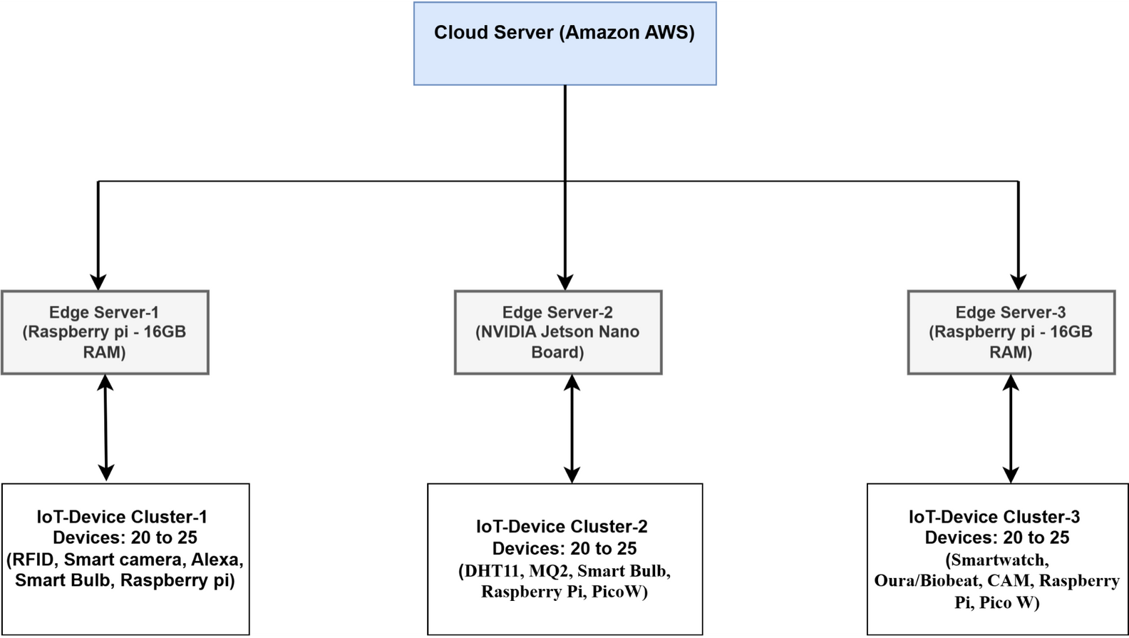
SYSTEM ARCHETICTURE
Notes:
what are protocols then in the first place: protocols are set oof rules and instructions that govern the communication between devices in a cyber physical system
why have this:
enables real time communication between many diverse components.
Enables reliability, secutity between systems

Slide 4

CLUSTER 1: CONTROL ROOM DEVICES / GRID CONTROL CENTER
Devices:
Smart Cameras (surveillance),
RFID Tag Readers (access control),
Raspberry Pi (sensor aggregator node),
Smart Bulb (facility lighting control),
Alexa/Voice Interface (simulate human interaction)
Purpose:
Simulate security surveillance,
access control, facility environmental control
human-operator interaction inside the critical infrastructure control room.
Attack Simulation:
Camera feed spoofing
Fake RFID access attempts
Ambiguous or repeated Alexa voice commands
Smart bulb flickering
Notes:
Cyber physical systems are basically systems that combine both physical processes and computerized elements to create a solution to a problem
involves a network of systems communication with each other in real time.

Slide 5
CLUSTER 2: FIELD SENSOR NETWORK / REMOTE GRID MONITORING STATIONS
Devices:
DHT11 Sensors (temperature/humidity monitoring),
MQ2 Sensors (gas leakage detection),
Smart Bulbs (remote lighting simulation),
Raspberry Pi Pico W (field node connector (smart meter, remote sensor node))
Purpose:
Simulate environmental and utility system monitoring in field locations within critical infrastructure.
Attack Simulation:
Sensor flooding
Low and slow drift
Ambiguous or repeated Alexa voice commands
Remote light control spoofing
Notes:
Cyber physical systems are basically systems that combine both physical processes and computerized elements to create a solution to a problem
involves a network of systems communication with each other in real time.

Slide 6
CLUSTER 3: HUMAN MONITORING AND SUPPORT/ GRID OPERATOR HEALTH MONITORING
Devices:
Smartwatch (staff motion and fatigue monitoring),
Biobeat / Oura Ring (stress, heart rate, sleep tracking),
ESP32-CAM (staff surveillance/monitoring),
Raspberry Pi Pico W (connect wearables (aggregators)
Purpose:
Monitor the physical and cognitive health status of critical infrastructure staff and operators to detect fatigue, stress, or other impairments during operation.
Attack Simulation:
Fake high heart rate/stress injection from wearables,
False fatigue/alarm signals
Camera feed lag or false movement alerts
Notes:
Cyber physical systems are basically systems that combine both physical processes and computerized elements to create a solution to a problem
involves a network of systems communication with each other in real time.

Slide 7
SYSTEM INTEGRATION & SIMULATION STATUS
All clusters — Control Room, Field Sensor Network, and Human Monitoring — have been successfully configured and tested simultaneously.
Each cluster operates with its own set of IoT devices (Raspberry Pi, Pico W, Smart Bulb, RFID, ESP32-CAM, Oura Ring, etc.)
Devices communicate using multi-protocol interfaces (MQTT, HTTP) over secured TCP/UDP channels (TLS/DTLS)
Real-time data is streamed to the Edge-to-Cloud Server accordingly.
Notes:
Cyber physical systems are basically systems that combine both physical processes and computerized elements to create a solution to a problem
involves a network of systems communication with each other in real time.

Slide 8
NEXT STEPS FOR THIS PROJECT
Scope: attacks executed across all clusters — Field Sensors, Edge Nodes, Human-Monitoring, and Control Room.
Sensor Attacks: flooding and spoofed readings (DHT11 / MQ-2 / Pico W).
Protocol Attacks: MQTT topic flooding and malformed payload injection (broker level).
Command Attacks: replay and command-injection via Alexa, RFID, and smart bulbs.
Vision Attacks: frame spoofing and camera feed tampering (ESP32-CAM).
Resource Attacks: model and GPU stress/throttling on Jetson inference nodes.
Goal: generate a multi-source dataset for the formal ML pipeline (clean → format → feature → model → evaluate).
Safety: all attacks confined to an isolated VLAN/lab network with rollback and monitoring controls.
Notes:
Cyber physical systems are basically systems that combine both physical processes and computerized elements to create a solution to a problem
involves a network of systems communication with each other in real time.

Slide 9
NEXT STEPS FOR THIS PROJECT
✅ Collect system logs and sensor data in native formats from each cluster (Control Room, Field Sensors, Human Monitoring).
🧹 Data Cleaning: remove duplicates, missing values, and irrelevant signals.
⚙️ Feature Formatting: align timestamps, normalize data, and structure by device/source.
🤖 Modeling: train predictive models (SVM, Random Forest, LSTM) and compare with LLM-assisted detection on Jetson.
📊 Evaluation: measure accuracy, latency, and robustness under simulated cyber-attacks
Notes:
Cyber physical systems are basically systems that combine both physical processes and computerized elements to create a solution to a problem
involves a network of systems communication with each other in real time.

Slide 10
NEXT STEPS FOR THIS PROJECT
Implement LLM on NVIDIA Jetson
Deploy a lightweight LLM (quantized/optimized) on the Jetson edge node.
Real-time anomaly interpretation and event summarization
Adaptive defense rule generation
Log intelligence and natural-language alerts
Notes:
Cyber physical systems are basically systems that combine both physical processes and computerized elements to create a solution to a problem
involves a network of systems communication with each other in real time.

Slide 11

THANK
YOU
ANY QUESTIONS
HTTPS://GITHUB.COM/YOUSSEFFWALEED/INDUSTRIAL-IOT-CYBERSECURITY

