Slide 1



AdventureWorks-Projects
View in Power BI
Last data refresh:
17/02/2026 21:37:19 UTC
Downloaded at:
17/02/2026 21:55:56 UTC

Slide 2
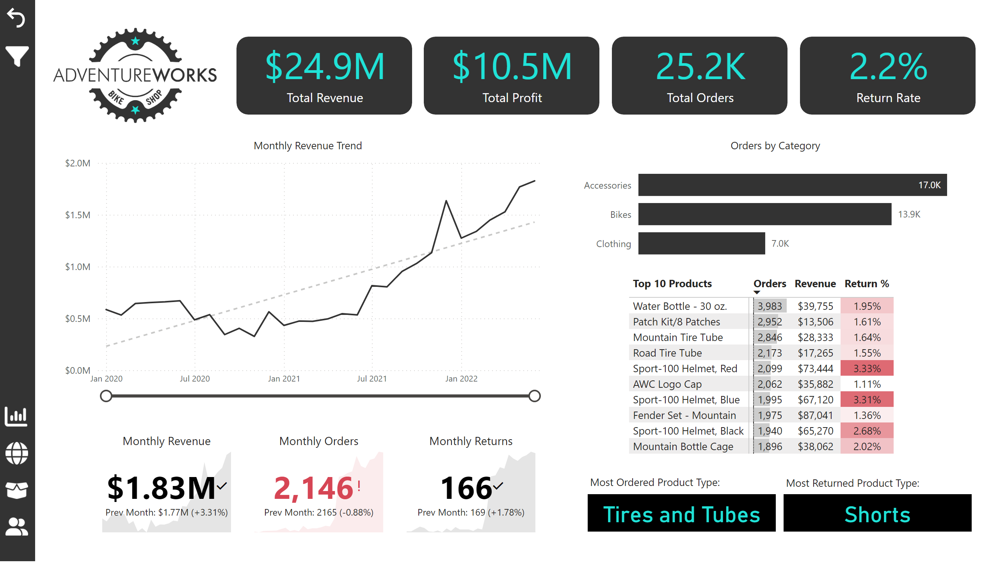
Exec Dashoboard
Notes:
Customer Button
No alt text provided
Total profit Card
No alt text provided
product Button
No alt text provided
VAL-ORD-SUBCATG
No alt text provided
Top 10 products
No alt text provided
Side Bar
No alt text provided
Monthly Revenue Trend
No alt text provided
Shape of profit
No alt text provided
actionButton
No alt text provided
Total Revenue Card
No alt text provided
Monthly Orders
No alt text provided
Logo
No alt text provided
Monthly Revenue
No alt text provided
Shape of Revenue
No alt text provided
Filter Button
No alt text provided
VAL-RET-SUBCATG
No alt text provided
Total orders Card
No alt text provided
Shape of orders
No alt text provided
Orders by Category
No alt text provided
slicer
No alt text provided
slicer
No alt text provided
return BG-SUBCAT
No alt text provided
Monthly Returns
No alt text provided
Text box-ret-SUBCAT
No alt text provided
Dashboard Button
No alt text provided
Shape of returnrate
No alt text provided
Total Returns Card
No alt text provided
ORders BG-SUBCAT
No alt text provided
shape
No alt text provided
Map Button
No alt text provided
Reset Button
No alt text provided
Text box-orders-SUBCAT
No alt text provided

Slide 3
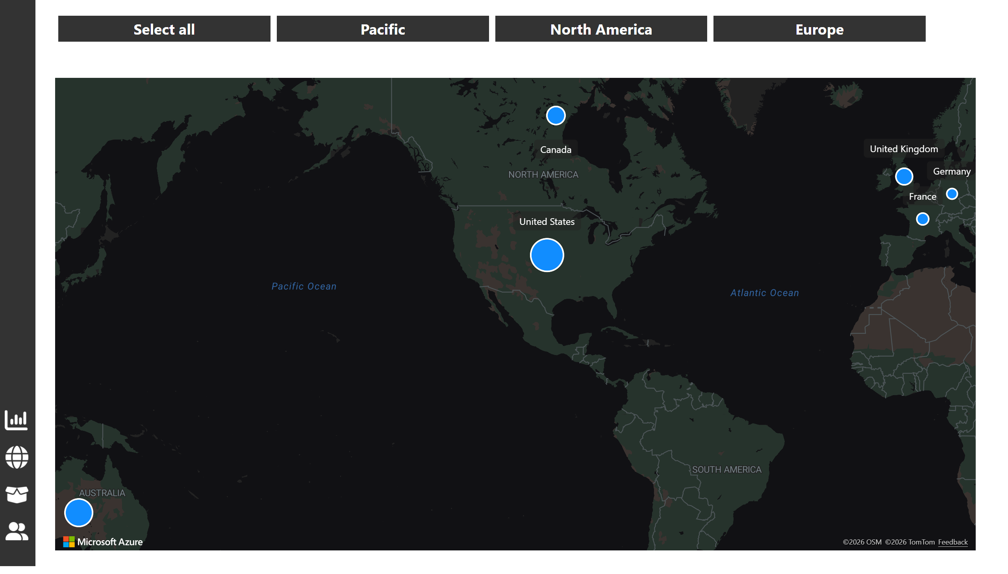
Map
Notes:
Customer Button
No alt text provided
slicer
No alt text provided
azureMap
No alt text provided
product Button
No alt text provided
Dashboard Button
No alt text provided
azureMap
No alt text provided
shape
No alt text provided
Map Button
No alt text provided

Slide 4
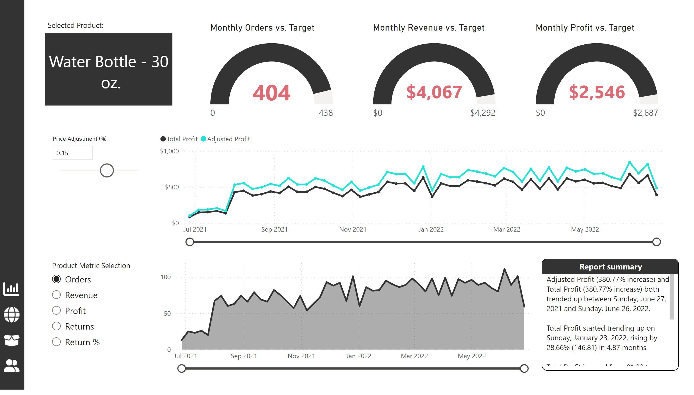
Product Details
Notes:
Map Button
No alt text provided
Dashboard Button
No alt text provided
product Card
No alt text provided
Numerical paramater slicer
No alt text provided
lineChart
No alt text provided
Report summary
No alt text provided
area chart date - selction
No alt text provided
Customer Button
No alt text provided
Monthly Orders vs. Target
No alt text provided
shape
No alt text provided
product Button
No alt text provided
textbox
No alt text provided
Monthly Revenue vs. Target
No alt text provided
Monthly Profit vs. Target
No alt text provided
Field pamter slicer
No alt text provided

Slide 5
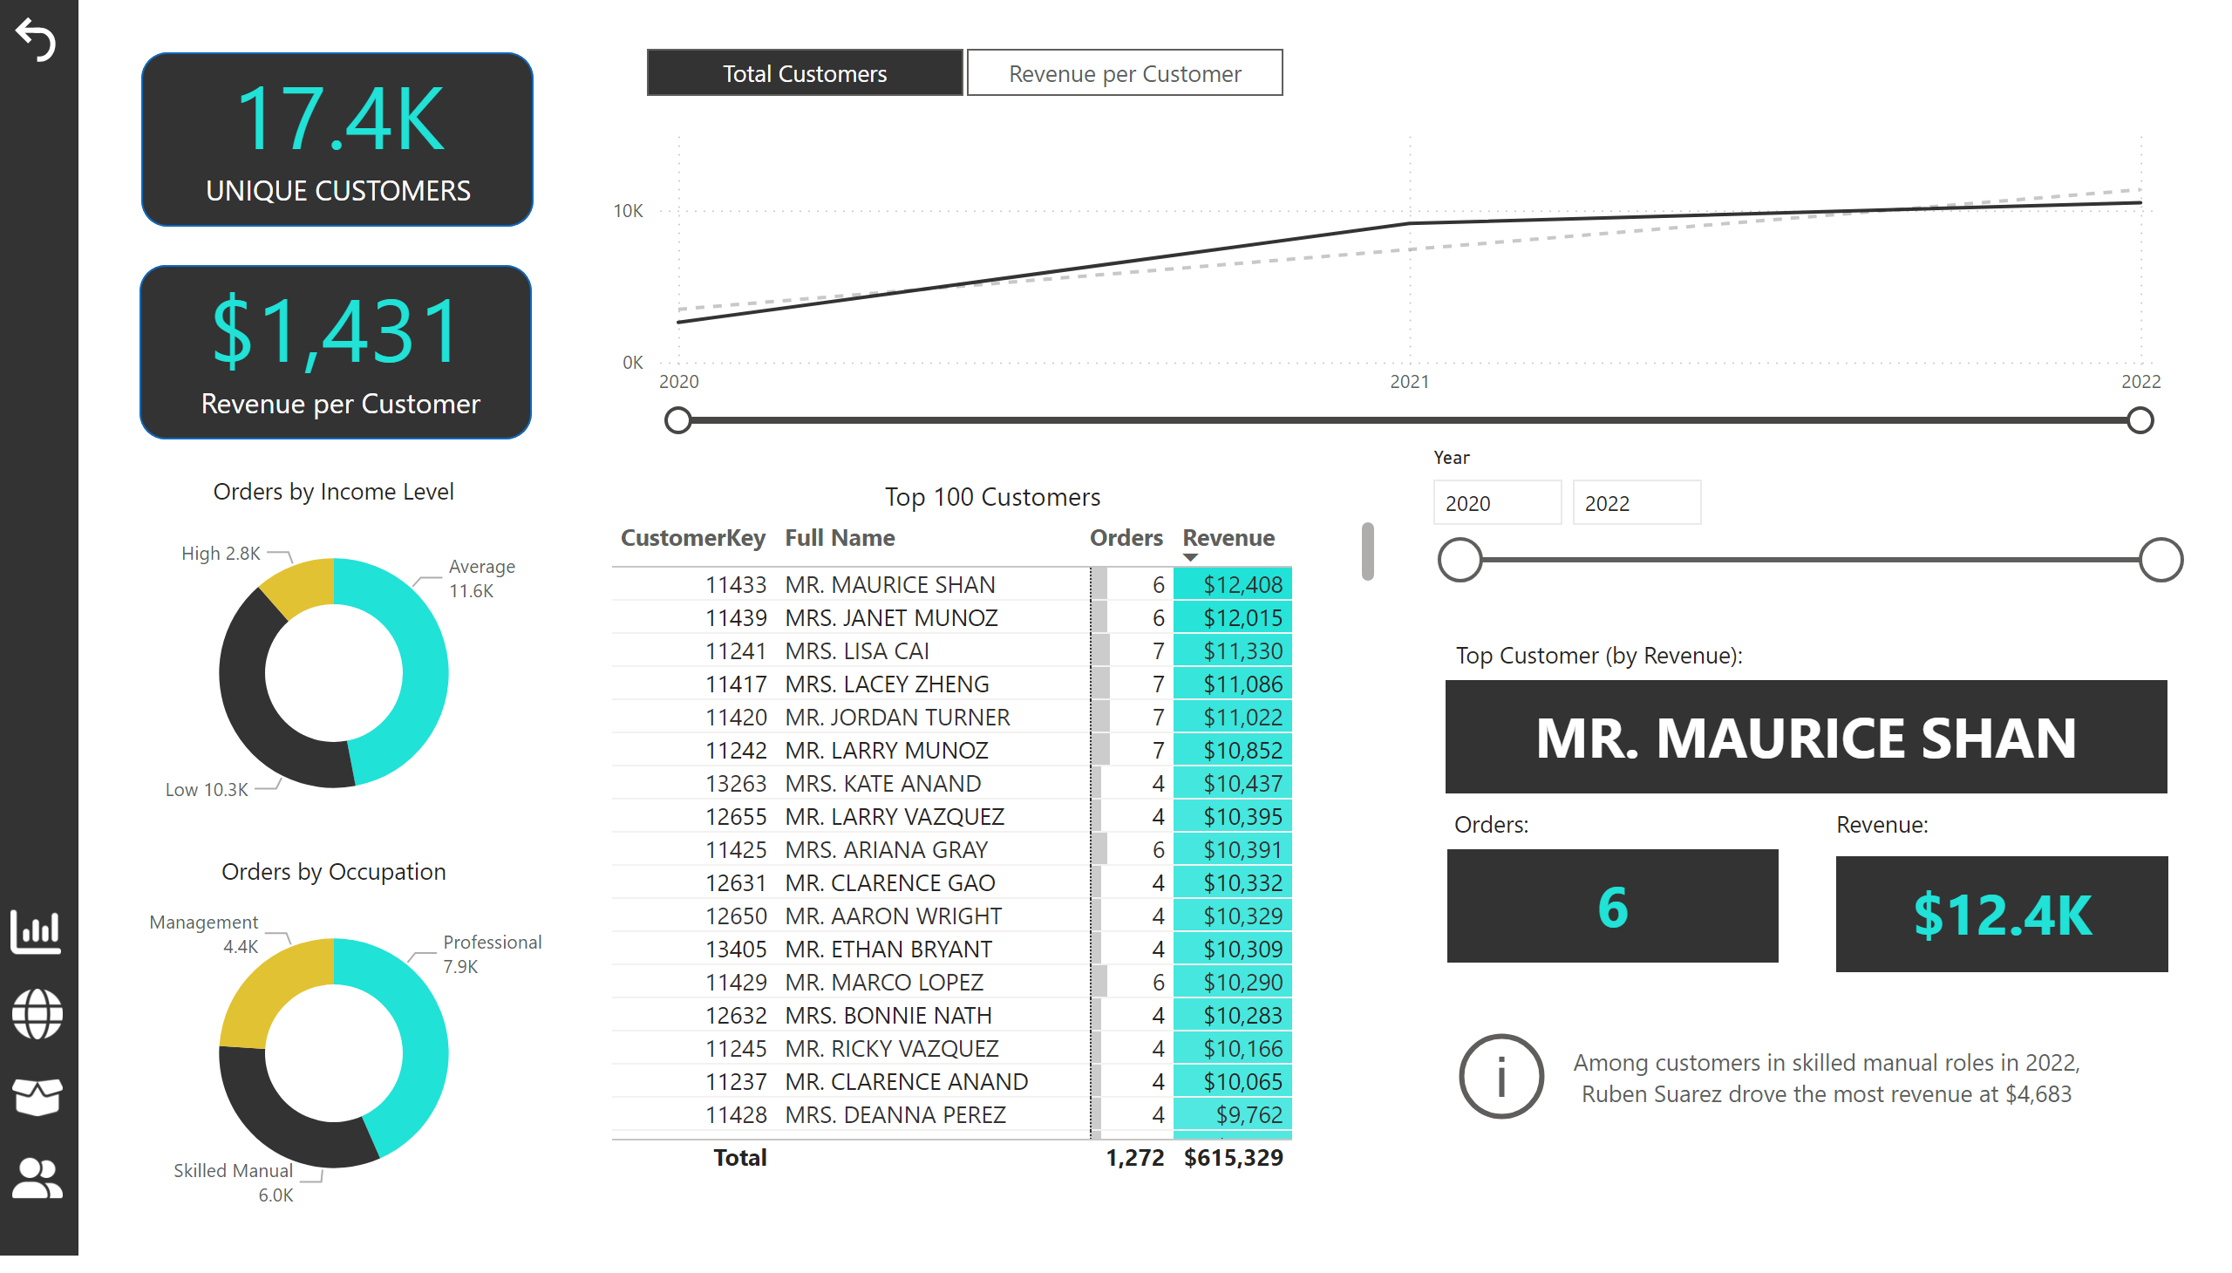
Customer Details
Notes:
Total Customers
No alt text provided
revenue by top customer card
No alt text provided
Top customer Card
No alt text provided
Top 100 Customers
No alt text provided
Customer Button
No alt text provided
slicer
No alt text provided
slicer
No alt text provided
shape
No alt text provided
Revenue per customer Card
No alt text provided
Orders by Income Level
No alt text provided
actionButton
No alt text provided
Reset Button
No alt text provided
textbox
No alt text provided
orders by top customers
No alt text provided
product Button
No alt text provided
Unique Customer card
No alt text provided
Map Button
No alt text provided
Dashboard Button
No alt text provided
textbox
No alt text provided
lineChart
No alt text provided
Orders by Occupation
No alt text provided
shape
No alt text provided
shape
No alt text provided
textbox
No alt text provided

Slide 6
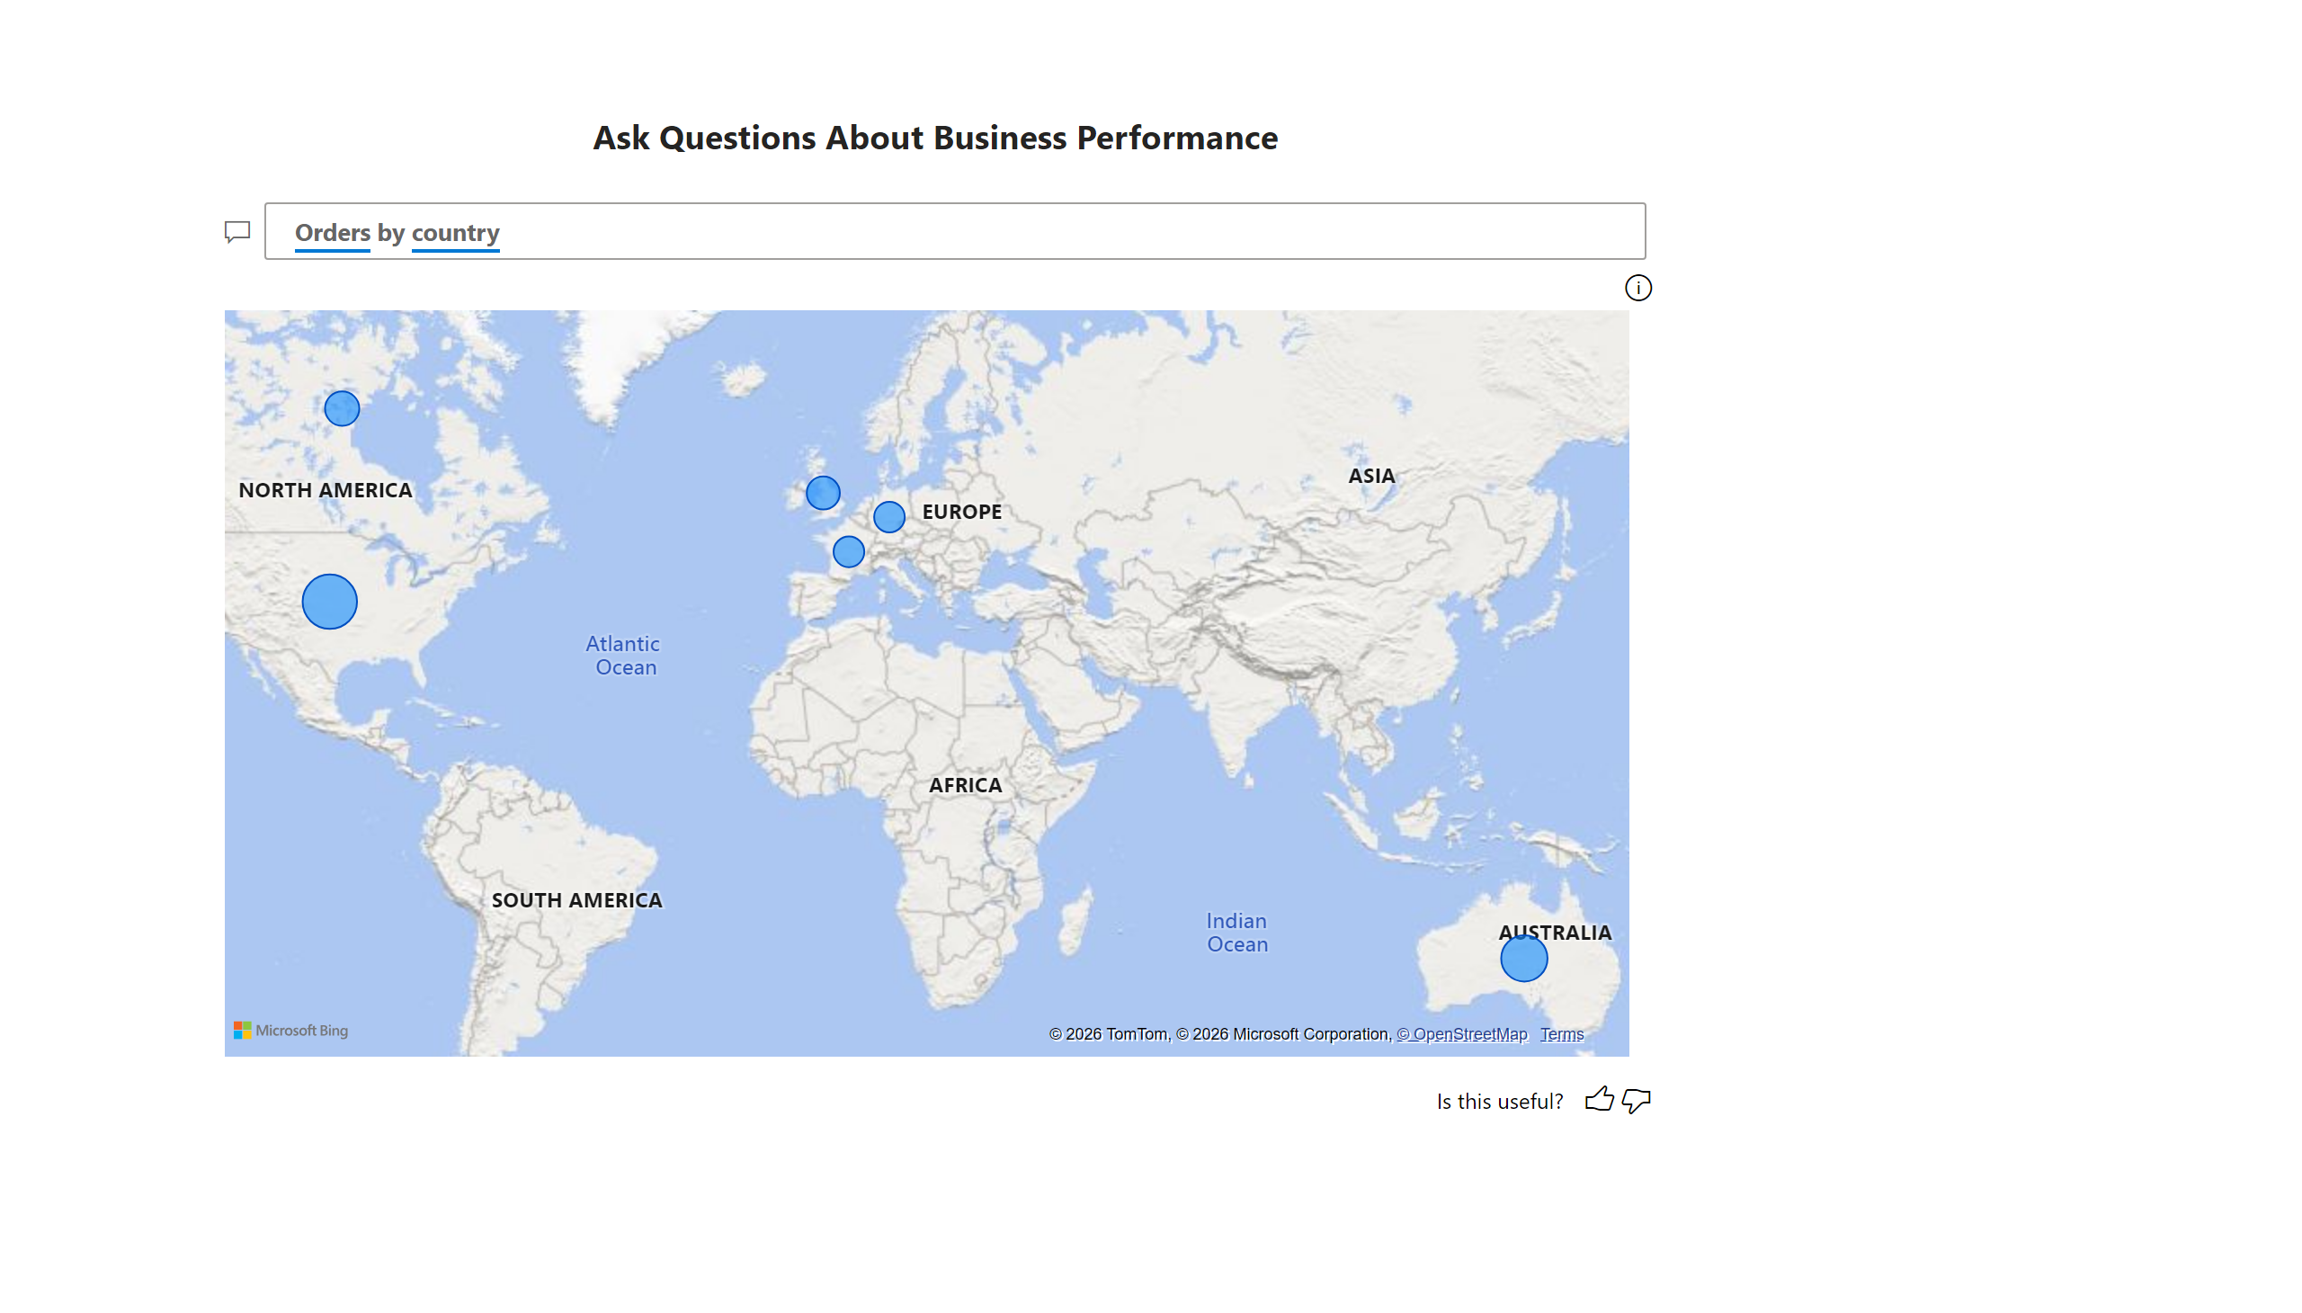
Q&A
Notes:
Ask Questions About Business Performance
No alt text provided

Slide 7
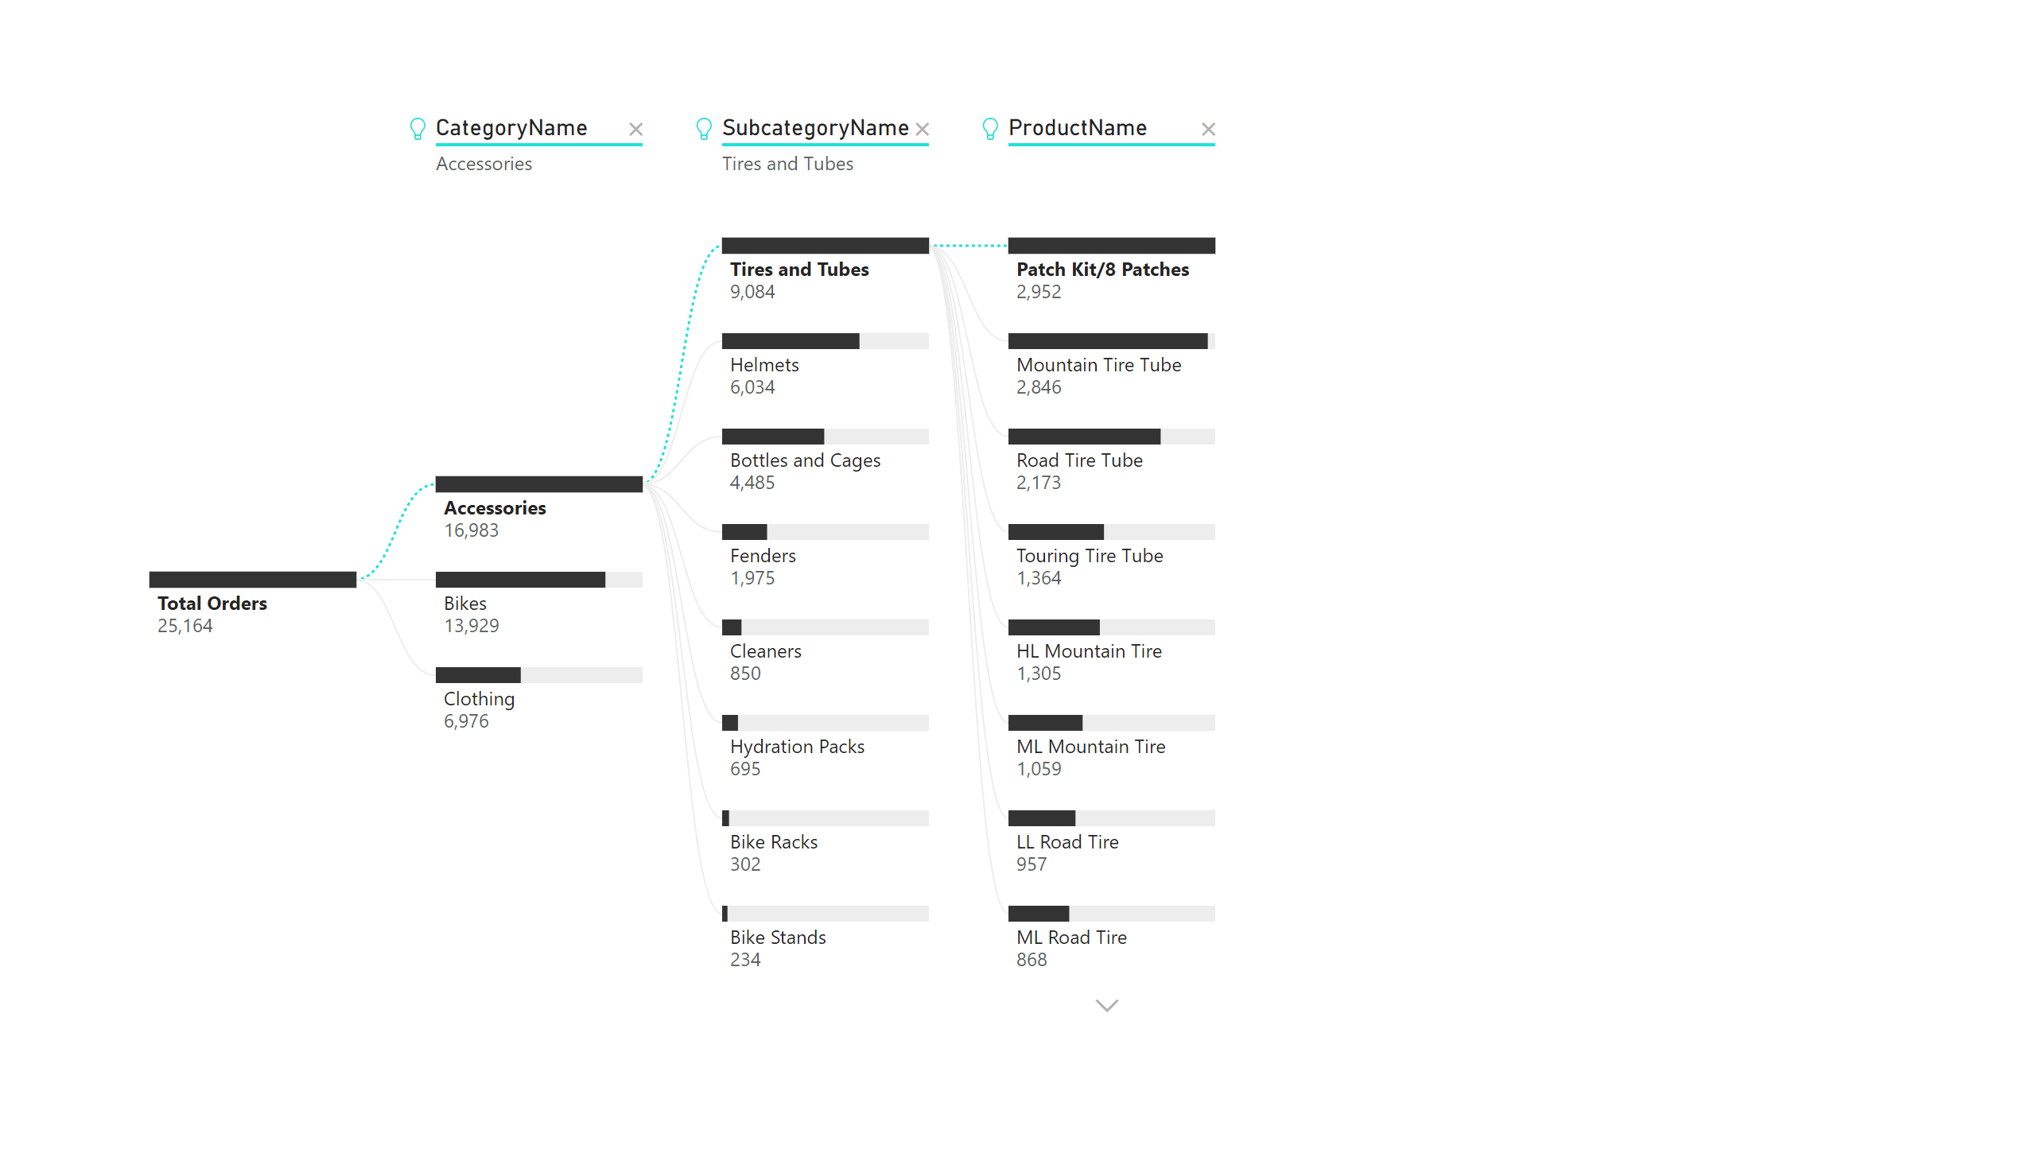
Decomposition Tree
Notes:
decompositionTreeVisual
No alt text provided

Slide 8
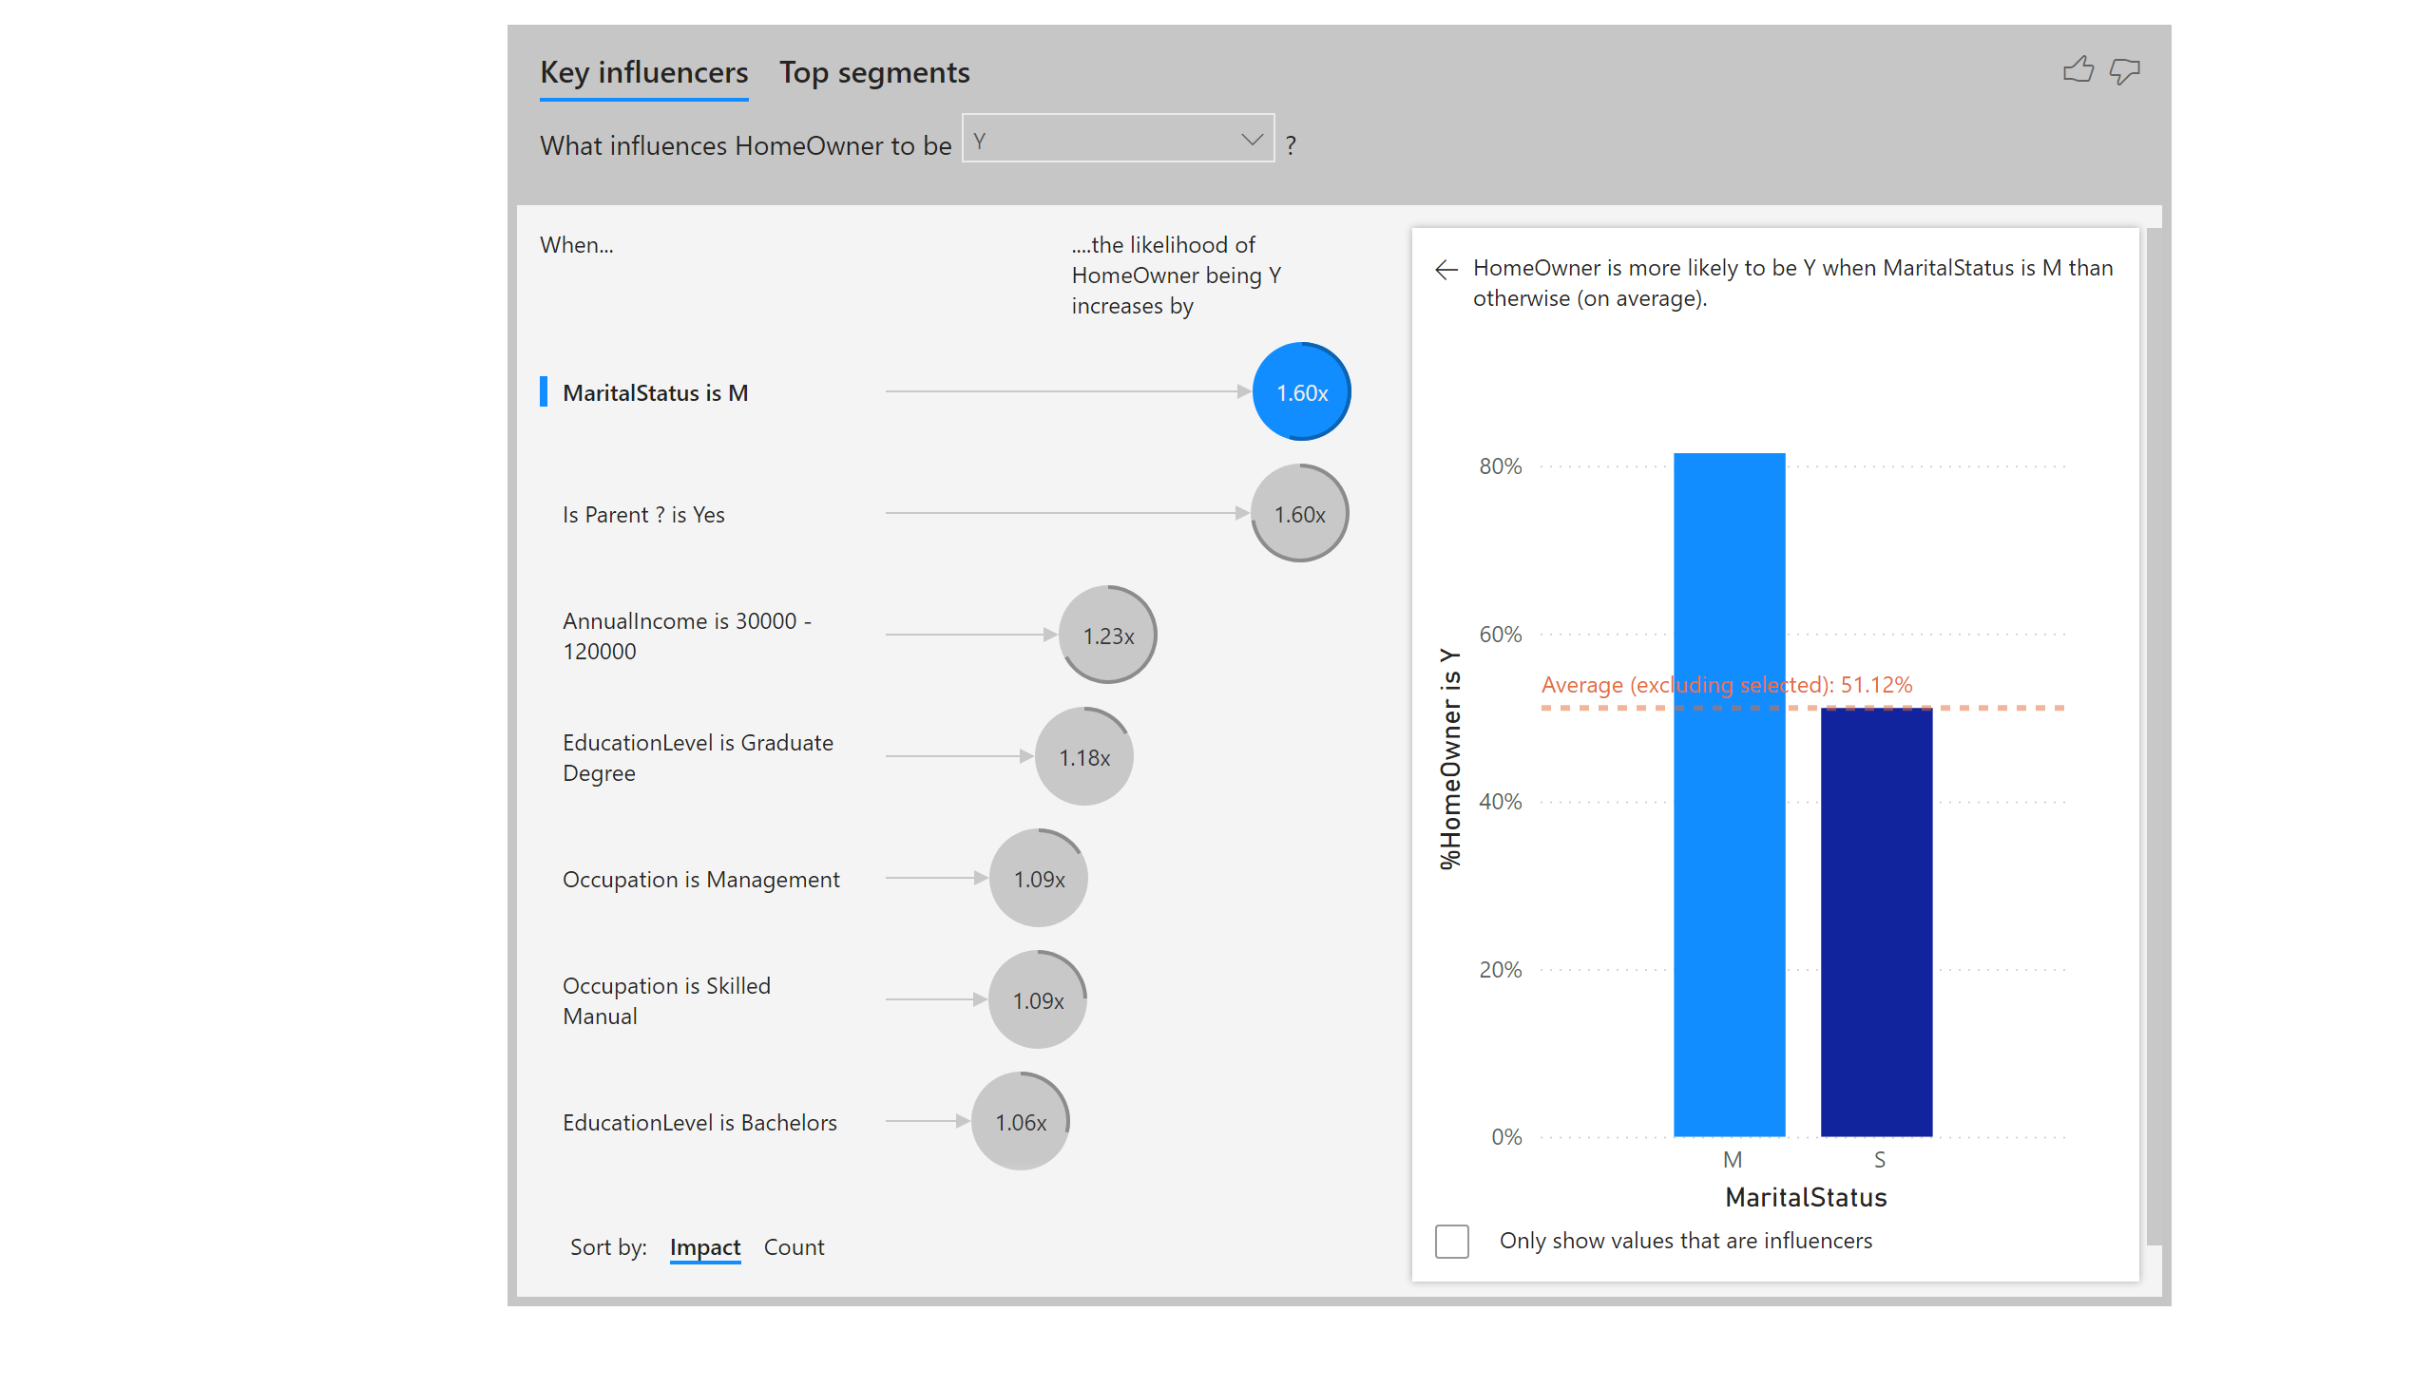
Key Influencers
Notes:
keyDriversVisual
No alt text provided

