Slide 1
Where to open your restaurant in New York City

Slide 2
Why is location important ?
Locations are of critical importance for restaurants because
it can ensure that the right kind of customer either lives
Or goes there
A restaurant could fail due to it’s location

Slide 3
Data
We got our data from the foursquare API and https://cocl.us/new_york_dataset
In total we had 306 neighborhood and 4 feature columns
After cleaning the data we ended up with 103 neighborhood

Slide 4
API Calls
We used the explore endpoint with a radius of 50 M and a limit of 20 results per call
The response contained the category of the venue

Slide 5
Methodology
We found out the most common 5 venues per neighborhood and clustered them into neighborhoods with similar interests
Through this clustering we could see the interests of each neighborhood and could recommend where to open the restuarant

Slide 6
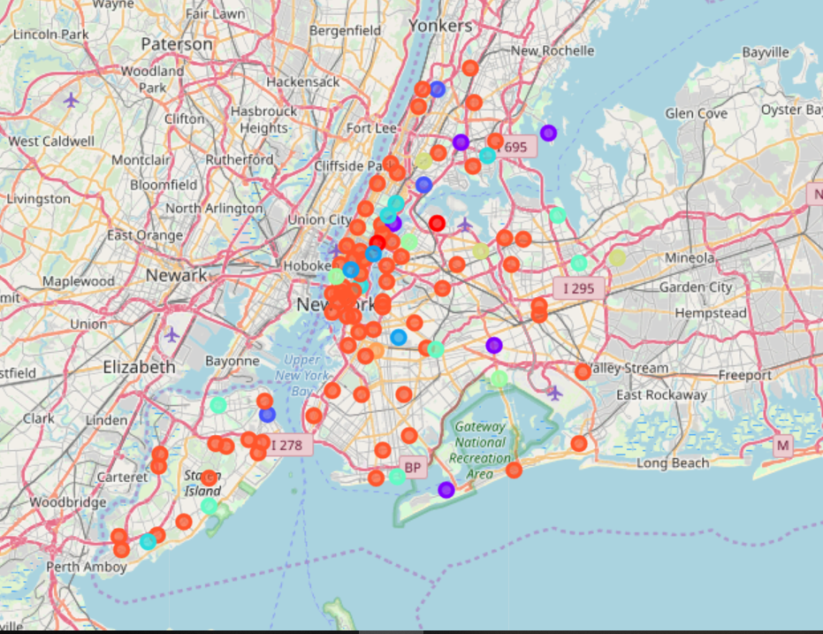
Visualization

Slide 7
Results
Cluster One | Fancy neighborhoods preference for expensive food, and activities like sushi restaurants and yoga studios
Cluster Two | Neighborhoods that prefer diners and bars
Cluster three | Neighborhoods that prefer discount and department stores
Cluster Four | Neighborhoods that prefers gyms and shopping stores
Cluster Five | Neighborhoods that prefers pizza places
Cluster Six | Neighborhoods with many bus stops and convenience stores
Cluster Seven | Neighborhoods that prefer Chinese restaurants
Cluster Eight | Neighborhoods that have a lot of parks
Cluster Nine | With one output is an outlier and more like belongs to Cluster eight
Cluster ten | The dominant cluster that shows neighborhoods with 72 outputs in almost all of them there is at least one restaurant, food court or food truck and it seems like the common trend of the city to have this variability.

Slide 8
Conclusion and future direction
Depending on the restaurant type a restaurant owner could choose his ideal neighborhood from the clusters produced
For further analysis include data that shows the living standards in the neighborhoods to help segment neighborhoods even better

