Slide 1
Project Backlog
TA Report System

Slide 2
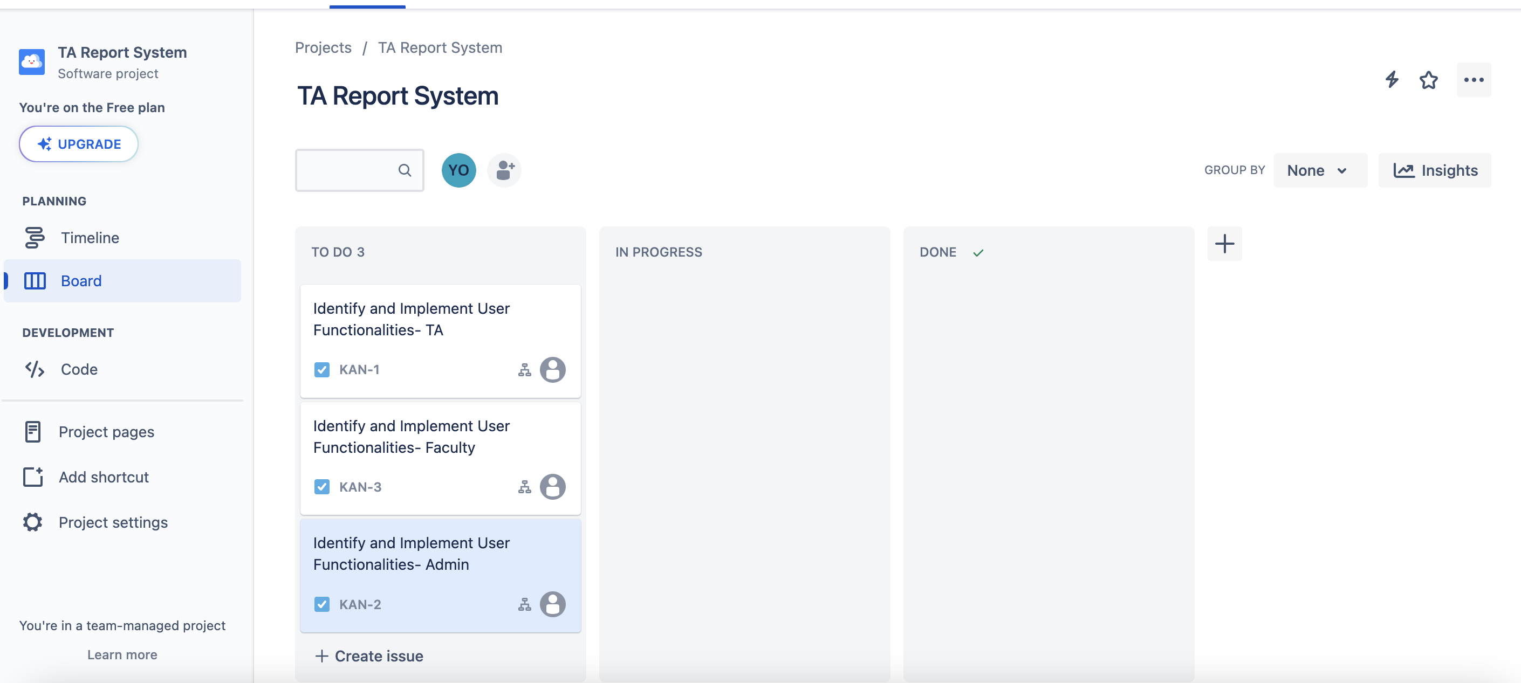
The Project Backlog:

Slide 3
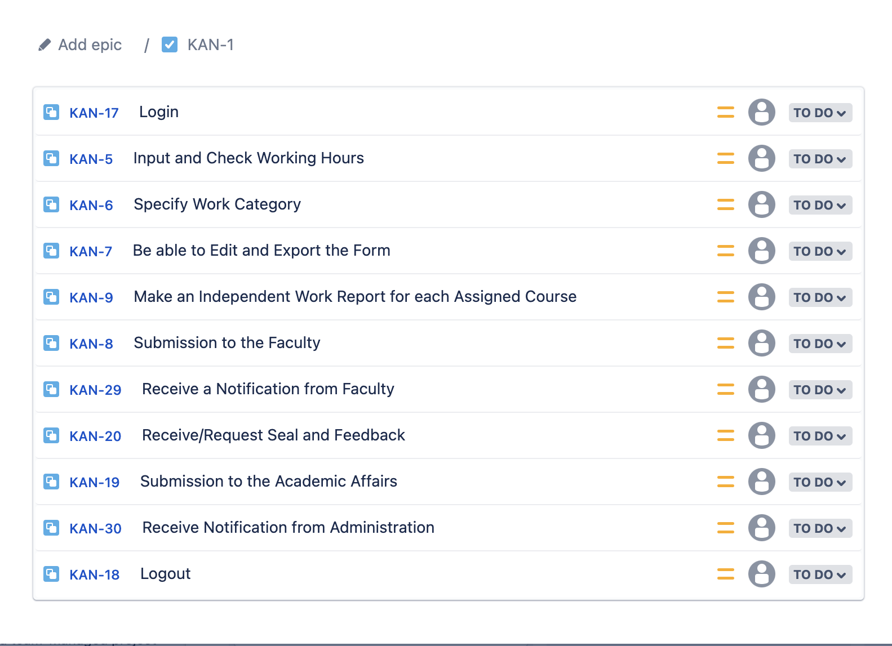
User Stories and Functionalities: TA

Slide 4
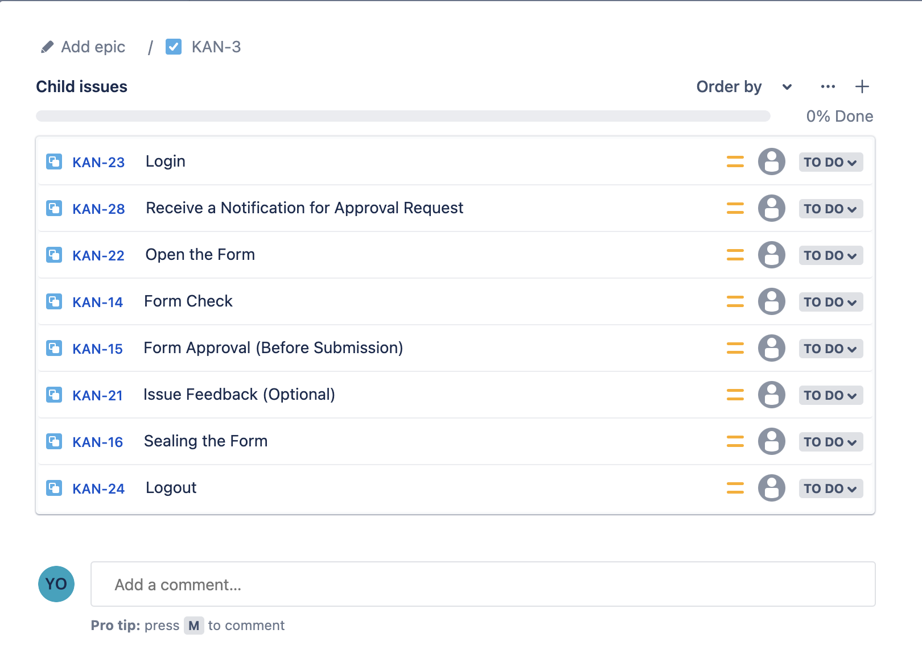
USER STORIES AND FUNCTIONALITIES: FACULTY

Slide 5
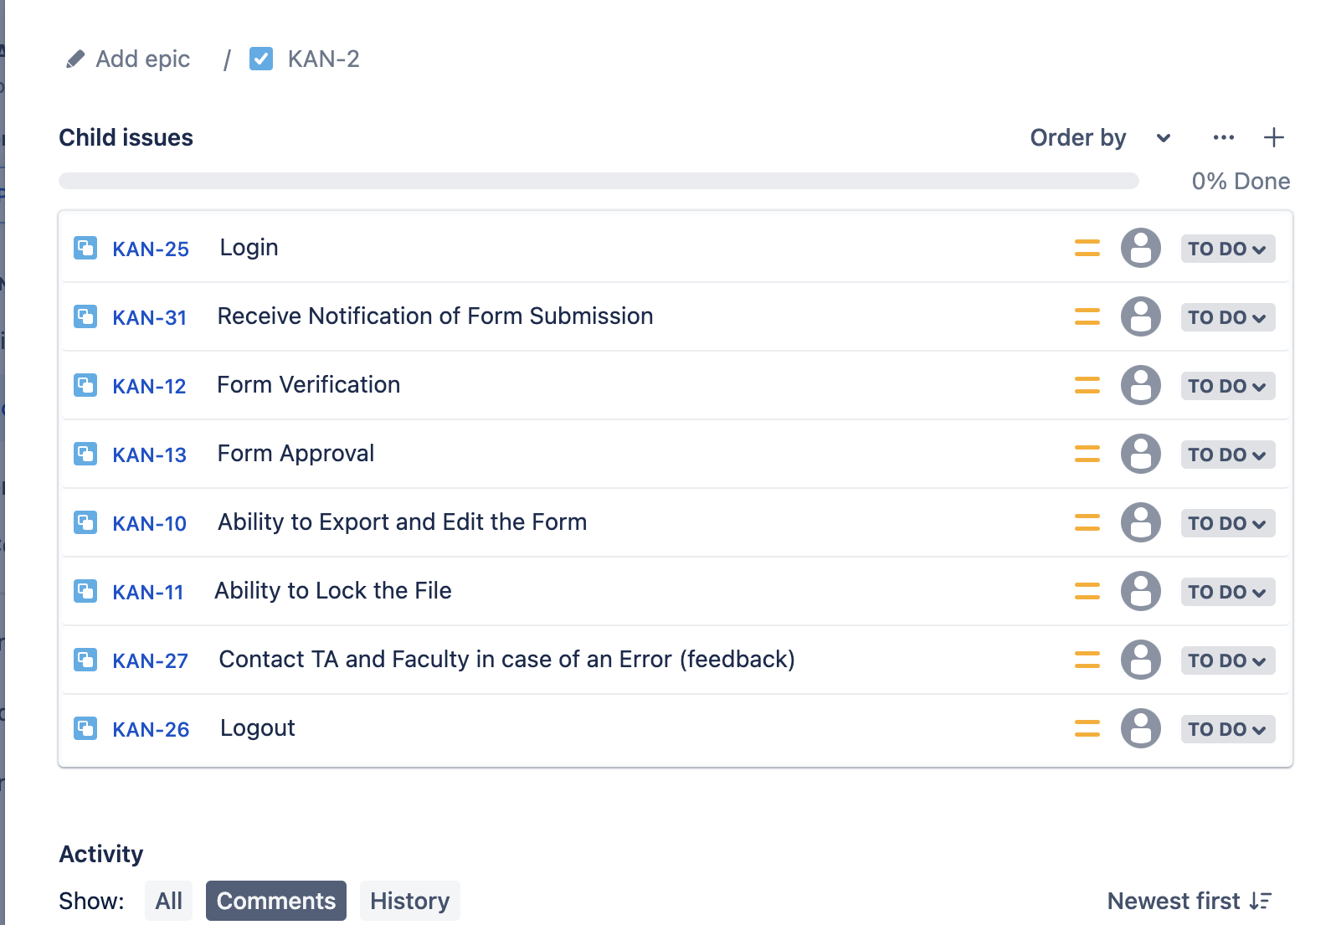
USER STORIES AND FUNCTIONALITIES: ADMINISTRATION

