Slide 1
Project: xxxxxx
You should not spend more than 10 minutes for this report!
That means, all considerations should have finished before you report it.
What is the title of your system
IE04 Weekly Progress Report
2022/10/12
Team: xxxx
Give your team an affectional name

Slide 2
Activities of Previous Week
Summarize your work to share your actual progress among members.
Task | Member | Status | Work Hours
Database setup | Hashimoto | 100% | 8:00
Design template update | Tomi | 100% | 7:30
Program start page | Machiya | 100% | 4:00
Program puzzle view page | Machiya | 36% | 5:00
Design quiz effects | Tomi | 100% | 1:30
Program puzzle edit page | Namikawa | 27% | 7:00
Puzzle page DB model modification | Machiya | 80% | 5:00
 |  | Total time: | 38:00

Slide 3
Plan for This Week
Build a plan based on the actual progress of the team. You need to reassess your work before deciding what to do.
Task | Member | Work Hours
Puzzle page DB model modification | Machiya | 5:00
Program quiz page view function | Machiya | 5:00
Program score page | Hashimoto | 4:00
Program statistics page | Hashimoto | 5:00
Design character icons for quiz | Tomi | 7:00
Program puzzle edit page | Namikawa | 3:00
 | Total time: | 29:00

Slide 4
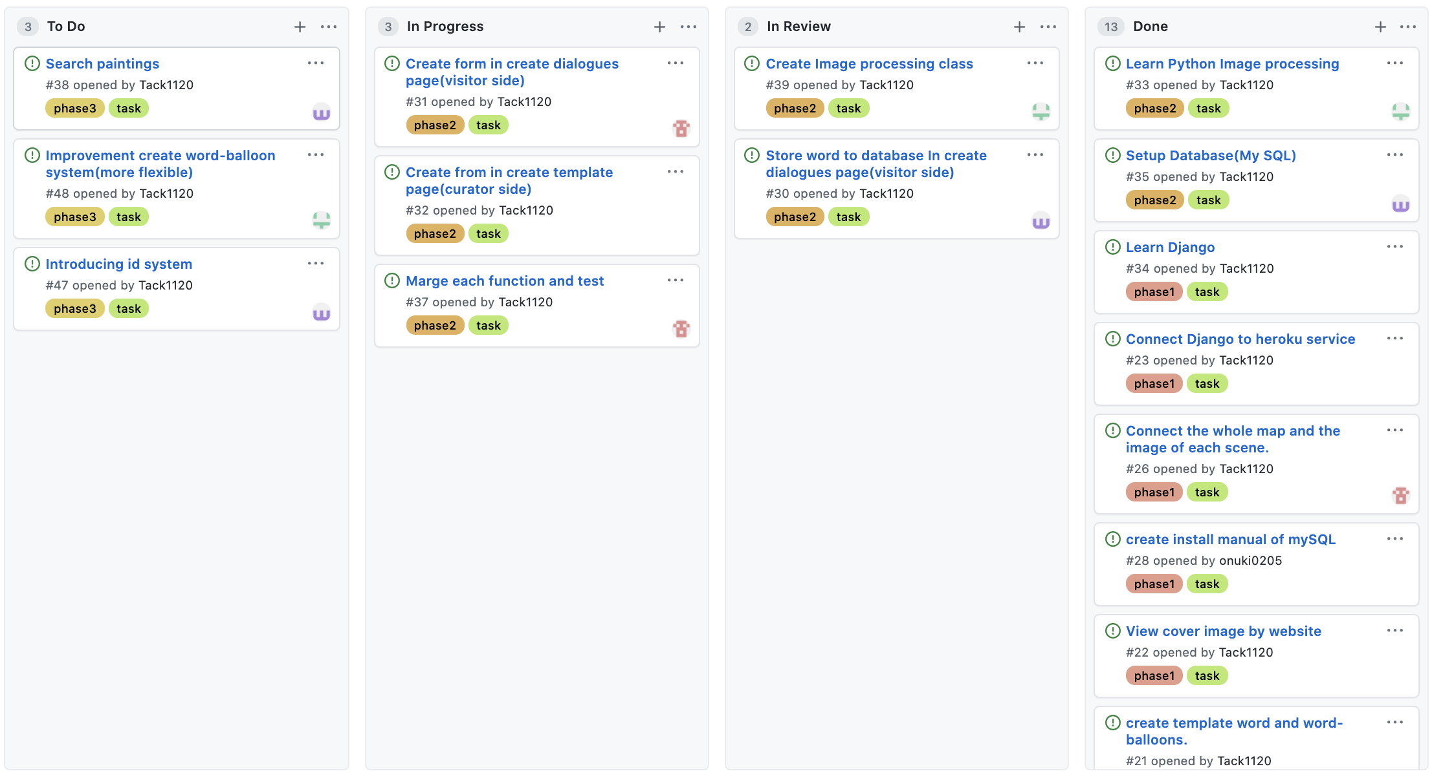
Phase Task Board
Place a screen-shot of the “project page” from the GitHub page

Slide 5
Issues & Risks (*if any)
Problem
Cause
Possible Solution
Deadline
Issues: Analyze what is hindering your progress. It is an existing problem that is causing delays.
Risks: Try to plan for possible problems that could cause delays.
This should help you analyze your current progress and prepare for future problems

