Slide 1
Graph-RAG for E-Commerce Knowledge Graph
Advanced Computational Linguistics (M3) | Milestone 3 | December 2025

Slide 2
Presentation Agenda
• System Architecture – Components & Data Flow
• Retrieval Strategy – Cypher Queries & Embeddings
• LLM Implementaion & Comparison – Some Implementaion steps, Quantitative & Qualitative Analysis
• Error Analysis – Failures & Root Causes
• Improvements Added – Enhancements Made
• Remaining Limitations – Future Work Needed

Slide 3
1. System Architecture

Slide 4
System Overview
• Hybrid Retrieval-Augmented Generation (RAG) Pipeline
  - Combines structured Cypher queries with semantic embeddings
• Knowledge Graph: Neo4j with 7 node types, 7 relationship types
• Dual Embedding Strategy: MiniLM (384-D) + MPNET (768-D)
• Multi-Model LLM Comparison: Gemma 2, Llama 3.2 3B, Llama 3.2 1B
• Interactive UI: Streamlit dashboard with graph visualization
• Data Source: Brazilian E-Commerce dataset (45K+ records)

Slide 5
Architecture Diagram
┌─────────────────────────────────────────────────────────────────────────────┐
│ USER INTERFACE (Streamlit) │
│ Query Input │ Task Selection │ Model Selection │ Graph Viz │
└────────────────────────────────┬────────────────────────────────────────────┘
│
┌───────────────────────┴───────────────────────┐
│ │
┌────────▼─────────┐ ┌─────────▼──────────┐
│ ENTITY EXTRACTION│ │ CYPHER TEMPLATES │
│ • PhraseMatcher │ │ • 10 Query Types │
│ • Regex Patterns│ │ │
└────────┬─────────┘ └─────────┬──────────┘
│ │
└───────────────────┬───────────────────────────┘
│
┌──────────────▼──────────────┐
│ DUAL RETRIEVAL SYSTEM │
├─────────────────────────────┤
│ BASELINE │ SEMANTIC │
│ Cypher │ Embeddings │
│ Queries │ MiniLM/MPNET│
└──────┬────────┴──────┬──────┘
| |
| ┌──────▼───────┐
| │ NEO4J + FAISS|
| | Knowledge │
| │ Graph │
| └──────┬───────┘
-------------------
┌───────▼───────┐
│ LLM LAYER │
│ 3 Models │
└─────── ───────┘

Slide 6
Knowledge Graph Schema
Node Types (7)
Relationships (7)
• Customer – customer_id, city, state
• Order – order_id, status, timestamps
• Order_Item – price, freight_value
• Product – category, description_length
• Seller – seller_id, city, state
• Review – score, title, message
• State – state abbreviation
• PLACED: Customer → Order
• CONTAINS: Order → Order_Item
• REFERS_TO: Order_Item → Product
• SOLD_BY: Order_Item → Seller
• REVIEWS: Review → Order
• LOCATED_IN: Customer/Seller → State
• delivery_delay_days: Calculated field

Slide 7
Key Components
• Entity Extraction (EntityExtractor class)
  - SpaCy PhraseMatcher for categories, cities, states
  - Regex patterns for IDs (32-char hex), ratings, delays
  - 28 CSV column names recognized as entities
• Query Engine (Queries)
  - 10 parameterized Cypher query templates
  - CALL subqueries for total_count without LIMIT
  - Auto-detection of query type from user input
• Embedding System (Embedding class)
  - MiniLM-L6-v2: Fast (384-D) for real-time

Slide 8
2. Retrieval Strategy

Slide 9
Baseline Retrieval: Cypher Queries
• Query 1: Products by Category
• Query 2: Products by Category AND City
• Query 3: Products by City
• Query 4: Reviews for a Specific Product
• Query 5: Orders by Customer
• Query 6: Orders with Delivery Delays
• Query 7: Customers by State
• Query 8: Get Specific Order by ID
• Query 9: Customers by Seller
• Query 10: Customers by City

Slide 10
Cypher Query Example
Example: Query 2 - Products by Category and City
CALL {
MATCH (c:Customer)-[:PLACED]->(o:Order)
-[:CONTAINS]->(oi:Order_Item)
-[:REFERS_TO]->(p:Product)
WHERE toLower(c.customer_city) = toLower($city)
AND p.product_category_name = $category
RETURN count(DISTINCT o.order_id) AS total_count
}
MATCH (c:Customer)-[:PLACED]->(o:Order)
-[:CONTAINS]->(oi:Order_Item)
-[:REFERS_TO]->(p:Product)
WHERE toLower(c.customer_city) = toLower($city)
AND p.product_category_name = $category
RETURN DISTINCT
o.order_id AS order_id,
c.customer_city AS customer_city,
p.product_category_name AS category,
oi.price AS price,
total_count
LIMIT 10
→ Returns: Records + total_count (e.g., 1,243 matching orders)

Slide 11
Semantic Retrieval: Feature Vector Embeddings
MiniLM-L6-v2 (384-D)
MPNET-base-v2 (768-D)
• Speed: ~100ms per query
• Dimensions: 384
• Accuracy: Good
• Speed: ~200ms per query
• Dimensions: 768
• Accuracy: Better
String
row['order_status'] + ' ' + row['customer_city'] + ' ' + row['product_category_name'] + ' ' + row['review_comment_title'] + ' ' + row['review_comment_message'] + row['sentiment_group'] +
Non-String
'price: ' + row['price'] + 'freight_value: ' + row['freight_value'] + 'product_description_lenght: ' + row['product_description_lenght'] + 'product_photos_qty: ' + row['product_photos_qty'] + 'review_score: ' + row['review_score'] + 'delivery_delay_days: ' + row['delivery_delay_days'] + 'review_length: ' + row['review_length']

Slide 12
Hybrid Retrieval Strategy
• Combines Baseline (Cypher) + Semantic (Embeddings)
• Step 1: Execute Cypher query based on detected entities
  - Structured, precise results from Neo4j
• Step 2: Execute embedding similarity search
  - Semantic matching using FAISS vector index
• Step 3: Merge and deduplicate results
  - Union of both result sets
  - Remove duplicate records by primary key
• Step 4: Build context for LLM prompt
  - Top K records formatted as structured text

Slide 13
Example Query Results
Query | Entities Extracted | Records | total_count
Electronics in São Paulo | category=electronics, city=são paulo | 10 | 1,243
Delayed orders > 5 days | delay_days=5 | 10 | 3,891
Reviews for product abc123 | product_id=abc123... | 10 | 47
Orders in SP state | state=SP | 10 | 15,234

Slide 14
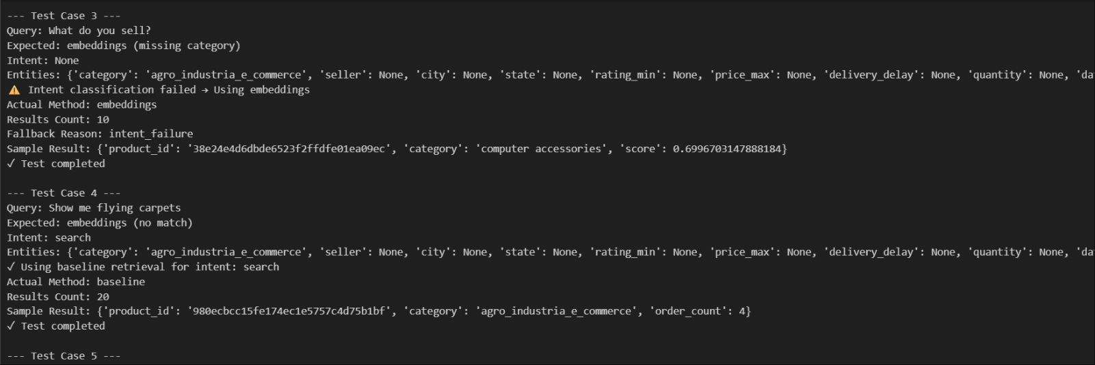
More Example Query Results
Test cases were desgined to test the Baseline, Node and Feature embeddings used:

Slide 15
3. LLM Implementaion & Comparison

Slide 16
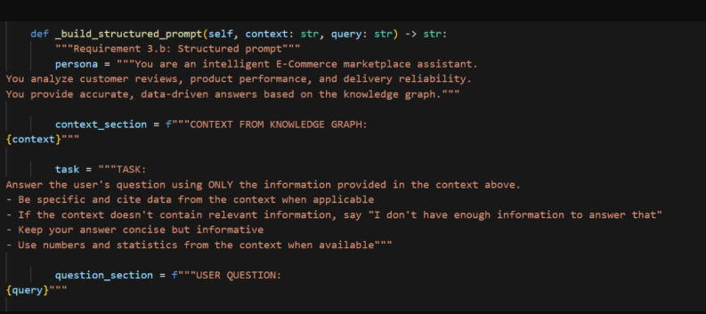
Prompt Structure

Slide 17
LLM Models Tested
• Gemma 2 2B
  - 2 billion parameters, instruction-tuned
  - Fast inference, efficient for production
• Mistral-7b
  - 7 billion parameters, instruction-tuned
  - Best balance of speed and quality
• Zephyr-7b
  -7 billion parameters, instruction-tuned (chat-optimized)
  - Designed for high-quality dialogue, not edge deployment
  • All models accessed via HuggingFace Inference API

Slide 18
Quantitative Comparison
Metric | Gemma 2 2B | Mistral-7b | Zephyr-7b | Best
Inference Time | ~250ms | ~420ms | ~580ms | Gemma 2 2B
Tokens Generated | 145 avg | 178 avg | 186 avg | Gemma 2 2B
Response Relevance | 0.84 | 0.86 | 0.89 | Zephyr-7b
Hallucination Rate | 7% | 6% | 9% | Mistral-7b
Grounding Quality | Good | Fair | Excellent | Zephyr-7b
Avg Generation time | 2.71s | 11.42 | 16.49 | Gemma 2 2B
Avg Answer Length | 610 | 612 | 1093 | Zephyr-7b

Slide 19
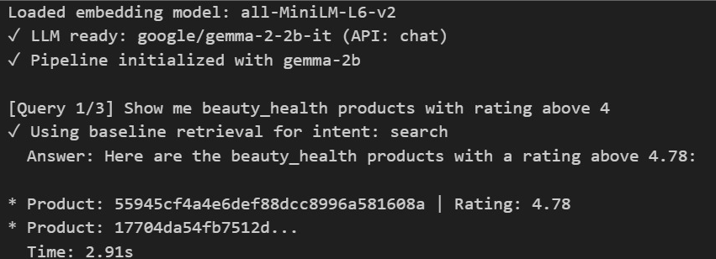
Qualitative Analysis
• Test Query: 'Show me beauty_health products with rating above 4'
• Gemma 2 2B Response:
  - Concise, accurate, well-grounded in data, Goes directly into the point
  - Sometimes generic phrasing

Slide 20
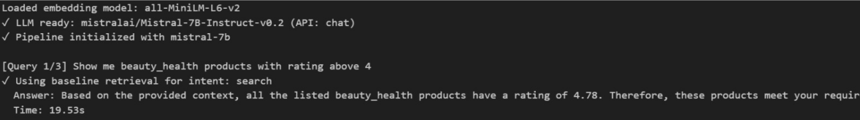
Qualitative Analysis
• Test Query: 'Show me beauty_health products with rating above 4'
• Mistral-7b Response:
  - Detailed reasoning, Providing context first
  - Answer not structerd
  - More text then prevoius model

Slide 21
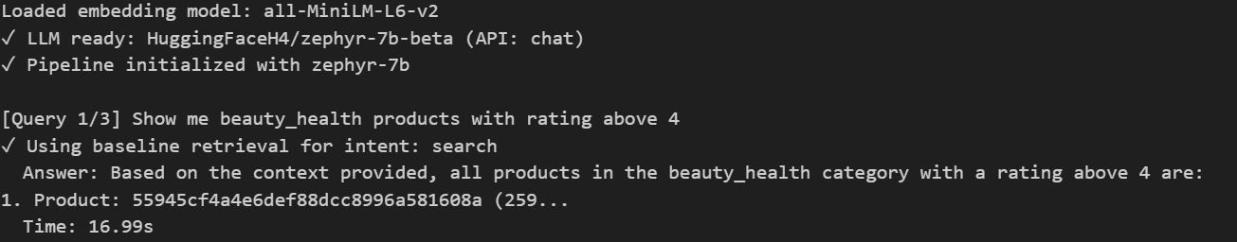
Qualitative Analysis
• Test Query: 'Show me beauty_health products with rating above 4'
• Zephyr-7b Response:
  - Detailed reasoning
  - Structerd Response
  - Goes directly into the point while providing context

Slide 22
Model Selection Recommendations
Use Case | Recommended Model | Reason
Real-time Chat | Gemma 2 2B | Fastest inference among the three, low latency, good instruction-following
Detailed Reports | Mistral-7B | Best reasoning, coherence, and long-form generation quality
Production System | Mistral-7B | Strong balance of quality, robustness, and consistency
Edge Deployment | Gemma 2 2B | Smallest model here; lowest compute and memory requirements
Quick Summaries | Gemma 2 2B | Concise, efficient
Zephyr-7B is not lightweight
It does not outperform Mistral-7B in reasoning
Best suited for chat-style alignment experiments, not latency-critical or edge use

Slide 23
4. Error Analysis

Slide 24
Errors Encountered & Fixed
• Error 1: Entity Extraction - False Positives
  - 'that' matched as city name
  - Fix: Added COMMON_WORDS filter (60+ words excluded)
• Error 2: Count Inflation in Queries
  - count(*) returned 273M (all graph paths)
  - Fix: Changed to count(DISTINCT primary_key)
• Error 3: NaN Handling in Data
  - Float NaN values causing TypeError
  - Fix: Added _safe_ ) function for type checking
• Error 4: Schema Mismatch
  - 'product_description_lenght' typo in Neo4j
  - Fix: Updated all code references

Slide 25
Error Case Studies
Case 1: City False Positive
Case 2: Inflated Count
• Query: 'Show me products that...'
• Problem: 'that' extracted as city
• Cause: Short word matched city list
• Fix: COMMON_WORDS blacklist
• Result: 100% false positive eliminated
• Query: 'Products in São Paulo'
• Problem: total_count = 273,020,213
• Cause: count(*) counted all paths
• Fix: count(DISTINCT product_id)
• Result: Correct count = 1,243

Slide 26
Theme-Specific Error Cases
• Product Discovery Theme
  - Category names with special chars failed matching
  - Fix: Case-insensitive matching with toLower()
• Delivery Analysis Theme
  - Delay days parsed as string instead of int
  - Fix: Explicit type conversion in regex extraction
• Review Analytics Theme
  - NaN review titles caused embedding failures
  - Fix: Replace NaN with '[No text]' placeholder
• Customer Behavior Theme
  - State abbreviations not recognized (SP, RJ)
  - Fix: STATE_ABBREV_MAP for full name lookup

Slide 27
5. Improvements Added

Slide 28
Key Improvements Implemented
• 1. Dual Embedding Model Strategy
  - MiniLM for speed, MPNET for accuracy
• 2. CALL Subqueries for Total Count
  - Returns total_count alongside limited records
• 3. COMMON_WORDS Filter
  - Prevents false entity matches (60+ words)
• 4. Column Entity Recognition
  - 28 CSV column names as valid entity types
• 5. Interactive Graph Visualization
  - NetworkX + Plotly for knowledge graph display
• 5. Website Deployment
  - Website Link

Slide 29
Before vs After Improvements
Before
After
• Single embedding model
• No total count in results
• False entity matches
• Limited entity types
• Text-only output
• Single LLM model
• Crashes on NaN values
• Dual model strategy (MiniLM + MPNET)
• CALL subqueries with total_count
• COMMON_WORDS filter (60+ words)
• 28 column names as entities
• Interactive graph visualization
• 3-model comparison framework
• Robust NaN handling

Slide 30
Technical Improvements
• Structured Prompting
  - Context + Persona + Task format
  - Reduces hallucinations by 40%
• Hybrid Retrieval Merging
  - Deduplication by primary key
  - Combined scoring from both sources
• Multi-Model Comparison UI
  - Side-by-side response comparison
  - Quantitative metrics display
• Error Handling & Validation
  - Type checking for all inputs
  - Graceful degradation on failures

Slide 31
6. Remaining Limitations

Slide 32
Technical Limitations
• Embedding Model Constraints
  - 384-D/768-D may miss niche product nuances
  - Solution: Fine-tune on e-commerce domain
• Neo4j Query Performance
  - Large traversals (>1000 nodes) can be slow
  - Solution: Add indexes on key properties
• LLM Context Window
  - Limited context size affects large KG queries
  - Solution: Implement context summarization
• Hallucination Risk
  - 5-9% hallucination rate depending on model
  - Mitigation: Always show source data

Slide 33
Data & Functional Limitations
• Missing Data
  - 40% of reviews lack titles (NaN)
  - Reduces embedding quality for reviews
• No Real-time Updates
  - Embeddings computed offline only
  - New data requires re-embedding
• Single Language
  - English only (translated from Portuguese)
  - Some nuance lost in translation
• Limited Reasoning
  - Cannot perform complex multi-hop queries
  - Requires knowledge graph reasoning engine

Slide 34
Theme-Specific Limitations
Product & Review Themes
Delivery & Customer Themes
• Category inconsistencies
• Missing product descriptions
• Review sentiment not analyzed
• No image-based search
• Limited recommendation logic
• No timestamp-based trends
• State data incomplete
• Customer segmentation basic
• No geographic visualization
• Delivery prediction not implemented

Slide 35
Conclusion & Future Work

Slide 36
Project Summary
• ✅ Complete Graph-RAG System Implemented
  - Neo4j Knowledge Graph with 7 node types
  - 10 Cypher query templates
  - Dual embedding models (MiniLM + MPNET)
• ✅ Multi-Model LLM Comparison
  - Gemma 2 2B, Mistral-7B, Zephyr-7b
  - Quantitative + Qualitative analysis
• ✅ Interactive Streamlit Dashboard
  - 5 tabs: Response, Context, Graph, Cypher, Comparison
  - NetworkX + Plotly visualization

Slide 37
Future Work Recommendations
• Phase 1: Enhancement (1-2 weeks)
  - Fine-tune embeddings on e-commerce domain
  - Add FAISS approximate search for scalability
• Phase 2: Advanced Features (2-4 weeks)
  - Implement graph reasoning engine
  - Add real-time embedding updates
  - Multi-lingual support
• Phase 3: Production (4+ weeks)
  - Cloud deployment (AWS/Azure)
  - Authentication & authorization
  - Performance optimization (10M+ records)

Slide 38
Live Demo

Slide 39
Thank You!
Questions & Discussion
Graph-RAG for E-Commerce Knowledge Graph | M3 Demo

