Slide 1
Weather Impact on UK Retail Sales
End-to-End Big Data Pipeline
SIC 7
BD Course
G 17
Notes:
Note:

Slide 2
Agenda
Team
Introduction
Problem Statement
Methodology
Key Tasks
Results and Insights
Conclusion
Q&A
Notes:
Note:

Slide 3
Team members
Team 17
Youssef Mohamed
Hager Ibraheem
Galal Mohamed
Notes:
Note:

Slide 4
Agenda
Team
Introduction
Problem Statement
Methodology
Key Tasks
Results and Insights
Conclusion
Q&A
Notes:
Note:

Slide 5
Introduction
Retailers operate in fast-changing environments.
Customer demand is affected by multiple factors — the biggest hidden one is WEATHER.
This project builds a big-data platform that integrates NOAA weather records with UK retail sales data to understand how temperature, rain, and seasons influence product purchases.
The goal:
Help retailers make smarter, data-driven decisions instead of relying on guesswork.
Notes:
Note:

Slide 6
Agenda
Team
Introduction
Problem Statement
Key Tasks
Methodology
Results and Insights
Conclusion
Q&A
Notes:
Note:

Slide 7
Problem Statement
Retail chains face three expensive problems:
1️⃣ Stockouts Hot day? Stores run out of cold drinks
Rainy day? They run out of umbrellas.
Lost revenue + unhappy customers.
2️⃣ Overstocking Cold week? Stores overstock cold drinks that don’t sell.
→ Wasted storage, lost profit, spoiled goods.
Notes:
Note:

Slide 8
Problem Statement
3️⃣ No real visibility of how weather affects demand Managers rely on:
* Gut feeling
* Last week’s sales
* Manual Excel trends
They cannot manually connect millions of sales rows with millions of weather observations.
This is a big data problem.
Notes:
Note:

Slide 9
Why Big Data?
Weather Data (NOAA GHCN Daily) Millions of daily observations Multiple weather stations
Dozens of features per day (TMAX, TMIN, PRCP…)
Needs heavy parsing, pivoting, enrichment
Traditional Excel / SQL is not enough.
A distributed big data platform is needed.
The datasets are large and complex:
Retail Data Millions of product price observations
Across many supermarkets & cities
120k+ unique products
50M+ total sales value
Notes:
Note:

Slide 10
Methodology
Our approach:
1. Ingest raw data using NiFi
2. Store raw data in HDFS (Data Lake)
3. Transform + Clean using Apache Spark
4. Model Data using a Star Schema
5. Load into Snowflake Data Warehouse
6. Visualize insights in a dynamic Dashboard
Each tool was selected because it solves a specific business & technical need.
Notes:
Note:

Slide 11
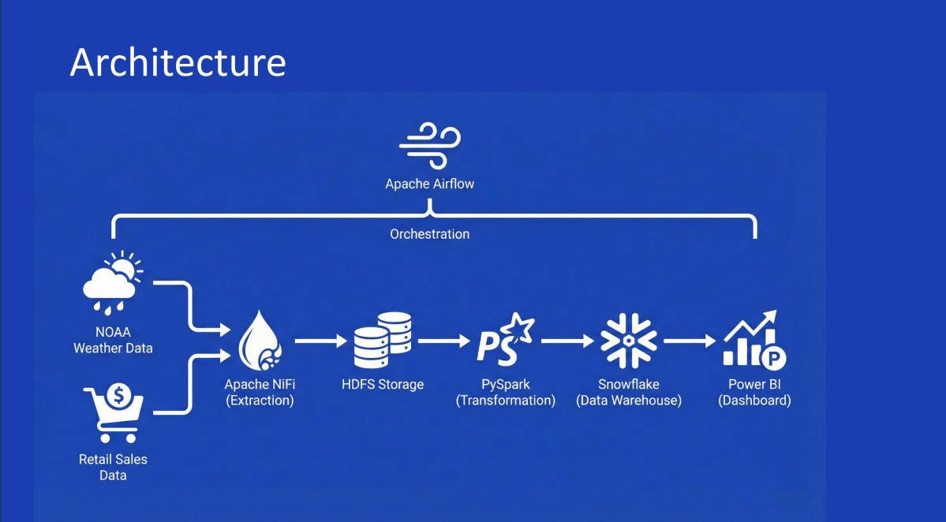

Slide 12
Why NiFi for Ingestion? (Business Justification)
Business Need Retailers receive data from many sources:
They need a reliable ingestion layer that: 1.Automates data loading
2.Handles multiple formats (CSV, Parquet, TXT)
3.Tracks and monitors data flows
4.Ensures consistency and reproducibility
Why NiFi Was the Perfect Choice
Built for data movement and flow automation
Visual UI → easier for teams to maintain
Can write directly to HDFS
Works perfectly with Airflow orchestration
Eliminates manual data copying completely
NiFi gave us a robust, production-style ingestion layer without writing custom scripts.
Notes:
Note:

Slide 13
Why HDFS for Storage?
Business Need Stores need to keep: * Raw data
* Historical weather
* Years of retail transactions
Data grows every day → storage must be scalable, cheap, fault-tolerant.
Why HDFS Fits Perfectly? * Distributed storage → handles very large datasets
* Works seamlessly with Spark
* Ideal for data lake raw zone
* Handles heavy datasets like NOAA easily
HDFS gives the retailer a long-term, scalable data lake
Notes:
Note:

Slide 14
Why Spark for Transformations?
Business Need
Weather and retail datasets required heavy transformations: * Cleaning, deduplication
* Pivoting weather elements
* Haversine distance calculations
* Many of join operations
* Building star schema dimensions and facts
Excel or Python Pandas CANNOT handle this scale.
Why Spark Was the Best Tool
* Distributed processing → handles millions of rows easily
* High-speed in-memory computing
* Can run on our existing Hadoop/YARN cluster
* Integrates with Snowflake connector
* Ideal for ETL and feature engineering
Spark made transformations fast, scalable, and reliable.
Notes:
Note:

Slide 15
Why Snowflake for the Warehouse?
Business Need The business users need:
* Fast analytical queries
* Clean, structured data
* A single source of truth
* Ability to run dashboards and BI tools
Why Snowflake Was the Right Choice? *Zero-maintenance cloud warehouse
* Auto-scaling compute → handles large queries quickly
* Separation of storage & compute (cost-efficient)
* Perfect for star schema dimensional models
* Strong integration with Spark
* High performance for BI dashboards
Snowflake transforms big data into business-friendly analytics
Notes:
Note:

Slide 16
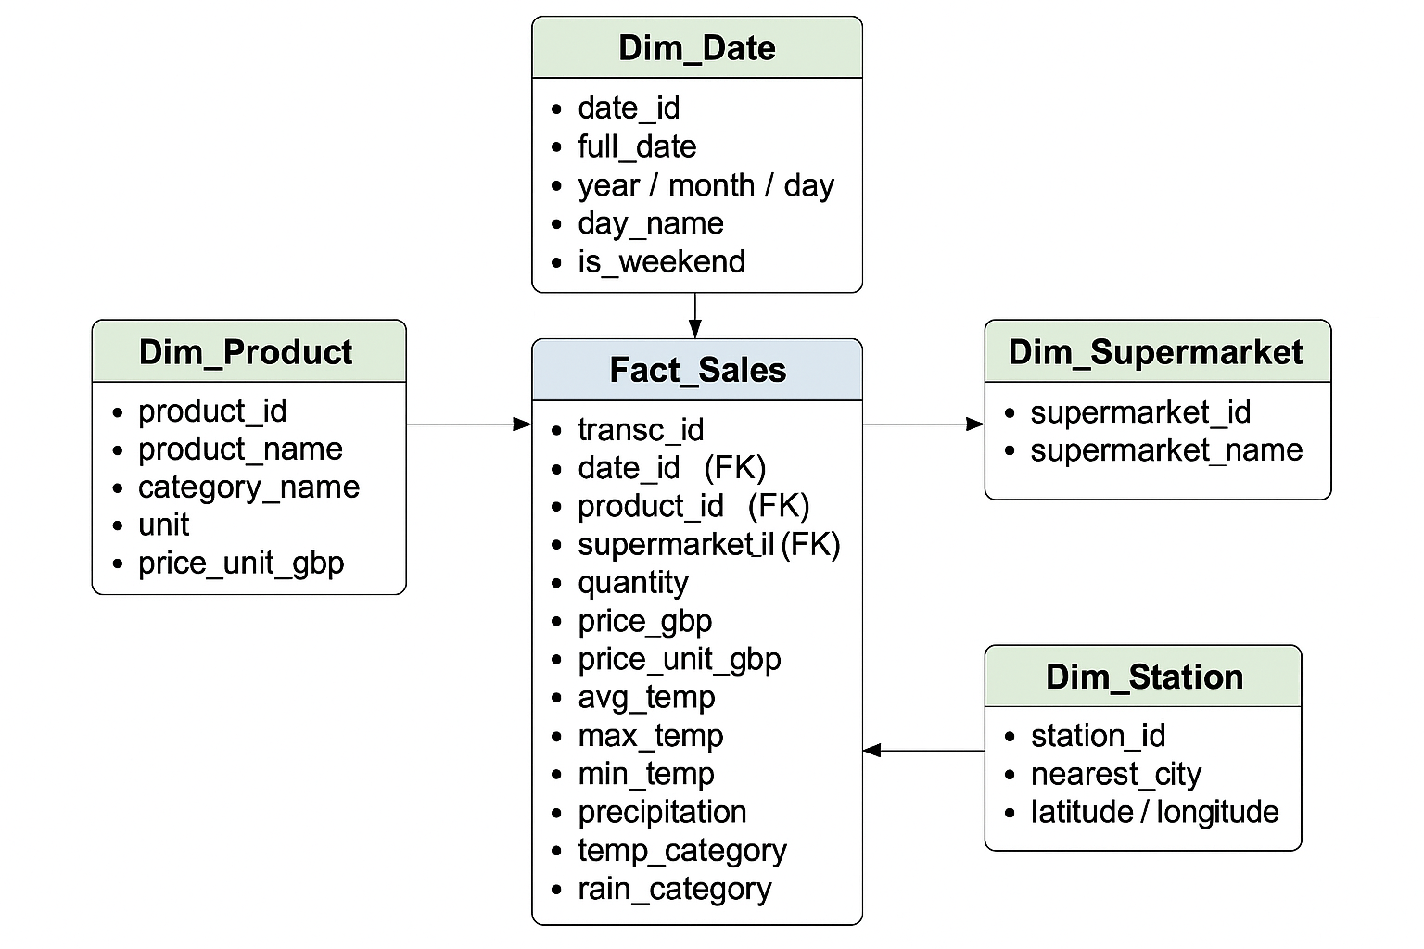
Star Schema
Notes:
Note:

Slide 17
Key Tasks Achieved
1. Set up full big-data environment in Docker
2. Used NiFi to ingest all datasets into HDFS raw zone
3. Cleaned & transformed retail and weather data with Spark
4. Mapped NOAA weather stations → cities using Haversine
5. Built Date, Product, Supermarket, and Station dimensions
6. Built Fact_Sales containing weather-enriched transactions
7. Loaded star schema into Snowflake using Spark connector
8. Created a comprehensive retail + weather dashboard
Notes:
Note:

Slide 18
Results & Insights (Business Value)
Notes:
Note:

Slide 19
Conclusion
We built a complete end-to-end big data analytics system that:
* Integrates multi-source datasets (weather + retail)
* Executes a professional ETL pipeline (NiFi + Spark + HDFS)
* Stores analytics-ready data in Snowflake
* Delivers data-driven insights via an interactive dashboard
Outcome:
The system empowers retailers to make smarter, faster, weather-informed decisions that reduce costs and increase profit.
Notes:
Note:

