Slide 1
CI/CD Pipelines
Fundamentals and Benefits

Slide 2
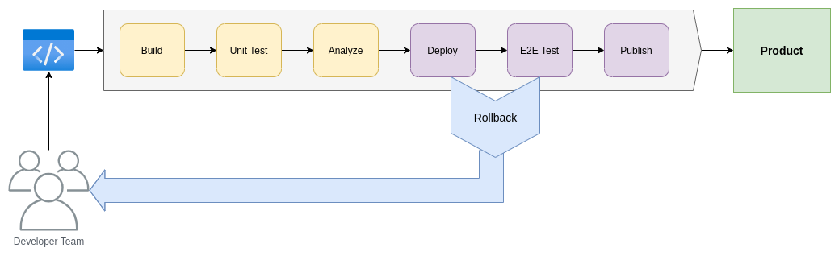
CI/CD Fundamentals
CI – Continuous Integration
  Gathering code from several developers
  Build and test the code (unit tests)
CD – Continuous Deployment
  Deploy and test the deployed app (end-to-end tests)
  Publish the “final” product

Slide 3
Essentials Benefits of CI/CD

Slide 4
Business benefits revenue

Slide 5
Business benefits cost
Catch Unit Test Failures
Catch compile

