Slide 1
Introduction
Project Overview: This project involves building a deep learning model to process and analyze text data from PDF documents using various AI technologies.
Key Technologies: Technologies used include Python, Streamlit, PyPDF2, TensorFlow, Keras, LangChain, and Google's Generative AI.
Purpose: To create an interactive application that extracts, processes, and summarizes text from PDFs, and answers user questions based on the content.
Photo by Hitesh Choudhary on Unsplash

Slide 2
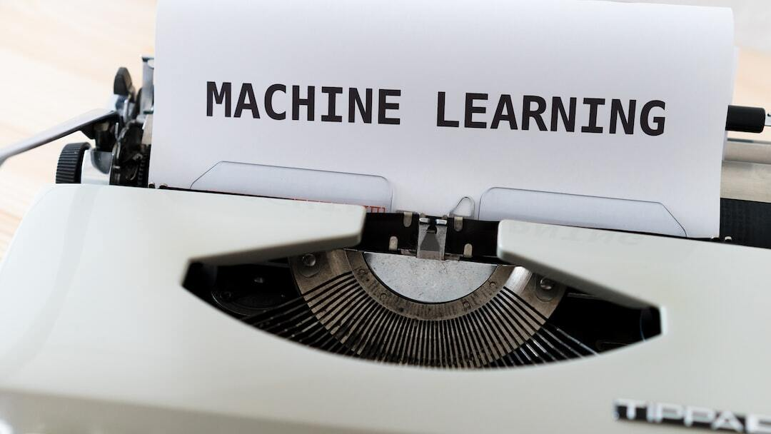
Objectives
Develop a Robust System: Create a system that can effectively process, analyze, and summarize text from PDF documents.
Utilize Advanced AI Models: Implement advanced AI models such as LSTM for text processing and Google Generative AI for conversational responses.
Enhance User Interaction: Build an interactive platform using Streamlit that allows users to upload PDFs and ask questions about the content.
Ensure Scalability: Design the system to handle a variety of PDF documents and large datasets efficiently.
Photo by Markus Winkler on Unsplash

Slide 3
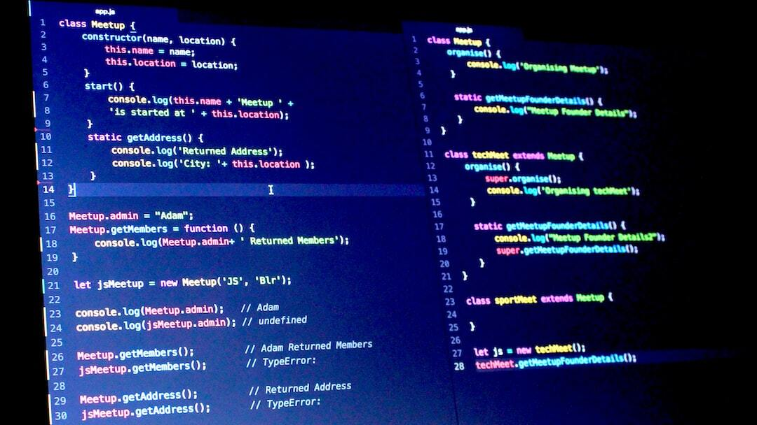
Project Journey - Code Overview
Code Structure: The code is structured to handle PDF text extraction, text processing, model training, and interactive user input.
Main Components: Includes modules for text extraction using PyPDF2, text chunking with LangChain, text tokenization, LSTM model building, and training using TensorFlow and Keras.
Interactive Application: Implemented using Streamlit to provide a user-friendly interface for uploading PDFs and querying their content.
Photo by NC Patro on Unsplash

Slide 4

Project Journey - PDF Text Extraction
Using PyPDF2: Utilized PyPDF2 library to read and extract text from PDF files.
Iterating Through Pages: Implemented a function to iterate through all pages of the PDF to extract the complete text.
Text Aggregation: Aggregated text from multiple PDF files to create a single comprehensive text source for further processing.
Photo by Limor Zellermayer on Unsplash

Slide 5

Project Journey - Text Chunking
Recursive Character Text Splitter: Used LangChain's RecursiveCharacterTextSplitter to divide the extracted text into manageable chunks.
Chunk Size and Overlap: Configured chunk size to 1000 characters with an overlap of 200 characters to maintain context across chunks.
Preparation for Tokenization: Prepared the text chunks for subsequent tokenization and sequence generation.
Photo by Walls.io on Unsplash

Slide 6
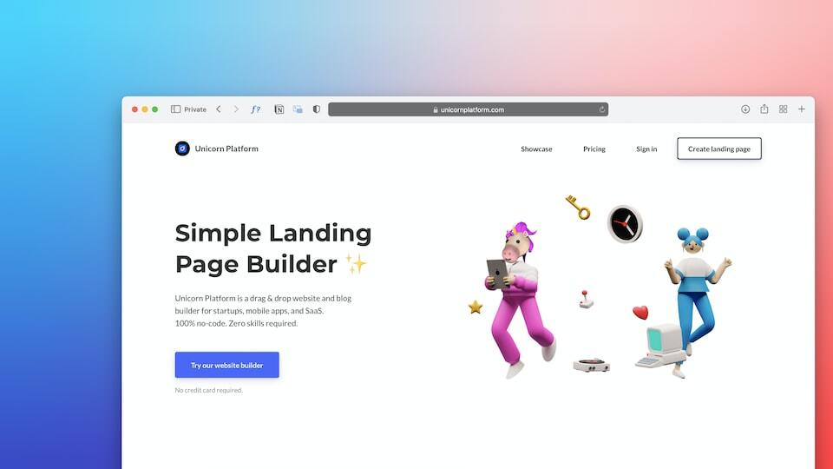
Project Journey - Tokenization and Sequencing
Tokenizer Initialization: Initialized a Tokenizer to convert text chunks into sequences of integers.
Fitting on Text Chunks: Fitted the Tokenizer on the text chunks to create a vocabulary index.
Sequence Generation: Generated sequences of integers representing the text and created a word index mapping.
Photo by Team Nocoloco on Unsplash

Slide 7
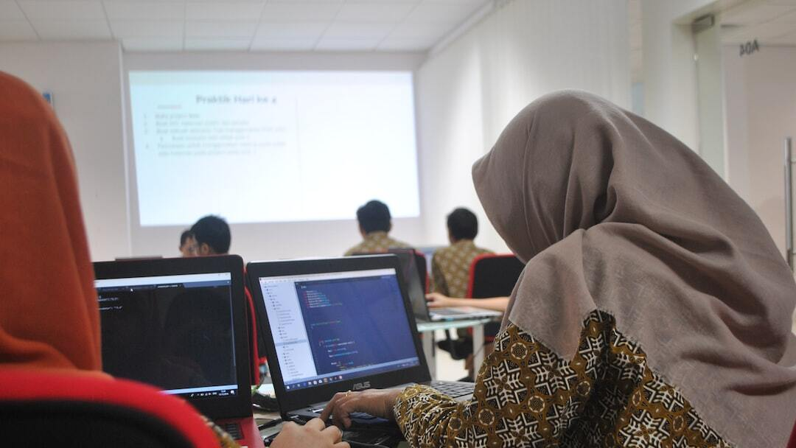
Project Journey - Building and Training LSTM Model
Model Architecture: Built an LSTM model using TensorFlow and Keras with an embedding layer, bidirectional LSTM layer, and a dense output layer.
Training Process: Trained the model on padded text sequences with a training-validation split to monitor performance.
Handling Sparse Data: Managed sparse data issues by reshaping input sequences for the loss function during training.
Photo by FLASHCOM INDONESIA on Unsplash

Slide 8
Project Journey - Conversational Chain
Generative AI Integration: Integrated Google Generative AI to create a conversational model for answering questions based on PDF content.
Custom Prompt Template: Designed a prompt template to ensure detailed and contextually accurate responses.
QA Chain Implementation: Utilized LangChain's QA chain to connect the conversational model with the text chunks for real-time interaction.
Photo by Jonathan Kemper on Unsplash

Slide 9

Benefits
Efficiency: Automates the extraction and processing of text from PDF documents, saving time and effort.
Accuracy: Uses advanced AI models to ensure accurate text analysis and summarization.
Interactivity: Provides an interactive platform for users to query the content of their PDF documents.
Scalability: Designed to handle large datasets and various types of PDF documents effectively.
Photo by Hitesh Choudhary on Unsplash

Slide 10
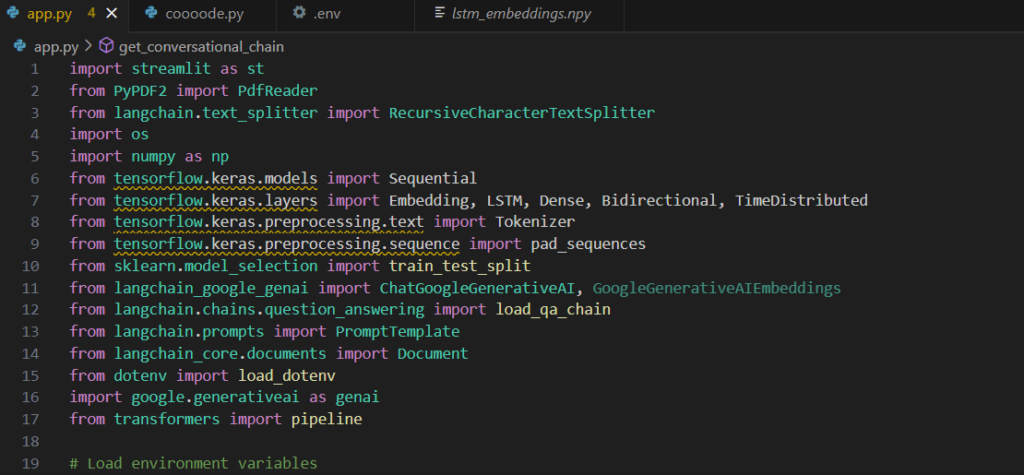
Code Snapshots

Slide 11
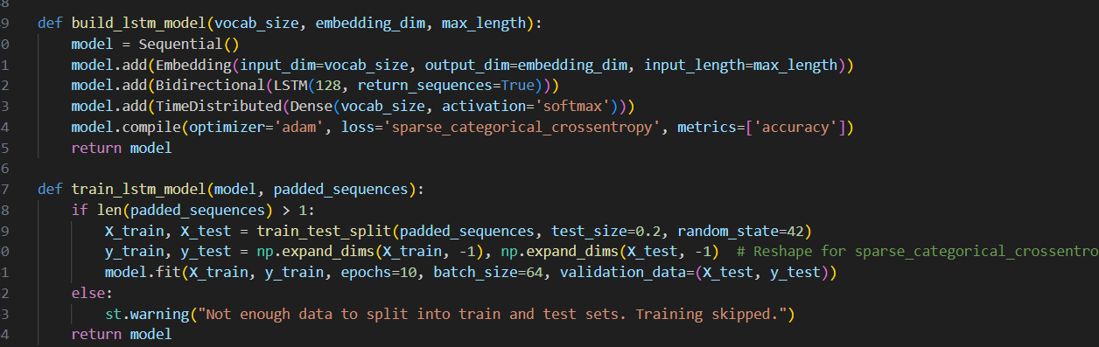
Code Snapshots

Slide 12
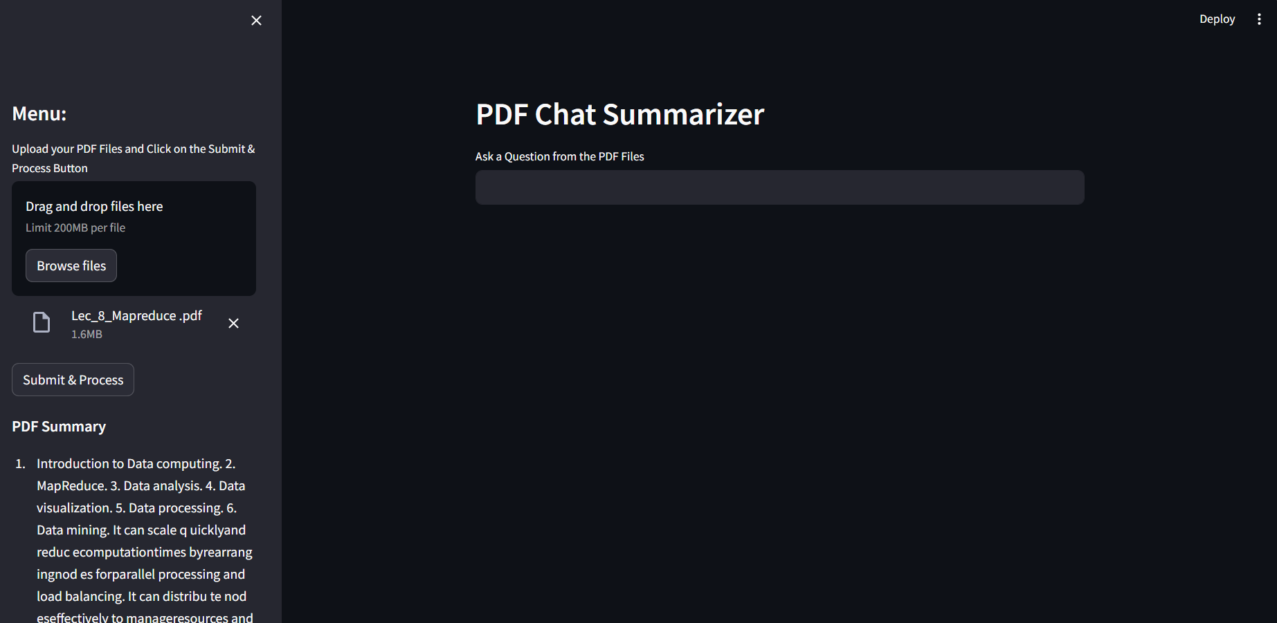
Outputs Snapshots

Slide 13
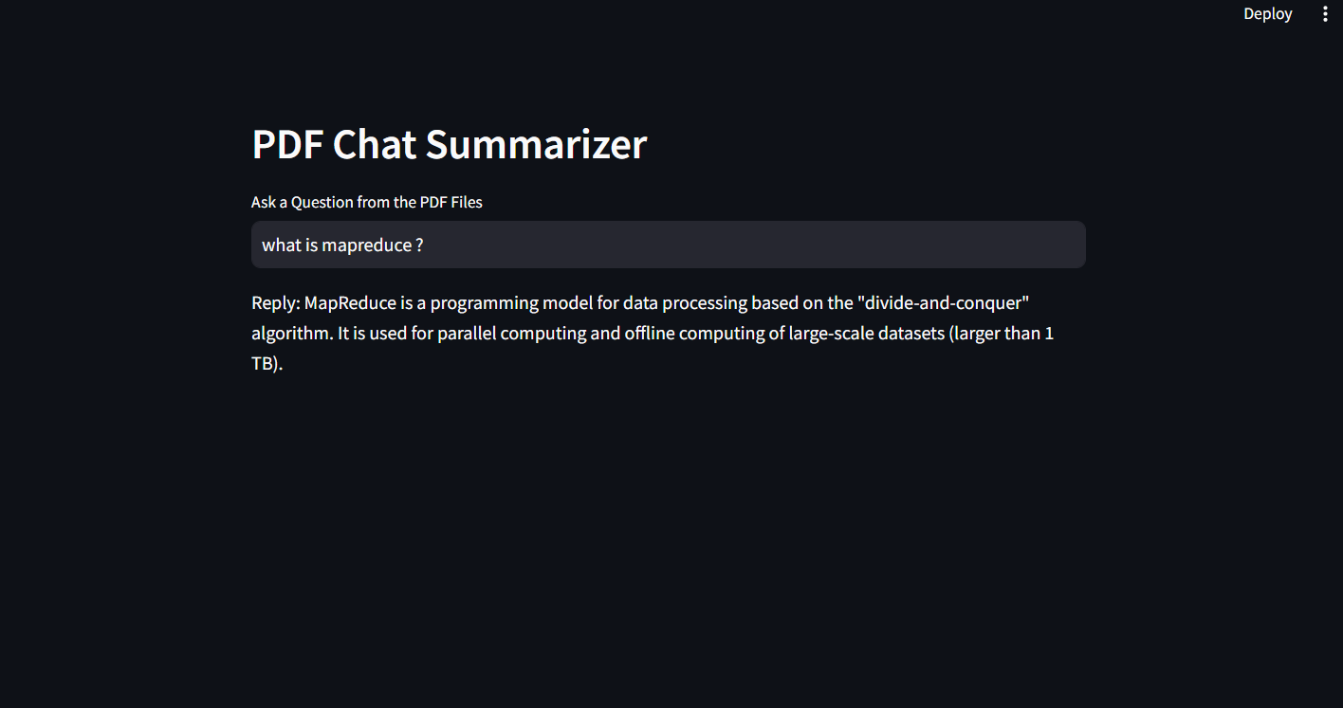
Outputs Snapshots

Slide 14
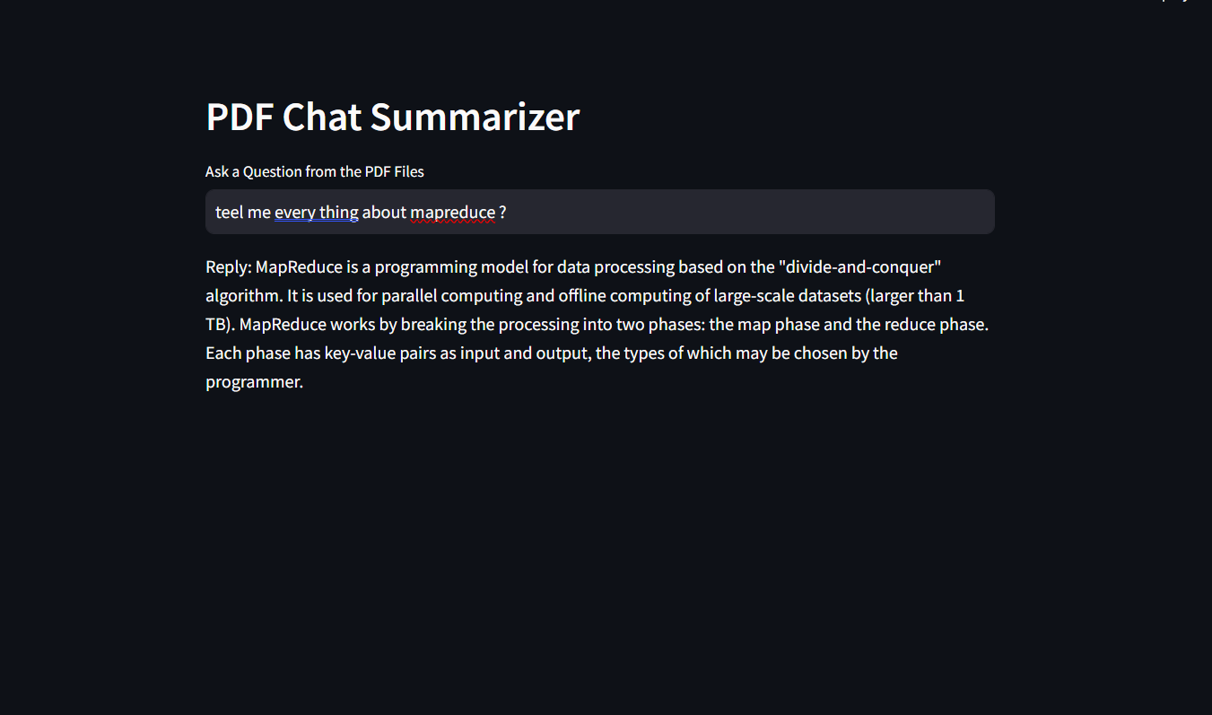
Outputs Snapshots

Slide 15
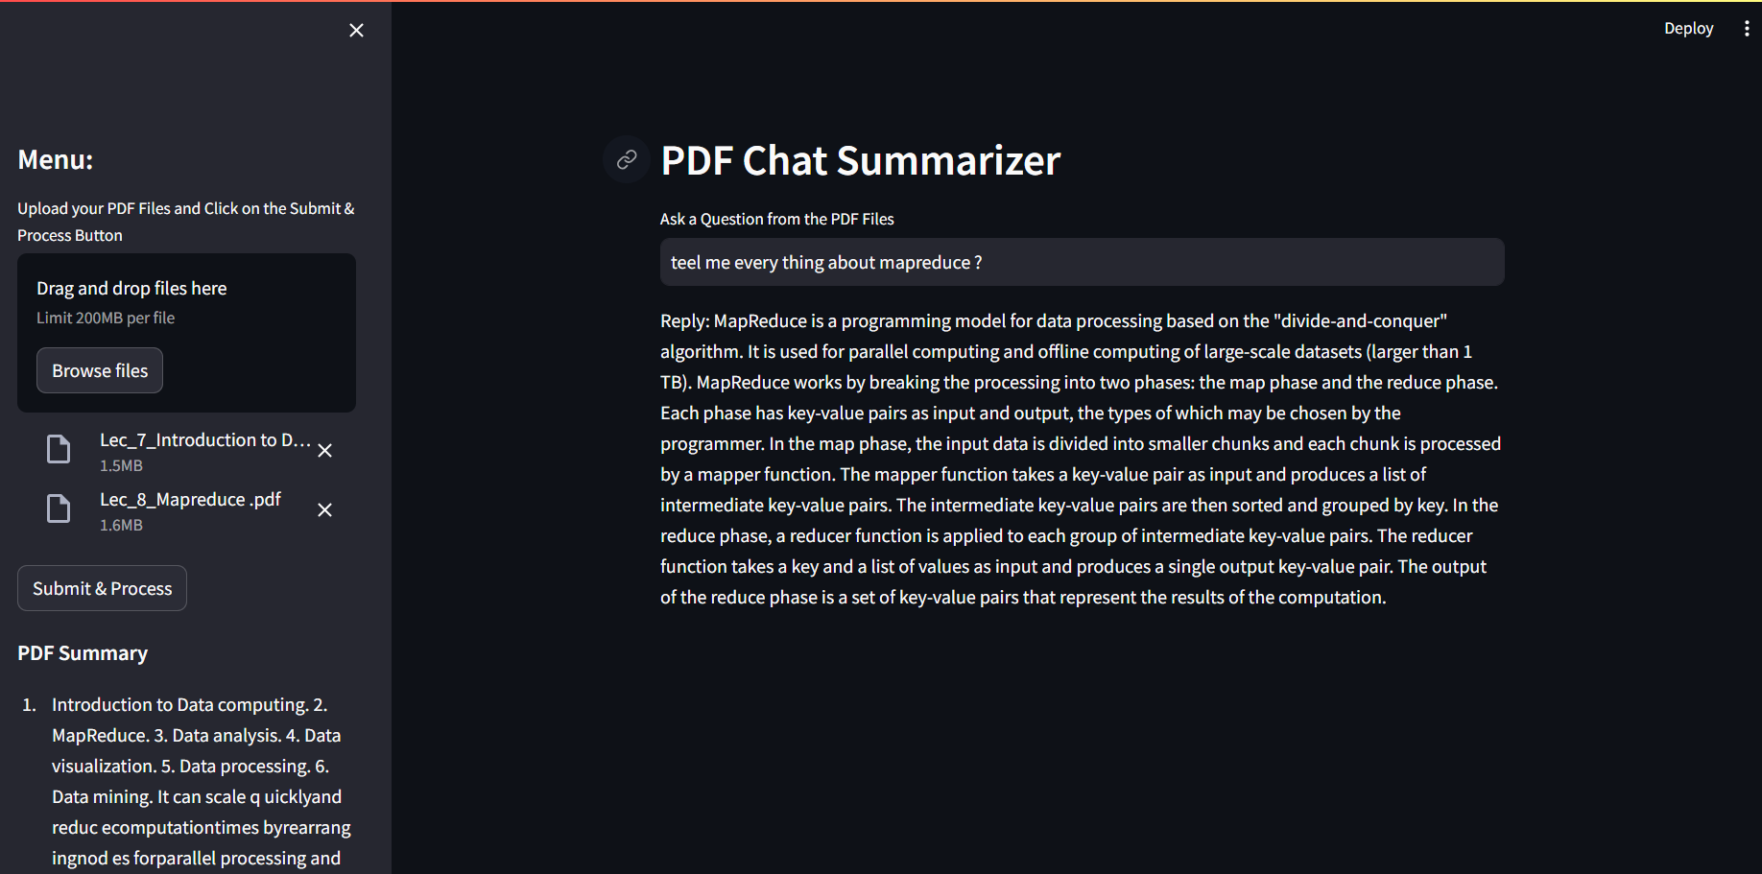
Outputs Snapshots

Slide 16
Conclusion
Project Summary: Successfully built and integrated various AI components to create an efficient and interactive text processing system.
Future Improvements: Potential improvements include optimizing the model for better performance and expanding the system's capabilities.
Final Thoughts: The project showcases the power of combining multiple AI technologies to solve complex text processing tasks.
Photo by Hitesh Choudhary on Unsplash

