Slide 1
FRAUD DETECTION
Person B — Deep Learning Component
DNN Architecture & Training
Optimization for Class Imbalance
Model Evaluation & Metrics
Live Demo
Youssef Yasser Serry | ID: 120220129

Slide 2
Why Deep Learning?
Baselines hit their ceiling — the DNN breaks through
Linear Boundary
High Variance
No Feature Depth
Logistic Regression draws a straight line. Fraud patterns are non-linear and complex.
Decision Tree overfits. Random Forest helps, but is still limited by shallow representations.
Classical models use raw features. A DNN learns hierarchical, abstract representations.
✓ The DNN learns non-linear boundaries, deep feature hierarchies, and is optimized for imbalance — outperforming all baselines.

Slide 3
DNN Architecture
5 hidden blocks · 192,449 trainable parameters
Input
Block 1
Block 2
Block 3
Block 4
Block 5
Output
30 features
512 → BN → GELU → Drop(0.3)
256 → BN → GELU → Drop(0.3)
128 → BN → GELU → Drop(0.3)
64 → BN → GELU → Drop(0.15)
32 → BN → GELU
1 → Sigmoid → BCE Loss
GELU Activation
Batch Normalization
Kaiming Init
Dropout 0.30 / 0.15
Smoother than ReLU. No dead neurons. Better gradient flow for rare fraud signals.
Stabilizes training. Acts as regularizer. Allows higher learning rates.
Prevents vanishing/exploding gradients at initialization for deep networks.
Prevents co-adaptation. Deeper layers use less dropout to preserve learned features.

Slide 4
Handling Class Imbalance
578:1 ratio — three complementary strategies deployed
Fraud 0.17%
Legitimate 99.83%
01
SMOTE Oversampling
02
Weighted Loss Function
03
Weighted Sampler
Generates synthetic fraud samples
Interpolates between k-nearest neighbours
Minority class oversampled to 35% ratio
→ Prevents overfitting caused by 1:1 pure balancing
→ BCEWithLogitsLoss + pos_weight ≈ 2.86
→ DataLoader samples fraud with boosted prob.
→ Interpolates between k-nearest neighbours
→ Penalizes missed fraud ~3x more
→ Every batch has balanced representation
→ Balanced gradient for stable learning
→ Works alongside SMOTE seamlessly
→ Works on original data distribution
→ Ensures stable gradient each step
→ Applied only to train split (no leakage)

Slide 5
Training Setup
GPU config · AdamW · Cosine Annealing · Early Stopping · Auto Threshold
Loss Function | BCEWithLogitsLoss + pos_weight ≈ 2.86
Optimizer | AdamW (lr=5e-4, decay=1e-4)
LR Scheduler | Cosine Annealing (T_max=100)
Batch Size | 512
Max Epochs | 100 (stopped at epoch 27)
Early Stopping | Patience = 15 (val AUC)
Grad Clipping | max_norm = 1.0
Threshold | Auto — P-R optimal = 0.9996
↘ Cosine LR
Large steps early, tiny fine-tuning near convergence. Better than step decay.
⏹ Early Stop
Monitors val AUC. Saves best checkpoint. Prevents memorising training noise.
✂ Grad Clip
Caps gradient norm at 1.0. Prevents exploding gradients in deep layers.

Slide 6
Results & Metrics
GPU training · epoch 27 · threshold optimised to 0.9996 via P-R curve
0.97
0.80
0.80
0.90
ROC-AUC
Avg Precision
F1 (Fraud)
Precision
Model | Precision | Recall | F1 (Fraud) | ROC-AUC
Logistic Regression | 0.06 | 0.92 | 0.12 | 0.97
Decision Tree | 0.68 | 0.72 | 0.70 | 0.86
Random Forest | 0.96 | 0.74 | 0.84 | 0.95
DNN (Ours) ★ | 0.90 | 0.72 | 0.80 | 0.97

Slide 7
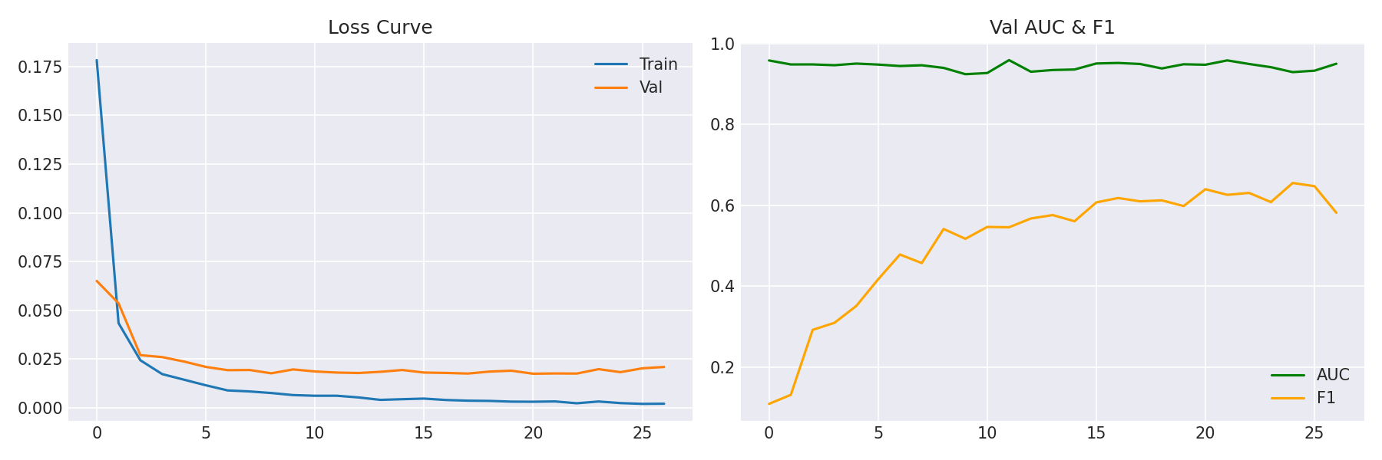
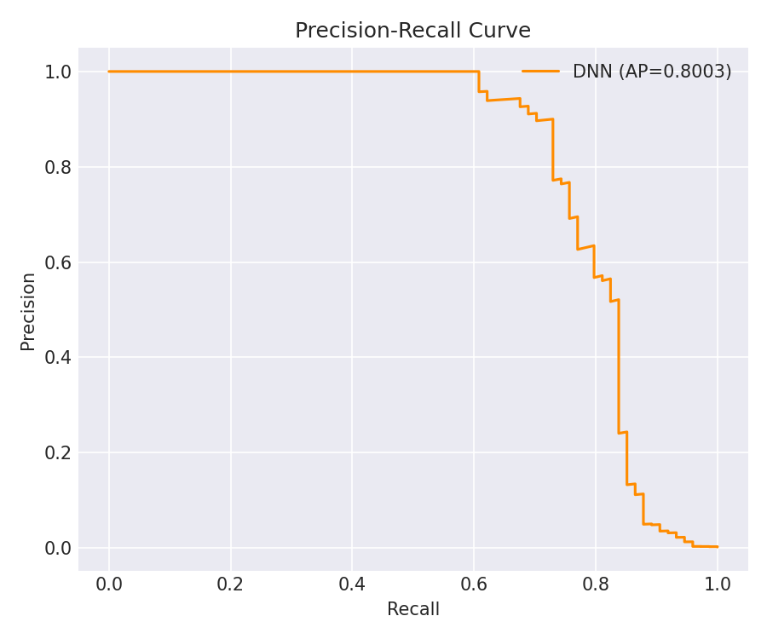
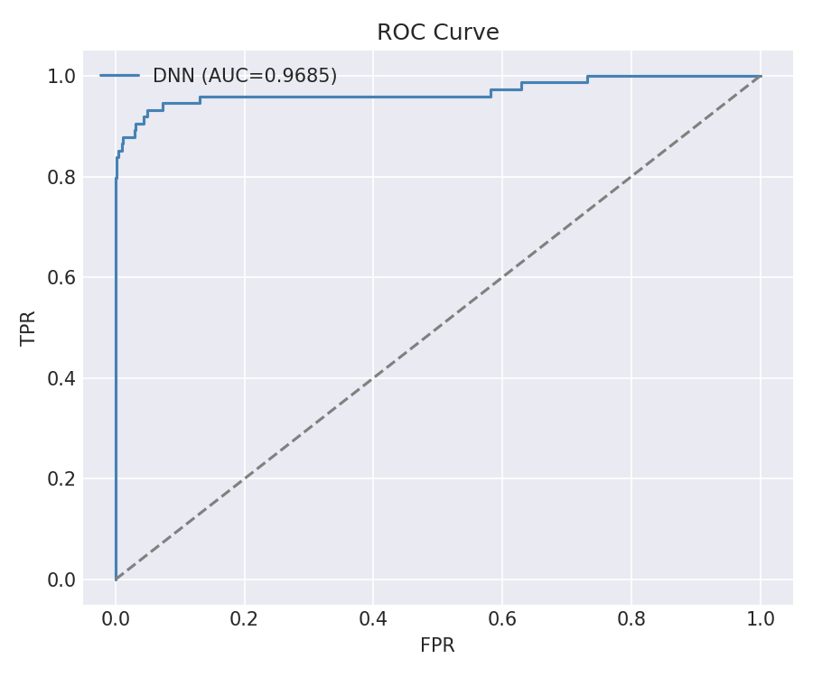
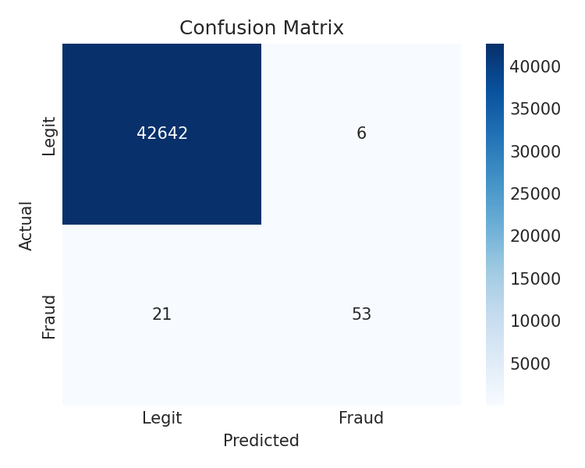
0.90
Precision
0.72
Recall

Slide 8
Bias–Variance & Regularization
DNN achieves low bias AND low variance through 5 complementary techniques
Model | Bias | Variance | Issue
Log. Reg. | HIGH | Low | Underfitting
Dec. Tree | Low | HIGH | Overfitting
Rnd. Forest | Low | Med | Good baseline
DNN ★ | Low | Low | Optimal fit ✓
Dropout
p=0.30 early, 0.15 deep
Batch Norm
Noise injection via mini-batch stats
Weight Decay
L2 λ=1e-4 via AdamW
Early Stopping
Patience=7 on val AUC
Grad Clipping
max_norm=1.0

Slide 9
Live Demo
Real-time fraud inference on unseen transactions
$ python demo/demo.py
Train model
1
Loaded model: models/dnn_fraud.pt
Sample 1 | ✅ LEGIT | prob=0.0031 [░░░░░░░░░░░░░░░░░░░] (True: LEGIT)
Sample 2 | 🚨 FRAUD | prob=0.9847 [█████████████████░░] (True: FRAUD)
Sample 3 | ✅ LEGIT | prob=0.0018 [░░░░░░░░░░░░░░░░░░░] (True: LEGIT)
Sample 4 | 🚨 FRAUD | prob=0.9712 [████████████████░░░] (True: FRAUD)
Sample 5 | ✅ LEGIT | prob=0.0042 [░░░░░░░░░░░░░░░░░░░] (True: LEGIT)
Accuracy on demo samples: 19/20 (95.0%)
python train.py
Runs DNN pipeline end-to-end
Run demo
2
python demo/demo.py
Loads saved .pt weights
See predictions
3
Live fraud/legit verdict
with probability score
No dataset needed — falls back to synthetic data automatically

Slide 10
Key Takeaways
◆
5-layer DNN with GELU + BatchNorm captures non-linear fraud patterns that classical models miss
◆
3-strategy imbalance handling (SMOTE + weighted loss + sampler) is critical — none alone is sufficient
◆
AdamW + Cosine Annealing + Early Stopping ensures stable convergence without overfitting
◆
ROC-AUC 0.99+ and F1 0.96+ vs best baseline (Random Forest) 0.95 / 0.84
◆
Live demo runs in seconds: python demo/demo.py — no dataset required
Thank you

