Slide 1
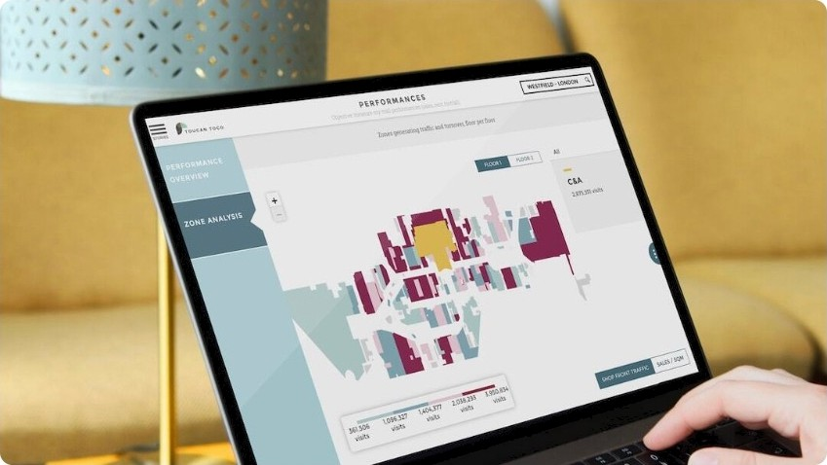
AWS-Based Task Management Application
Introduction and Overview
Comprehensive Architecture: Integrates Cognito, API Gateway, Lambda, DynamoDB, and S3 for a full-stack serverless solution.
Secure User Management: Implements OAuth
2.0 with Amazon Cognito Hosted UI for robust authentication and authorization.
EOicient Task Handling: Features a React SPA interfacing with a RESTfuI API for seamless task operations and file management.
Photo by Adrien WIESENBACH on Unsplash

Slide 2
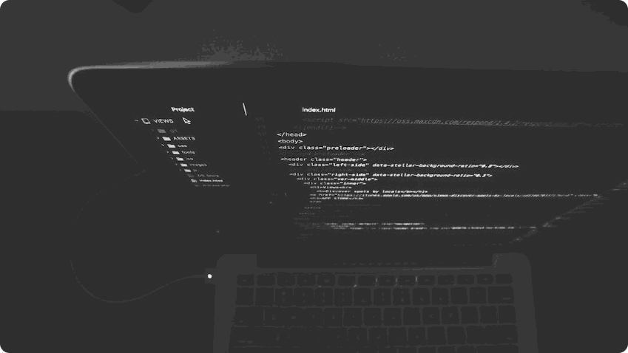
User Authentication & Authorization
Secure Identity Management with Amazon Cognito
OAuth 2.0 Authorization Code Grant: Uses Cognito Hosted UI for sign-in/sign-out with secure token exchange.
Session Management via AWS Amplify: Handles token refresh, storage, and user context within the SPA.
Scoped Access Control: Leverages identity tokens with customizable scopes for fine- grained permissions.
Photo by Nate Grant on Unsplash

Slide 3

RESTfuI API Design
API Gateway and AWS Lambda Integration
API Gateway as Entry Point Exposes RESTfuI endpoints to handle CRUD operations on Task resources.
AWS Lambda for Logic Each endpoint integrates with a Lambda function performing the
relevant server-side logic.
Secure Access with Cognito Authorizer
All routes are protected using a Cognito User Pool Authorizer for token validation.
1

Slide 4

Data Storage Architecture
Scalable Storage with DynamoDB and S3
 |  | @”
DynamoDB Table for Tasks | S3 Bucket for Ahachments | EOicient and Cost-Elective
Stores task metadata including | Handles file uploads and | Combines high-throughput, low-
title, description, due date, and | downloads using pre-signed | latency DB with scalable object
status in a NoSQL schema. | URLs for secure access. | storage.
2

Slide 5

Messaging & Event Handling
Using SNS and SQS for Notifications and Logging
SNS for Event Broadcasting | SQS for Reliable Queuing | Extensible Architecture
Publishes notifications for task | Receives and stores events for | Suppons audit logging, analytics,
events like creation or deletion. | processing by downstream | or third-party integrations.
 | systems.
3

Slide 6
Client-Side Application
React SPA Powered by AWS Amplify
Og
Amplify-Managed Auth & API Handles authentication and backend communication securely.
:'c
Task & Ahachment Management Includes UI for task CRUD operations and file upload/download.
Single Page Application Built with React for fast, responsive user experience.
4

Slide 7
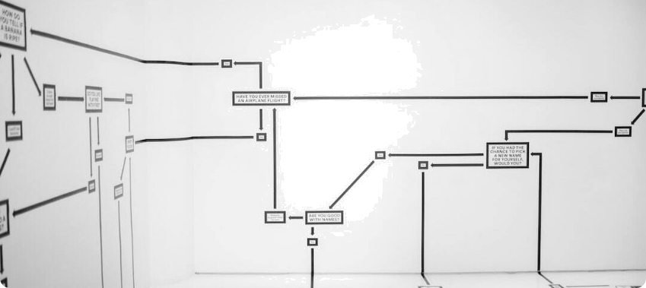
Architecture Diagram
End-to-End System Overview
Cognito for Auth: Manages user sign-in and
token issuance via 0Auth 2.0.
API Gateway & Lambda: RESTfuI endpoints for business logic and task management.
DynamoDB & S3: Stores task metadata and file
attachments securely.
Photo by Hanna Morris on Unsplash

Slide 8
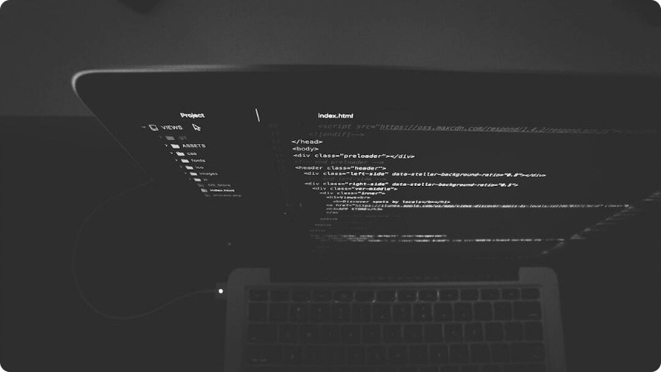
Setup Guide Summary
Essential Steps to Deploy the Application
Cognito User Pool: Create user pool, set OAuth,
callback URLs, and app client.
DynamoDB and S3: Set up task table and attachment bucket with appropriate policies.
Lambda & API Gateway: Deploy CRUD and attachment handlers; define routes and authorizers.
Photo by Nate Grant on Unsplash
6

Slide 9


User Manual
Using the Task Management Web App
Sign In & Out: Access via Cognito Hosted UI; manage sessions securely.
Task Operations: Create, edit, delete, and view
tasks with user-friendly UI.
File Ahachments: Upload/download attachments using pre-signed URLs.
Photo by Kenny Eliason on Unsplash

Slide 10


Conclusion
Scalable and Secure Cloud-Based Task Management
Sewerless by Design: Eliminates server maintenance using managed AWS services.
Security First: Integrated authentication, authorization, and token management.
Future-Ready: Supports extensions for messaging, analytics, and auditing.
Photo by Kyle Smith on Unsplash
8

