Slide 1

Healthcare provider fraud detection
By: Jumana Mohab, Youssef Wael, Omar Hefny, Ahmed Tamer

Slide 2
Project Overview:
We built a model that predicts which healthcare providers are likely to be involved in fraudulent billing. This helps medicare prioritize investigations.

Slide 3
Why is fraud detection important:
Billing for services not provided
01
Upcoding
02
Unbundling
03
Claims for deceased patients
04

Slide 4
Datasets:
We used multiple datasets, such as:
Beneficiary data (patient demographics and chronic conditions)
Inpatient claims (hospital stays)
Outpatient claims (visits and tests)
Combined claims
Fraud labels
All connected using BeneID and Provider.
The datasets have three levels:
Beneficiary-level (patient info)
Claim-level (each visit/procedure)
Provider-level (final prediction)
Since fraud prediction is done per provider, we need to aggregate claims up to provider level

Slide 5
Data Quality checks:
We checked for:
Missing values in chronic conditions and payment fields
Duplicated entries
Outliers in reimbursement amounts
Inconsistencies between inpatient and outpatient claims
They help us decide what preprocessing steps were required.

Slide 6
Data Observations:
Before modeling, we noticed:
Some providers submit far more claims than others
Claim amounts vary widely, especially with inpatient claims
Some features have noticeable skew/outliers
Beneficiary ages range widely, affecting average provider age
These influenced how we engineered features

Slide 7
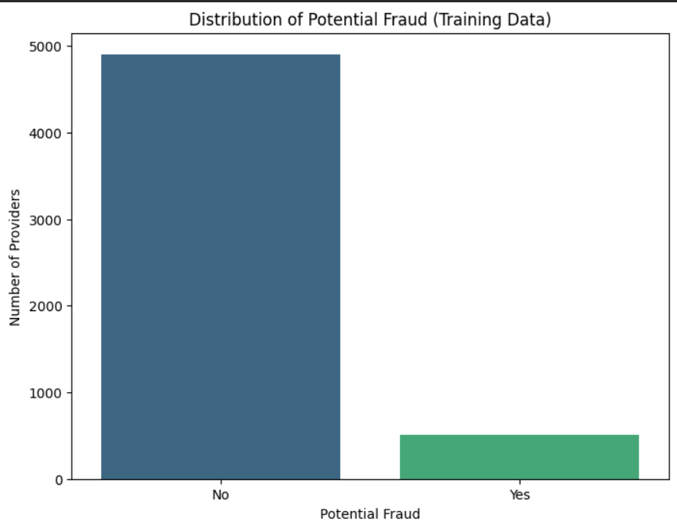
Fraud vs Non-Fraud: Class Distribution
Fraud cases are only around 10% of all providers. This severe imbalance affects model training because the majority class dominates.

Slide 8
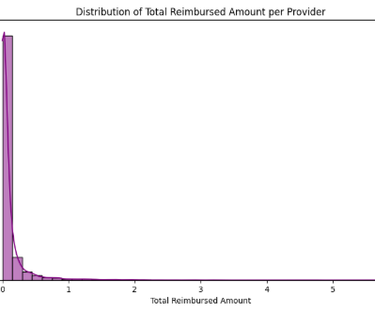
Reimbursement behaviour across providers
We plotted the average reimbursement amount per claim. From observation, most providers fall in a typical range, but there is a long tail of providers with very high average reimbursement amounts. These extremes may indicate unusual financial behaviour.

Slide 9
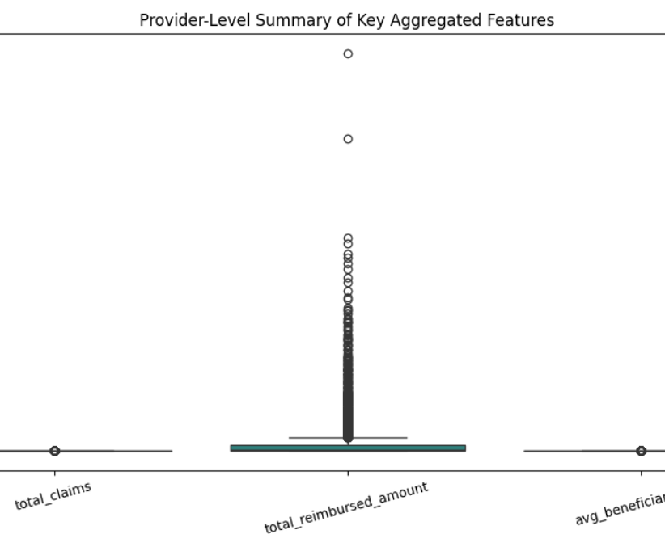
Provider-level feature spread
We examined aggregated provider metrics:
Total claims submitted
Total reimbursed amount
Average age of beneficiaries per provider
Boxplots show a lot of variation and several outliers, which are important to keep in mind during modeling.

Slide 10
Why aggregation was essential
Since each provider has many patients and many claims:
Claim-level data is too granular
Provider-level predictions require a single feature row per provider
Aggregation allows us to summarize behavior and detect patterns
Without aggregation, training would be impossible.

Slide 11
What Features We Engineered:
Total number of claims
Total reimbursed amount
Average reimbursement per claim
Number of unique beneficiaries
Average beneficiary age
Counts of chronic conditions
Inpatient vs outpatient ratios

Slide 12
Insights after aggregation
Comparing aggregated metrics between fraud and non-fraud providers:
Fraudulent providers often have more extreme values
Some show unusually high average reimbursements
Claim count patterns differ noticeably

Slide 13
The Class Imbalance Issue
Since fraud is rare (around 10%), a model could easily achieve high accuracy by always prediction “not fraud”. We needed techniques to ensure the model learns the minority class clearly

Slide 14
How we handled imbalance
Class weighting
01
SMOTE oversampling
02
Undersampling
03
Cost-sensitive learning
04
Final approach: SMOTE + class weighting.
It improves recall while maintaining reasonable precision

Slide 15
Algorithms Considered
Linear/Logistic Regression – Simple, interpretable baseline.
Decision Trees – Capture non-linear patterns.
Random Forest – Ensemble method, reduces overfitting.
SVM – Good for classification with clear margins.
k-NN – Predicts based on nearest neighbors.

Slide 16
Our model comparison will include:
Logistic regression (baseline + interpretability)
Random forest (robust performance for mixed features)
Gradient boosting (usually high accuracy)

Slide 17
Evaluating the models
We will use metrics suitable for imbalanced classification:
Precision (how many predicted frauds were correct)
Recall (how many actual frauds were caught)
F1-score
ROC-AUC
Precision-Recall AUC
Confusion matrix (for real-world impact)

Slide 18
Expected Model Strengths
Tree-based models often perform better on tabular data like claims. We expect random forest and gradient boosting to outperform logistic regression. We will compare their evaluation plots to choose the best

Slide 19
Error Analysis: Why does it matter?
We will review:
False Positives:
False Negatives:
Legitimate providers incorrectly flagged, which leads to wasted investigations
Fraudulent providers missed, which leads to financial loss
Understanding mistakes helps us improve the feature set or adjust class weighting

Slide 20
Project Summary:
We have:
Explored and understood all datasets
Performed data quality checks
Aggregated claims into provider-level features
Identified key behavioural differences
Addressed class imbalance
Prepared multiple models for training
Assisted medicare in identifying high-risk providers efficiently

