Slide 1

Welcome to ADVENTURE sudoku
Here is how to play the game… ( describe the rules of sudoku in brief describe the rules of sudoku in brief describe the rules of sudoku in brief describe the rules of sudoku in brief describe the rules of sudoku in brief )
You’ll get to choose from two different adventures (space or ocean)
Feel free to edit and choose appropriate colors and fonts
Try to make the word rotate a bit
Maybe 2 classes rleft & rright and switch
Let’s Go
Let’s Go
Let’s Go

Slide 2
Feel free to edit and choose appropriate colors and fonts
Enter Name:
Youssef wafik
Choose Level:
Level one
submit

Slide 3





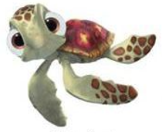








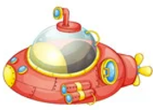
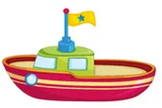

Feel free to edit and choose appropriate colors and fonts
Feel free to edit and choose appropriate colors and fonts
Rocket ships
Aliens
Fish
Boats
Space
On hover inc size of chosen group
Ocean
Buttons to get choice
start

Slide 4


Font color turs red at 10 secodns
Time
1
2
3
4
name
9
Youssef wafik
Score
2
start
High score
6
Feel free to edit and choose appropriate colors and fonts

Slide 5

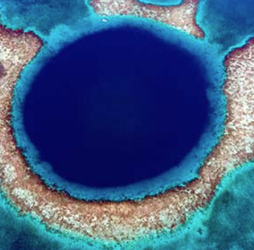
Time
1
2
3
4
name
17
Youssef wafik
Score
3
start
High score
4
Feel free to edit and choose appropriate colors and fonts

