Slide 1

Train S-A-C Agent for Ball Balance Control Using RL Agents
Kramer-Correia Construction

Slide 2
Objectives
Study the kinematics of the Kinova Gen3 robot arm
Generate a proper quintic trajectory and train the robot
Train a Soft Actor-Critic (SAC) reinforcement learning agent
Design an effective reward function.
Design appropriate policy and value functions for the SAC agent
Compare the performance of different trained agents

Slide 3


What We will discuss
1
2
3
Kinova Gen3 robot Parts and its kinematics
Soft-Actor-Critic (SAC)
Learning
Environment Explanation
4
5
5
Robot and RL model interaction
Reward function and Training Network
Show Results

Slide 4
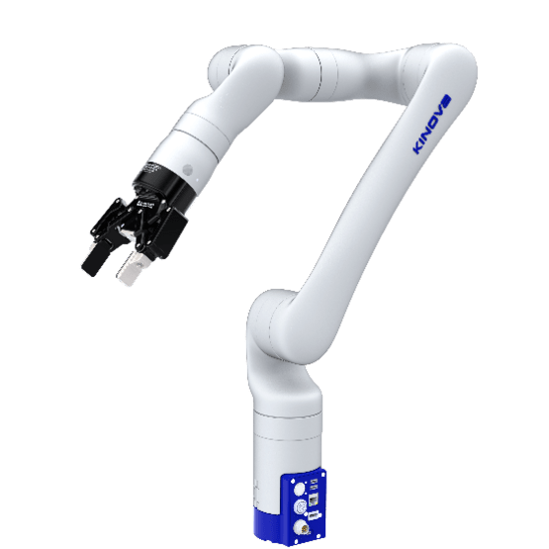
Kinova Gen3 robot Parts
Kinova Gen3 has 7-DoF
7 Joint
6 Links
Only the final two joints are actuated and contribute to motion in the pitch and roll axes
For the ball Ballincing Task there is 22 observation elements

Slide 5
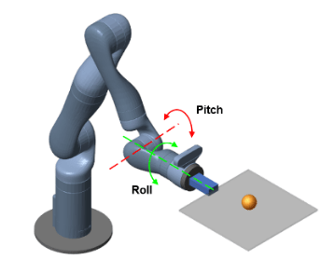
Observations
Observation Component | Quantity
Sine of joint angles (2 joints) | 2
Cosine of joint angles (2 joints) | 2
Joint angular velocities (2 joints) | 2
Ball position (x, y) | 2
Ball velocity (dx, dy) | 2
Plate orientation (quaternions) | 4
Plate angular velocities (quaternion derivatives) | 4
joint torques | 2
Ball radius | 1
Ball mass | 1
Total | 22

Slide 6
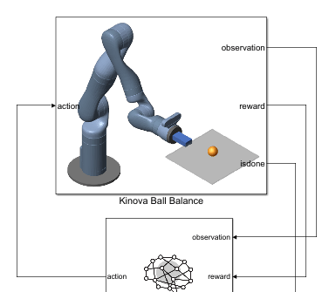
System overview
Kinova ball Balance
Input: Action
output: Observations, Reward, isDone Signal
RL Agent:
Input: Observations, Reward, isDone Signal
Output: Action

Slide 7
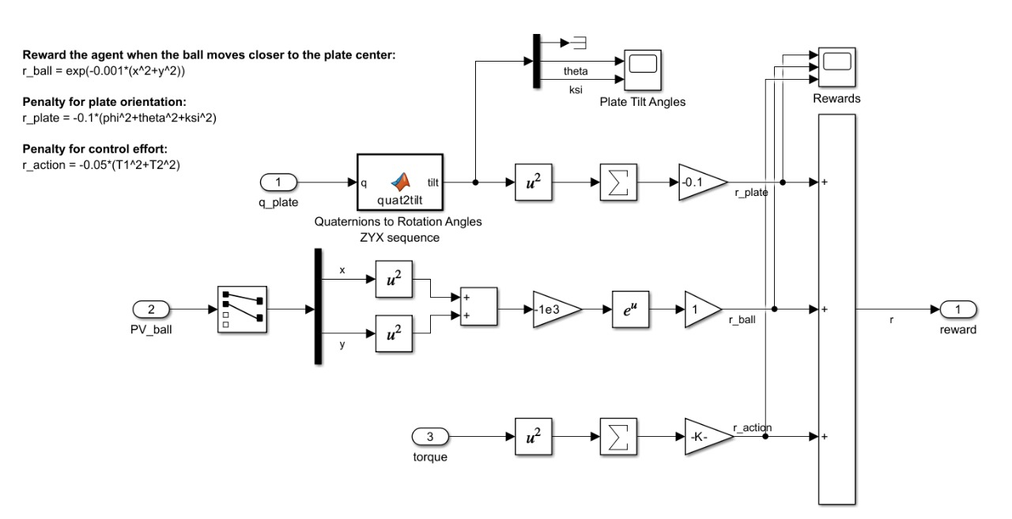
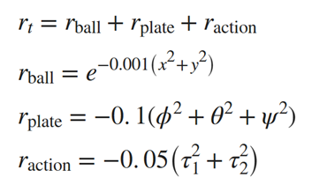
Current Award Function

Slide 8
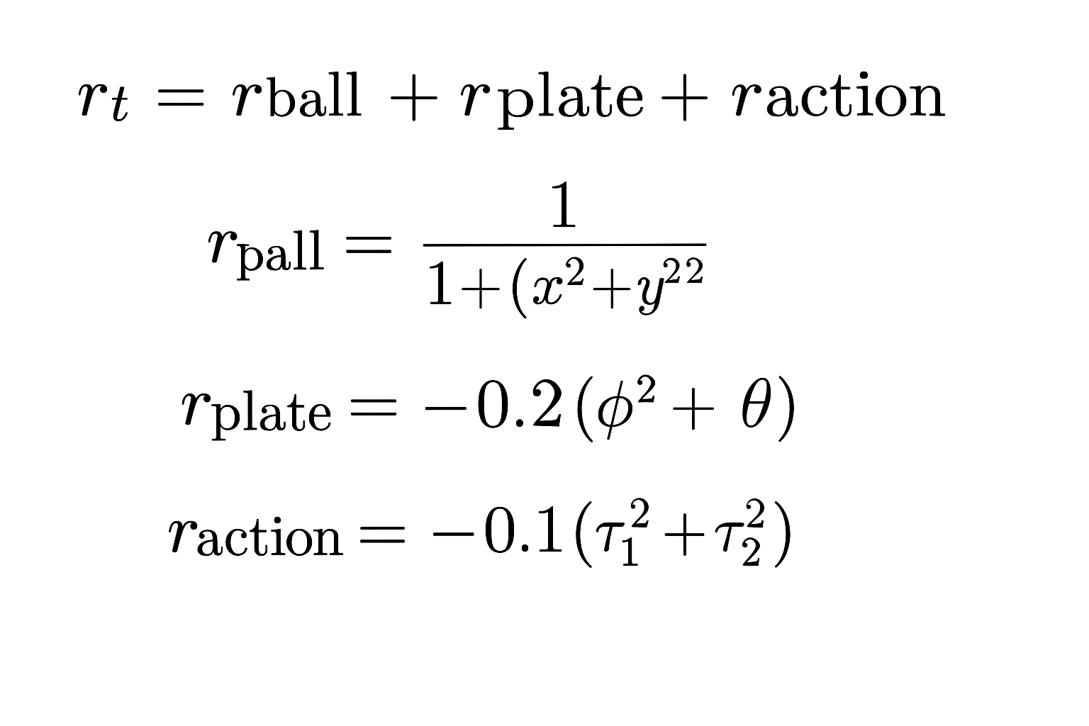
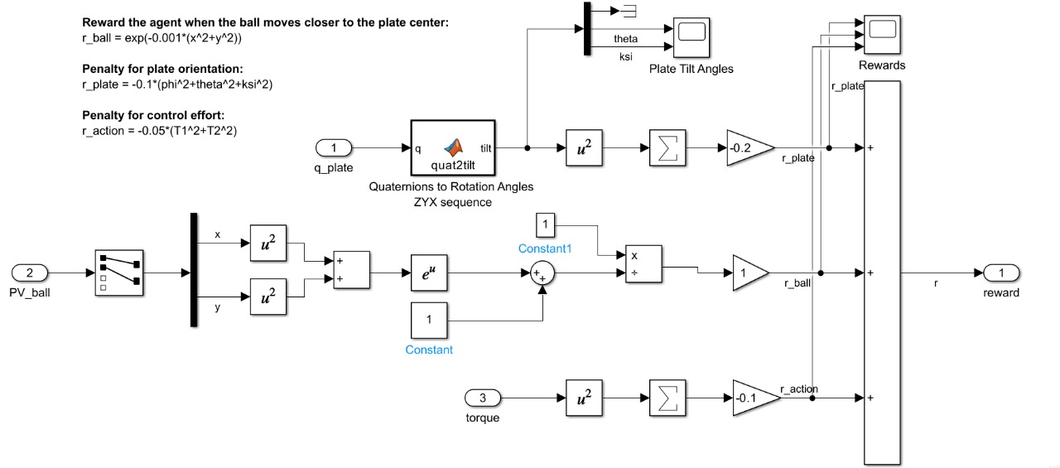
)
2
New Award Function
New Award Function

Slide 9
Actor Network
Actor Network
Critic Network
Network used

Slide 10

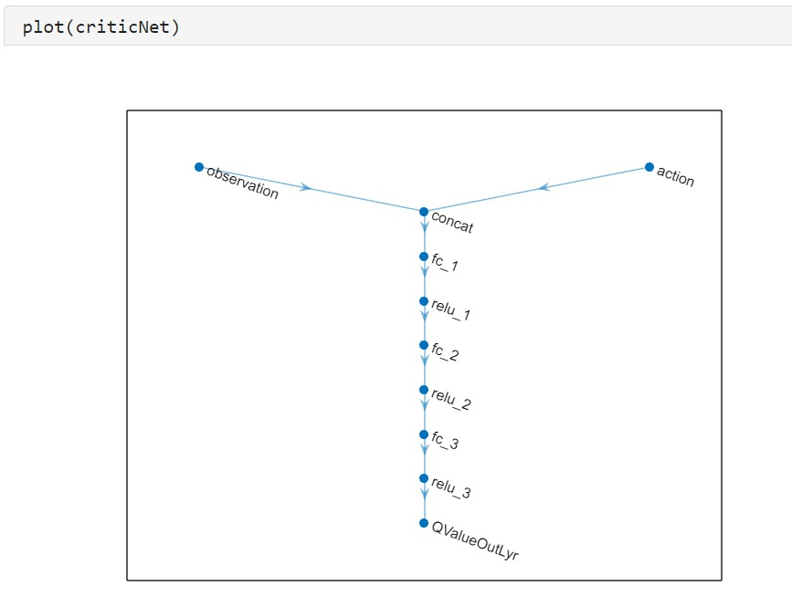
1) Critic Network
Input layer:
vector of 22 observations
layer accepting action values
Three fully connected (dense) layers, typically with 128, 64 and 32 units.
Each layer is followed by a ReLU activation function.
Output:
Single scalar output representing the Q-value
Add 16 units FC Layer Followed by ReLU

Slide 11
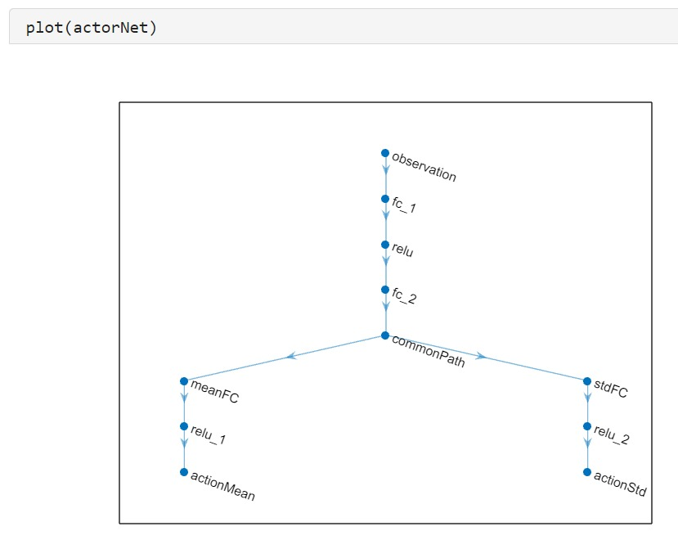
2) Actor Network
Input layer:
vector of observations
Two fully connected (dense) layers, typically with 128 and 64 units.
Each layer is followed by a ReLU activation function.
Branching Structure:
Mean Branch: 32 unit follwoed by ReLU
Standard DevaitionBranch: number of actions, ReLU
Output: The network outputs both the mean and standard deviation for each action dimension
Add 32 units FC Layer Followed by ReLU

Slide 12
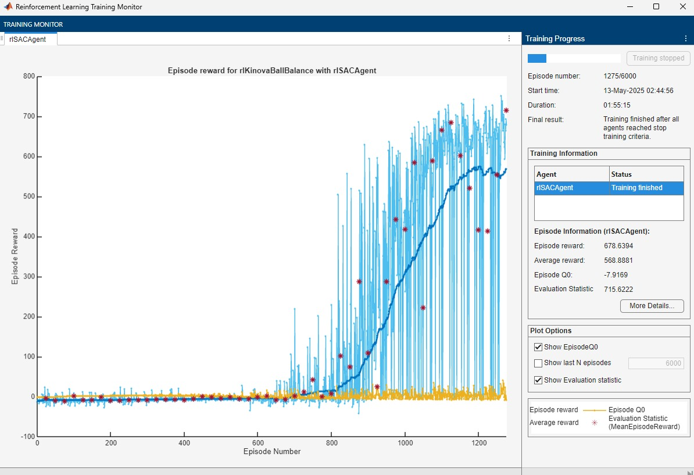
Old Award Function + Old Network
Results
Parameter | Value
Agent Type | rlSACAgent
Status | Training finished
Episode number | 1275
Episode reward | 678.6394
Episode steps | 1000
Total agent steps | 429523
Average reward | 568.8881
Average steps | 863.75
Episode Q0 | -7.9169
Evaluation Statistic (MeanEpisodeReward) | 715.6222
Averaging window length | 100
Training stopped by | EvaluationStatistic
Training stopped at | 700

Slide 13
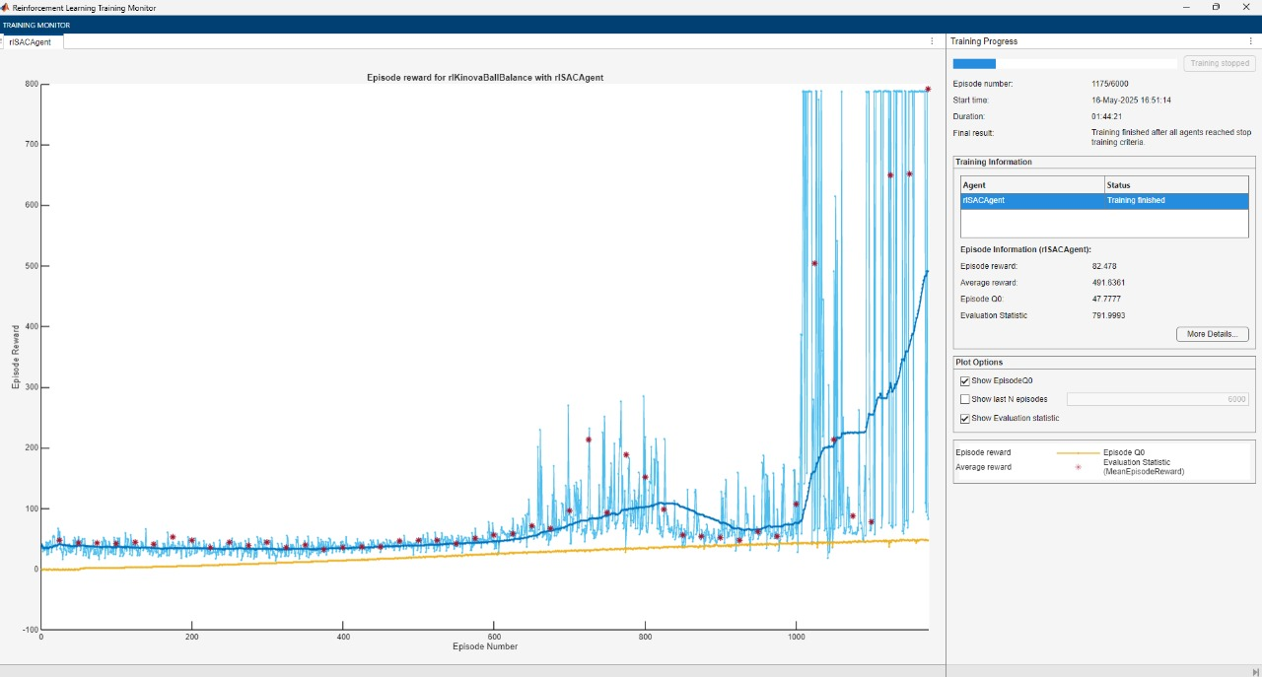
New Award Function + New Network
Results
Parameter | Value
Agent Type | rlSACAgent
Status | Training finished
Episode number | 1175
Episode reward | 878.6394
Episode steps | 1000
Total agent steps | 359523
Average reward | 491.2281
Average steps | 763.75
Episode Q0 | -7.1269
Evaluation Statistic (MeanEpisodeReward) | 791.9993
Averaging window length | 100
Training stopped by | EvaluationStatistic
Training stopped at | 700

Slide 14
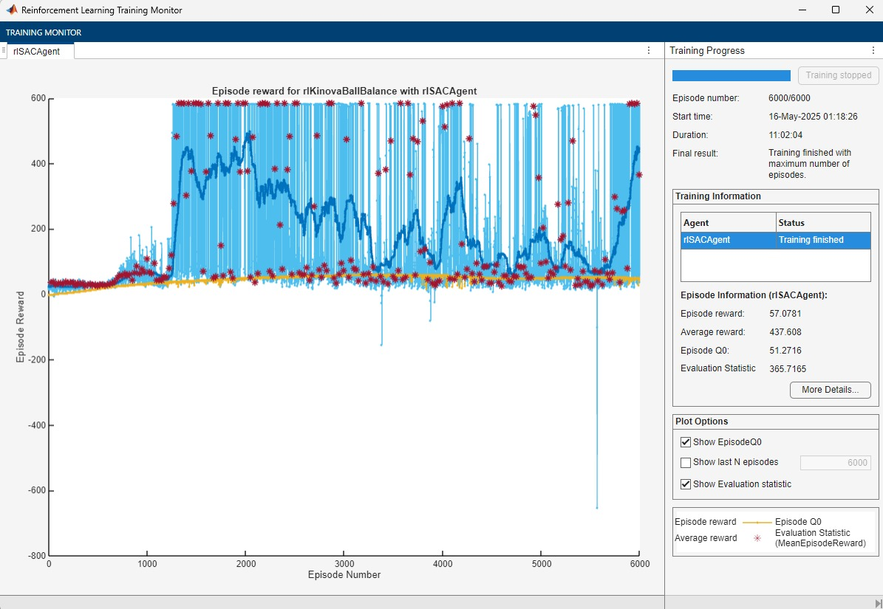
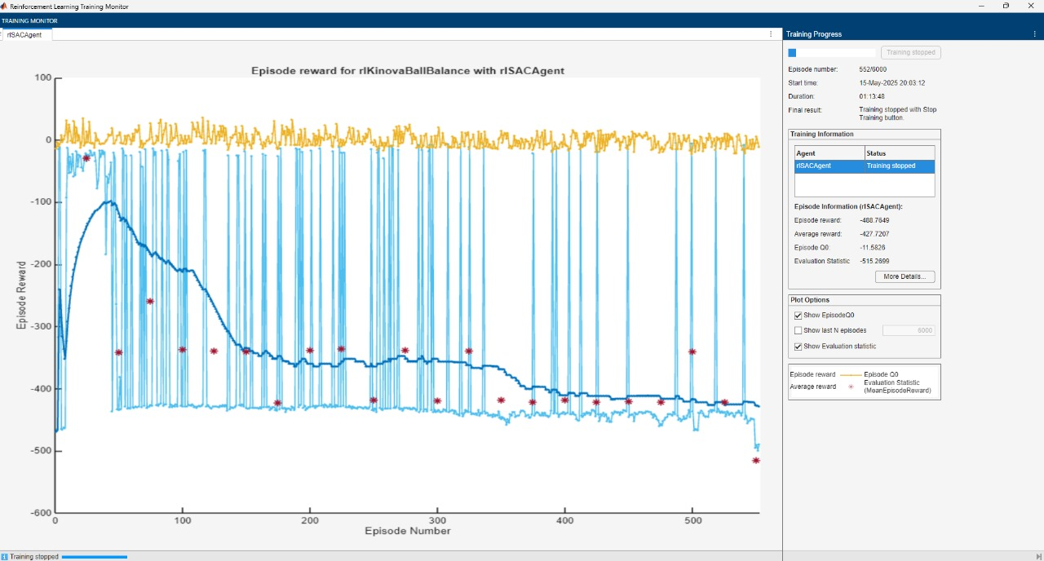
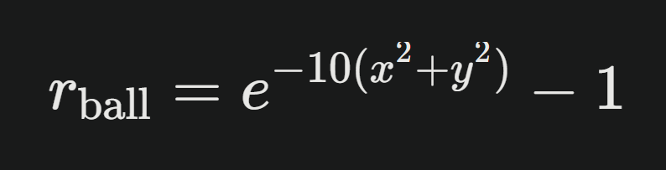
Results
Failed Tries

Slide 15
Thank you

