Slide 1
GPU Acceleration for Hand Pose Estimation
Intern: Youssef Zaky
Period: Feb 1st – April 30th
Supervisor: Dr. Cheng Li

Slide 2
Outline
Background / Problem
CUDA Basics
Implementation

Slide 3
Hand Pose Estimation: Processing Steps

Slide 4
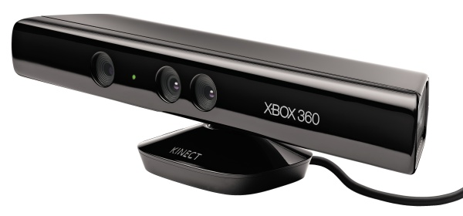

Processing Steps

Slide 5
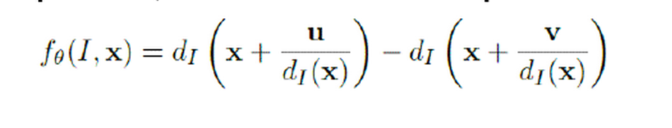
Processing Steps

Slide 6
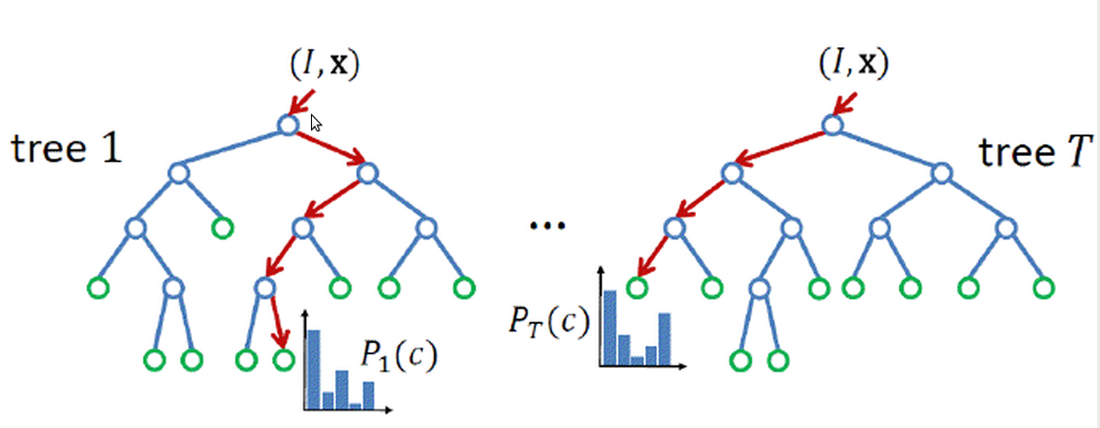
Processing Steps

Slide 7
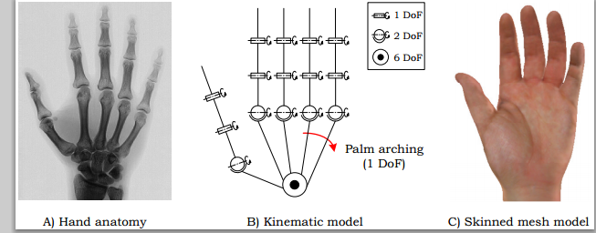
Processing Steps

Slide 8
Goals
Render hand pose images using the GPU
Perform matching on the GPU

Slide 9
CUDA
A general-purpose parallel computing platform and programming model for graphics processing units (GPU)

Slide 10
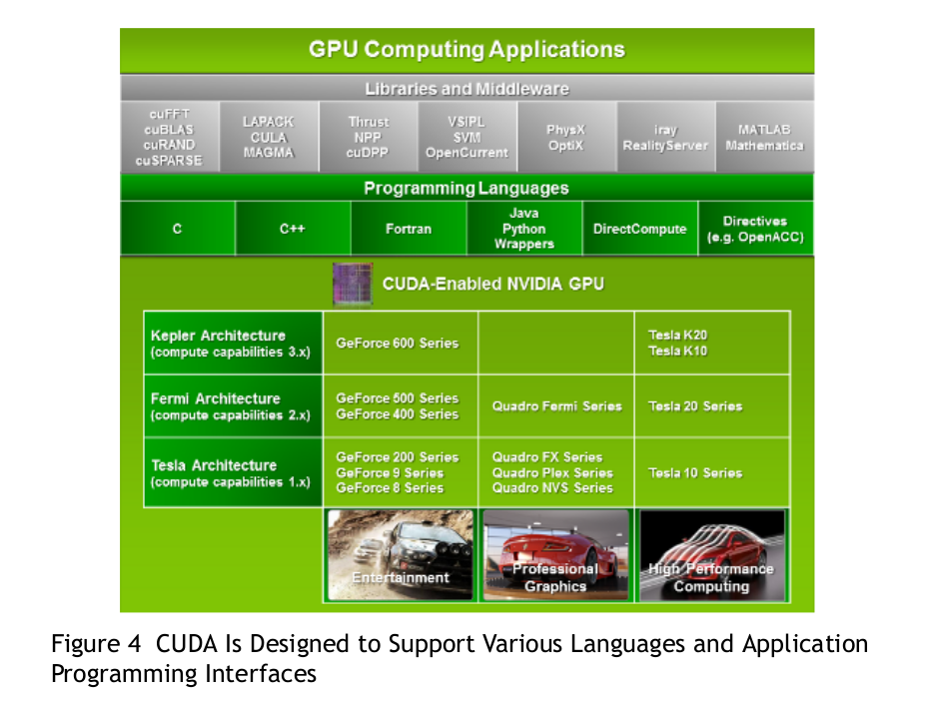
CUDA

Slide 11
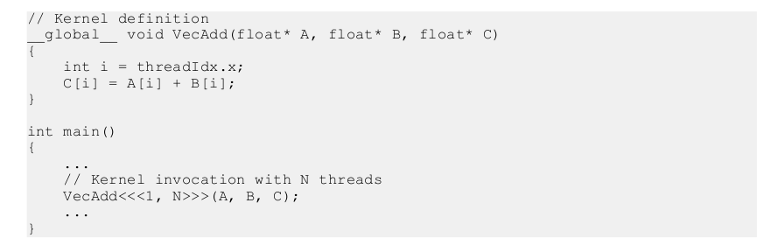
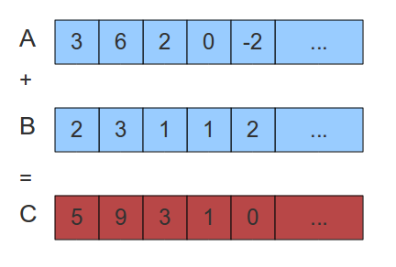
Kernel Functions

Slide 12
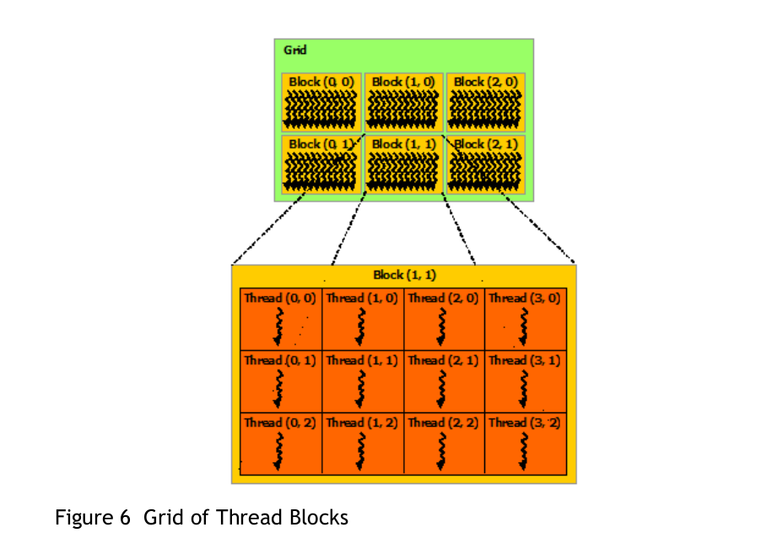
Thread Hierarchy

Slide 13
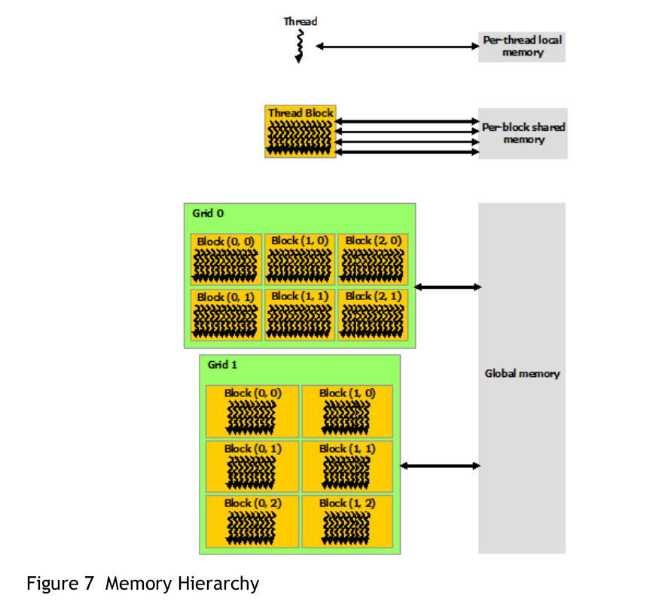
Memory Hierarchy

Slide 14
Goals
Render hand pose images using the GPU
Perform matching on the GPU

Slide 15
Implementation
OGRE (built on OpenGL) and Libhand
  Renders hand pose images
Cuda-OpenGL interop API
  map images from OGRE to Cuda using textures
Cuda kernels
  Sobel Filter
  Encoding Gradient
  Compute Score for each image
  Find top matches

Slide 16
Implementation
OGRE (built on OpenGL) and Libhand
  Renders hand pose images
Cuda-OpenGL interop API
  map images from OGRE to Cuda using textures
Cuda kernels
  Sobel Filter
  Encoding Gradient
  Compute Score for each image
  Find top matches

Slide 17
Cuda – OpenGL Interoperability API
Register GL graphics resources with Cuda
Map the resources to Cuda for kernel processing
Unmap the resources
In our case the resources are textures

Slide 18
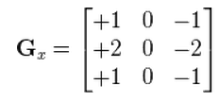
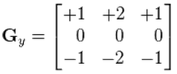


Sobel Filter

Slide 19
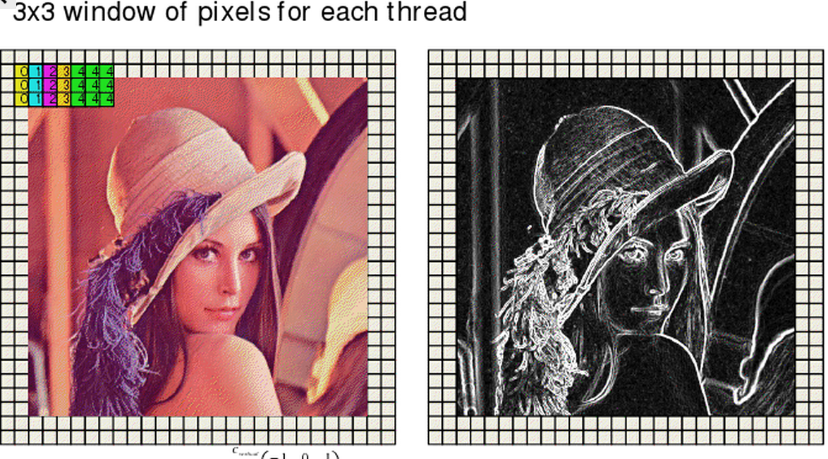
Sobel Filter Kernel

Slide 20
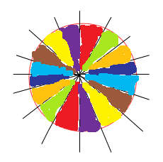
Gradient Encoding
Put the angle at each pixel into one of eight bins
Take the neighberhood 'OR'
00000001
01000000
00000001
00001000
01000000
00000010
11001011
00000001
10000000
00000010

Slide 21
Why Encoding
Makes matching more robust to noise
Two pixels match if there is a match in their neighberhoods

Slide 22
Image Score
Per Pixel Score
Reduction
Image Score
Sum

Slide 23
Top Matches
Sort the Scores in Parallel
Return indexes of Top Matches

Slide 24
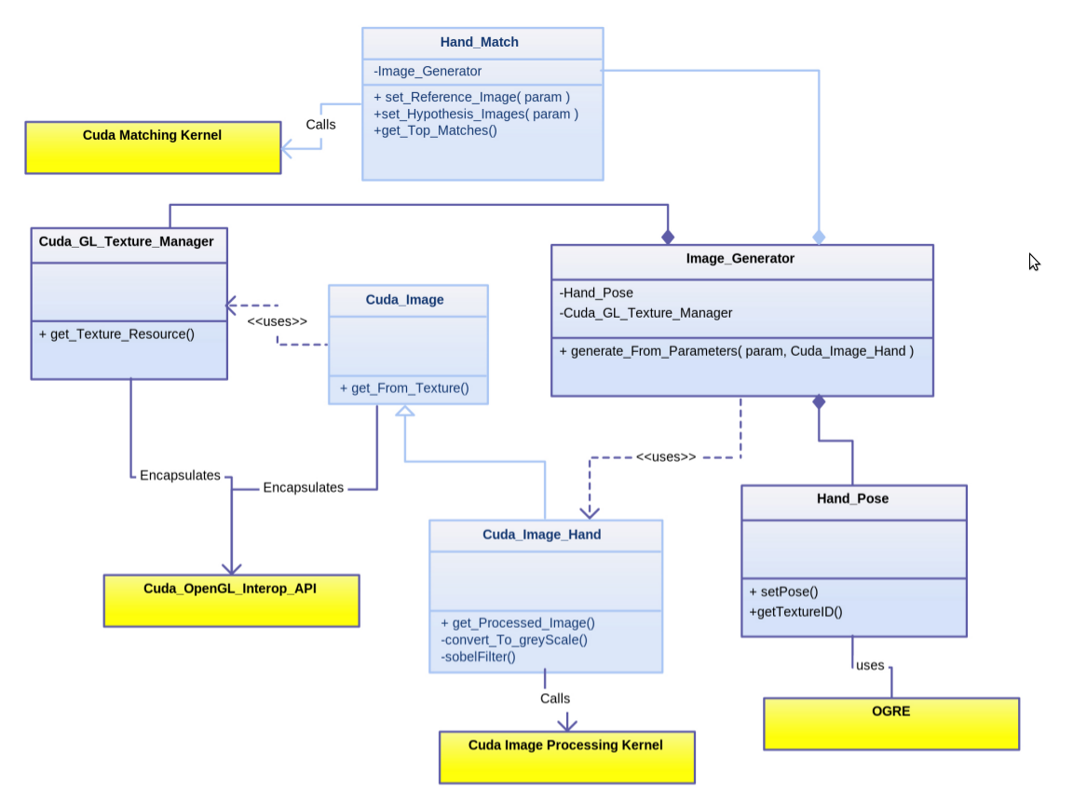
System Architecture

Slide 25
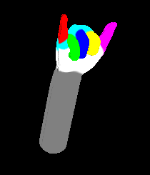
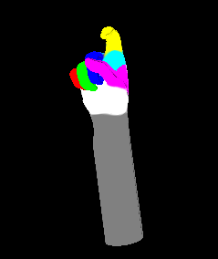
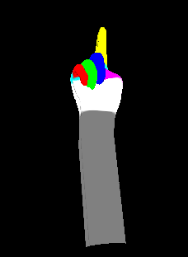
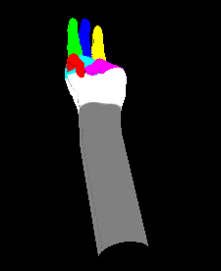
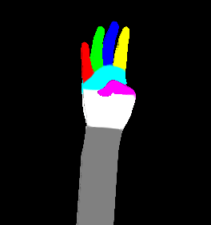
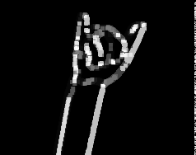
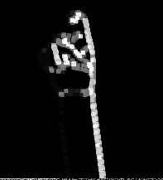
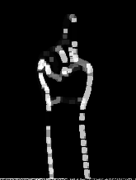
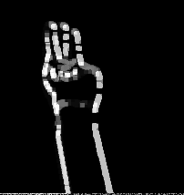
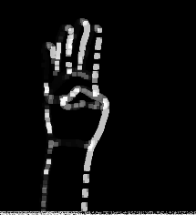
Examples of Rendering and Filtering

Slide 26
Performance
Rendering and Matching 200 Hand Poses:
128 x 128 images: ~0.35 seconds
256 x 256 images: ~0.42 seconds
512 x 512 images: ~0.5 seconds

Slide 27
Conclusions
Improving performance:
  Parallel rendering
  Optimizing cuda kernels
Modify to use depth images

Slide 28
Acknowledgements
Dr. Cheng Li
Dr. Xu Chi
Ashwin Nanjappa

