Slide 1



TypeScript
National Telecommunication Institute
Ministry of Communications and Information Technology

Slide 2

Content:
1) What's Typescript ?
2) Get Started
3) Typescript

Slide 3

What's TypeScript
TypeScript is an open-source object-oriented language developed and maintained by Microsoft, licensed under Apache 2 license. It is a typed superset of Javascript that compiles to plain JavaScript
TypeScript was developed under Anders Hejlsberg, who also led the creation of the C# language. TypeScript was first released in October 2012.

Slide 4
Prerequisites
Basic knowledge of JavaScript is required.

Slide 5
Install TypeScript
install Node.js: https://nodejs.org/en/download/
In cmd : npm install -g typescript
tsc -v => Version 5.1.6
To run file terminal : tsc AppName.ts
To make file watch : tsc AppName.ts --watch

Slide 6
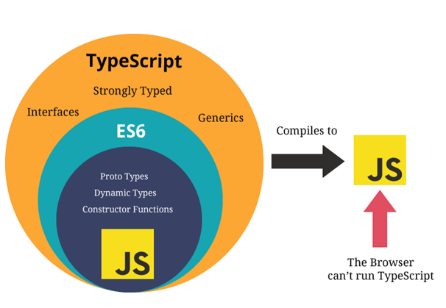

Slide 7
Typescript
Types
Enum
Interfaces
Generic
Union
Classes
Decorator
Modules and namespaces

Slide 8
Thanks
National Telecommunication Institute

