Slide 1
Heap sort

Slide 2
Heap sort
Combine the better features of both insertion sort and merge sort and it’s used as the built in sorting function in many programming language.
Merge Sort sorts in O(nlgn)
Insertion Sort sorts in place
represented by where the tree is completely filled except for the bottom level
It depends on Max heap property

Slide 3

Max heap property
For every node $x$ in the heap, the parent of $x$ greater than or equal to the value of $x$.
12
12
12
8
3
8
12
8
14
Blue node has heap property
Blue node has heap property
Blue node does not have heap property

Slide 4

Heap Tree
For every node, we can compute parent, left, right
$$Last Parent= \left\lfloor \frac{heap size}{2}\right\rfloor$$
1
10
2
5
2
3
4
3
5
1
1
2
7
6

Slide 5

Heap Tree
For node $i$:
$$Parent\left(i\right)= \left\lfloor \frac{i}{2}\right\rfloor$$
$$Left\left(i\right)=2∗i$$
$$Right\left(i\right)=2∗i+1$$
For $i=2$, Find Parent, Left, Right:
1
10
2
5
2
3
4
3
5
1
1
2
7
6

Slide 6

Heap Tree
For $i=2$, Find Parent, Left, Right:
$Parent\left(i\right)= \left\lfloor \frac{2}{2}\right\rfloor =2$
$Left\left(i\right)=2∗2=4$
$Right\left(i\right)=2∗2+1=5$
1
10
2
5
2
3
4
3
5
1
1
2
7
6

Slide 7
Heap Tree
The height of node h is the number of edges in the longest path from the node to the leaf
The height of the tree is the height of its root.

Slide 8

Heap Tree
a heap of height $h$ has the minimum number of elements when it has just one node at the lowest level.
Hence minimum number of nodes possible in a heap of height $h$ is $2^{h}$ nodes
1
10
2
5
2
3
4
3

Slide 9

Heap Tree
a heap of height $h$ has the maximum number of elements when its lowest level is completely filled.
maximum number of nodes possible in a heap of height $h$ is $2^{h+1}−1$ nodes
1
10
2
5
2
3
4
3
5
1
1
2
7
6

Slide 10
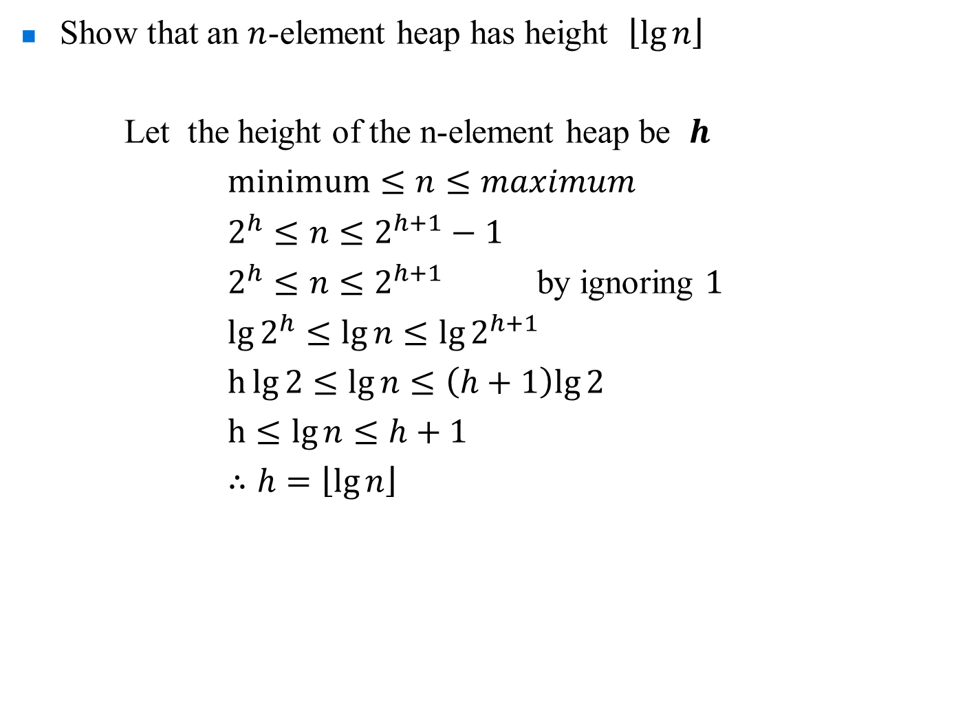
Heap Tree
Show that an $n$-element heap has height $\left\lfloor \lg{n}\right\rfloor$
Let the height of the n-element heap be $h$
$minimum≤n≤maximum$
$2^{h}≤n≤2^{h+1}−1$
$2^{h}≤n≤2^{h+1}$ by ignoring $1$
$\lg{2^{h}}≤\lg{n}≤\lg{2^{h+1}}$
$h\lg{2}≤\lg{n}≤\left(h+1\right)lg{2}$
$h≤\lg{n}≤h+1$
$∴h=\left\lfloor \lg{n}\right\rfloor$

Slide 11
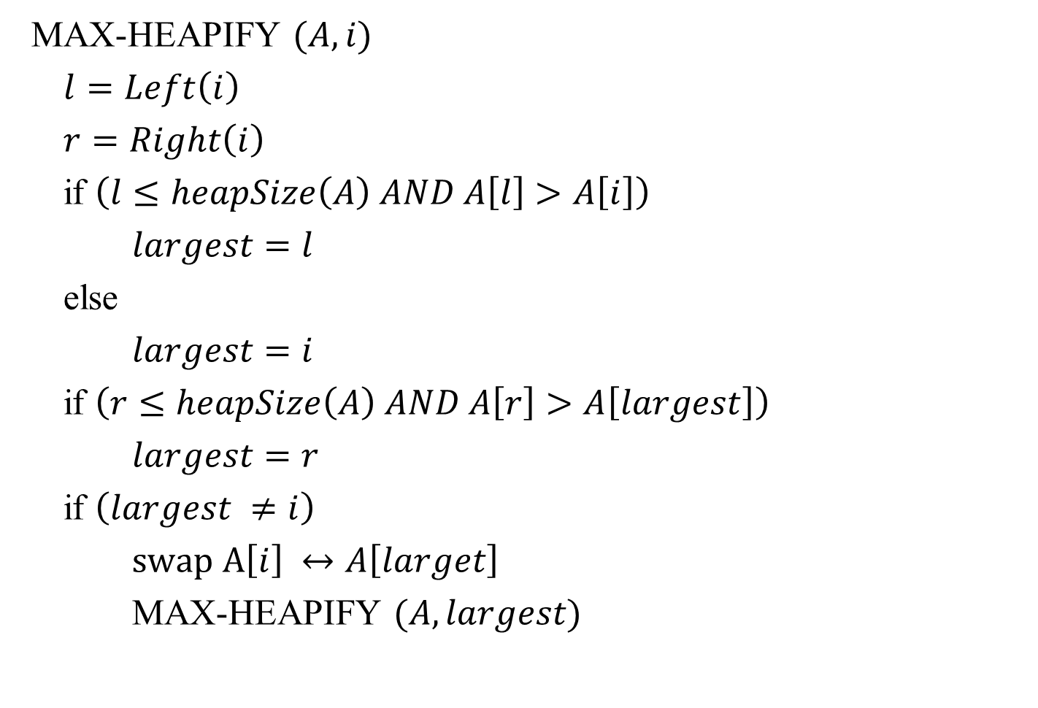
Maxheapify
MAX-HEAPIFY $(A, i)$
$l=Left\left(i\right)$
$r=Right\left(i\right)$
if $\left(l≤heapSize\left(A\right) AND A\left[l\right]>A\left[i\right]\right)$
$largest=l$
else
$largest=i$
if $\left(r≤heapSize\left(A\right) AND A\left[r\right]>A\left[largest\right]\right)$
$largest=r$
if $\left(largest ≠i\right)$
$swap A\left[i\right] ↔A\left[larget\right]$
MAX-HEAPIFY $(A, largest)$

Slide 12
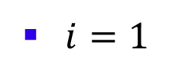
Maxheapify
$i=1$
1
2
2
5
7
3
4
3
5
1
6
4
6
7

Slide 13
Maxheapify
$i=1$
1
2
2
5
7
3
4
3
5
1
6
4
6
7

Slide 14
Maxheapify
$i=1$
1
2
2
5
7
3
4
3
5
1
6
4
6
7

Slide 15
Maxheapify
$i=1$
1
2
2
5
7
3
4
3
5
1
6
4
6
7

Slide 16
Maxheapify
$i=1$
1
7
2
5
2
3
4
3
5
1
6
4
6
7

Slide 17
Maxheapify
1
7
2
5
2
3
4
3
5
1
6
4
6
7

Slide 18

Maxheapify
$i=3$
1
7
2
5
2
3
4
3
5
1
6
4
6
7

Slide 19
Maxheapify
$i=3$
1
7
2
5
2
3
4
3
5
1
6
4
6
7

Slide 20
Maxheapify
1
7
2
5
6
3
4
3
5
1
6
4
2
7

Slide 21

Maxheapify
$i=7$
1
7
2
5
6
3
4
3
5
1
6
4
2
7

Slide 22
Maxheapify
1
7
2
5
6
3
4
3
5
1
6
4
2
7

Slide 23
Maxheapify
MAX-HEAPIFY $(A, i)$
$l=Left\left(i\right)$
$r=Right\left(i\right)$
if $\left(l≤heapSize\left(A\right) AND A\left[l\right]>A\left[i\right]\right)$
$largest=l$
else
$largest=i$
if $\left(r≤heapSize\left(A\right) AND A\left[r\right]>A\left[largest\right]\right)$
$largest=r$
if $\left(largest ≠i\right)$
$swap A\left[i\right] ↔A\left[larget\right]$
MAX-HEAPIFY $(A, largest)$

Slide 24

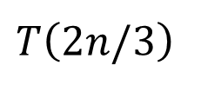








Maxheapify – Analysis
MAX-HEAPIFY $(A, i)$
$l=Left\left(i\right)$
$r=Right\left(i\right)$
if $\left(l≤heapSize\left(A\right) AND A\left[l\right]>A\left[i\right]\right)$
$largest=l$
else
$largest=i$
if $\left(r≤heapSize\left(A\right) AND A\left[r\right]>A\left[largest\right]\right)$
$largest=r$
if $\left(largest ≠i\right)$
$swap A\left[i\right] ↔A\left[larget\right]$
MAX-HEAPIFY $(A, largest)$
$1$
$1$
$1$
$1$
$1$
$1$
$1$
$1$
$1$
$T\left(2n/3\right)$

Slide 25
Maxheapify – Analysis
worst Case:
1
1
2
8
4
3
4
3
5
7

Slide 26
Maxheapify – Analysis
worst Case:
1
1
2
8
4
3
4
3
5
7

Slide 27
Maxheapify – Analysis
worst Case:
1
8
2
1
4
3
4
3
5
7

Slide 28
Maxheapify – Analysis
worst Case:
1
8
2
1
4
3
4
3
5
7

Slide 29
Maxheapify – Analysis
worst Case:
1
8
2
7
4
3
4
3
5
1

Slide 30
Maxheapify – Analysis
worst Case:
1
8
2
7
4
3
4
3
5
1

Slide 31

Maxheapify – Analysis
$T\left(n\right)=T\left(2n/3\right)+1$
$T\left(n\right)=Θ\left(\lg{n}\right)$ by MT

Slide 32

BuildingHeap
BULD-MAX-HEAP $(A)$
$HeapSize\left(A\right)=A.length$
for $i=A.length/2$ downto $1$
$\text{MAX}\text{−}\text{HEAPIFY}(A,i)$

Slide 33
BuildingHeap
4 | 1 | 3 | 2 | 16 | 9 | 10 | 14 | 8 | 7
1
4
2
1
3
3
4
2
5
16
6
9
10
7
8
14
9
8
10
7

Slide 34
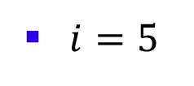
BuildingHeap
$i=5$
1
4
2
1
3
3
4
2
5
16
6
9
10
7
8
14
9
8
10
7

Slide 35
BuildingHeap
$i=5$
1
4
2
1
3
3
4
2
5
16
6
9
10
7
8
14
9
8
10
7

Slide 36

BuildingHeap
$i=4$
1
4
2
1
3
3
4
2
5
16
6
9
10
7
8
14
9
8
10
7

Slide 37
BuildingHeap
$i=4$
1
4
2
1
3
3
4
2
5
16
6
9
10
7
8
14
9
8
10
7

Slide 38
BuildingHeap
$i=4$
1
4
2
1
3
3
4
2
5
16
6
9
10
7
8
14
9
8
10
7

Slide 39
BuildingHeap
$i=4$
1
4
2
1
3
3
4
14
5
16
6
9
10
7
8
2
9
8
10
7

Slide 40
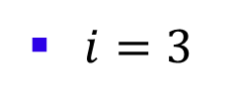
BuildingHeap
$i=3$
1
4
2
1
3
3
4
14
5
16
6
9
10
7
8
2
9
8
10
7

Slide 41
BuildingHeap
$i=3$
1
4
2
1
3
3
4
14
5
16
6
9
10
7
8
2
9
8
10
7

Slide 42
BuildingHeap
$i=3$
1
4
2
1
3
3
4
14
5
16
6
9
10
7
8
2
9
8
10
7

Slide 43
BuildingHeap
$i=3$
1
4
2
1
10
3
4
14
5
16
6
9
3
7
8
2
9
8
10
7

Slide 44
BuildingHeap
$i=3$
1
4
2
1
10
3
4
14
5
16
6
9
3
7
8
2
9
8
10
7

Slide 45

BuildingHeap
$i=2$
1
4
2
1
10
3
4
14
5
16
6
9
3
7
8
2
9
8
10
7

Slide 46
BuildingHeap
$i=2$
1
4
2
1
10
3
4
14
5
16
6
9
3
7
8
2
9
8
10
7

Slide 47
BuildingHeap
$i=2$
1
4
2
1
10
3
4
14
5
16
6
9
3
7
8
2
9
8
10
7

Slide 48
BuildingHeap
$i=2$
1
4
2
16
10
3
4
14
5
1
6
9
3
7
8
2
9
8
10
7

Slide 49
BuildingHeap
$i=2$
1
4
2
16
10
3
4
14
5
1
6
9
3
7
8
2
9
8
10
7

Slide 50
BuildingHeap
$i=2$
1
4
2
16
10
3
4
14
5
1
6
9
3
7
8
2
9
8
10
7

Slide 51
BuildingHeap
$i=2$
1
4
2
16
10
3
4
14
5
7
6
9
3
7
8
2
9
8
10
1

Slide 52
BuildingHeap
$i=2$
1
4
2
16
10
3
4
14
5
7
6
9
3
7
8
2
9
8
10
1

Slide 53
BuildingHeap
$i=1$
1
4
2
16
10
3
4
14
5
7
6
9
3
7
8
2
9
8
10
1

Slide 54
BuildingHeap
$i=1$
1
4
2
16
10
3
4
14
5
7
6
9
3
7
8
2
9
8
10
1

Slide 55
BuildingHeap
$i=1$
1
4
2
16
10
3
4
14
5
7
6
9
3
7
8
2
9
8
10
1

Slide 56
BuildingHeap
$i=1$
1
16
2
4
10
3
4
14
5
7
6
9
3
7
8
2
9
8
10
1

Slide 57
BuildingHeap
$i=1$
1
16
2
4
10
3
4
14
5
7
6
9
3
7
8
2
9
8
10
1

Slide 58
BuildingHeap
$i=1$
1
16
2
4
10
3
4
14
5
7
6
9
3
7
8
2
9
8
10
1

Slide 59
BuildingHeap
$i=1$
1
16
2
14
10
3
4
4
5
7
6
9
3
7
8
2
9
8
10
1

Slide 60
BuildingHeap
$i=1$
1
16
2
14
10
3
4
4
5
7
6
9
3
7
8
2
9
8
10
1

Slide 61
BuildingHeap
$i=1$
1
16
2
14
10
3
4
4
5
7
6
9
3
7
8
2
9
8
10
1

Slide 62
BuildingHeap
$i=1$
1
16
2
14
10
3
4
8
5
7
6
9
3
7
8
2
9
4
10
1

Slide 63
BuildingHeap
$i=1$
1
16
2
14
10
3
4
8
5
7
6
9
3
7
8
2
9
4
10
1

Slide 64
BuildingHeap
BULD-MAX-HEAP $(A)$
$HeapSize\left(A\right)=A.length$
for $i=A.length/2$ downto $1$
$\text{MAX}\text{−}\text{HEAPIFY}(A,i)$

Slide 65
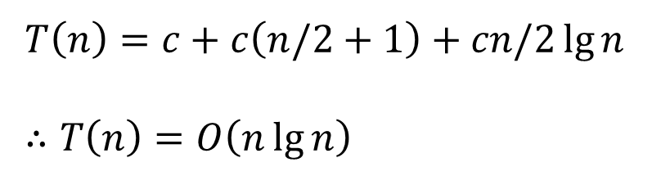
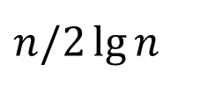
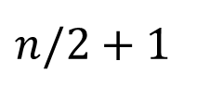

BuildingHeap – Analysis
BULD-MAX-HEAP $(A)$
$HeapSize\left(A\right)=A.length$
for $i=A.length/2$ downto $1$
$\text{MAX}\text{−}\text{HEAPIFY}(A,i)$
$1$
$n/2+1$
$n/2\lg{n}$
$T\left(n\right)=c+c\left(n/2+1\right)+cn/2\lg{n}$
$∴T\left(n\right)=O\left(n\lg{n}\right)$

Slide 66

Heap Sort
HEAPSORT $(A)$
BULD-MAX-HEAP $(A)$
for $i=A.length$ downto $2$
$exchange A\left[1\right] ↔A\left[i\right]$
$HeapSize\left(A\right)=HeapSize\left(A\right) −1$
$\text{MAX}\text{−}\text{HEAPIFY}(A,1)$

Slide 67
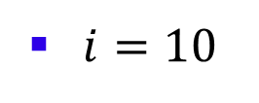
Heap Sort
$i=10$
16 | 14 | 10 | 8 | 7 | 9 | 3 | 2 | 4 | 1
1
16
2
14
10
3
4
8
5
7
6
9
3
7
8
2
9
4
1
10

Slide 68
Heap Sort
$i=10$
16 | 14 | 10 | 8 | 7 | 9 | 3 | 2 | 4 | 1
1
16
2
14
10
3
4
8
5
7
6
9
3
7
8
2
9
4
1
10

Slide 69
Heap Sort
$i=10$
1 | 14 | 10 | 8 | 7 | 9 | 3 | 2 | 4 | 16
1
1
2
14
10
3
4
8
5
7
6
9
3
7
8
2
9
4
16
10

Slide 70
Heap Sort
$i=10$
1 | 14 | 10 | 8 | 7 | 9 | 3 | 2 | 4 | 16
1
1
2
14
10
3
4
8
5
7
6
9
3
7
8
2
9
4
16
10

Slide 71
Heap Sort
$i=10$
1 | 14 | 10 | 8 | 7 | 9 | 3 | 2 | 4 | 16
1
1
2
14
10
3
4
8
5
7
6
9
3
7
8
2
9
4
16
10

Slide 72
Heap Sort
$i=10$
1 | 14 | 10 | 8 | 7 | 9 | 3 | 2 | 4 | 16
1
1
2
14
10
3
4
8
5
7
6
9
3
7
8
2
9
4
16
10

Slide 73
Heap Sort
$i=10$
14 | 1 | 10 | 8 | 7 | 9 | 3 | 2 | 4 | 16
1
14
2
1
10
3
4
8
5
7
6
9
3
7
8
2
9
4
16
10

Slide 74
Heap Sort
$i=10$
14 | 1 | 10 | 8 | 7 | 9 | 3 | 2 | 4 | 16
1
14
2
1
10
3
4
8
5
7
6
9
3
7
8
2
9
4
16
10

Slide 75
Heap Sort
$i=10$
14 | 8 | 10 | 1 | 7 | 9 | 3 | 2 | 4 | 16
1
14
2
8
10
3
4
1
5
7
6
9
3
7
8
2
9
4
16
10

Slide 76
Heap Sort
$i=10$
14 | 8 | 10 | 1 | 7 | 9 | 3 | 2 | 4 | 16
1
14
2
8
10
3
4
1
5
7
6
9
3
7
8
2
9
4
16
10

Slide 77
Heap Sort
$i=10$
14 | 8 | 10 | 4 | 7 | 9 | 3 | 2 | 1 | 16
1
14
2
8
10
3
4
4
5
7
6
9
3
7
8
2
9
1
16
10

Slide 78

Heap Sort
$i=9$
14 | 8 | 10 | 4 | 7 | 9 | 3 | 2 | 1 | 16
1
14
2
8
10
3
4
4
5
7
6
9
3
7
8
2
9
1
16
10

Slide 79
Heap Sort
$i=9$
1 | 8 | 10 | 4 | 7 | 9 | 3 | 2 | 14 | 16
1
1
2
8
10
3
4
4
5
7
6
9
3
7
8
2
9
14
16
10

Slide 80
Heap Sort
$i=9$
1 | 8 | 10 | 4 | 7 | 9 | 3 | 2 | 14 | 16
1
1
2
8
10
3
4
4
5
7
6
9
3
7
8
2
9
14
16
10

Slide 81
Heap Sort
$i=9$
1 | 8 | 10 | 4 | 7 | 9 | 3 | 2 | 14 | 16
1
1
2
8
10
3
4
4
5
7
6
9
3
7
8
2
9
14
16
10

Slide 82
Heap Sort
$i=9$
10 | 8 | 1 | 4 | 7 | 9 | 3 | 2 | 14 | 16
1
10
2
8
1
3
4
4
5
7
6
9
3
7
8
2
9
14
16
10

Slide 83
Heap Sort
$i=9$
10 | 8 | 1 | 4 | 7 | 9 | 3 | 2 | 14 | 16
1
10
2
8
1
3
4
4
5
7
6
9
3
7
8
2
9
14
16
10

Slide 84
Heap Sort
$i=9$
10 | 8 | 9 | 4 | 7 | 1 | 3 | 2 | 14 | 16
1
10
2
8
9
3
4
4
5
7
6
1
3
7
8
2
9
14
16
10

Slide 85
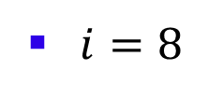
Heap Sort
$i=8$
10 | 8 | 9 | 4 | 7 | 1 | 3 | 2 | 14 | 16
1
10
2
8
9
3
4
4
5
7
6
1
3
7
8
2
9
14
16
10

Slide 86
Heap Sort
$i=8$
2 | 8 | 9 | 4 | 7 | 1 | 3 | 10 | 14 | 16
1
2
2
8
9
3
4
4
5
7
6
1
3
7
8
10
9
14
16
10

Slide 87
Heap Sort
$i=8$
2 | 8 | 9 | 4 | 7 | 1 | 3 | 10 | 14 | 16
1
2
2
8
9
3
4
4
5
7
6
1
3
7
8
10
9
14
16
10

Slide 88
Heap Sort
$i=8$
9 | 8 | 3 | 4 | 7 | 1 | 2 | 10 | 14 | 16
1
9
2
8
3
3
4
4
5
7
6
1
2
7
8
10
9
14
16
10

Slide 89
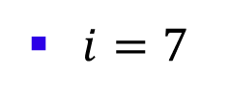
Heap Sort
$i=7$
9 | 8 | 3 | 4 | 7 | 1 | 2 | 10 | 14 | 16
1
9
2
8
3
3
4
4
5
7
6
1
2
7
8
10
9
14
16
10

Slide 90
Heap Sort
$i=7$
2 | 8 | 3 | 4 | 7 | 1 | 9 | 10 | 14 | 16
1
2
2
8
3
3
4
4
5
7
6
1
9
7
8
10
9
14
16
10

Slide 91
Heap Sort
$i=7$
2 | 8 | 3 | 4 | 7 | 1 | 9 | 10 | 14 | 16
1
2
2
8
3
3
4
4
5
7
6
1
9
7
8
10
9
14
16
10

Slide 92
Heap Sort
$i=7$
2 | 8 | 3 | 4 | 7 | 1 | 9 | 10 | 14 | 16
1
2
2
8
3
3
4
4
5
7
6
1
9
7
8
10
9
14
16
10

Slide 93
Heap Sort
$i=7$
8 | 7 | 3 | 4 | 2 | 1 | 9 | 10 | 14 | 16
1
8
2
7
3
3
4
4
5
2
6
1
9
7
8
10
9
14
16
10

Slide 94
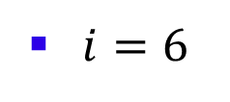
Heap Sort
$i=6$
8 | 7 | 3 | 4 | 2 | 1 | 9 | 10 | 14 | 16
1
8
2
7
3
3
4
4
5
2
6
1
9
7
8
10
9
14
16
10

Slide 95
Heap Sort
$i=6$
1 | 7 | 3 | 4 | 2 | 8 | 9 | 10 | 14 | 16
1
1
2
7
3
3
4
4
5
2
6
8
9
7
8
10
9
14
16
10

Slide 96
Heap Sort
$i=6$
1 | 7 | 3 | 4 | 2 | 8 | 9 | 10 | 14 | 16
1
1
2
7
3
3
4
4
5
2
6
8
9
7
8
10
9
14
16
10

Slide 97
Heap Sort
$i=6$
1 | 7 | 3 | 4 | 2 | 8 | 9 | 10 | 14 | 16
1
1
2
7
3
3
4
4
5
2
6
8
9
7
8
10
9
14
16
10

Slide 98
Heap Sort
$i=6$
7 | 4 | 3 | 1 | 2 | 8 | 9 | 10 | 14 | 16
1
7
2
4
3
3
4
1
5
2
6
8
9
7
8
10
9
14
16
10

Slide 99
Heap Sort
$i=5$
7 | 4 | 3 | 1 | 2 | 8 | 9 | 10 | 14 | 16
1
7
2
4
3
3
4
1
5
2
6
8
9
7
8
10
9
14
16
10

Slide 100
Heap Sort
$i=5$
2 | 4 | 3 | 1 | 7 | 8 | 9 | 10 | 14 | 16
1
2
2
4
3
3
4
1
5
7
6
8
9
7
8
10
9
14
16
10

Slide 101
Heap Sort
$i=5$
2 | 4 | 3 | 1 | 7 | 8 | 9 | 10 | 14 | 16
1
2
2
4
3
3
4
1
5
7
6
8
9
7
8
10
9
14
16
10

Slide 102
Heap Sort
$i=5$
2 | 4 | 3 | 1 | 7 | 8 | 9 | 10 | 14 | 16
1
2
2
4
3
3
4
1
5
7
6
8
9
7
8
10
9
14
16
10

Slide 103
Heap Sort
$i=5$
4 | 2 | 3 | 1 | 7 | 8 | 9 | 10 | 14 | 16
1
4
2
2
3
3
4
1
5
7
6
8
9
7
8
10
9
14
16
10

Slide 104
Heap Sort
$i=4$
4 | 2 | 3 | 1 | 7 | 8 | 9 | 10 | 14 | 16
1
4
2
2
3
3
4
1
5
7
6
8
9
7
8
10
9
14
16
10

Slide 105
Heap Sort
$i=4$
1 | 2 | 3 | 4 | 7 | 8 | 9 | 10 | 14 | 16
1
1
2
2
3
3
4
4
5
7
6
8
9
7
8
10
9
14
16
10

Slide 106
Heap Sort
$i=4$
1 | 2 | 3 | 4 | 7 | 8 | 9 | 10 | 14 | 16
1
1
2
2
3
3
4
4
5
7
6
8
9
7
8
10
9
14
16
10

Slide 107
Heap Sort
$i=4$
1 | 2 | 3 | 4 | 7 | 8 | 9 | 10 | 14 | 16
1
1
2
2
3
3
4
4
5
7
6
8
9
7
8
10
9
14
16
10

Slide 108
Heap Sort
$i=4$
3 | 2 | 1 | 4 | 7 | 8 | 9 | 10 | 14 | 16
1
3
2
2
1
3
4
4
5
7
6
8
9
7
8
10
9
14
16
10

Slide 109
Heap Sort
$i=3$
3 | 2 | 1 | 4 | 7 | 8 | 9 | 10 | 14 | 16
1
3
2
2
1
3
4
4
5
7
6
8
9
7
8
10
9
14
16
10

Slide 110
Heap Sort
$i=3$
1 | 2 | 3 | 4 | 7 | 8 | 9 | 10 | 14 | 16
1
1
2
2
3
3
4
4
5
7
6
8
9
7
8
10
9
14
16
10

Slide 111
Heap Sort
$i=3$
1 | 2 | 3 | 4 | 7 | 8 | 9 | 10 | 14 | 16
1
1
2
2
3
3
4
4
5
7
6
8
9
7
8
10
9
14
16
10

Slide 112
Heap Sort
$i=3$
1 | 2 | 3 | 4 | 7 | 8 | 9 | 10 | 14 | 16
1
1
2
2
3
3
4
4
5
7
6
8
9
7
8
10
9
14
16
10

Slide 113
Heap Sort
$i=3$
2 | 1 | 3 | 4 | 7 | 8 | 9 | 10 | 14 | 16
1
2
2
1
3
3
4
4
5
7
6
8
9
7
8
10
9
14
16
10

Slide 114
Heap Sort
$i=2$
2 | 1 | 3 | 4 | 7 | 8 | 9 | 10 | 14 | 16
1
2
2
1
3
3
4
4
5
7
6
8
9
7
8
10
9
14
16
10

Slide 115
Heap Sort
$i=2$
1 | 2 | 3 | 4 | 7 | 8 | 9 | 10 | 14 | 16
1
1
2
2
3
3
4
4
5
7
6
8
9
7
8
10
9
14
16
10

Slide 116
Heap Sort
$i=2$
1 | 2 | 3 | 4 | 7 | 8 | 9 | 10 | 14 | 16
1
1
2
2
3
3
4
4
5
7
6
8
9
7
8
10
9
14
16
10

Slide 117
Heap Sort
1 | 2 | 3 | 4 | 7 | 8 | 9 | 10 | 14 | 16

Slide 118
Heap Sort
HEAPSORT $(A)$
BULD-MAX-HEAP $(A)$
for $i=A.length$ downto $2$
$exchange A\left[1\right] ↔A\left[i\right]$
$HeapSize\left(A\right)=HeapSize\left(A\right) −1$
$\text{MAX}\text{−}\text{HEAPIFY}(A,1)$

Slide 119
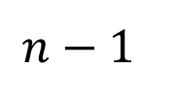

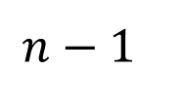


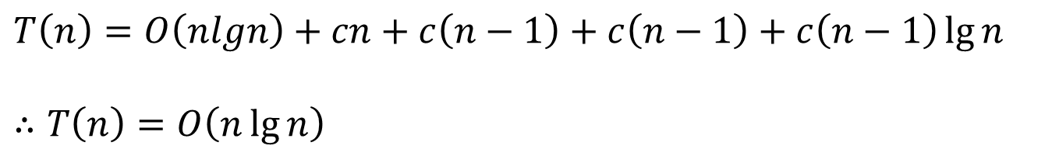
Heap Sort – Analysis
HEAPSORT $(A)$
BULD-MAX-HEAP $(A)$
for $i=A.length$ downto $2$
$exchange A\left[1\right] ↔A\left[i\right]$
$HeapSize\left(A\right)=HeapSize\left(A\right) −1$
$\text{MAX}\text{−}\text{HEAPIFY}(A,1)$
$$O\left(nlgn\right)$$
$$n$$
$$n−1$$
$$n−1$$
$$(n−1)\lg{n}$$
$T\left(n\right)=O\left(nlgn\right)+cn+c\left(n−1\right)+c\left(n−1\right)+c\left(n−1\right)\lg{n}$
$∴T\left(n\right)=O\left(n\lg{n}\right)$

