Slide 1
Check Point : RDBMR (Relational Database Management system)
Tayachi Yosra

Slide 2
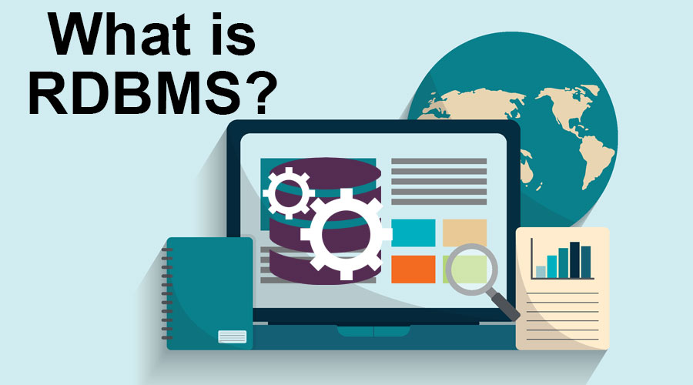
What is a RDBMS ?
A relational database management system (RDBMS) is a collection of programs and capabilities that enable IT teams and others to create, update, administer and otherwise interact with a relational database. RDBMSes store data in the form of tables, with most commercial relational database management systems using Structured Query Language (SQL) to access the database. However, since SQL was invented after the initial development of the relational model, it is not necessary for RDBMS use.
The RDBMS is the most popular database system among organizations across the world. It provides a dependable method of storing and retrieving large amounts of data while offering a combination of system performance and ease of implementation.

Slide 3
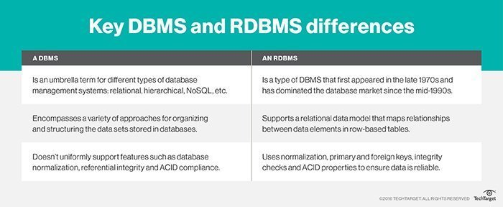
RDBMS vs. DBMS
Furthermore, RDBMSes make it easy to add new data to the system or alter existing tables while ensuring consistency with the previously available content.
Other advantages of the RDBMS include:
1
Number of allowed users. While a DBMS can only accept one user at a time, an RDBMS can operate with multiple users.
2
Hardware and software requirements. A DBMS needs less software and hardware than an RDBMS.
3
Amount of data. RDBMSes can handle any amount of data, from small to large, while a DBMS can only manage small amounts.
4
Database structure. In a DBMS, data is kept in a hierarchical form, whereas an RDBMS utilizes a table where the headers are used as column names and the rows contain the corresponding values.

Slide 4
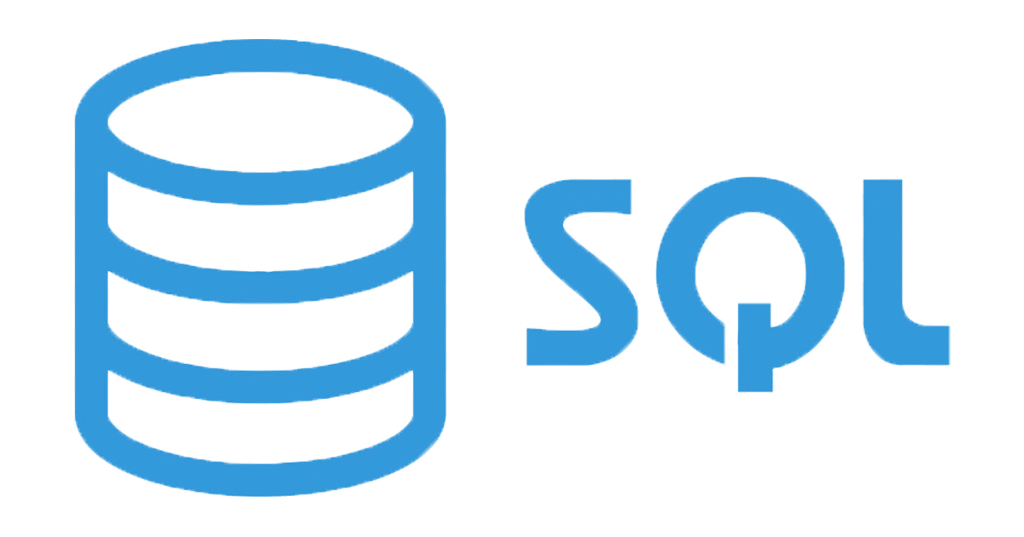
What is SQL ?(Structured Query Language)
SQL Stands for Structured Query Language which is specially designed to communicate with databases so its can be perform database activity like writing statement like insert, update, delete, create, alter and drop database objects,etc.
RDBMS manage and maintain entity relationship(ER) so its have major components are Table,Column(Attribute) and row(Record).
A pure relational database, as designed by Codd, is built on tuples grouped into relations, consistent with first-order predicate logic. Real-world relational databases have tables that contain fields, constraints, and triggers, and tables are related through foreign keys. SQL is used to declare the data to be returned, and a SQL query processor and query optimizer turn the SQL declaration into a query plan that is executed by the database engine.

Slide 5
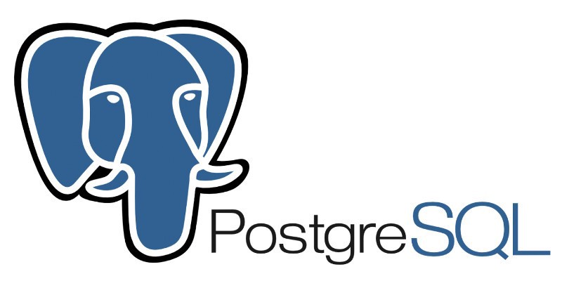
What is PostgreSQL
Essayez par vous-même avec ces deux simples « planètes » :
PostgreSQL is a powerful, open source object-relational database system that uses and extends the SQL language combined with many features that safely store and scale the most complicated data workloads. The origins of PostgreSQL date back to 1986 as part of the POSTGRES project at the University of California at Berkeley and has more than 30 years of active development on the core platform.
PostgreSQL has earned a strong reputation for its proven architecture, reliability, data integrity, robust feature set, extensibility, and the dedication of the open source community behind the software to consistently deliver performant and innovative solutions. PostgreSQL runs on all major operating systems, has been ACID-compliant since 2001, and has powerful add-ons such as the popular PostGIS geospatial database extender. It is no surprise that PostgreSQL has become the open source relational database of choice for many people and organisations.

Slide 6
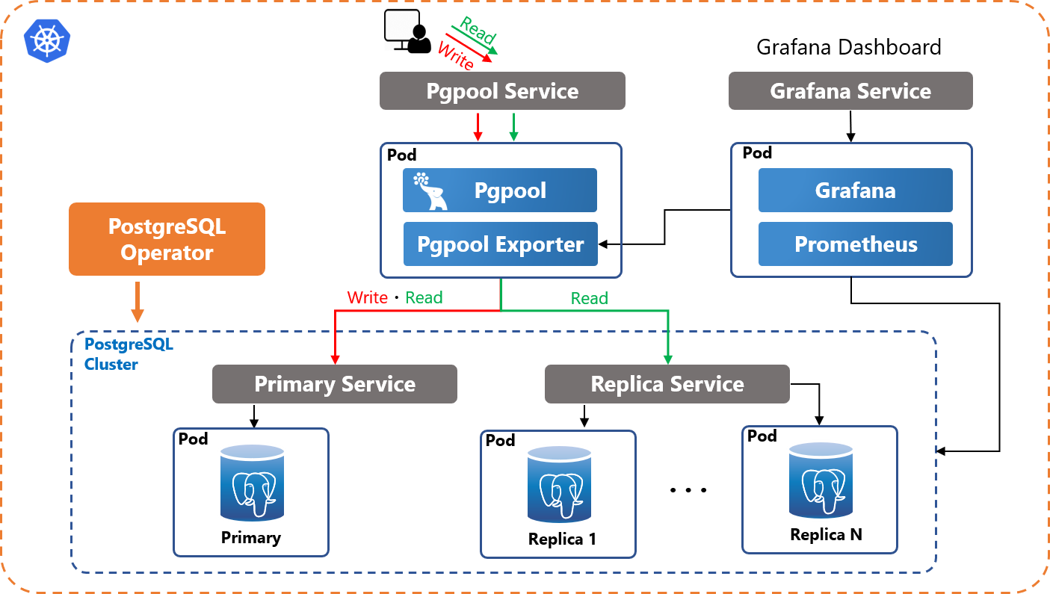
Why use PostgreSQL
PostgreSQL comes with many features aimed to help developers build applications, administrators to protect data integrity and build fault-tolerant environments, and help you manage your data no matter how big or small the dataset. In addition to being free and open source, PostgreSQL is highly extensible. For example, you can define your own data types, build out custom functions, even write code from different programming languages without recompiling your database!
PostgreSQL tries to conform with the SQL standard where such conformance does not contradict traditional features or could lead to poor architectural decisions. Many of the features required by the SQL standard are supported, though sometimes with slightly differing syntax or function. Further moves towards conformance can be expected over time. As of the version 13 release in September 2020, PostgreSQL conforms to at least 170 of the 179 mandatory features for SQL:2016 Core conformance. As of this writing, no relational database meets full conformance with this standard.

Slide 7
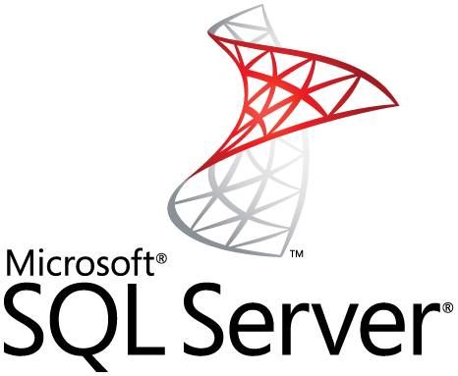
What is SQL Server
SQL Server is a relational database management system, or RDBMS, developed and marketed by Microsoft.
Similar to other RDBMS software, SQL Server is built on top of SQL, a standard programming language for interacting with the relational databases. SQL server is tied to Transact-SQL, or T-SQL, the Microsoft’s implementation of SQL that adds a set of proprietary programming constructs.
SQL Server works exclusively on Windows environment for more than 20 years. In 2016, Microsoft made it available on Linux. SQL Server 2017 became generally available in October 2016 that ran on both Windows and Linux.

Slide 8
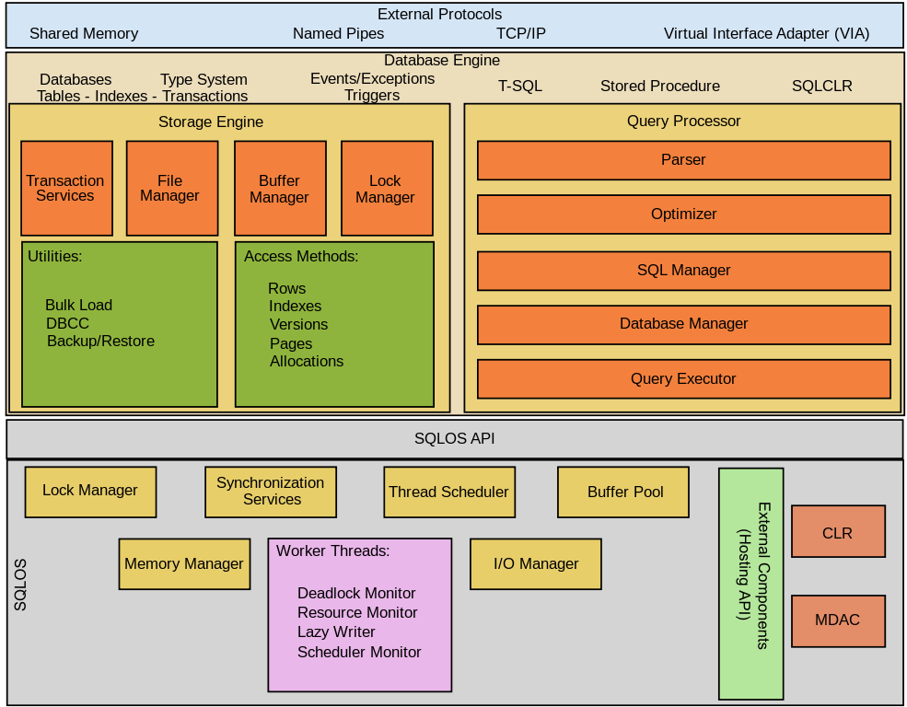
SQL Server Architecture
SQL Server consists of two main components: Database Engine , SQLOS

Slide 9
Data Engine :
The core component of the SQL Server is the Database Engine. The Database Engine consists of a relational engine that processes queries and a storage engine that manages database files, pages, pages, index, etc. The database objects such as stored procedures, views, and triggers are also created and executed by the Database Engine.
Relational Engine
The Relational Engine contains the components that determine the best way to execute a query. The relational engine is also known as the query processor.
The relational engine requests data from the storage engine based on the input query and processed the results.
Some tasks of the relational engine include querying processing, memory management, thread and task management, buffer management, and distributed query processing.
Storage Engine
The storage engine is in charge of storage and retrieval of data from the storage systems such as disks and SAN.

Slide 10
SQLOS
Under the relational engine and storage engine is the SQL Server Operating System or SQLOS.
SQLOS provides many operating system services such as memory and I/O management. Other services include exception handling and synchronization services.
SQL Server Services and Tools
Microsoft provides both data management and business intelligence (BI) tools and services together with SQL Server.
For data management, SQL Server includes SQL Server Integration Services (SSIS), SQL Server Data Quality Services, and SQL Server Master Data Services. To develop databases, SQL Server provides SQL Server Data tools; and to manage, deploy, and monitor databases SQL Server has SQL Server Management Studio (SSMS).
For data analysis, SQL Server offers SQL Server Analysis Services (SSAS). SQL Server Reporting Services (SSRS) provides reports and visualization of data. The Machine Learning Services technology appeared first in SQL Server 2016 which was renamed from the R Services.

Slide 11
PostgreSQL vs SQL Server
PostgreSQL and SQL Server (or MSSQL) are two widely used relational databases. Although they share a number of core traits, there are major differences between them. In this article, we provide a detailed rundown of the similarities and differences between PostgreSQL and SQL Server. Among the most significant distinctions is that PostgreSQL is open source, while SQL Server is owned and licensed by Microsoft. In addition, you will learn about differences between the two systems when it comes to licensing and cost, ease of use, SQL syntax and compliance, data types, available features, performance, and security, among many others. Over 40 topics are covered in head-to-head comparisons. It will be particularly useful for organizations who are thinking of making the switch from a commercial to an open-source database, but need more information on the possible trade-offs and advantages of the two systems. However, it is intended for anyone who is curious to learn more about relational databases. We conclude that SQL Server has historically been popular with organizations that rely on other Microsoft products, but PostgreSQL has risen to the top of the field not only because of the advantages of going open source but also for its robust features and active community of users.

Slide 12
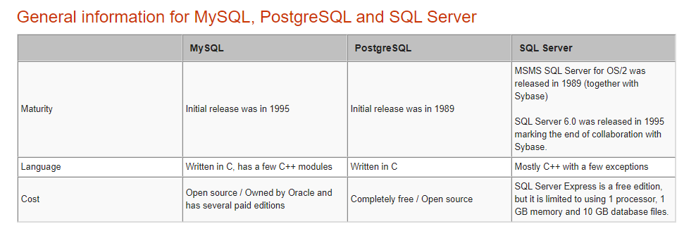

Slide 13
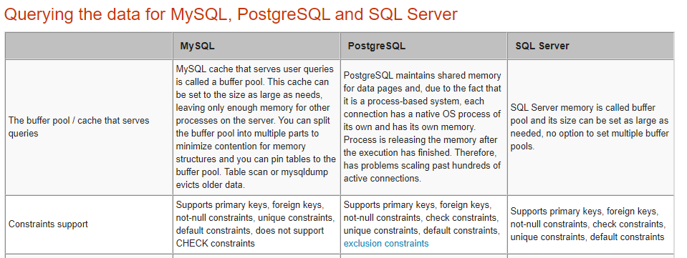

Slide 14
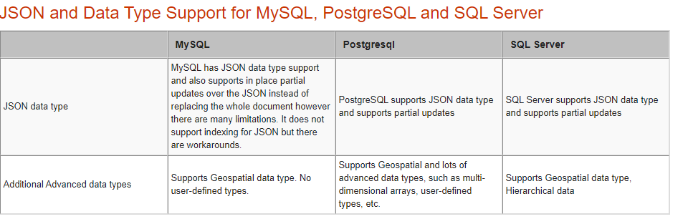

Slide 15
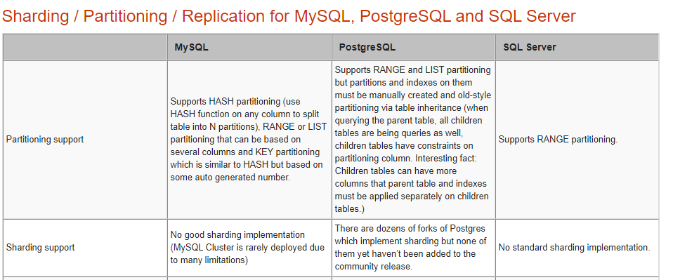

Slide 16
THANK YOU FOR YOUR ATTENTION

